Slide 1

Machine Unlearing using Forgetting Neural Networks
Amartya Hatua Trung T. Nguyen
Filip Cano Andrew H. Sung

Slide 2
Motivation
Machine Unlearning using Forgetting Neural Networks Filip Cano
2017: Forgetting Neural are first described, inspired by early findings about memory in humans, with no clear use 📖.
Early 2020’s: Machine Unlearning becomes a popular problem
“The hammer before the nail”
📖 Cano, Sarma, Subirana, Theory of Intelligence with Forgetting. MIT CBMM Memo no. 71. 2017

Slide 3

The Machine Unlearning Problem
Machine Unlearning using Forgetting Neural Networks Filip Cano
$A$ : training algorithm (possibly randomized)
$D$ dataset, $D=R∪F$, where $R$ is the retain set and $F$ the forget set
$θ=A\left(D\right)$ is the original model, $θ^{∗}=A(R)$ is the perfect unlearning model
Unlearning produces $\tilde{θ}=U(θ, F)$, with the following two goals:
Utility: Performance on the distribution of $R$ is retained
Unlearning: $\tilde{θ}$ contains no information about $F$

Slide 4

Membership Inference Attacks
Machine Unlearning using Forgetting Neural Networks Filip Cano
We evaluate unlearning through membership inference attack (MIA)
Adversary has black box access to trained model $f_{θ}$, and has to learn whether $\left(x,y\right)∈F$.
Loss-based MIA: $Λ\left(x,y\right)=\frac{\operatorname{Pr}{[}L\left(f_{θ}\left(x\right),y\right)| (x,y)∈F]}{\operatorname{Pr}{[}L\left(f_{θ}\left(x\right),y\right)| \left(x,y\right)∉F]}$
If $Λ\left(x,y\right)>threshold$ → $\left(x,y\right)∈F$

Slide 5
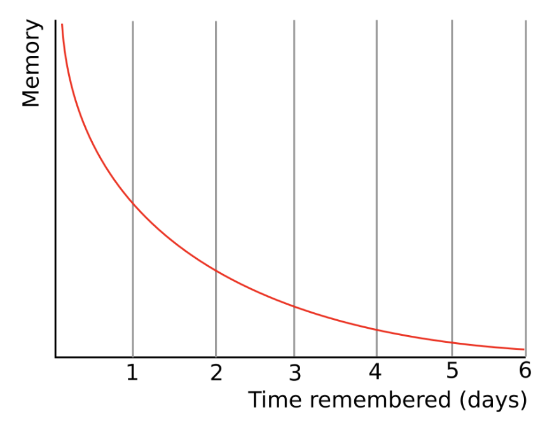
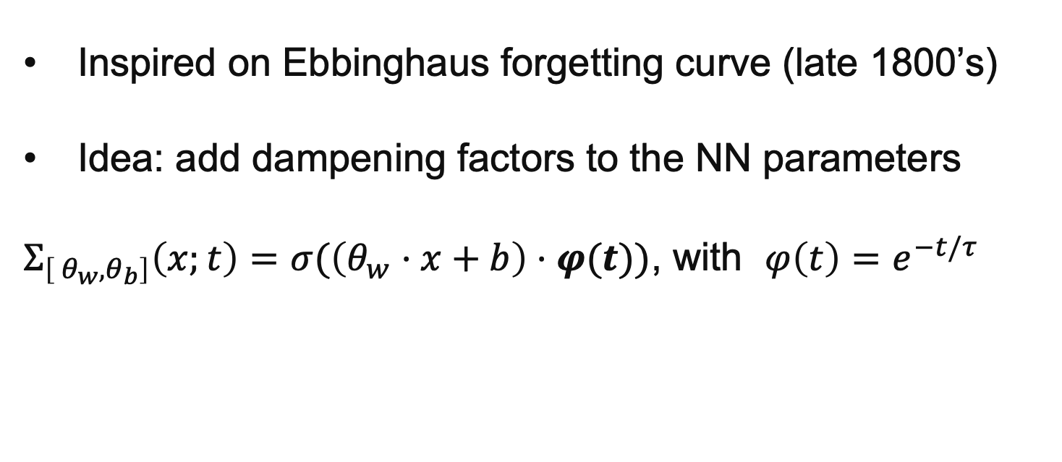
Forgetting Neural Networks (FNN)
Machine Unlearning using Forgetting Neural Networks Filip Cano
Inspired on Ebbinghaus forgetting curve (late 1800’s)
Idea: add dampening factors to the NN parameters
$Σ_{\left[ θ_{w}, θ_{b}\right]}\left(x;t\right)=σ(\left(θ_{w}⋅x+b\right)⋅φ(t))$, with $φ\left(t\right)=e^{−t/τ}$

Slide 6
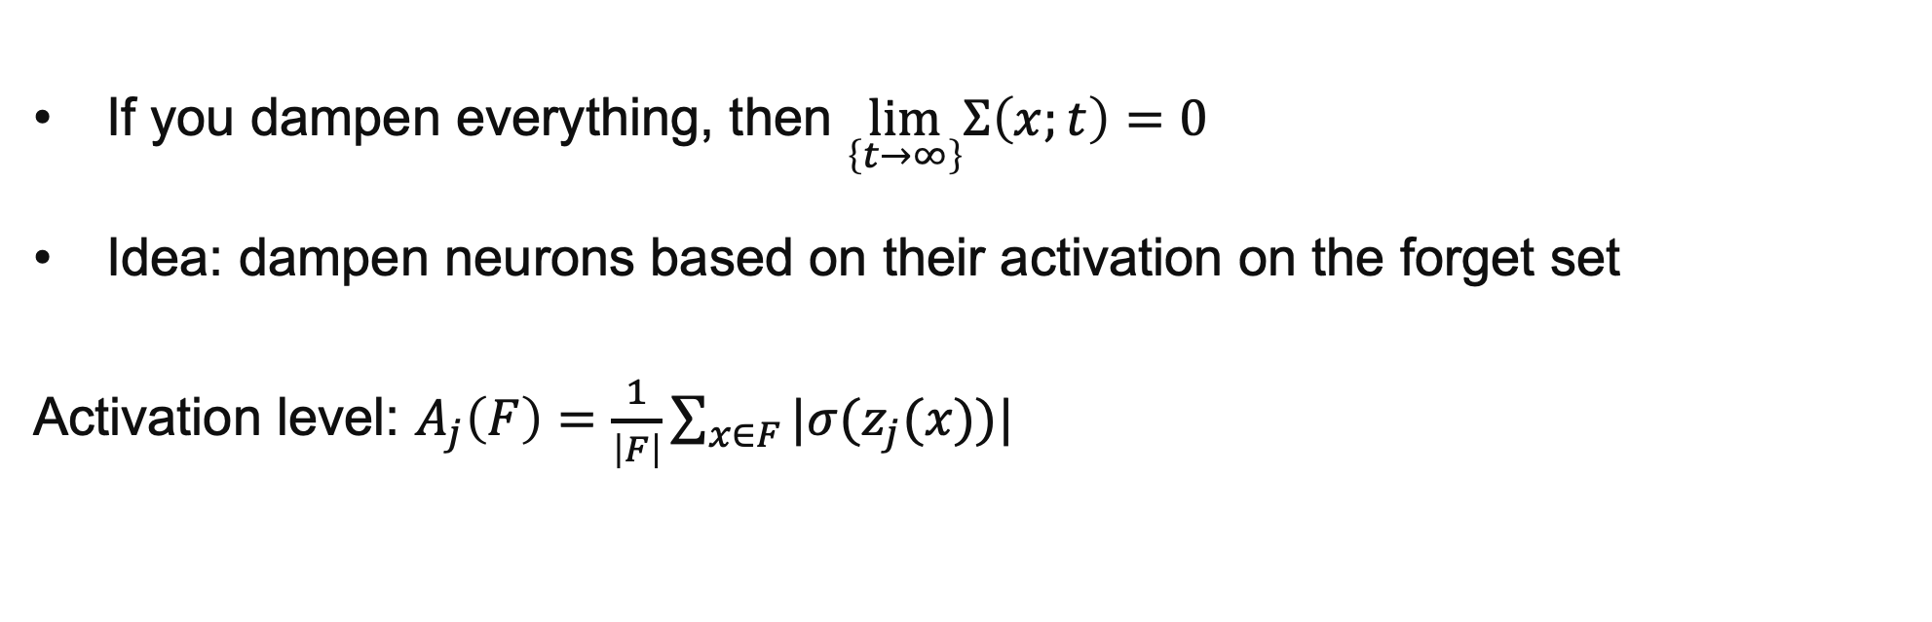
Targetting What to Forget
Machine Unlearning using Forgetting Neural Networks Filip Cano
If you dampen everything, then $\lim_{\left\{t→∞\right\}}Σ\left(x;t\right)=0$
Idea: dampen neurons based on their activation on the forget set
Activation level: $A_{j}\left(F\right)=\frac{1}{\left|F\right|}\sum_{x∈F}{|σ(z_{j}(x))|}$

Slide 7
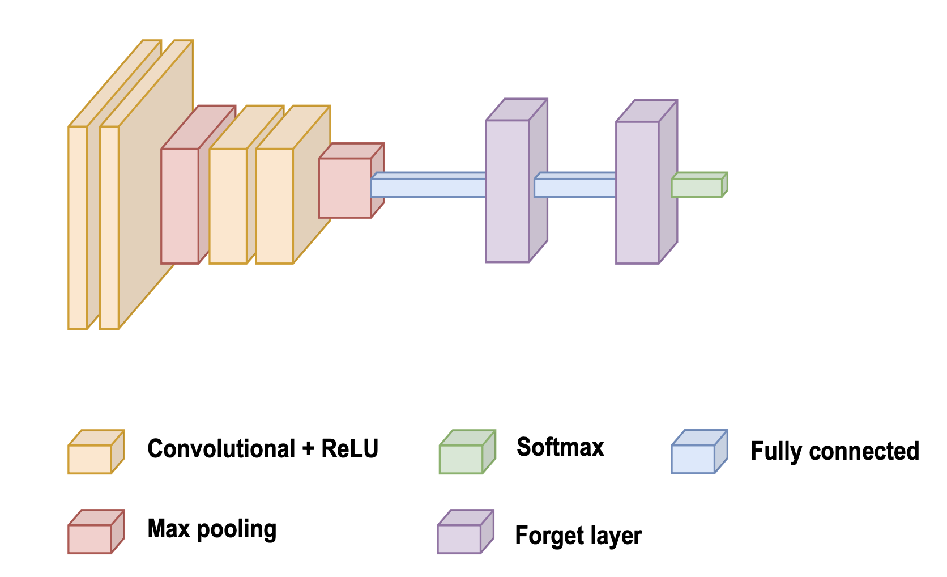
Targeting Where to Forget (Forgetting Layers)
Machine Unlearning using Forgetting Neural Networks Filip Cano
Forgetting all layers uniformly may be too much
Forgetting is targeted to the last connected layers

Slide 8
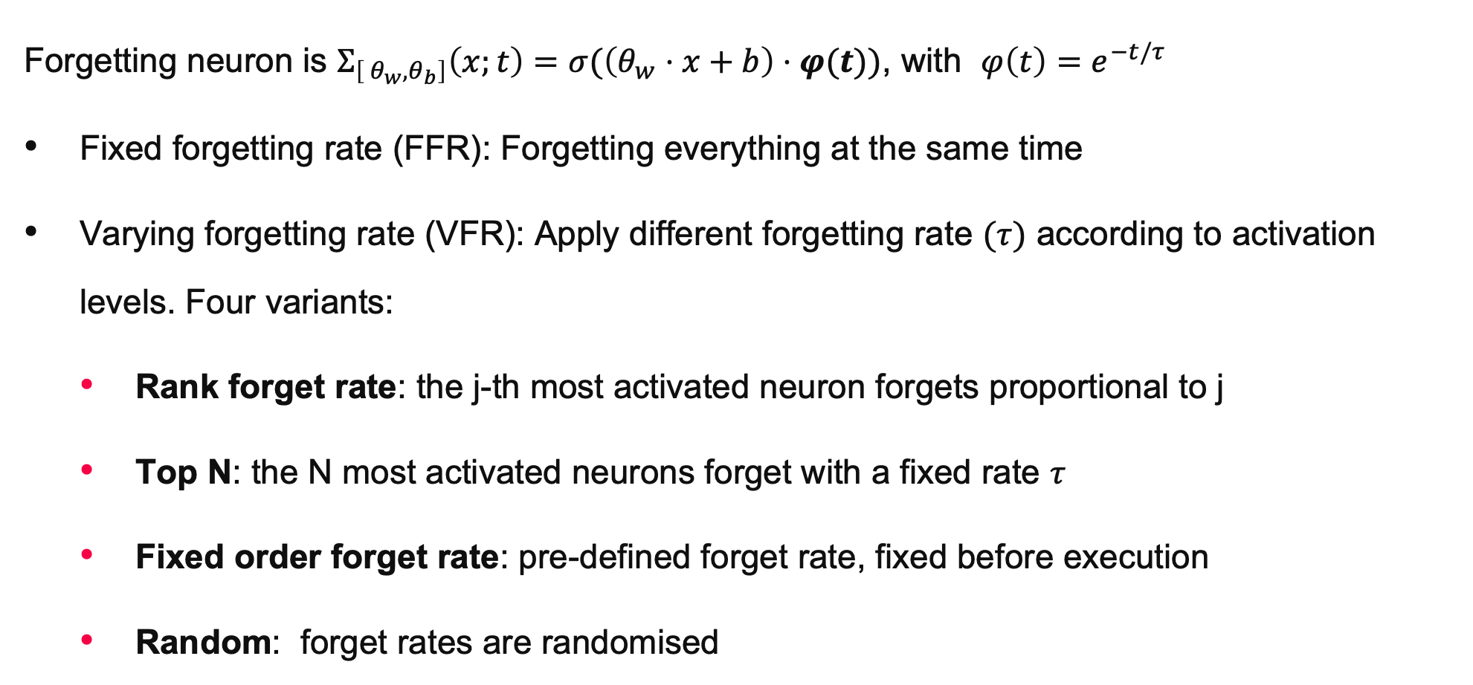
Targeting Where to Forget (Forgetting Rate Variants)
Machine Unlearning using Forgetting Neural Networks Filip Cano
Forgetting neuron is $Σ_{\left[ θ_{w}, θ_{b}\right]}\left(x;t\right)=σ(\left(θ_{w}⋅x+b\right)⋅φ(t))$, with $φ\left(t\right)=e^{−t/τ}$
Fixed forgetting rate (FFR): Forgetting everything at the same time
Varying forgetting rate (VFR): Apply different forgetting rate $(τ)$ according to activation levels. Four variants:
Rank forget rate: the j-th most activated neuron forgets proportional to j
Top N: the N most activated neurons forget with a fixed rate $τ$
Fixed order forget rate: pre-defined forget rate, fixed before execution
Random: forget rates are randomised

Slide 9
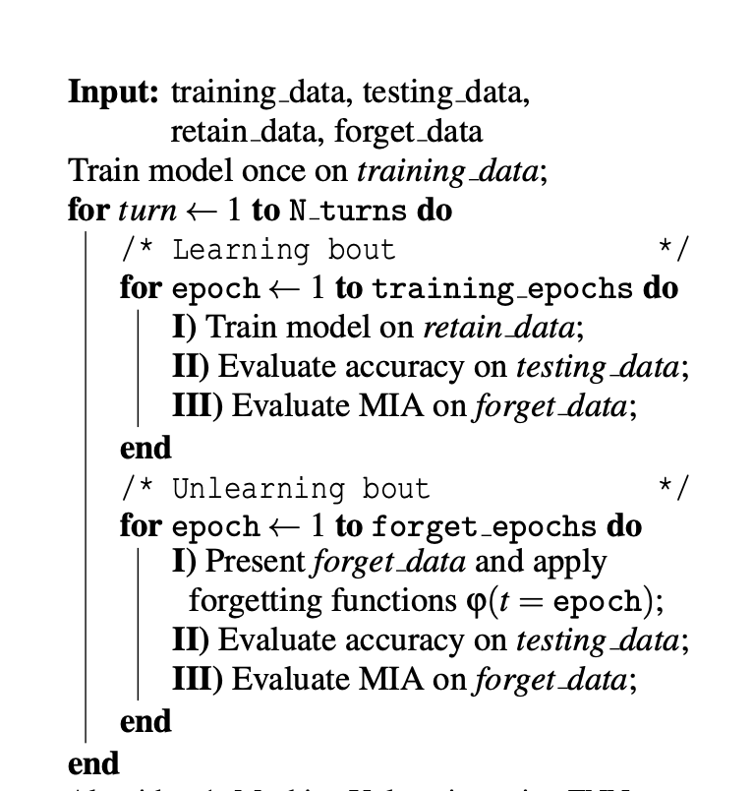
Machine Unlearning Algorithm
Machine Unlearning using Forgetting Neural Networks Filip Cano
Apply learning-unlearning bouts
Train on retain set
Calculate activations and apply forgetting
Test MIA on forget set

Slide 10
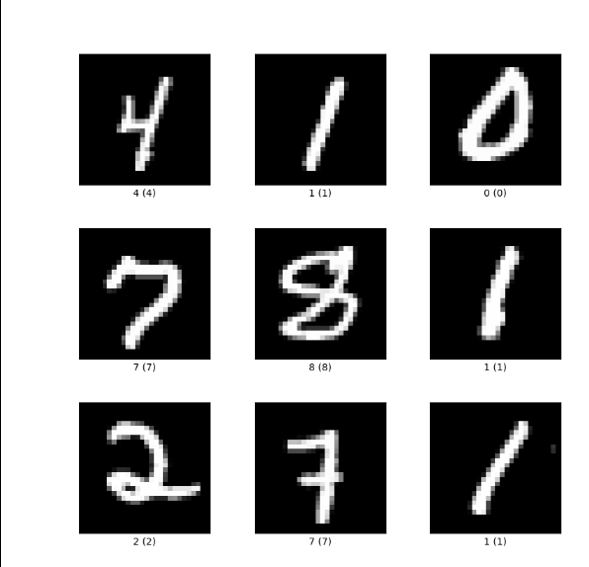
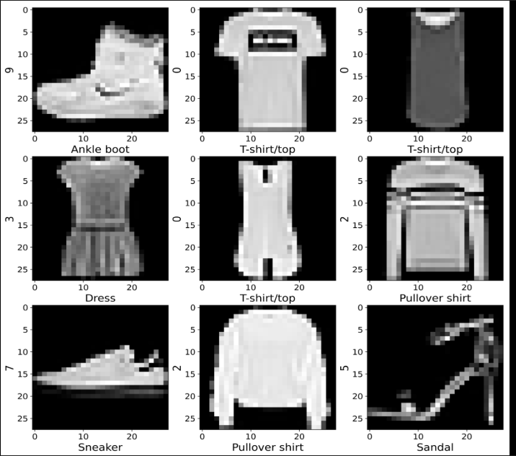
How Well Does it Work? Experimental Setup
Machine Unlearning using Forgetting Neural Networks Filip Cano
MNIST HDR and MNIST Fashion
Convolutional + fully connected network

Slide 11
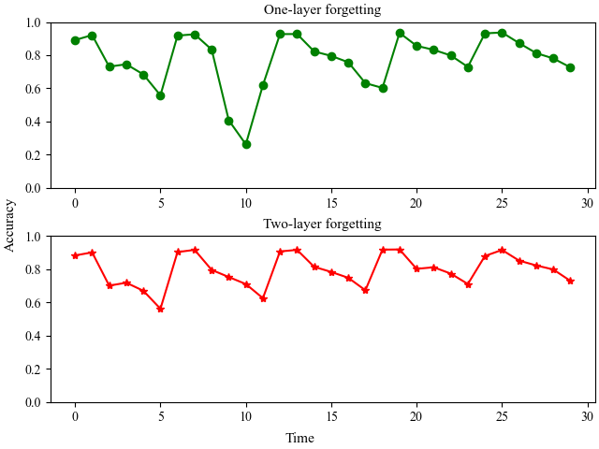
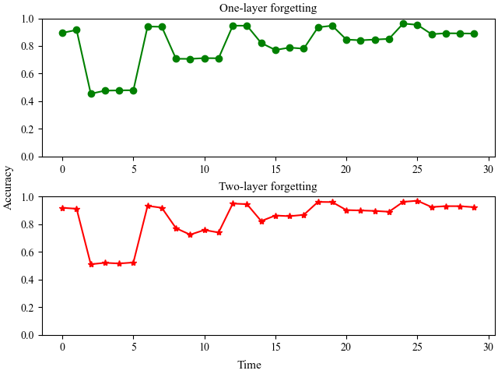
Accuracy: Fixed Forget Rate
Machine Unlearning using Forgetting Neural Networks Filip Cano
Learning-forgetting curves
Digit
Fashion

Slide 12
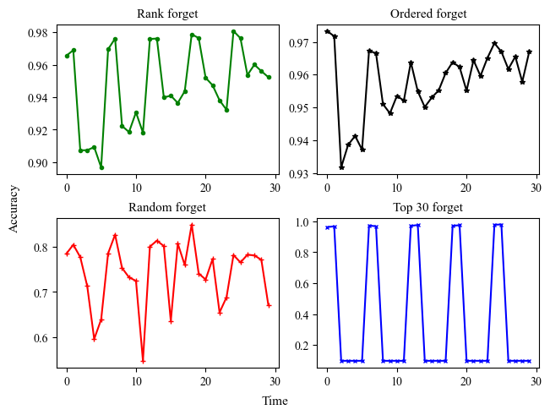
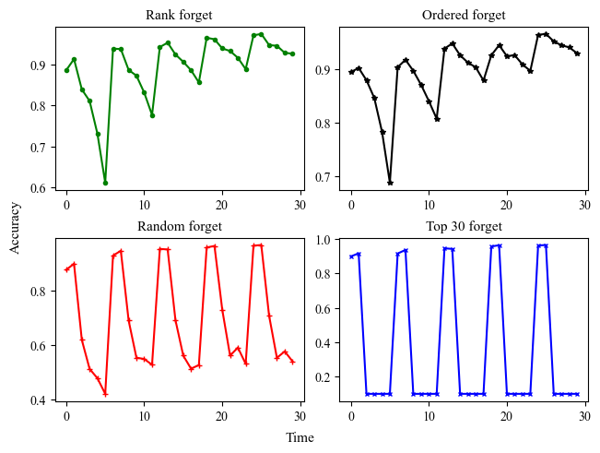
Accuracy: Varying Forgetting Rate
Machine Unlearning using Forgetting Neural Networks Filip Cano
Learning-forgetting curves for MNIST Fashion
1 Forget Layer
2 Forget Layer
Rank Forgetting works best

Slide 13
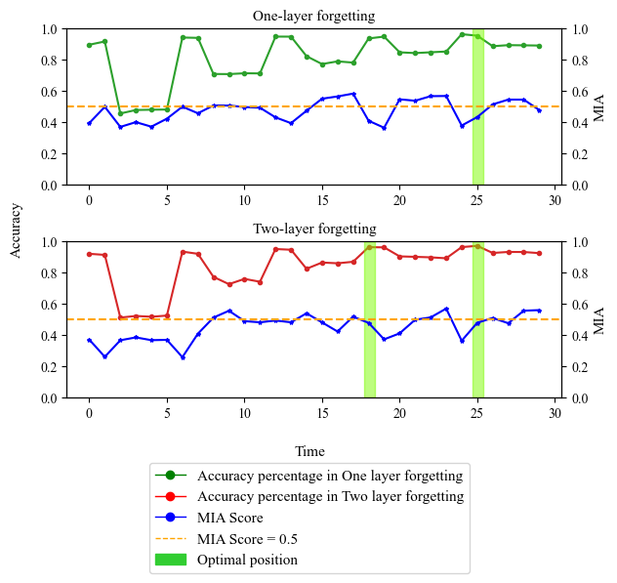
Experimental Results: MIA on Fixed Forgetting Rate
Machine Unlearning using Forgetting Neural Networks Filip Cano
Accuracy vs MIA score over time
MIA score = 0.5 is “ideal”
Optimal positions: high accuracy, MIA score close to 0.5 on forget set

Slide 14
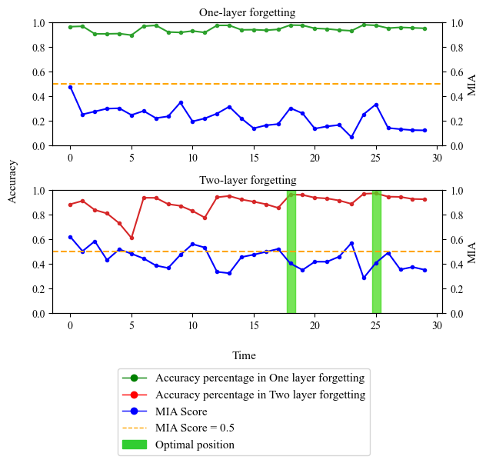
MIA on Varying (Rank) Forgetting Rate
Machine Unlearning using Forgetting Neural Networks Filip Cano
Accuracy vs MIA score over time
MIA score = 0.5 is “ideal”
Optimal positions: high accuracy, MIA score close to 0.5 on forget set

Slide 15
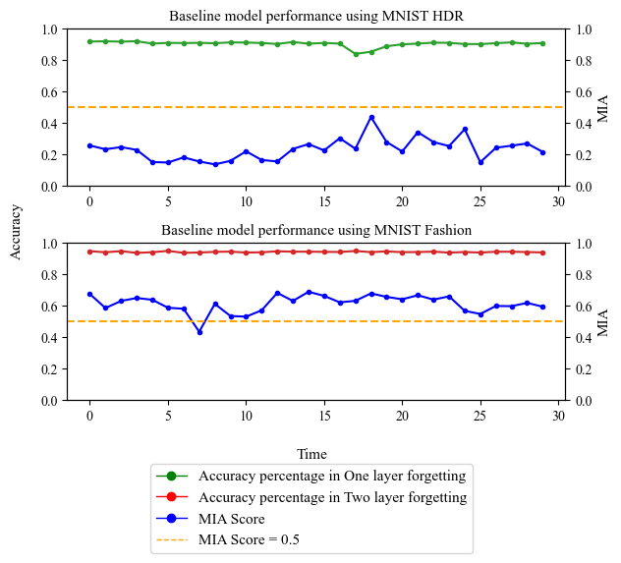
MIA on Baseline (full retraining)
Machine Unlearning using Forgetting Neural Networks Filip Cano
Accuracy vs MIA score over time
MIA score = 0.5 is “ideal”
Optimal positions: high accuracy, MIA score close to 0.5 on forget set

Slide 16
Discussion / Limitations / Future Work
Machine Unlearning using Forgetting Neural Networks Filip Cano
ML inspired in nature can be useful, but machines do not work as brains
The over-forgetting phenomenon: forgetting too much
No formal guarantees on accuracy or required epochs
Future Work:
Other Varying Forget Rate methods
Scale beyond MNIST

Slide 17

Concluding Remarks
Machine Unlearning using Forgetting Neural Networks Filip Cano
Machine Unlearning is the problem of efficiently “forgetting” training data.
Forgetting Neural Networks dampen the signal of concrete neurons
By targeting the neurons most activated by the data to forget, FNNs can be an efficient method for machine unlearning
After ~20 epochs, accuracy over 95% with MIA score close to 0.5 on MNIST Digit and Fashion.
This work has been supported by the European Research Council under Grant No.: ERC-2020-AdG 101020093.

