Slide 1



Analyzing Intentional Behavior in Autonomous Agents under Uncertainty
Filip Cano Córdoba, Samuel Judson,
Timos Antonopoulos, Katrine Bjørner,
Nicholas Shoemaker, Scott J. Shapiro,
Ruzica Piskac and Bettina Könighofer
24 August 2023
This work has received funding from the European Union’s Horizon 2020 research and innovation programme under grant agreement Nº 956123 - FOCETA.
Notes:
Safety of autonomous agents in real-world
One aspect often overlooked
Unexpected safety violations

Slide 2
Intentional Behavior as part of Accountability
Analyzing Intentional Behavior in Autonomous Agents under Uncertainty Filip Cano Córdoba
An agent caused a harm ⇨ Hold it accountable!
📖 Moral responsibility depends on action and intended consequences.
Different levels of responsibility if:
The agent tried to avoid harm, but it happened accidentally.
The agent neglected safety measures.
The agent caused harm intentionally.
📖 Brahman and van Hees., An Anatomy of Moral Responsibility, Mind (Vol. 121, No. 483), 2012

Slide 3
Analyze Intentional Behavior
Analyzing Intentional Behavior in Autonomous Agents under Uncertainty Filip Cano Córdoba
We propose a method to analyze evidence of intentional behavior
Intention in Belief-Desire-Intention models is “easy“ 📖
For agents in probabilistic models
Perfect information → Agent maximizes probability to fulfill its intention
Imperfect information → How close to optimal?
📖 Rao and Georgeff, Modeling Rational Agents with BDI-Architecture, KR 1991
Notes:
To do: maybe rework some words, and add some animation

Slide 4
Intention Inference from Counterfactual Questions
Analyzing Intentional Behavior in Autonomous Agents under Uncertainty Filip Cano Córdoba
📖 Counterfactual reasoning is widely used in accountability
Factual: sequence of events that actually happened, lead to outcome.
Counterfactual:
What could the agent have done differently along the factual situation?
What would the agent have done in counterfactual situations?
📖 Lewis, D., Counterfactuals, Harvard University Press, 1973

Slide 5










Modelling
Analyzing Intentional Behavior in Autonomous Agents under Uncertainty Filip Cano Córdoba
Why MDPs?
Standard formalization of Reinforcement Learning 📖
Great tools available 🛠️
Environment: Markov Decision Process (MDP).
Agent: Policy on the MDP.
Intention: Set of states in the MDP.
observation
Environment (MDP)
Agent
$$0.6$$
$$0.1$$
$${act}_{1}$$
$${act}_{1}$$
$$0.4$$
$$0.9$$
$${act}_{2}$$
action
$$0.78$$
$$0.22$$
s
📖 Sutton and Barto., Reinforcement Learning: An Introduction, MIT Press, 2018
🛠️ Denhert et al., A Storm is Coming: A Modern Probabilistic Model Checker, CAV, 2017
Notes:
Change MDP model to something more linear. Animate the example of from one state reaching another one

Slide 6
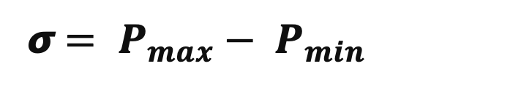


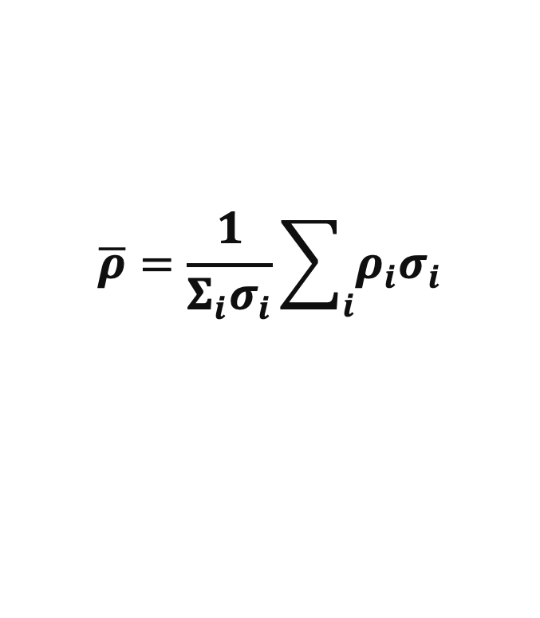

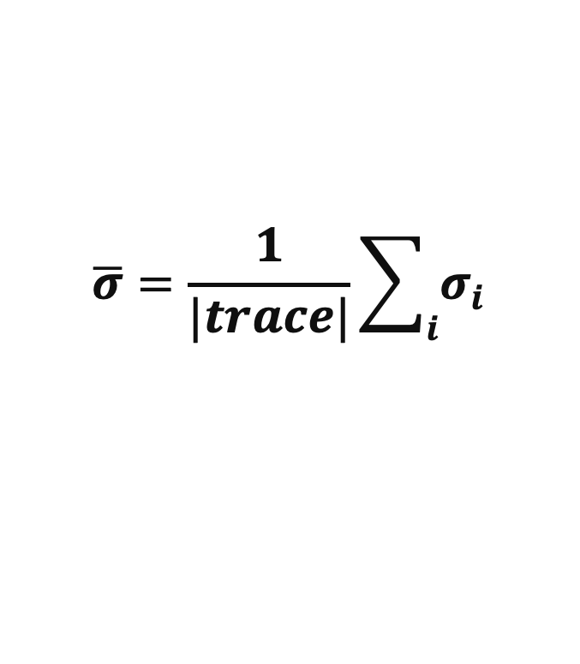
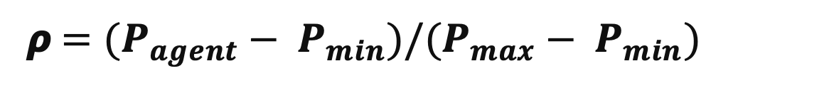
Agency and Intention-Quotient
Analyzing Intentional Behavior in Autonomous Agents under Uncertainty Filip Cano Córdoba
Single state:
1
BB
$$P_{max}$$
Agency
0.5
$$P_{agent}$$
Probability
𝞼${ = P}_{max} −{ P}_{min}$
$$P_{min}$$
Intention quotient
0
Time
𝞺${ =(P}_{agent} −{ P}_{min})/{(P}_{max} −{ P}_{min})$
Multiple states
Agency
Intention quotient
$$\overline{σ}=\frac{1}{|trace|}\sum_{i}{σ_{i}}$$
$$\overline{ρ}=\frac{1}{Σ_{i}σ_{i}}\sum_{i}{ρ_{i}σ_{i}}$$
s

Slide 7
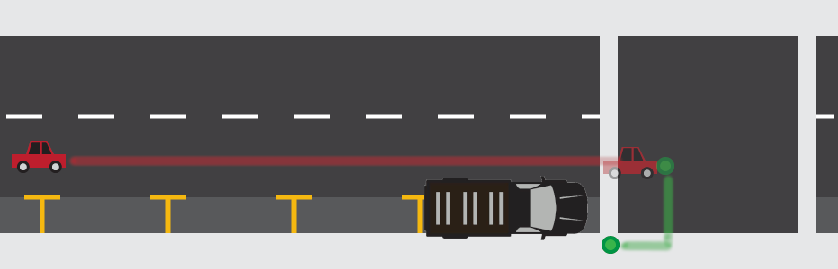





Driving Example 1
Analyzing Intentional Behavior in Autonomous Agents under Uncertainty Filip Cano Córdoba
A car is driving on the street.
A pedestrian crosses the street.
Was the hit intentional?
Could the agent have prevented it?

Slide 8
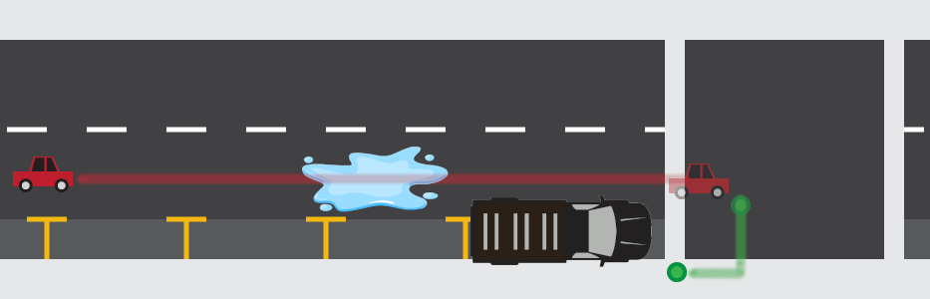
Driving Example 2
Analyzing Intentional Behavior in Autonomous Agents under Uncertainty Filip Cano Córdoba
A big water puddle makes the agent lose control of the car.
Was the hit intentional?
Could the agent have prevented it?
Not enough evidence!

Slide 9
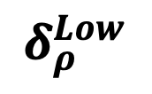
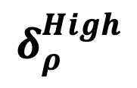

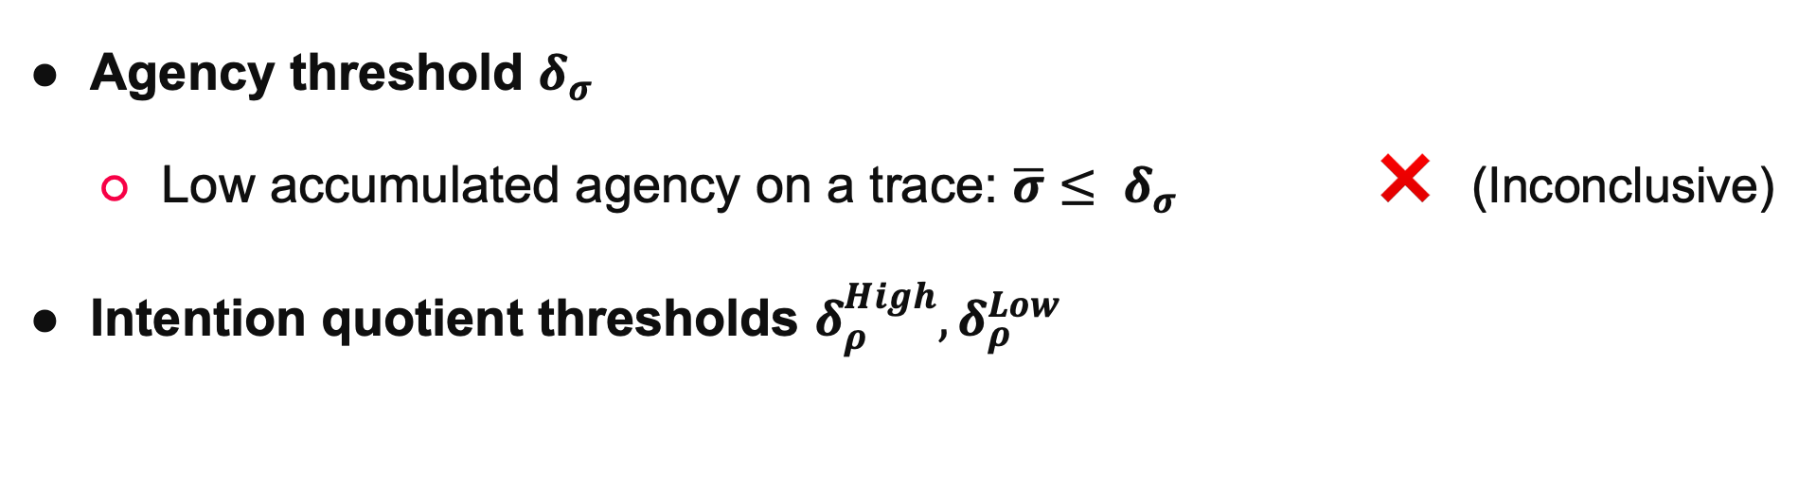
Thresholds on Evidence
Analyzing Intentional Behavior in Autonomous Agents under Uncertainty Filip Cano Córdoba
Agency threshold $δ_{σ}$
Low accumulated agency on a trace: $\overline{σ}≤ δ_{σ}$ ❌ (Inconclusive)
Intention quotient thresholds $δ_{ρ}^{High},δ_{ρ}^{Low}$
Unintentional
❌ (Inconclusive)
Intentional
0
$$δ_{ρ}^{Low}$$
$$δ_{ρ}^{High}$$
$$\overline{ρ}$$
1

Slide 10



Counterfactual Traces
Analyzing Intentional Behavior in Autonomous Agents under Uncertainty Filip Cano Córdoba
❌ (Inconclusive) → Produce more evidence

Slide 11



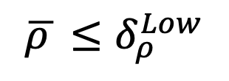



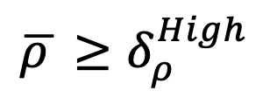


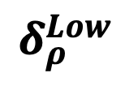
Overview of the Method
Analyzing Intentional Behavior in Autonomous Agents under Uncertainty Filip Cano Córdoba
1
$$P$$
Intentional
$$τ_{ref}$$
$$π_{max}$$
✅ Enough evidence
$$π$$
$$\overline{ρ }≥δ_{ρ}^{High}$$
$$π_{min}$$
$$δ_{ρ}^{High}$$
❌ Inconclusive
Counterfactual
Generation
$$\overline{ρ}$$
$$T= \{τ_{1}, τ_{2}, τ_{ref}\}$$
$$τ_{1}$$
$$τ_{2}$$
$$δ_{ρ}^{Low}$$
Unintentional
❌ Inconclusive
$$\overline{ρ }≤δ_{ρ}^{Low}$$
Aggregate Results
✅ Enough evidence
0

Slide 12
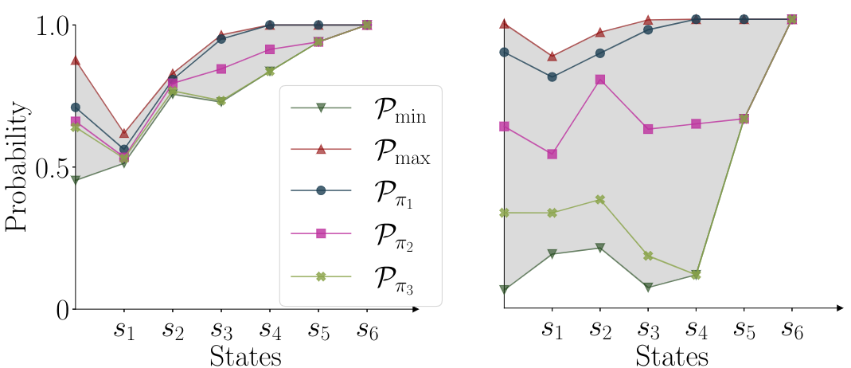
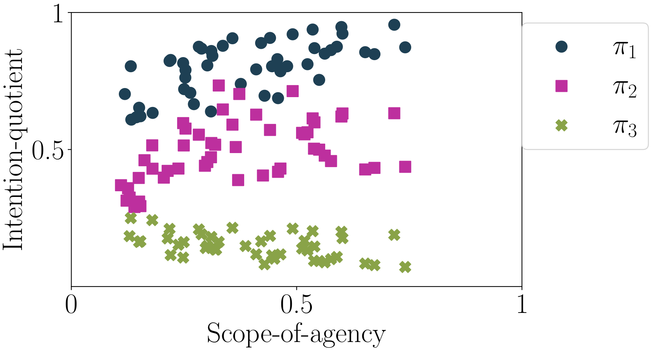
Case Study
Analyzing Intentional Behavior in Autonomous Agents under Uncertainty Filip Cano Córdoba
MDP size: 120k states, 400k transitions.
10 seconds to compute one trace.
Comparison of 3 agents.

Slide 13

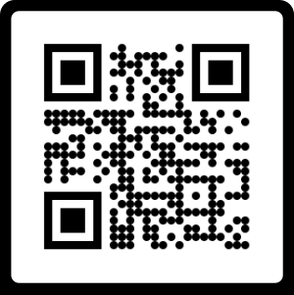
Contributions
Analyzing Intentional Behavior in Autonomous Agents under Uncertainty Filip Cano Córdoba
Infer evidence of intentional behavior from counterfactual analysis.
What could the agent have done differently?
What would the agent have done in different situations?
Concrete methodology for Markov Decision Processes using model checking.
This work has received funding from the European Union’s Horizon 2020 research and innovation programme under grant agreement Nº 956123 - FOCETA.

