Slide 1

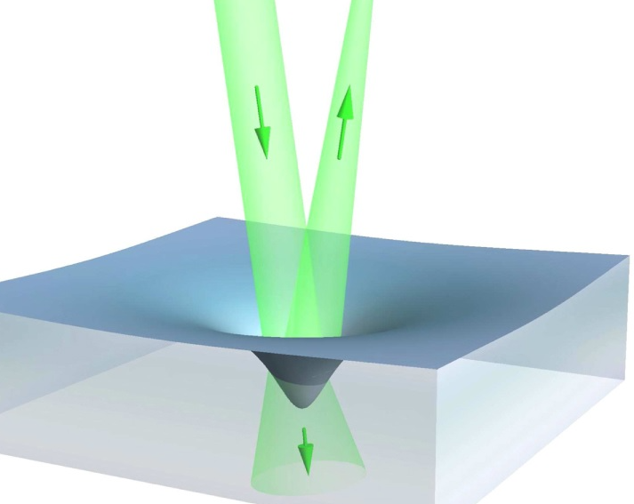
Visualising the Abraham-Minkowski Light Field Momentum
By Mateo Guzmán Subiría
Supervised by Dr Michael Mazilu
Image credit: Zhang, et al. (2015).
Notes:
Good morning, everybody, it’s great to see you all here today. I am Mateo Guzman Subiria and I am here to present my project on visualising the Abraham-Minkowski Light Field Momentum.

Slide 2
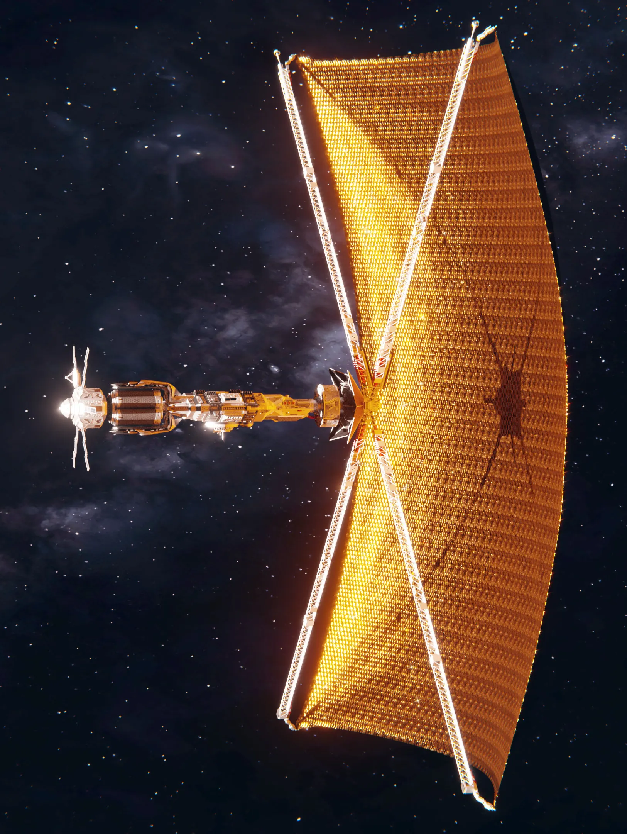

Introduction
Light carries momentum
Vacuum | Dielectric media[1]
$g_{vac}=ε_{0}E×B$ | Abraham $g∝\frac{1}{n}$ vs Minkowski $g∝n$
2
Fig. 1: Artistic impression of a solar sail in space. Image by Bert Willemsen.
[1] Boyd and Milonni, 2010.
Notes:
As you all know, light carries momentum. An excellent example of this is the working principle behind solar sails. In vacuum, the electromagnetic momentum density takes the following form. However, in dielectric media, its form has been a matter of debate for more than a century. The two main formulations pertain to Abraham and Minkowski which relate the EM momentum density to the medium refractive index in the following ways.

Slide 3



Project Outline
Goal | Implementation | Measurements
To visualise EM fields and their momenta in linear dielectrics | Simulations of pulses propagating through photonic crystal systems | Field intensities The Maxwell Stress Tensor The Lorentz force The accumulated impulse in optical system sections
3
Notes:
The goal of my project is to visualise EM fields and their momenta in linear dielectrics paying special attention to behaviours predicted by Abraham or Minkowski.
The implementation consists of simulating light pulses propagating through photonic crystal systems of varying indices of refraction and measuring their intensities and their momenta through the Maxwell Stress Tensor, and the Lorentz force, and then compute the impulse accumulated in sections of the optical systems.

Slide 4

Background
Notes:
Let’s start by defining and explaining some key ideas.

Slide 5
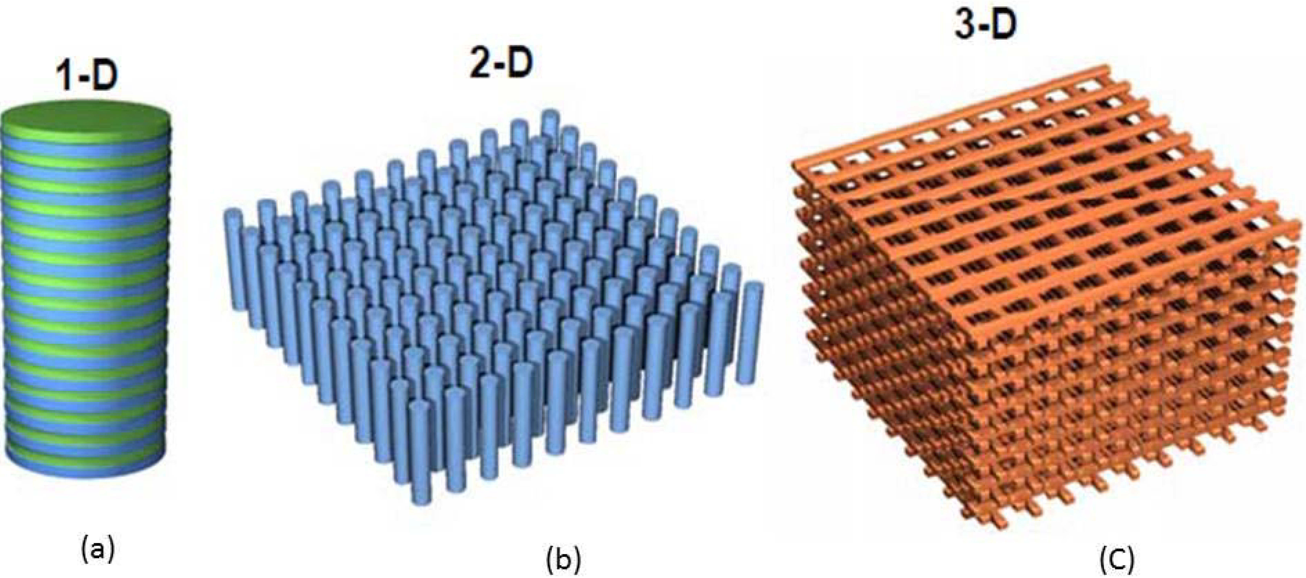
Photonic Crystals
Materials with periodically modulated dielectric constants [2]
We dehomogenise dielectric media and represent them as photonic crystals
Fig. 2: Schematic illustrations of photonic crystals with simple periodic patterns in 1D, 2D and 3D. Taken from (Robinson and Nakkeeran, 2013).
5
[2] Yablonovitch, 1994.
Notes:
Photonic crystals are highly ordered materials with periodically modulated dielectric constants. When the periodicity of the crystals is much smaller than the wavelength of the light, we can treat the macroscopic optical properties of the crystal as effective homogeneous media in a process called homogenisation. In this project, we do the reverse: we dehomogenise dielectric media and represent them as photonic crystals.

Slide 6
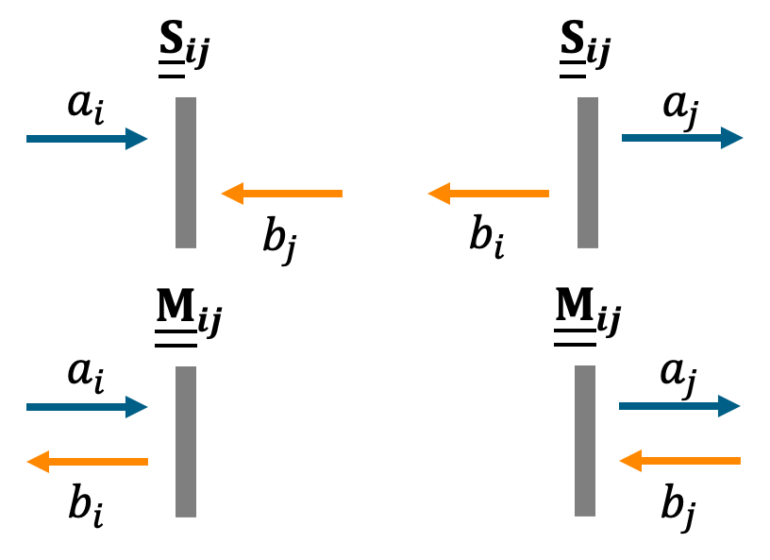


The Transfer Matrix Method (TMM) [3]
Plane waves (PW) $→$ Fourier components of an EM wave: light pulse
Plane waves are represented by complex amplitudes
The optical properties of elements (layers & interfaces) are represented as matrices
Fig. 3: A diagram illustrating the working principle behind the S and M matrices of an optical element (grey rectangle). The subscripts $i$ and $j$ refer to positions relative to the element.
6
[3] Mackay and A. Lakhtakia, 2020.
Notes:
We employ EM plane waves exploiting their orthogonality to use them as Fourier components in the decomposition of a light pulse. The use of plane waves allows us to apply the transfer matrix method which is a formalism for analysing the propagation of waves through systems with spatially varying properties.
The plane waves are represented by the complex amplitudes 𝑎 and 𝑏 which correspond to forward and backward propagating components. These amplitudes encapsulate plane wave amplitudes and phases.
The optical properties of elements (layers & interfaces) are represented as matrices which act on ab-vectors. The scattering (S) matrices relate the input states 𝑎_𝑖 and 𝑏_𝑗 and output states 𝑎_𝑗 and 𝑏_𝑖 of a scattering process. Meanwhile, the transfer (M) matrices relate the wave values on one side of an element to those on the other.

Slide 7
The Simulation
Notes:
Now, we move on to creating the simulation.

Slide 8









Wavenumber Dependence
In this study, s-polarisation and normal incidence $θ=0$
The pulse is composed of many PWs with different wavenumbers $k=\frac{2π}{λ}$
The optical system (OS) a PW "sees" depends on its wavevector $k$
Reflection and transmission coefficients $→f\left(θ,n\right)$
Propagation phase shift $Δφ→f\left(k,n\right)$
The chain of matrices representing an OS needs to be reproduced for each $k$
$$\hat{x}$$
$$\hat{z}$$
$$\hat{y}$$
$$B$$
Optical System
$$k$$
$$θ$$
$$E$$
Fig. 4: A diagram illustrating the simulation orientation, angle of incidence, and polarisation.
$$e^{iΔφ}=e^{inkh}$$
8
Notes:
In our project, the plane waves are s-polarised and enter the optical systems at normal incidence 𝜃=0. With our refraction plane parallel to the x-z plane, this means the electric fields point parallel to the y axis, the magnetic fields point parallel to the x axis, and z gives the propagation direction.
The pulse is composed of many plane waves with different wavenumbers. The optical system each plane wave “sees” depends on its wavevector as the reflection and transmission coefficients depend the angle of incidence and the propagation phase shift depends on the wavenumber. Thus, the chain of matrices representing an optical system needs to be reproduced for each wavenumber.

Slide 9
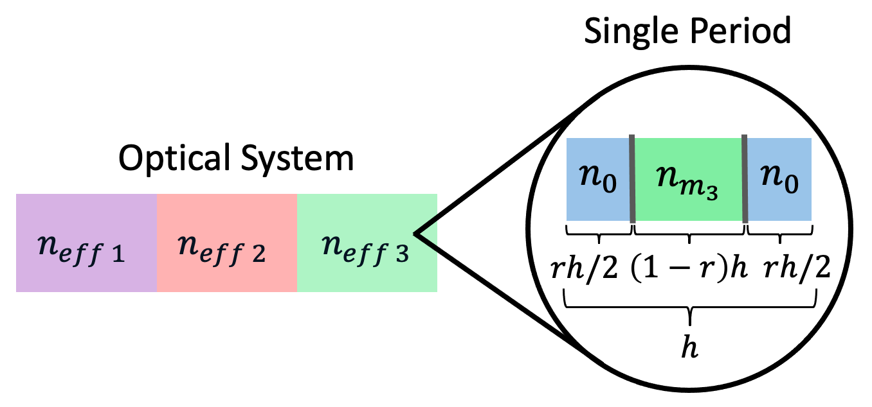
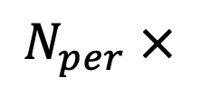
Optical Elements
$$N_{per} ×$$
Fig. 5: A diagram illustrating the microscopic composition of the simulated photonic crystals in an example optical system.
9
Notes:
Each photonic crystal is composed of periods which all have 5 composite elements: a vacuum portion, an interface, a medium portion, an interface, and a vacuum portion. The periods are characterised by their width ℎ (which must be smaller than the light wavelengths), the fraction of the vacuum portion 𝑟, and the refractive index of the medium portion 𝑛_𝑚. Each crystal is uniquely defined by these values and the number of periods in the crystal.
The effective index of refraction of a crystal 𝑛_𝑒𝑓𝑓 is calculated from the eigenvalue of a period which is treated as a phase shift induced on a plane wave. That way, a period is treated as an effective medium through which light propagates.

Slide 10
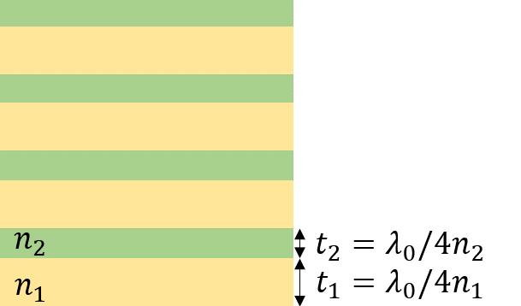


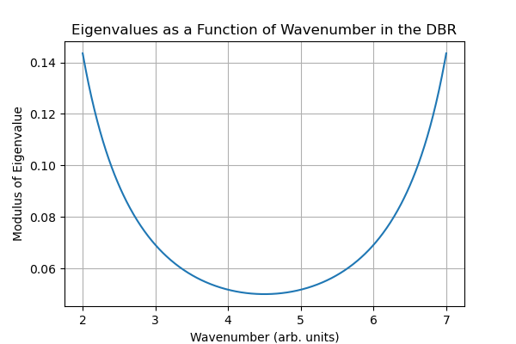





The Distributed Bragg Reflector (DBR)
Periodic quarter-wavelength stacks of high and low refractive index materials
Destructive interference $→$ periodically attenuated transmission $→$ reflection
Test properties $h_{DBR}, n_{DBR}$ and $N_{DBR}$
$$n_{0}$$
$$h_{i}=λ_{DBR}/4n_{0}$$
$$n_{DBR}$$
$$h_{j}=λ_{DBR}/4n_{DBR}$$
Fig. 6: A diagram of a DBR. Modified from FlexCompute.
10
Fig.7: The DBR photonic bandgap.
Notes:
For one of our optical systems, we incorporate a DBR structure. This consists of periodic quarter-wavelength stacks of high and low refractive index materials. This structure produces destructive interference periodically attenuating transmission so that the pulse is reflected. We ensure that the properties of the DBR, its width, its index of refraction and its number of periods, produce a photonic band gap in our wavenumber range. We test this through the eigenvalues of the DBR periods. For transmission, these should be smaller than 1 so that over a few periods the pulse exponentially decays.

Slide 11
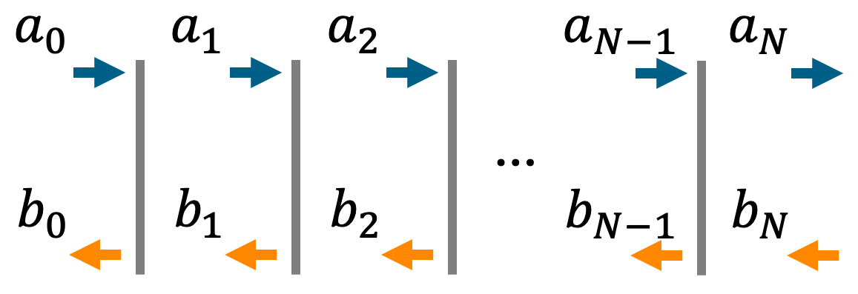
Pulse Propagation
Fig. 8: The TMM applied over many optical elements. Each grey line represents an optical element (layer or interface).
Compute exit vector
Back-propagate through the OS
Normalise all vectors relative to $a_{0}$
Normalise all vectors relative to 𝑎_0
Apply spectral and temporal modulation (FT)
11
*repeat for every wavenumber
Notes:
The sequence for propagating the pulse through the systems is as follows.
We first compute the exit vector, that at the RHS of the system, which should be the eigenvector of the last period. In the case with the DBR at the end, we pick the attenuating forward-propagating eigenvector. In the case with no DBR, we place a vacuum crystal and pick the forward-propagating eigenvector which assumes that this crystal prolongs itself to infinity so that the pulse is not reflected at any other interface.
Then, we back-propagate this vector through the optical system by inverting the M matrices, cascading them, and operating them to obtain the ab-vectors at each position.
These are all normalised relative to the forward-propagating vector at the LHS 𝑎_0 so that the initial phase and amplitude are 0 and 1 respectively.
This process must be repeated for each wavenumber.
Finally, we apply spectral and temporal modulations to these vectors corresponding to Fourier transform of a pulse in position space.
The total fields are given by superpositions of all these spectral components for a time and position.

Slide 12
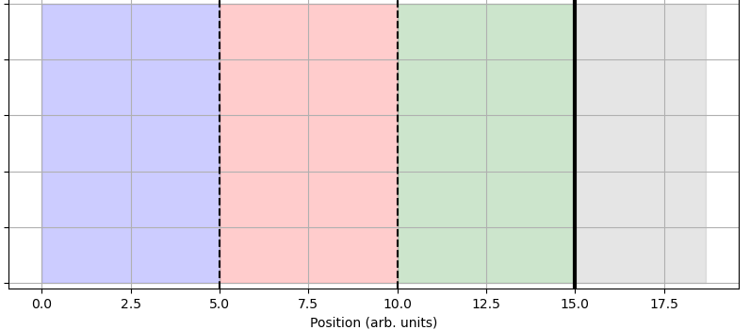
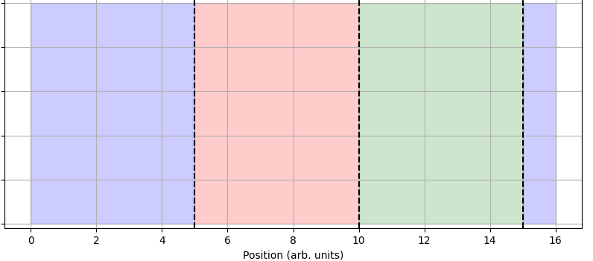









The Systems
OS1: vacuum, crystal 1 $\left(n_{eff1}=1.5\right)$, crystal 2 $\left(n_{eff2}=2.5\right)$, DBR structure
OS2: vacuum, crystal 1 $\left(n_{eff1}=1.5\right)$, crystal 2 $\left(n_{eff2}=2.5\right)$, vacuum
$$n_{0}$$
$$n_{eff1}$$
$$n_{eff2}$$
$$DBR$$
$$n_{0}$$
$$n_{eff1}$$
$$n_{eff2}$$
$$n_{0}$$
a) Optical System 1
b) Optical System 2
Fig. 9: Plots of the two employed optical systems. The dashed lines represent boundaries between crystals and the continuous line represents a boundary with the DBR.
12
Notes:
The two systems that we work with have a vacuum crystal, a crystal with 𝑛_𝑒𝑓𝑓=1.5, another crystal with 𝑛_𝑒𝑓𝑓=2.5 and then a DBR or yet another vacuum crystal.

Slide 13
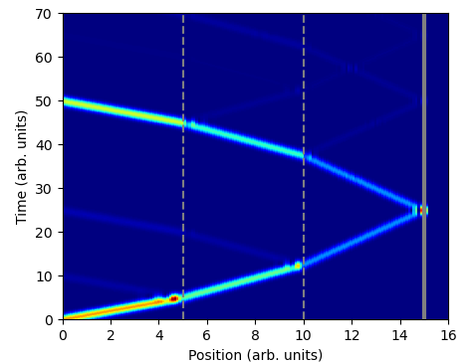
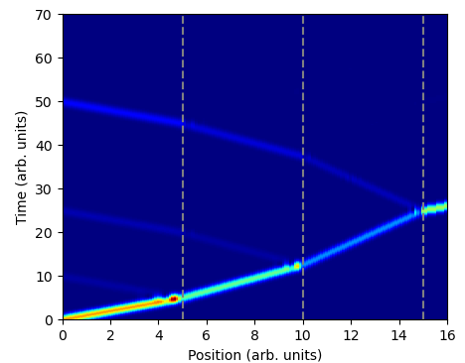
The Systems
$$n_{0}$$
$$n_{eff1}$$
$$n_{eff2}$$
$$DBR$$
$$n_{0}$$
$$n_{eff1}$$
$$n_{eff2}$$
$$n_{0}$$
a) Optical System 1
b) Optical System 2
Fig. 10: Pulse intensities as a function of time and position for both systems. The dashed lines represent boundaries between crystals and the continuous line represents a boundary with the DBR.
13
Notes:
Here you can see the pulses propagating in time and space for both our systems. The first system results in a full reflection of the pulse at the DBR while the second one partially transmits the pulse into the final vacuum crystal. In both cases, we see partial reflections at the boundaries between sections.

Slide 14
Measurements
Notes:
So now that we have visualised the pulse as it propagates, let’s move on to measuring its intensity and momentum.

Slide 15
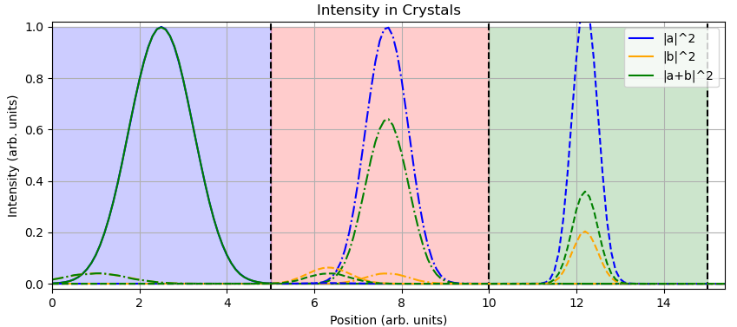

Intensities
Both systems are identical before the last crystal
Total field intensity attenuation with $n_{eff}$
Back-reflection counteracts forward momentum
Abraham-like behaviour
No $∝\frac{1}{n_{eff}}$ dependence
Fig. 11: Intensities at $t=2.50$ arb. units (full line), $t=9.00$ (dot-dash line), and $t=18.00$ (dashed line).
15
Notes:
Focusing on the intensities, we note that both systems should have identical propagations before interacting with the last crystal which is why this crystal is not shown here. The total field intensity in green is attenuated in crystals with increasing 𝑛 effective.
In dielectric media, we see reflections as the pulse propagates through the periods. The EM momentum density points parallel to the propagation so these reflections counteract the forward momentum. This is in accordance with Abraham’s prediction that the momentum should be reduced with refractive index. However, we did not measure the expected ∝1/𝑛_𝑒𝑓𝑓 dependence.

Slide 16




The Maxwell Stress Tensor (MST)
Describes the distribution of EM forces per unit area acting on a surface
The Momentum Continuity Equation relates $\overset{⃡}{T}$ to momentum
Different proposed forms in linear dielectrics which agree in vacuum
$${\overset{⃡}{T}}_{vac}=ε_{0}E_{i}E_{j}+\frac{1}{μ_{0}}B_{i}B_{j}−\frac{1}{2}δ_{ij}\left(ε_{o}E⋅E+\frac{1}{μ_{0}}B⋅B\right)$$
$$∇∙\overset{⃡}{T}=f+\frac{1}{c^{2}}\frac{∂S}{∂t}$$
$$g_{vac}=\frac{S}{c^{2}}$$
16
Notes:
To measure momentum more directly we introduce the Maxwell stress tensor. This is a second order tensor that describes the distribution of EM forces per unit area acting on a surface. In vacuum, it takes this form. It is related to momentum through the Momentum Continuity equation where 𝐟 gives the transfer of mechanical momentum density (so a force density) and 𝐒 is the Poynting vector. Note that in vacuum, the EM momentum density 𝐠 is related to 𝐒 through this relation.
There are different proposed forms of the MST in linear dielectrics, but they all converge to the expression above in vacuum.

Slide 17





The Maxwell Stress Tensor (MST)
Surface integrals over the MSTs centred at each period $→$ momentum flux into the medium layers
$$∇∙\overset{⃡}{T}=f+\frac{1}{c^{2}}\frac{∂S}{∂t}$$
Volume integral
+ divergence theorem
$$∯_{S}{\overset{⃡}{T}⋅dS}=\iiint_{V}{\left(f+\frac{1}{c^{2}}\frac{∂S}{∂t}\right)dV}$$
1D and $θ=0$
$$∯_{S}{{\overset{⃡}{T}}_{tp}⋅dS}⇒{{\overset{⃡}{T}}_{tp}}_{L}⋅\left(−\hat{z}\right)+{{\overset{⃡}{T}}_{tp}}_{R}⋅\hat{z}$$
Fig. 5: A diagram illustrating the microscopic composition of the simulated photonic crystals in an example optical system.
17
Notes:
Performing a volume integral on the Momentum Continuity Equation and applying the divergence theorem reveals that doing a closed surface integral on the MST centred at each period delivers the momentum flow rate into the periods.
Placing the integration surface at the period edges, which are vacuum, we can employ the unambiguous version of the MST in vacuum. This is why our photonic crystals have small vacuum portions at the edges.
Since this is a 1D problem at normal incidence, the surface integral becomes a simple projection along the z direction.

Slide 18
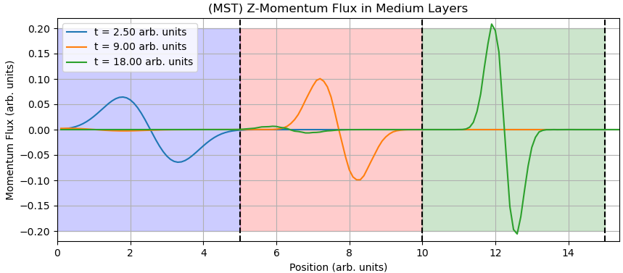

The Maxwell Stress Tensor (MST)
Both systems are identical before the last crystal
Sharpening of momentum flux peaks with $n_{eff}$
Minkowski-like behaviour
No $∝n_{eff}$ dependence
Fig. 12: Z-momentum fluxes in medium layers at different times before reflection.
18
Notes:
Again, both systems are identical prior to interacting with the last crystal, so here I show snapshots of the momentum fluxes for one of the optical systems. There is a sharpening of momentum flux peaks with 𝑛 effective, which corresponds to the Minkowski prediction of enhanced momentum in dielectrics. However, the expected ∝𝑛_𝑒𝑓𝑓 dependence was not detected.

Slide 19







The Lorentz (Bulk) Force
EM force acting on a charge distribution
Formulation for the total force of radiation on a solid object
Integration over the medium layer widths $→$ force surface density in the medium layer
$$f=ρE+J×B$$
$f_{v}=\frac{∂P}{∂t}×B$ $=ε_{0}\left(n^{2}−1\right)\frac{∂E}{∂t}×B$
$$↑$$
$$P=ε_{0}\left(n^{2}−1\right)E$$
non-magnetisation $μ\text{=}μ_{0}$
$$\frac{∂}{∂t}E_{k}=−iωE_{k}=−ickE_{k}$$
19
Notes:
On the other hand, we have the Lorentz force law, which delivers the EM force acting on a charge distribution. We employ a particular formulation of this law for the total force of radiation acting on a solid object. As we employ non-magnetisable media, the constitutive relation for electric fields simplifies the expression for the force density. Finally, we integrate over the medium layer widths to produce the force surface density on the medium layer. This has the same dimensions as the momentum flux which permits a comparison with the MST values.

Slide 20
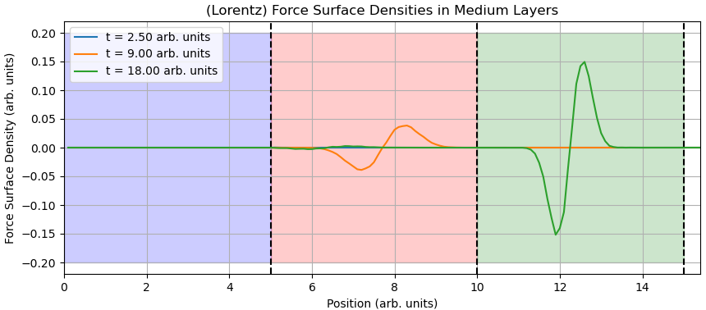

The Lorentz (Bulk) Force
Both cases are identical before the last crystal
Sharpening of force surface density peaks with $n_{eff}$
Minkowski-like behaviour
No $∝n_{eff}$ dependence
No force in vacuum
Fig. 13: Z-force surface densities in medium layers at different times before reflection.
20
Notes:
Once more, both systems are identical prior to interacting with the last crystal. There is a sharpening of force surface density peaks with 𝑛 effective, which corresponds to the Minkowski prediction of enhanced momentum in dielectrics. However, the expected ∝𝑛_𝑒𝑓𝑓 dependence was not detected. Note that there is correctly no force in vacuum as it is not polarisable.

Slide 21


Impulse
Numerical integration over time
Sum over periods of an OS section for total impulse surface density imparted
Normalise with respect to the original momentum surface density of the pulse
$$Δη_{z}\left(t\right)=\int_{t_{0}}^{t}{f_{z}\left(t^{′}\right)dt^{′}}⇒\sum_{t^{′}=t_{0}}^{t}{f_{z}\left(t^{′}\right)Δt}$$
$$∯_{S}{\overset{⃡}{T}⋅dS}=\iiint_{V}{\left(f+\frac{1}{c^{2}}\frac{∂S}{∂t}\right)dV}$$
21
Notes:
Lastly, we compute the accumulated impulse surface density by numerically integrating the forces and fluxes over time. Moreover, we integrate over the periods of a section of the optical system to determine the total impulse surface density imparted to that section. The impulses are normalised with respect to the initial momentum of the pulse to check that momentum is conserved. Comparing the MST and Lorentz values we are effectively computing both sides of the Momentum Continuity equation minus the Poynting vector term, which when computed has a very minor contribution.

Slide 22
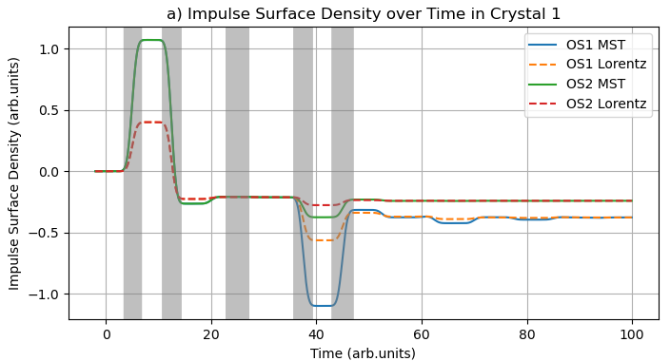
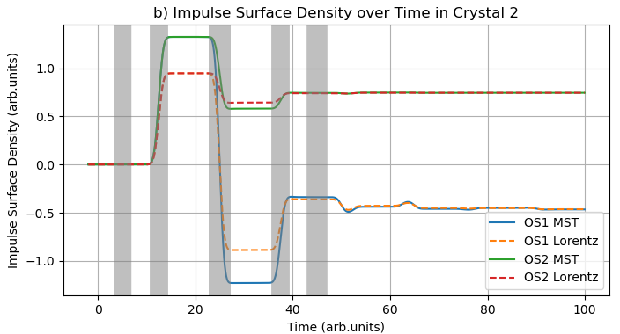
Impulse
Fig. 14: Accumulated z-impulses as a function of time in crystals 1 and 2 for both optical systems and momentum flux calculation methods. The bands mark times of major boundary interactions.
22
*The graphs are corrected versions of those in the report.
Notes:
Here we see the accumulated z-impulses as a function of time in crystals 1 and 2 for both optical systems and momentum flux calculation methods. The bands mark times of major boundary interactions. It is notable that both Lorentz and the MST methods deliver the same final impulse surface densities even if there are transient disagreements in the short term.

Slide 23
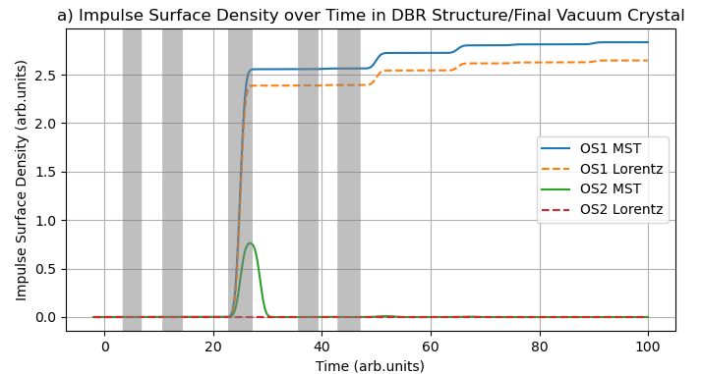
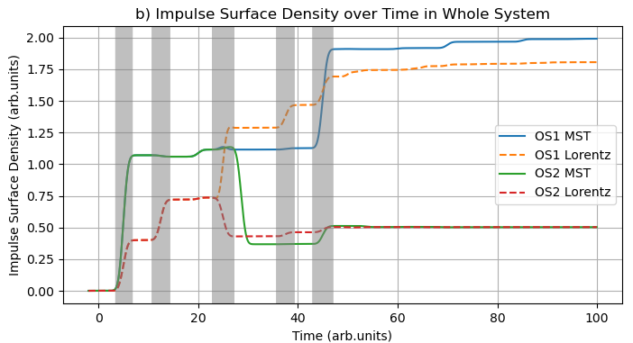
Impulse
Fig. 15: Accumulated z-impulses as a function of time in the DBR/final vacuum crystal and for the whole system for both optical systems and momentum flux calculation methods. The bands mark times of major boundary interactions.
23
*The graphs are corrected versions of those in the report.
Notes:
Here we see the accumulated z-impulses again but in the DBR, in the case of OS1, or in the final vacuum crystal, in the case of OS2, and in the whole system. The vacuum crystal accumulates no total impulse and the DBR accumulates more than twice the initial momentum surface density. This is due to the reflections at the boundaries between crystals which result in fractional pulses reaching the DBR after the main pulse. Notably, the Lorentz and the MST methods do not deliver the same final impulse surface densities for the DBR, which affects the final total impulse surface density in the whole system. The OS2 case does converge, revealing that there is a peculiarity with the DBR structure. At the current moment, this issue has not been resolved but would be the focus of work if more time was available.

Slide 24
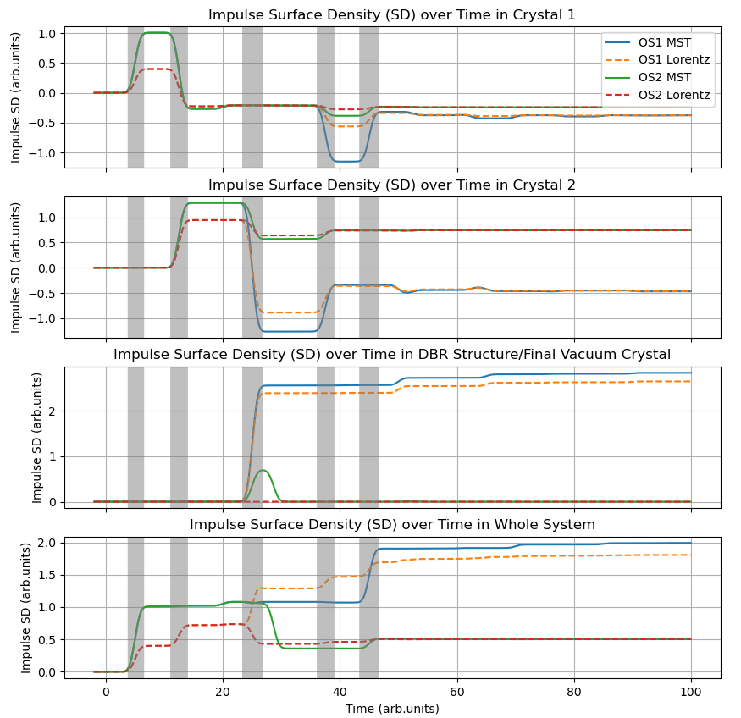

Impulse
Transient behaviour is different due to the non-uniqueness of the MST
$∇ ⋅\overset{⃡}{T}′=0$ or $∇ ⋅\overset{⃡}{T}′=−\frac{∂\overset{⃡}{T}′}{∂t}$
Momentum is conserved
Experimentally, only the total impulse could be measured
Fig. 16: Accumulated z-impulses as a function of time in the different system sections. The bands mark times of major boundary interactions.
24
Notes:
The difference in the transient behaviour can be explained by the non-uniqueness of the MST. We could add a divergenceless term with no effect for the momentum continuity equation or a term such as this one that vanishes when we integrate over time to obtain the impulse.
Looking at how much momentum is imparted in OS1, we conclude that our simulation correctly conserves momentum, at least for the MST calculation, as it gains twice as much as the initial momentum.
It is worth mentioning that in a real experiment, since the speed of light is much faster than the mechanical waves in a solid, it would only be this final total impulse which could be measured rather than the transient phenomena.

Slide 25

Conclusion
We developed computational tools to visualise the field momentum of light waves in dielectric media
We simulated optical media as 1D photonic crystals and employed the TMM to find the fields of a pulse at the different elements of the system
Results:
The intensities are reduced with $n_{eff}$
The momentum fluxes and force surface densities were enhanced with $n_{eff}$
Identical accumulated impulse surface densities in the crystals with transient disagreements
Our simulations correctly conserve momentum and allow the creation and testing of a variety of media through the input of a few simple variables
25
Notes:
I will conclude by saying that we indeed managed to visualise EM fields and their momenta as they propagate through linear dielectrics, and produced tools that allow the creation and testing of a variety of media through the input of a few simple variables.
Thank you very much for your attention.

Slide 26
References
[1] P. W. Milonni and R. W. Boyd, “Momentum of light in a dielectric medium,” Adv. Opt. Photon., vol. 2, pp. 519–553, Dec 2010.
[2] E. Yablonovitch, “Photonic crystals,” Journal of Modern Optics, vol. 41, pp. 173–194, Dec 1994.
[3] T. G. Mackay and A. Lakhtakia, The Transfer-Matrix Method in Electromagnetics and Optics. MorganClaypool, 2020.
Notes:
I will conclude by saying that we indeed managed to visualise EM fields and their momenta as they propagate through linear dielectrics, and produced tools that allow the creation and testing of a variety of media through the input of a few simple variables.
Thank you very much for your attention.

Slide 27
Image references
Bert Willemsen. (2020). Solar Sail. immeasurably.art. Accessed 17/04/2024 at https://immeasurably.art/projects/k4qQNz
S. Robinson and R. Nakkeeran, “Photonic crystal ring resonator based optical filters,” in Advances in Photonic Crystals (V. M. Passaro, ed.), ch. 1, Rijeka: IntechOpen, 2013.
FlexCompute. (2024). Distributed Bragg reflector and cavity. Flexcompute, Inc. Accessed 17/04/2024 at https://www.flexcompute.com/tidy3d/examples/notebooks/DistributedBraggReflectorCavity/
Notes:
I will conclude by saying that we indeed managed to visualise EM fields and their momenta as they propagate through linear dielectrics, and produced tools that allow the creation and testing of a variety of media through the input of a few simple variables.
Thank you very much for your attention.

