Slide 1


Romanian Language Processing: A Study on Grammar Correction and News Summarization
Slidesgo School
Matei Vlad Cristian
Research advisor:
Șl. Dr. Ing. Dumitru-Clementin Cercel
University Politehnica of Bucharest
Notes:
Hello everyone! This semester, the goal of my research was to continue the experiments and studies previously conducted to develop a grammar corrector for our language.

Slide 2
WHY. GEC, ANS for Romanian language?
Unsaturated Research
Insufficient researchers to advance new discoveries for the Romanian language. Opportunity and potential exist for new experiments.
Significant Impact
Many would benefit from a well-performing grammar checker or an automatic news summarizer, including: ordinary people, foreign students, journalists, writers, …
1
Notes:
Because research is not saturated :
- There are very few advances in the development of a grammar checker for our language.
And then:
A well-performing GEC or an automatic summarizer model can indeed have a significant impact. According to statistics, there are many Romanians who would benefit from a GEC or an AS model.

Slide 3
What are the objectives ?
Notes:
The main goal of this work is to contribute to the progress of research in the field of natural language processing applied to the Romanian language by addressing two fundamental tasks: automatic news summarization and automatic correction of grammatical errors.

Slide 4
| ANS | What are the objectives ?
01
Build an original dataset containing press articles from the Republic of Moldova along with their corresponding summaries.
02
Train different models, such as Pointer-Generator Network (PGNs ), T5 (base, large ) and test RoGPT2 to compare their performances.
2
Notes:
For the Automatic News Summarizer: build an original dataset containing press articles from the Republic of Moldova, accompanied by the corresponding summaries. And then train different models, such as Pointer-Generator Network (PGNs), T5 (base, large) and test RoGPT2 to compare their performances.

Slide 5
| GEC | What are the objectives ?
01
Publishing a new synthetically generated parallel dataset (MEID ), for Romanian language, which will contain more than 2 million pairs of correct and wrong sentences generated artificially.
02
Train T5 models (base, large ), along with optimization techniques (back-translation, round-trip translation ), perform ablation studies, test different LLMs (zero-shot, few-shot, +- CoT ) and compare the results.
2
Notes:
For the Grammar Error Corrector: the first objective is to publish a new synthetically generated parallel dataset (MEID), for Romanian language, which will contain more than 2 million pairs of correct and wrong sentences generated artificially. Then,

Slide 6
The Datasets.

Slide 7
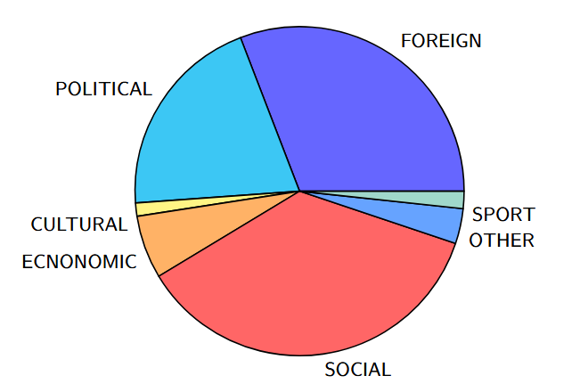
| ANS | Datasets Establishment
MoldovanNews
01
Collected from four Moldovan news websites (Tv6, Radio Chisinau, NordNews, Cotidianul ) using web scraping.
For each article, were selected the following: Title, Content, Abstract (as the first paragraph of the news), Tags, Topic.
Automatic News Summarization
The dataset comprises 254K news articles.
3
Notes:
In this research paper, I will use two datasets. The first is RONACC, which is presented as a native parallel dataset containing naturally occurring grammatical errors from television .. The errrors being corrected by people. The dataset consists of approximately 10,000 entries, and the probability distribution of the errors can be seen in the image.

Slide 8
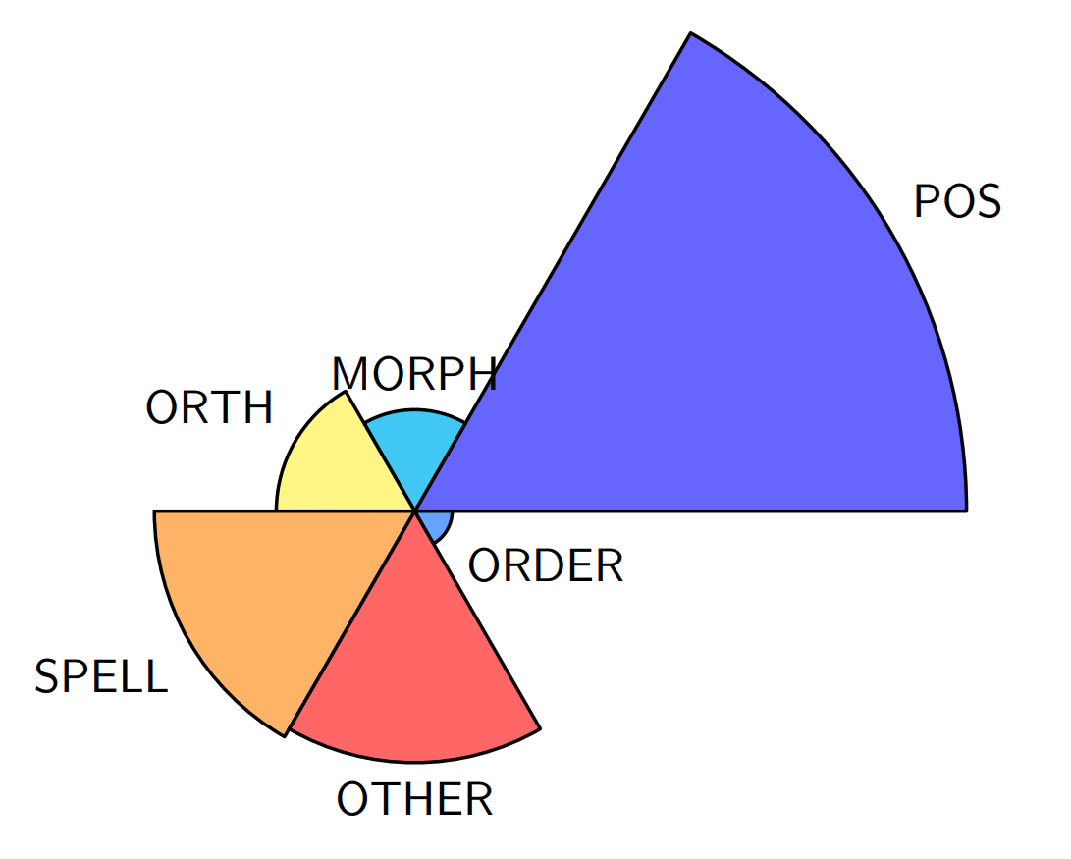
| GEC | Datasets Establishment
RoNACC
01
The Romanian National Audiovisual Council Corpus (RONACC) is presented as a native corpus, encompassing correct sentences spoken on Romanian TV, alongside sentence pairs representing common written mistakes.
Grammatical Error Correction
The total number of GOLD labeled sentences is approximately 10K.
3
Notes:
In this research paper, I will use two datasets. The first is RONACC, which is presented as a native parallel dataset containing naturally occurring grammatical errors from television .. The errrors being corrected by people. The dataset consists of approximately 10,000 entries, and the probability distribution of the errors can be seen in the image.

Slide 9
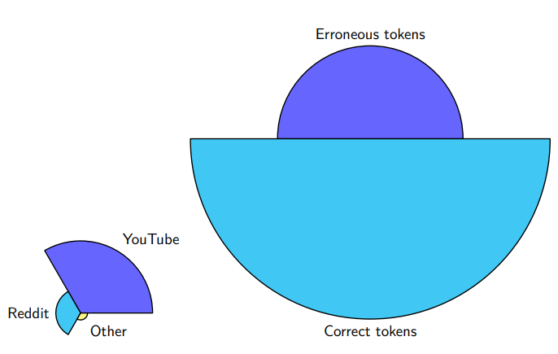
| GEC | Datasets Establishment
RoComments
02
The dataset was mostly composed of comments from Youtube and Reddit. Only Romanian sentences between 10 and 25 words were retained.
Aprox. 21% of the words contain erros. ! Much higher rate than in most similar datsets.
Grammatical Error Correction
It comprises 3K real-world Romanian sentence pairs.
3
Notes:
In this research paper, I will use two datasets. The first is RONACC, which is presented as a native parallel dataset containing naturally occurring grammatical errors from television .. The errrors being corrected by people. The dataset consists of approximately 10,000 entries, and the probability distribution of the errors can be seen in the image.

Slide 10
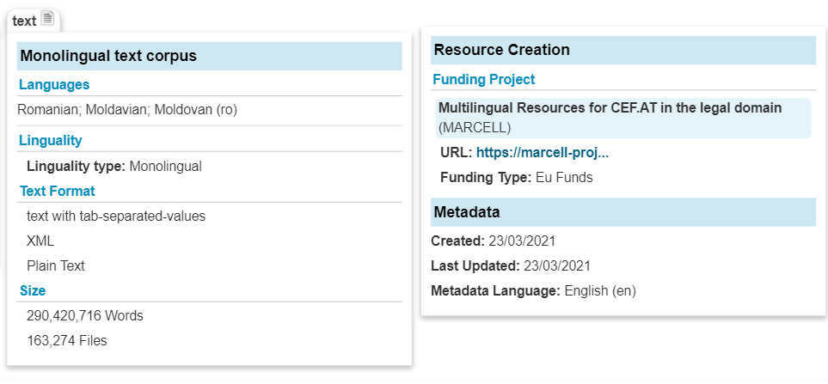
| GEC | Datasets Establishment
MARCELL-RO
03
As part of the MARCELL CEF Telecom project, which aims to collect and deeply annotate a large comparable corpus of legal documents, the MARCELL-RO corpus is presented as containing national legislative texts from the period 1881-2021.
Juridic Simple Dataset
The dataset was selected due to the very low chance of errors found in legal documents and because it has already been manually annotated by RACAI with information for each word such as:
POS tagging
Lemma
Case
Gender
Number and Form.
4
Notes:
The second dataset utilized in this research is MARCELL, a juridic simple dataset. This dataset will be employed to artificially generate grammatical errors, under the assumption that natural grammatical errors are highly unlikely to appear in legal documents.

Slide 11
Grammar Error Correction

Slide 12
MEIDv2 (MARCELL ERROR INJECTION DATASET)
Notes:
Next, I will introduce MEIDv2. The method of its construction will be explained.

Slide 13
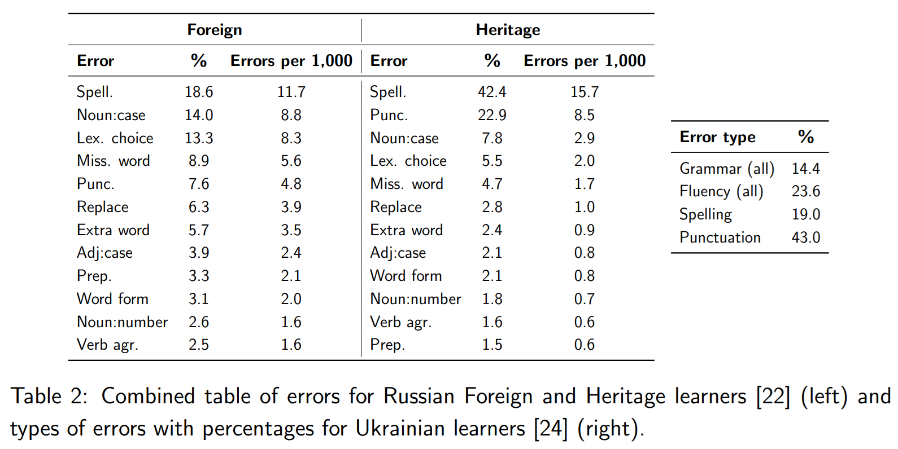
MEIDv2
Error Distribution Analysis
01
5
Notes:
As in the previous semester, I aimed to consider the distribution of natural errors that could occur in the Romanian language. Given the morphological complexity of our language and its similarities to Slavic languages, I used studies published in that field as inspiration.

Slide 14
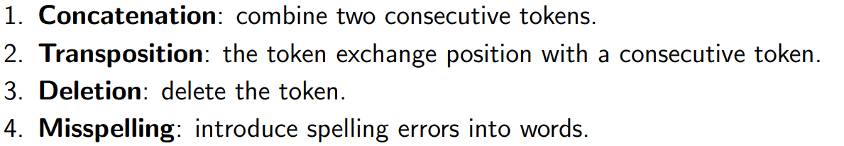
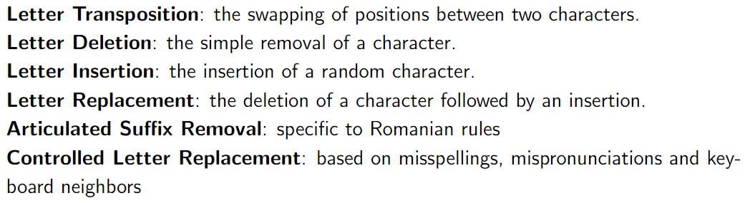
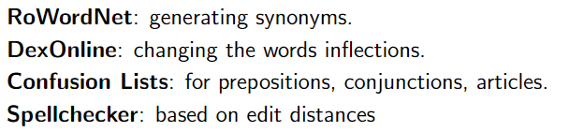
Error injection rules
MEIDv2
02
Hierarchy of rules
6
Notes:
Considering the distribution of errors I aimed to achieve, I empirically created a hierarchy of rules, each associated with a series of empirically established generation probabilities. What I added this semester was a method for generating synonyms using DexOnline, not just inflections as I had done previously.

Slide 15
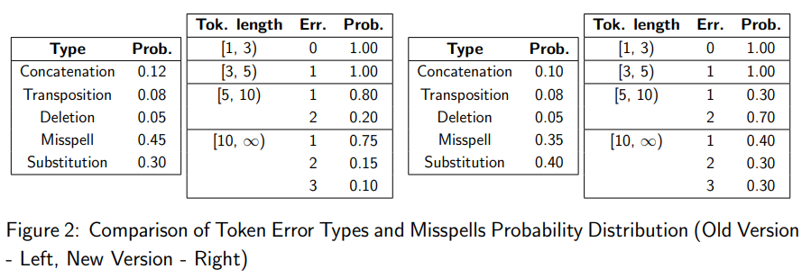
Error injection rules
MEIDv2
03
7
Notes:
Some examples of probability distributions and their utility include: how many words to select based on the sentence length to alter grammatically? With what likelihood do I choose which type of error to generate? This semester, I tried to alter the sentences more aggressively, as the experiments were to be conducted on larger models. I wanted to have more errors, more diverse alterations, with a greater focus on substitution.

Slide 16
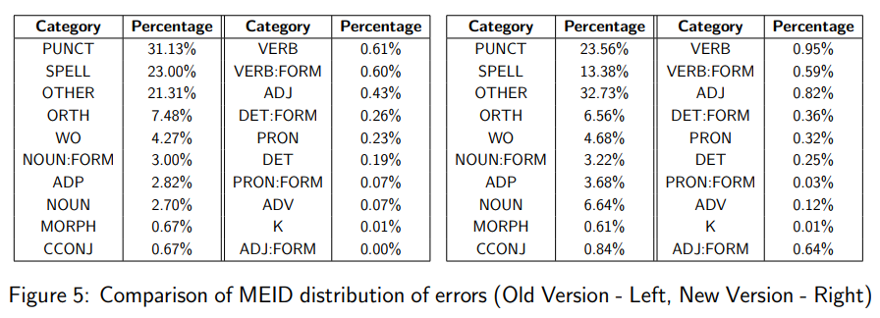
MEIDv2
Final Distribution of Errors
04
8
Notes:
As can be seen, by adjusting the probabilities for generating synthetic errors, significant differences emerge in the final errors distributions. The errors generated are more diverse, with the number of incorrect nouns being 2.5 times higher. Also, I obtained twice as many incorrect adjectives, and a substantial increase in errors related to verbs, determiners, pronouns, adverbs and other types.
I think it’s a good sign that punctuation and spelling errors have decreased a bit compared to the likelihood of encountering other types of errors.

Slide 17
The Architecture
Notes:
After creating the dataset, I selected an architecture to perform the training.

Slide 18
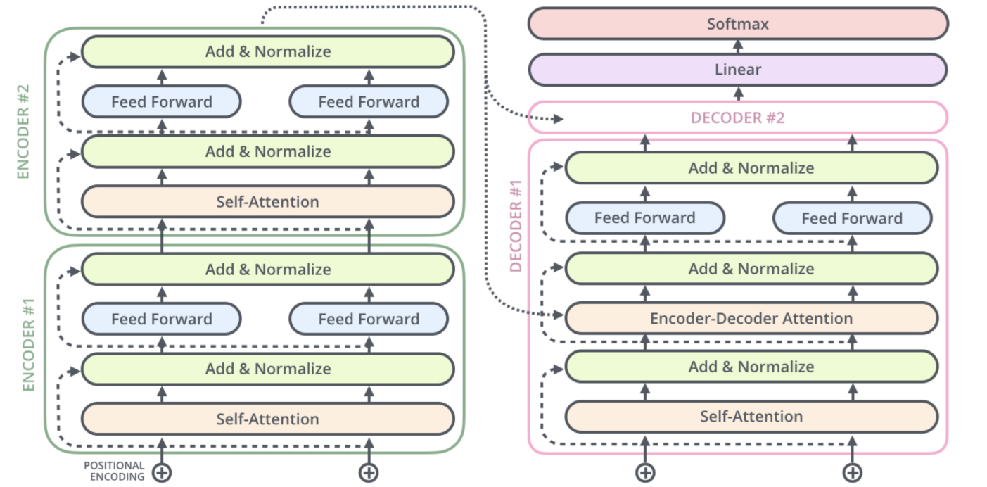
T5
T5 Base Model
01
9
Notes:
I chose a T5Base and Large model, published on Hugging Face by Stefan Dumitrescu. What can be said about T5 is that it essentially represents a basic Transformer architecture, with the specific feature of being a unified framework used for transfer learning across multiple tasks during the embedding creation phase.

Slide 19
Data Augmentation
Notes:
Next, I will present the two data augmentation techniques that I used.

Slide 20
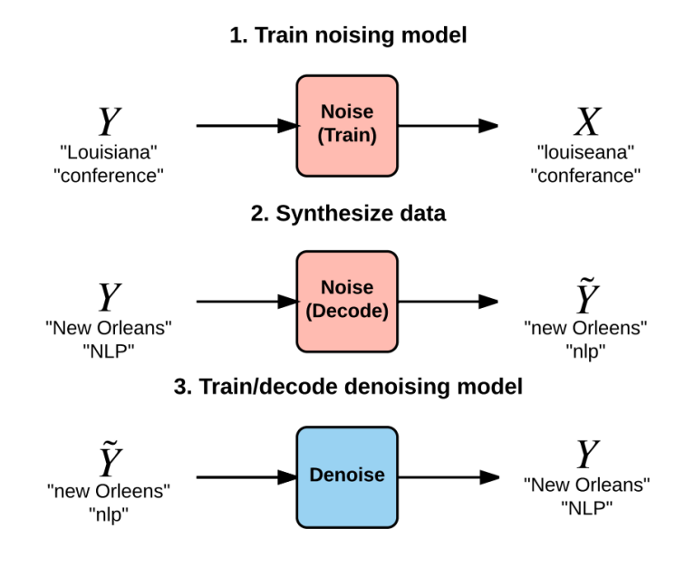
Back-Translation
01
6
Notes:
Back-Translation is a noise generation method, successfully used in GEC. The model learns to generate noise by taking a correct sentence as input and an incorrect one as reference. Later at the decode step, I could augment the correct sentences into wrong ones as shown in the Figure. I used the training portion of RoNACC to train the model, ensuring that the noise generated is close to the natural errors encountered in real-world data.

Slide 21
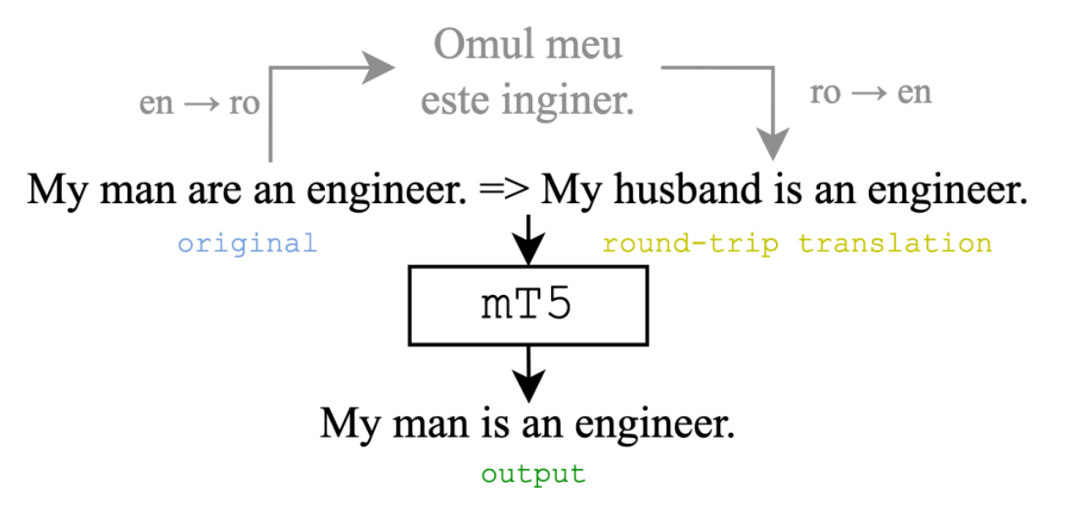
Round-Trip Translation
01
11
Notes:
Round-Trip Translation involves translating the text using an imperfect translation model into a bridge language, text which is then back-translated into the original language. This process introduces grammatical error, but it can also correct other errors. The method is used for input augmentation, providing two variants from which to generate the final prediction.

Slide 22
Experiments
Notes:
As for the experiments, I started with a filtering step.

Slide 23
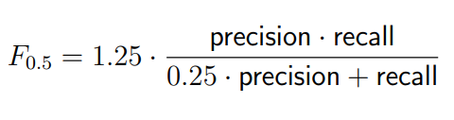
Expriments
01
PreTraining Phase
300K filtered examples from MEID2
FineTuning Phase
RONACC
ERRANT
Results
+/- beam search = 8
12
Notes:
Regarding the experiments, I used the resources provided by our faculty. After the model was pretrained on MEIDv2, fine-tuning followed on RONACC. There are many details to add, but there is not enough time to describe them. It is important to note that for evaluation, the most suitable metric is F0.5, with the intention of focusing on minimizing false positives by prioritizing precision over recall. In the end, the final evaluation was provided by ERRANT. Also, to make a more accurate comparison with the state-of-the-art, I chose to use a subset of only 300K examples from MEID version two, compared to the 1 million examples used in last semester's experiments.

Slide 24
Results
Notes:
Ok. Now I will present the results.

Slide 25
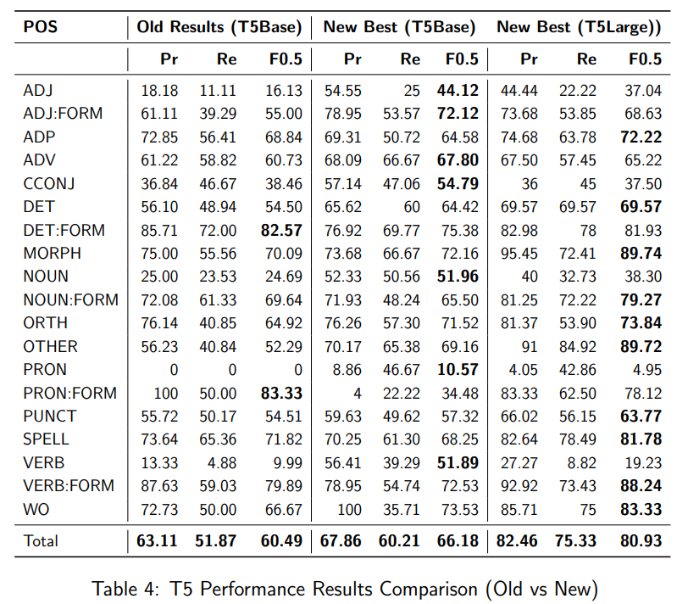
Results – Performance Evaluation
01
9
Notes:
As shown, the new version with T5Base resulted in about a 6% improvement in the F0.5 score, while the T5Large present an improvement of 20 F0.5 points.
It is very clear how the new version of the MEID dataset influences the final results. Errors such as DET:FORM and PRON:FORM were much easier to correct before, but now ADJ, NOUN, PRON, and VERB are more easily identified and corrected. This could be the effect of the new probability of replacing words with their synonyms, and the addition of the new method.

Slide 26
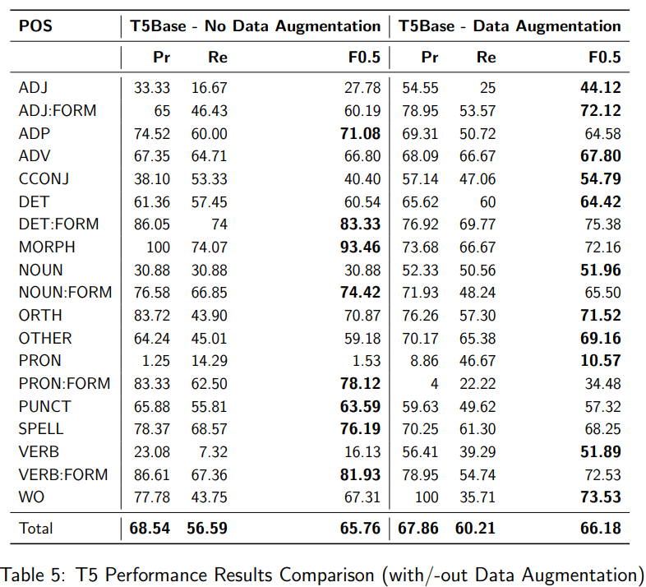
Results – Performance Evaluation
02
9
Notes:
To better visualize the effect of the augmentation methods, I will present this comparison (with or without data augmentation).
As observed, the effect of the augmentation methods can be seen. Some of their suggestions - replacing words with synonyms, in the case of Round-Trip Translation, - or the noise introduced by Back-Translation are appropriate choices, leading to significant improvements in scores for a lot of synonym variation categories. However, when the model relied just on the main dataset, the results for the cateogries which implies :FORM are better.

Slide 27
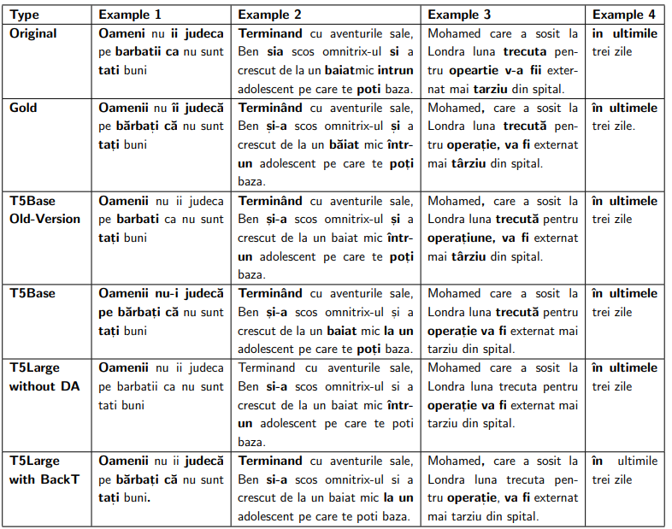
Results – Qualitative Evaluation
03
9
Notes:
After that, I also conducted a qualitative evaluation, testing several examples found in the RONACC dataset. As can be seen, the models performs quite well; however, more attention should be given to diacritics. Just one thing to mention: it can be observed how the T5Base model, which also relies on Round-Trip Translation, predicts very fluently and accurately, as shown in the example: it predicts “Oamenii nu ii judecat pe barbate ca nu sunt tati buni” into “Oamenii nu-i judeca pe barbati ca nu sunt tati buni.”. Another general improvement should be the correction of punctuation marks.

Slide 28
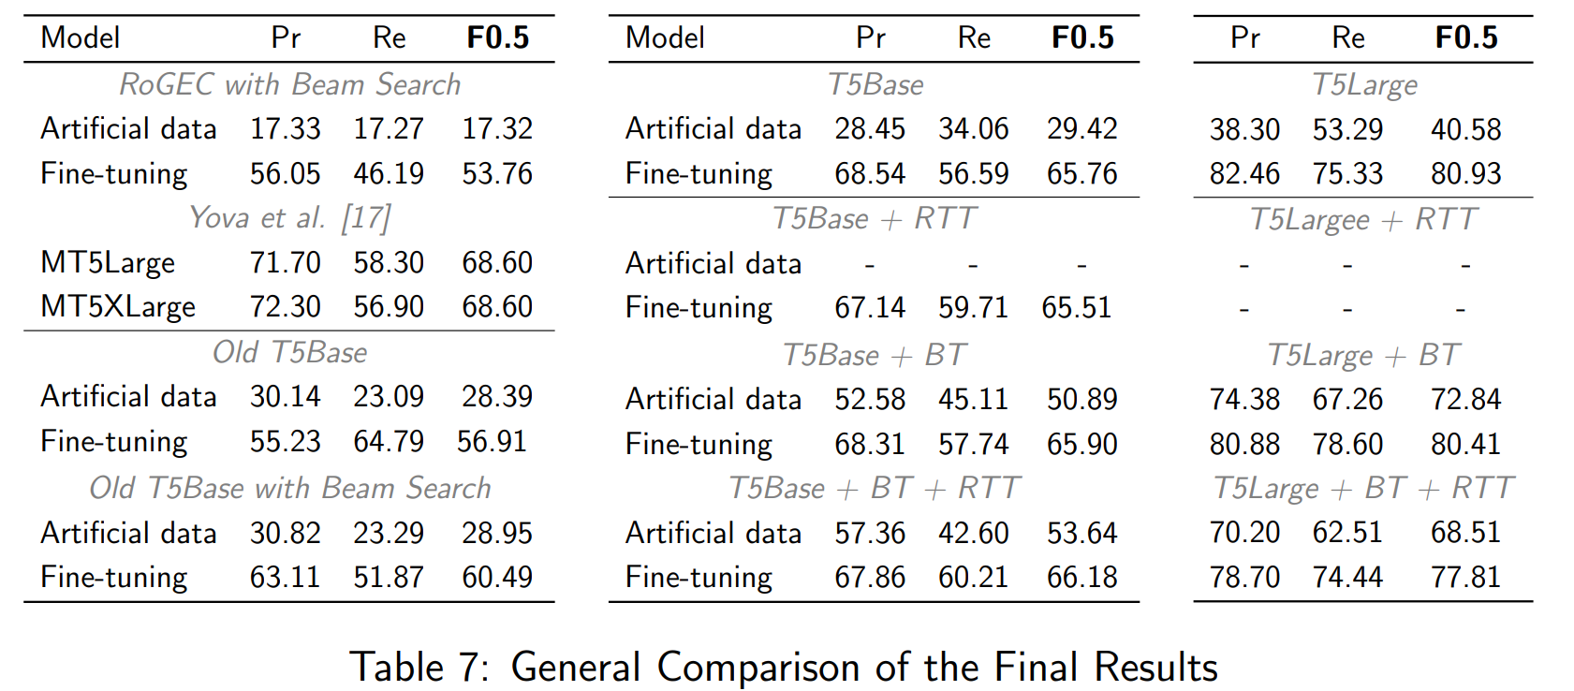
Results – SOTA Comparison
04
12
Notes:
The left subtable shows the state-of-the-art results at the top, followed by results from my previous research. The middle subtable presents the results from T5Base, while the right subtable shows the results from T5Large.
An important observation is the performance of the new T5Base model. Despite the new dataset containing only 300 hundred thousands examples, instead of 1 million in the earlier version, the model achieved a better result of around 29 points, compared to the previous 28 points. This suggests that MEIDv2 is more suitable and that 300 hunder thounsands examples are enough for a T5 model to learn the probability distribution using a simple, fixed, rule-based technique without uncontrolled noise.
Without additional optimizations, larger architectures lead to significant improvements. The T5Large model achieved an F0.5 score of 80.93 points, approximately 12 points higher than the state-of-the-art obtained with MT5XLarge, 37 points higher than RoGEC, and 20 points higher than my previous results.
In conclusion, the data augmentation methods were highly effective. The same T5Base model, trained only on artificial data, nearly matched the performance of the earlier T5Base fine-tuned on the RoNACC dataset. An this because of the new MEIDv2 dataset and Back-Translation, and Round-Trip Translation. Moreover, simply applying BackTranslation during pretraining boosted the results from 29 points to 50, so about 20 points improvement.
For T5Large, the results were even more impressive. Using only artificial data and backtranslation, the model achieved a score of 72 points, a lot over the state-of-the-art and outperforming any T5Base model fine-tuned on RoNACC. The improvement brought by backtranslation was around 32 points"

Slide 29
Conclusion & Future directions
01
02
MEIDv2
T5 Results, F0.5 = 80.9
02
02
LLMs
Expriments
1 mil entries
The state-of-the-art (SOTA) had an F0.5 score of 68.6.
Use LLMs to augment data
Test the dataset with other models. (GPTs)
12
Notes:
In conclusion, I created a new dataset, tailored to the identified needs. Then, I achieved a state-of-the-art score of 80.9 F0.5, which is 12% higher than the previous one obtained with an MT5XLarge model. In the future, I would like to explore augmenting the dataset using LLMs and testing other GPT-type models.

Slide 30
Thank you
Research advisor:
Șl. Dr. Ing. Dumitru-Clementin Cercel
University Politehnica of Bucharest

