Slide 1


The Learning Agency Lab PII Data Detection
Slidesgo School
Matei Vlad Cristian
University Politehnica of Bucharest

Slide 2
I've tried multiple solutions, I've researched websites like Medium, or other options proposed in discussions on Kaggle.
1

Slide 3
Solutions
BERT-base-ner
- Score: 0.7
- Epochs: 3
- Size: 512
- Inference: predictions & regex
- No Extra Data
- Training Time: less than 1 hour
Notes:
1. Advancing research through the development of models specialized for the Romanian Language. I will solve 2 tasks:
-- News summarization
-- NER on historical documents
2. I'll create / contribute to the creation of 2 datasets:
-- Moldovan News for the first task
-- HistNERo for the second task

Slide 4
Solutions
DeBERTa-v3-medium
- Score: 0.92
- Epochs: 3
- Size: 512
- Inference: predictions & regex
- No Extra Data
- Training Time: 3h
+ Cross-Validation: 4 folds
+ Confidence Threshold for O label: 0.9
Notes:
1. Advancing research through the development of models specialized for the Romanian Language. I will solve 2 tasks:
-- News summarization
-- NER on historical documents
2. I'll create / contribute to the creation of 2 datasets:
-- Moldovan News for the first task
-- HistNERo for the second task

Slide 5
The dataset

Slide 6
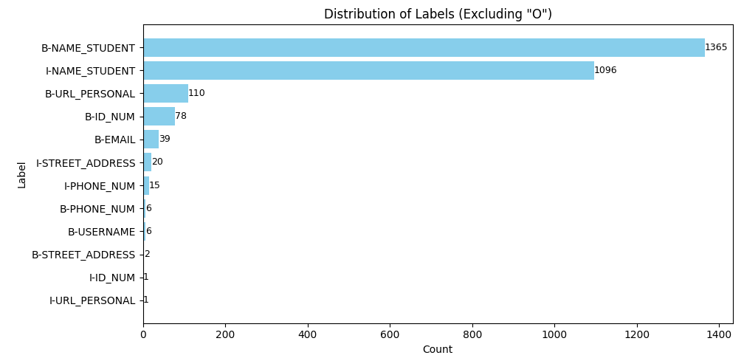

Slide 7
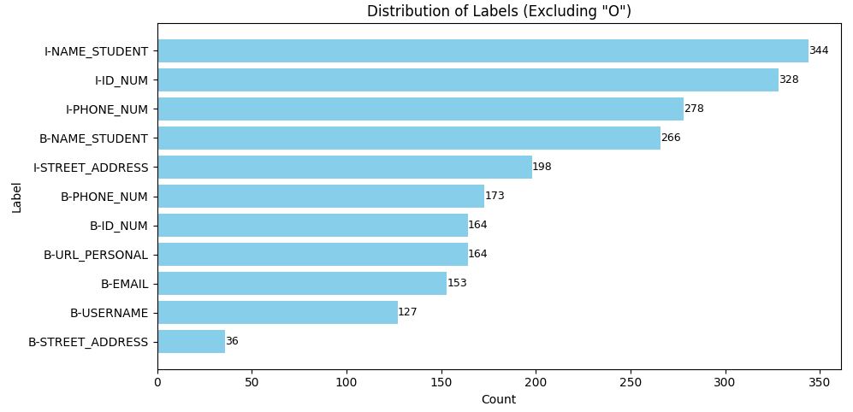

Slide 8
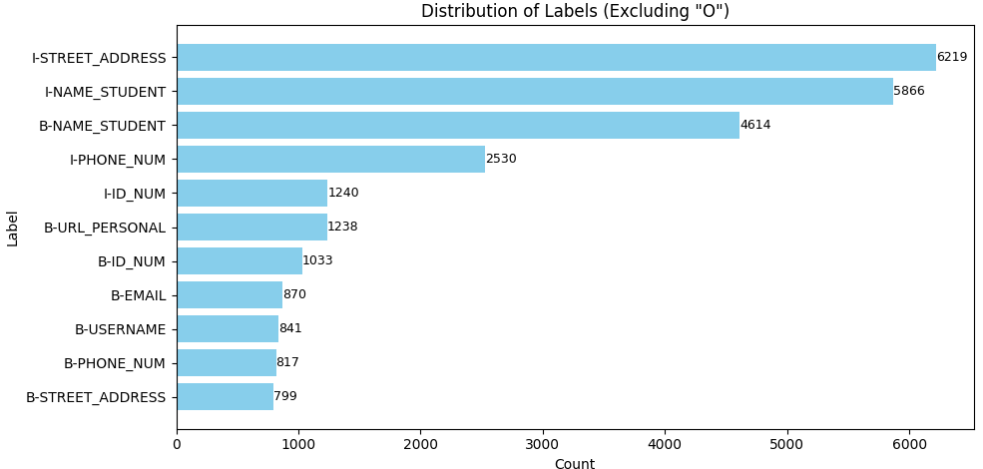

Slide 9
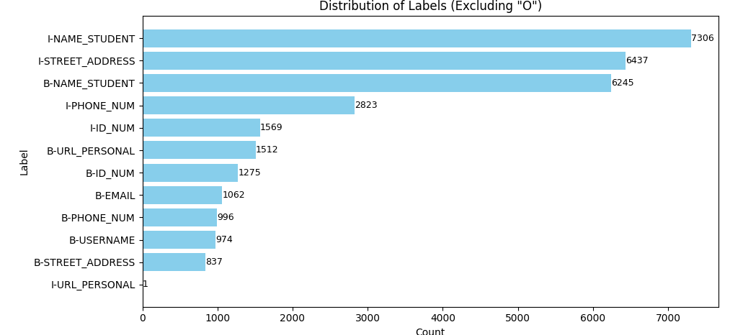

Slide 10
Solutions
DeBERTa-v3-large
- Score: 0.956
- Epochs: 3-4
- Size: 1024
- Inference: predictions & regex
- My dataset + Recommended Dataset (any combination)
- Training Time: 9h
+ Cross-Validation: 4-3 folds
+ Confidence Threshold for O label: 0.9
Notes:
1. Advancing research through the development of models specialized for the Romanian Language. I will solve 2 tasks:
-- News summarization
-- NER on historical documents
2. I'll create / contribute to the creation of 2 datasets:
-- Moldovan News for the first task
-- HistNERo for the second task

Slide 11
Best Solution – Milestone II
2. DeBERTa-v3-large + Lora
- Score: 0.958
- Epochs: 8
- Size: 1024
- Inference: predictions & regex
- just the Recommended Dataset
- Training Time: 4h
+ Cross-Validation: 1 fold (75% train – 25% tets)
+ Confidence Threshold for O label: 0.9
Notes:
1. Advancing research through the development of models specialized for the Romanian Language. I will solve 2 tasks:
-- News summarization
-- NER on historical documents
2. I'll create / contribute to the creation of 2 datasets:
-- Moldovan News for the first task
-- HistNERo for the second task

Slide 12
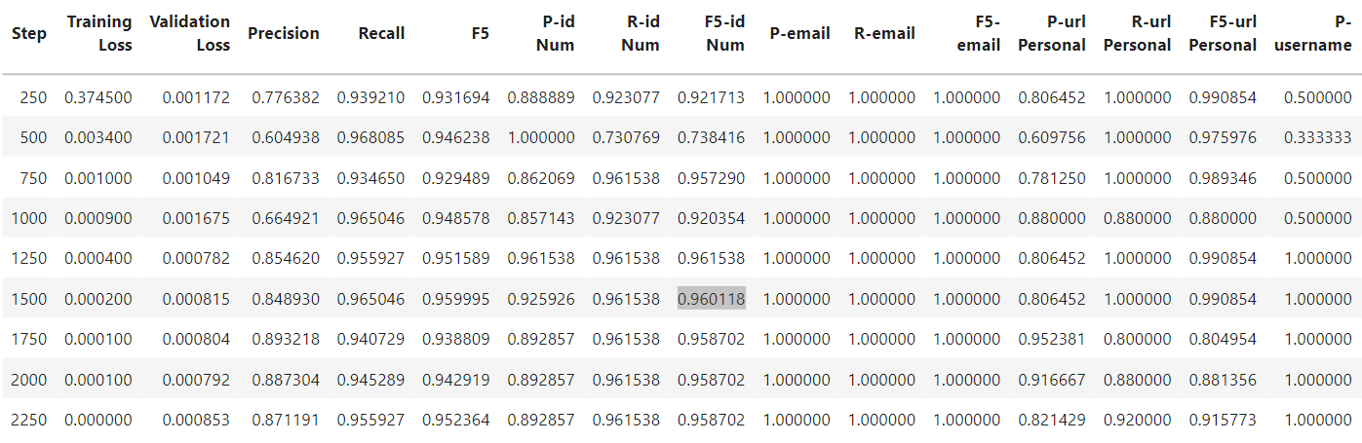
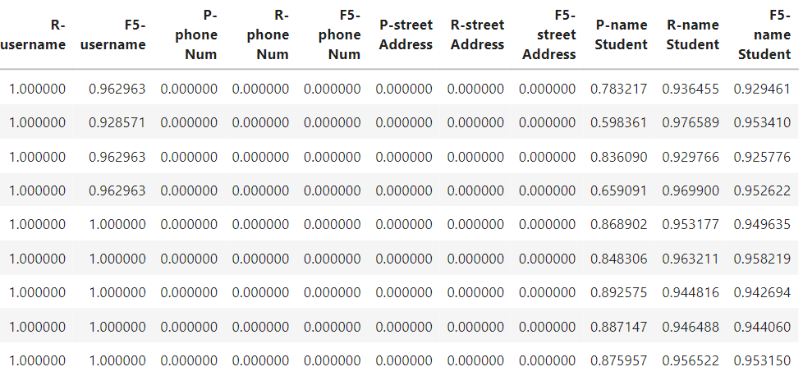
Solutions
Notes:
1. Advancing research through the development of models specialized for the Romanian Language. I will solve 2 tasks:
-- News summarization
-- NER on historical documents
2. I'll create / contribute to the creation of 2 datasets:
-- Moldovan News for the first task
-- HistNERo for the second task

Slide 13
DeBERTa-v3-large + LoRa
0.958
0.5
0.6
0.7
0.8
0.9
0.956
BERT-base-ner
DeBERTa-v3-medium
DeBERTa-v3-large + extra datasets

Slide 14
Thank you
University Politehnica of Bucharest

