Slide 1
Design Patterns
Curs 4
{Dev}School Java
27.10.2022

Slide 2
What’s a design pattern?
Design patterns are typical solutions to commonly occurring problems in software design. They are like pre-made blueprints that you can customize to solve a recurring design problem in your code.
The pattern is not a specific piece of code, but a general concept for solving a particular problem. You can follow the pattern details and implement a solution that suits the realities of your own program.

Slide 3
Algorithm vs Pattern
Patterns are often confused with algorithms, because both concepts describe typical solutions to some known problems.
While an algorithm always defines a clear set of actions that can achieve some goal, a pattern is a more high-level description of a solution. The code of the same pattern applied to two different programs may be different.
An analogy to an algorithm is a cooking recipe: both have clear steps to achieve a goal. On the other hand, a pattern is more like a blueprint: you can see what the result and its features are, but the exact order of implementation is up to you.

Slide 4
What does the pattern consist of?
Most patterns are described very formally so people can reproduce them in many contexts.
Here are the sections that are usually present in a pattern description:
Intent of the pattern briefly describes both the problem and the solution.
Motivation further explains the problem and the solution the pattern makes possible.
Structure of classes shows each part of the pattern and how they are related.
Code example in one of the popular programming languages makes it easier to grasp the idea behind the pattern.

Slide 5
Types of Design Patterns
Creational Design Patterns
Structural Design Patterns
Behavioural Design Patterns

Slide 6
Creational Design Patterns
Notes:
Creational patterns provide various object creation mechanisms, which increase flexibility and reuse of existing code.

Slide 7
Creational Design Patterns
Factory
Builder
Singleton

Slide 8

Problem
Imagine that you’re the owner of a pizza shop. Nowadays, it required to have the business online, therefore you’ll write some code for an app.
After a while, your app becomes pretty popular. Each day you receive dozens of requests and people are asking for more pizza types.
Great news, right? But how about the code?

Slide 9
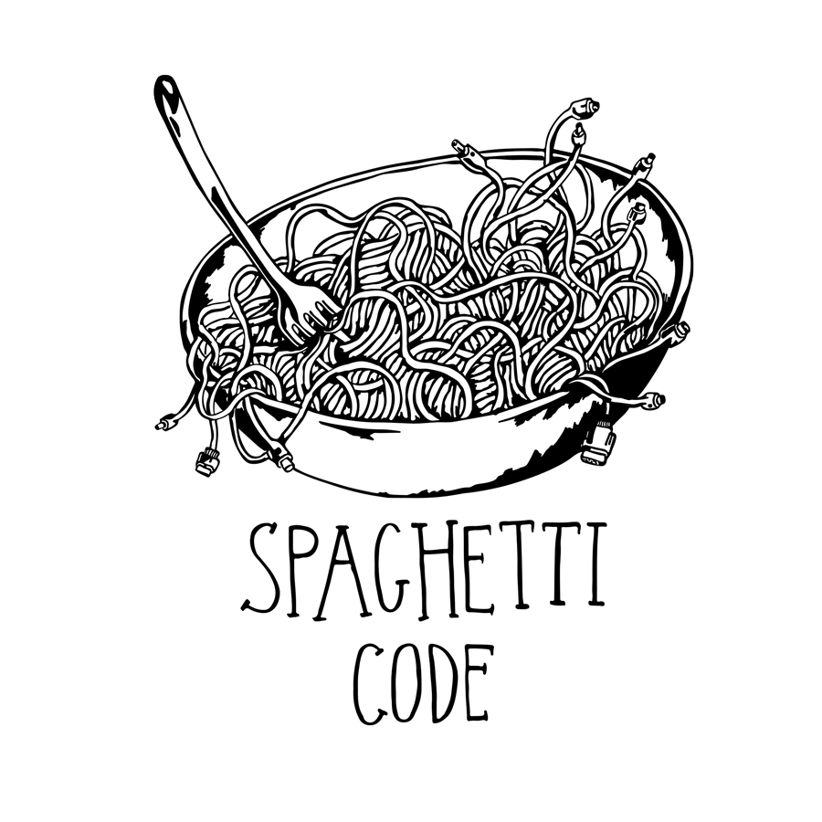
Codebase changes
What happens if we add a new pizza type into the app?
If we later decide to add 20 pizza type to the app?
Result: pretty nasty code, riddled with conditionals that switch the app’s behaviour depending on the class of transportation objects.
Notes:
Adding Ships into the app would require making changes to the entire codebase. Moreover, if later you decide to add another type of transportation to the app, you will probably need to make all of these changes again.
As a result, you will end up with pretty nasty code, riddled with conditionals that switch the app’s behavior depending on the class of transportation objects.

Slide 10
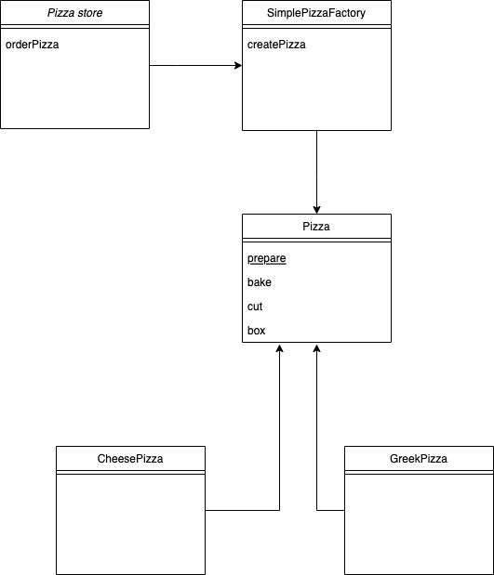
SimpleFactory

Slide 11
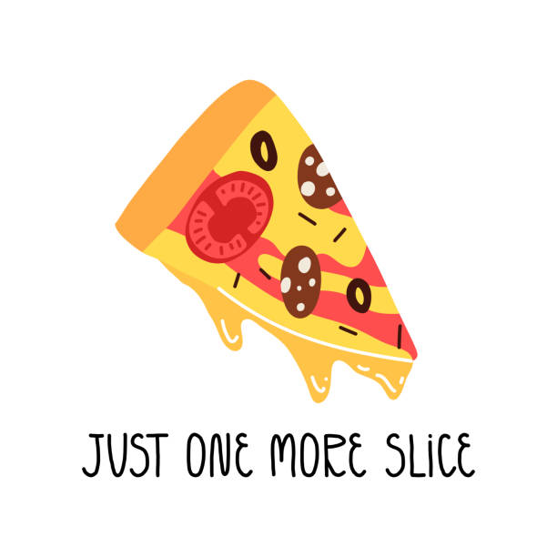
Huston we have a problem
Imagine that you want expand and deliver in many cities. You are in Bucharest, you want to franchise in Iasi, Timisoara, Cluj.
But, in each city people want to have different type of pizza
Great news, right? But how about the code?

Slide 12
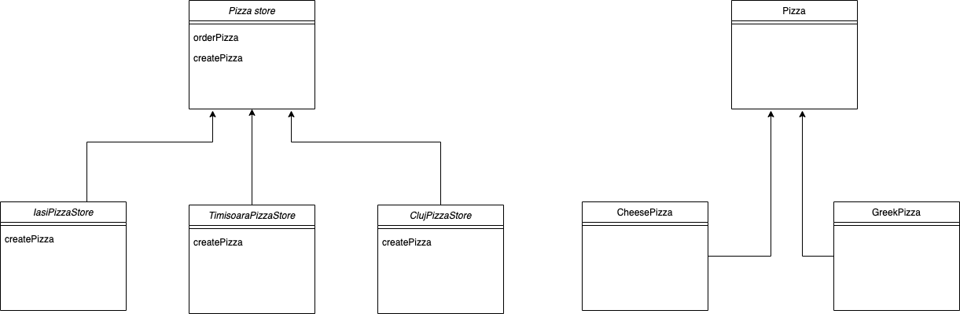
Factory
Factory Method is a creational design pattern that provides an interface for creating objects in a superclass, but allows subclasses to alter the type of objects that will be created.

Slide 13
Solution
The Factory Method pattern suggests that you replace direct object construction calls (using the new operator) with calls to a special factory method.
Don’t worry: the objects are still created via the new operator, but it’s being called from within the factory method. Objects returned by a factory method are often referred to as products.

Slide 14
Pros & Cons
At first glance, this change may look pointless: we just moved the constructor call from one part of the program to another.
However, consider this: now you can override the factory method in a subclass and change the class of products being created by the method.
There’s a slight limitation though: subclasses may return different types of products only if these products have a common base class or interface. Also, the factory method in the base class should have its return type declared as this interface.

Slide 15
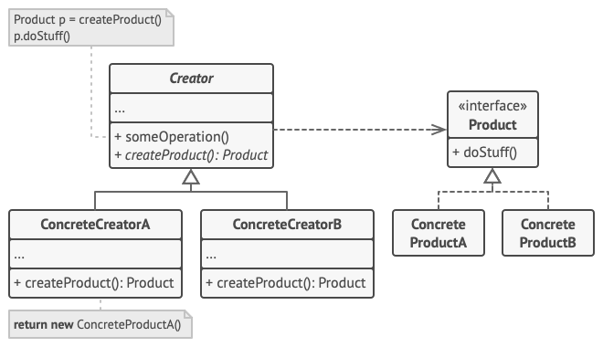
Structure
Notes:
How the client is impacted by this pattern ?

Slide 16
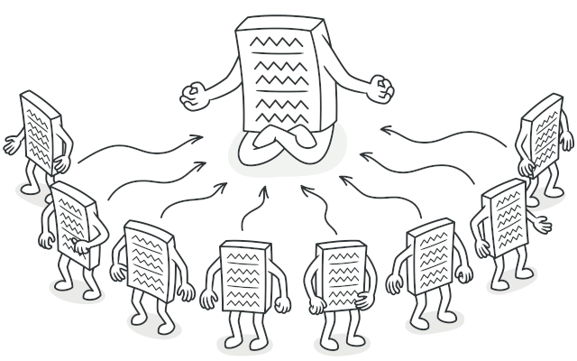
Singleton
Singleton is a creational design pattern that lets you ensure that a class has only one instance, while providing a global access point to this instance.

Slide 17
Problem
The Singleton pattern solves two problems at the same time, violating the Single Responsibility Principle:
Ensure that a class has just a single instance.
Why would anyone want to control how many instances a class has? The most common reason for this is to control access to some shared resource—for example, a database or a file.
Here’s how it works: imagine that you created an object, but after a while decided to create a new one. Instead of receiving a fresh object, you’ll get the one you already created.
Note that this behaviour is impossible to implement with a regular constructor since a constructor call must always return a new object by design.

Slide 18
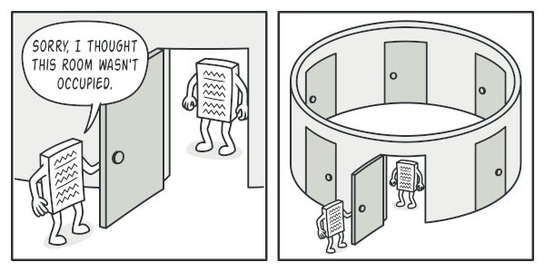
Clients may not even realize that they’re working with the same object all the time.

Slide 19
Provide a global access point to that instance.
Remember those global variables that you used to store some essential objects?
While they’re very handy, they’re also very unsafe since any code can potentially overwrite the contents of those variables and crash the app.
Just like a global variable, the Singleton pattern lets you access some object from anywhere in the program. However, it also protects that instance from being overwritten by other code.
Notes:
There’s another side to this problem: you don’t want the code that solves problem #1 to be scattered all over your program. It’s much better to have it within one class, especially if the rest of your code already depends on it.
Nowadays, the Singleton pattern has become so popular that people may call something a singleton even if it solves just one of the listed problems.

Slide 20
Solution
All implementations of the Singleton have these two steps in common:
Make the default constructor private, to prevent other objects from using the new operator with the Singleton class.
Create a static creation method that acts as a constructor. Under the hood, this method calls the private constructor to create an object and saves it in a static field. All following calls to this method return the cached object.
If your code has access to the Singleton class, then it’s able to call the Singleton’s static method. So whenever that method is called, the same object is always returned.

Slide 21

Real-World Analogy
Notes:
The government is an excellent example of the Singleton pattern. A country can have only one official government. Regardless of the personal identities of the individuals who form governments, the title, “The Government of X”, is a global point of access that identifies the group of people in charge.

Slide 22
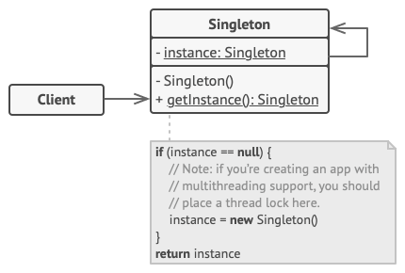
How to Implement?
Add a private static field to the class for storing the singleton instance.
Declare a public static creation method for getting the singleton instance.
Implement “lazy initialization” inside the static method. It should create a new object on its first call and put it into the static field. The method should always return that instance on all subsequent calls.
Make the constructor of the class private. The static method of the class will still be able to call the constructor, but not the other objects.
Go over the client code and replace all direct calls to the singleton’s constructor with calls to its static creation method.
Notes:
Use the Singleton pattern when a class in your program should have just a single instance available to all clients; for example, a single database object shared by different parts of the program.
The Singleton pattern disables all other means of creating objects of a class except for the special creation method. This method either creates a new object or returns an existing one if it has already been created.
Use the Singleton pattern when you need stricter control over global variables.
Unlike global variables, the Singleton pattern guarantees that there’s just one instance of a class. Nothing, except for the Singleton class itself, can replace the cached instance.
Note that you can always adjust this limitation and allow creating any number of Singleton instances. The only piece of code that needs changing is the body of the getInstance method.

Slide 23

Cons
The pattern requires special treatment in a multithreaded environment so that multiple threads won’t create a singleton object several times.
It may be difficult to unit test the client code of the Singleton because many test frameworks rely on inheritance when producing mock objects. Since the constructor of the singleton class is private and overriding static methods is impossible in most languages, you will need to think of a creative way to mock the singleton. Or just don’t write the tests. Or don’t use the Singleton pattern.

Slide 24
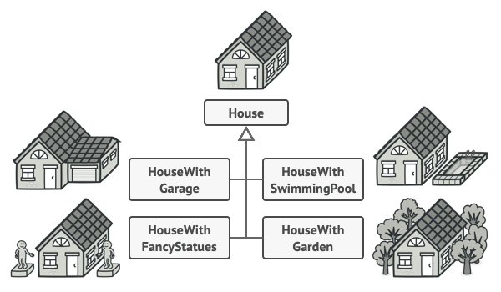
Problem
Imagine a complex object that requires laborious, step-by-step initialization of many fields and nested objects.
Such initialization code is usually buried inside a monstrous constructor with lots of parameters. Or even worse: scattered all over the client code.
Notes:
For example, let’s think about how to create a House object. To build a simple house, you need to construct four walls and a floor, install a door, fit a pair of windows, and build a roof. But what if you want a bigger, brighter house, with a backyard and other goodies (like a heating system, plumbing, and electrical wiring)?
The simplest solution is to extend the base House class and create a set of subclasses to cover all combinations of the parameters. But eventually you’ll end up with a considerable number of subclasses. Any new parameter, such as the porch style, will require growing this hierarchy even more.
There’s another approach that doesn’t involve breeding subclasses. You can create a giant constructor right in the base House class with all possible parameters that control the house object. While this approach indeed eliminates the need for subclasses, it creates another problem.

Slide 25
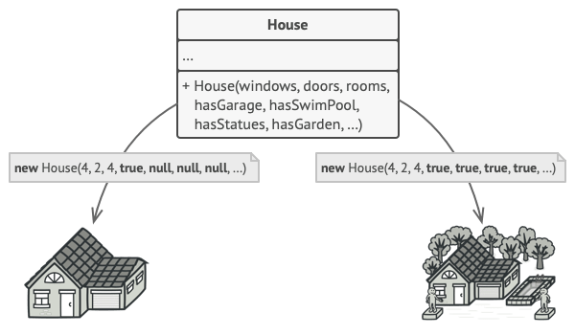
One class with giant constructor
Notes:
In most cases most of the parameters will be unused, making the constructor calls pretty ugly. For instance, only a fraction of houses have swimming pools, so the parameters related to swimming pools will be useless nine times out of ten.

Slide 26
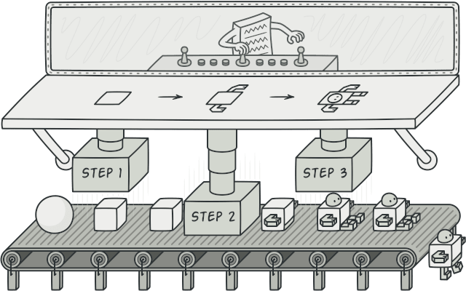
Builder
Builder is a creational design pattern that lets you construct complex objects step by step. The pattern allows you to produce different types and representations of an object using the same construction code.

Slide 27
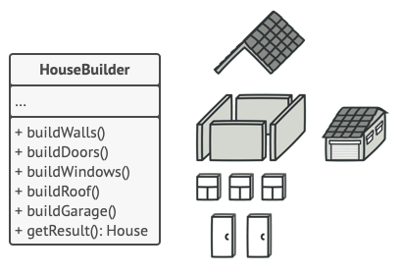
Solution
The Builder pattern suggests that you extract the object construction code out of its own class and move it to separate objects called builders.
Notes:
The pattern organizes object construction into a set of steps (buildWalls, buildDoor, etc.). To create an object, you execute a series of these steps on a builder object. The important part is that you don’t need to call all of the steps. You can call only those steps that are necessary for producing a particular configuration of an object.
Some of the construction steps might require different implementation when you need to build various representations of the product. For example, walls of a cabin may be built of wood, but the castle walls must be built with stone.
In this case, you can create several different builder classes that implement the same set of building steps, but in a different manner. Then you can use these builders in the construction process (i.e., an ordered set of calls to the building steps) to produce different kinds of objects.

Slide 28
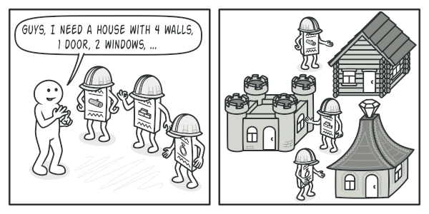
Different builders execute the same task in various ways
Notes:
In this case, you can create several different builder classes that implement the same set of building steps, but in a different manner. Then you can use these builders in the construction process (i.e., an ordered set of calls to the building steps) to produce different kinds of objects.
For example, imagine a builder that builds everything from wood and glass, a second one that builds everything with stone and iron and a third one that uses gold and diamonds. By calling the same set of steps, you get a regular house from the first builder, a small castle from the second and a palace from the third. However, this would only work if the client code that calls the building steps is able to interact with builders using a common interface.

Slide 29
Structural Design Patterns
Notes:
Structural patterns explain how to assemble objects and classes into larger structures while keeping these structures flexible and efficient.

Slide 30

Problem
Imagine that you’re working on a notification library which lets other programs notify their users
about important events.

Slide 31
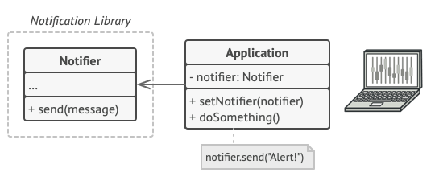
A program could use the notifier class to send notifications about important events to a predefined set of emails.
Notes:
The initial version of the library was based on the Notifier class that had only a few fields, a constructor and a single send method. The method could accept a message argument from a client and send the message to a list of emails that were passed to the notifier via its constructor. A third-party app which acted as a client was supposed to create and configure the notifier object once, and then use it each time something important happened.

Slide 32
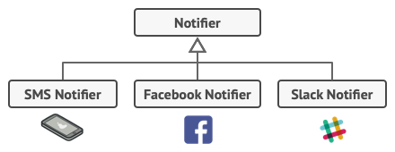
Different types of notifiers? How hard can that be?
At some point, you realize that users of the library expect more than just email notifications. Many of them would like to receive an SMS about critical issues. Others would like to be notified on Facebook and, of course, the corporate users would love to get Slack notifications.
Notes:
At some point, you realize that users of the library expect more than just email notifications. Many of them would like to receive an SMS about critical issues. Others would like to be notified on Facebook and, of course, the corporate users would love to get Slack notifications.

Slide 33
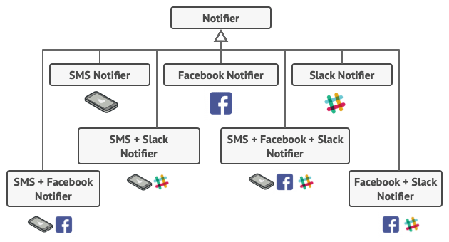
“Why can’t you use several notification types at once? If your house is on fire, you’d probably want to be informed through every channel.”
Notes:
You tried to address that problem by creating special subclasses which combined several notification methods within one class. However, it quickly became apparent that this approach would bloat the code immensely, not only the library code but the client code as well.
Extending a class is the first thing that comes to mind when you need to alter an object’s behavior. However, inheritance has several serious caveats that you need to be aware of.
Inheritance is static. You can’t alter the behavior of an existing object at runtime. You can only replace the whole object with another one that’s created from a different subclass.
Subclasses can have just one parent class. In most languages, inheritance doesn’t let a class inherit behaviors of multiple classes at the same time.

Slide 34
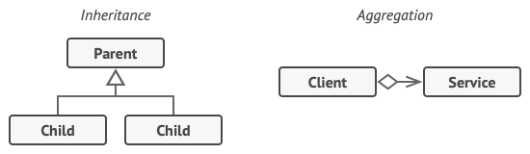
Solution
Notes:
One of the ways to overcome these caveats is by using Aggregation or Composition instead of Inheritance. Both of the alternatives work almost the same way: one object has a reference to another and delegates it some work, whereas with inheritance, the object itself is able to do that work, inheriting the behavior from its superclass.
With this new approach you can easily substitute the linked “helper” object with another, changing the behavior of the container at runtime. An object can use the behavior of various classes, having references to multiple objects and delegating them all kinds of work. Aggregation/composition is the key principle behind many design patterns, including Decorator. On that note, let’s return to the pattern discussion.

Slide 35
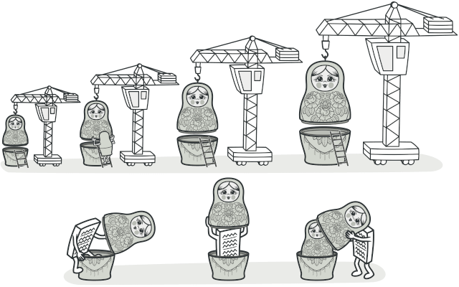
Decorator
Decorator is a structural design pattern that lets you attach new behaviours to objects by placing these objects inside special wrapper objects that contain the behaviours.

Slide 36
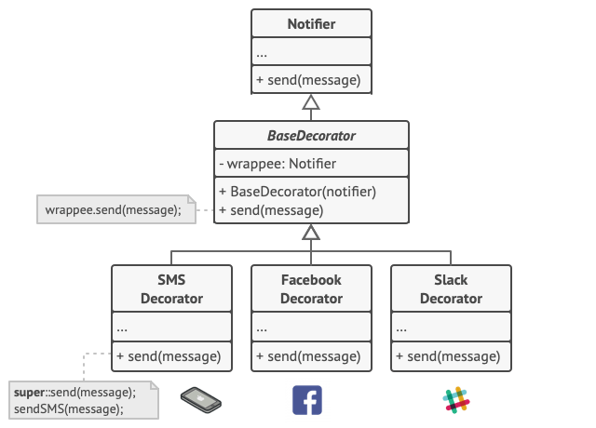
Notes:
The last decorator in the stack would be the object that the client actually works with. Since all decorators implement the same interface as the base notifier, the rest of the client code won’t care whether it works with the “pure” notifier object or the decorated one.
We could apply the same approach to other behaviors such as formatting messages or composing the recipient list. The client can decorate the object with any custom decorators, as long as they follow the same interface as the others.

Slide 37
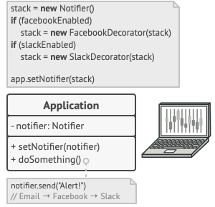
How is the impact on client code?

Slide 38
Real-World Analogy
Notes:
Wearing clothes is an example of using decorators. When you’re cold, you wrap yourself in a sweater. If you’re still cold with a sweater, you can wear a jacket on top. If it’s raining, you can put on a raincoat. All of these garments “extend” your basic behavior but aren’t part of you, and you can easily take off any piece of clothing whenever you don’t need it.

Slide 39
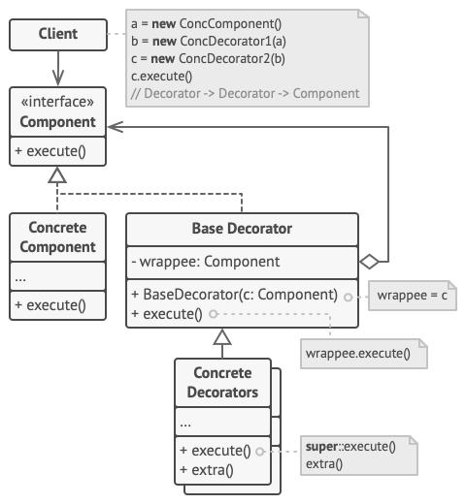
Structure

Slide 40
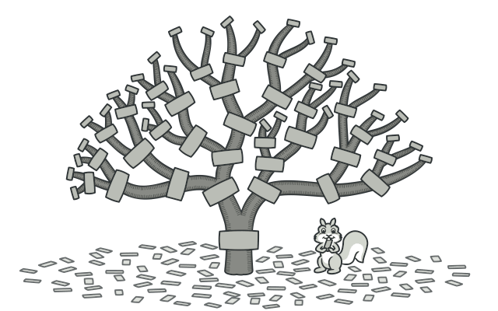
Composite
Composite is a structural design pattern that lets you compose objects into tree structures and then work with these structures as if they were individual objects.

Slide 41
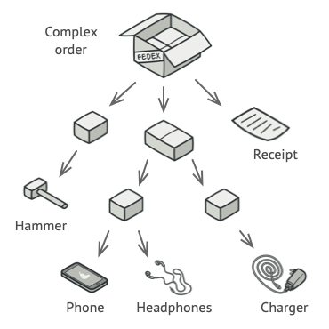
Problem
Using the Composite pattern makes sense only when the core model of your app can be represented as a tree.
For example, imagine that you have two types of objects: Products and Boxes. A Box can contain several Products as well as a number of smaller Boxes.
These little Boxes can also hold some Products or even smaller Boxes, and so on.
Notes:
Say you decide to create an ordering system that uses these classes. Orders could contain simple products without any wrapping, as well as boxes stuffed with products...and other boxes. How would you determine the total price of such an order?
You could try the direct approach: unwrap all the boxes, go over all the products and then calculate the total. That would be doable in the real world; but in a program, it’s not as simple as running a loop. You have to know the classes of Products and Boxes you’re going through, the nesting level of the boxes and other nasty details beforehand. All of this makes the direct approach either too awkward or even impossible.

Slide 42
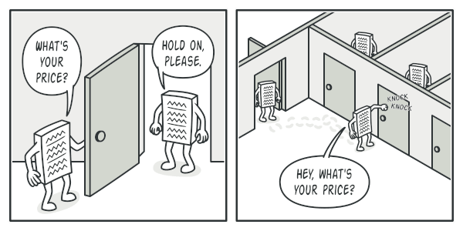
Solution
The Composite pattern suggests that you work with Products and Boxes through a common interface which declares a method for calculating the total price.
Notes:
How would this method work? For a product, it’d simply return the product’s price.
For a box, it’d go over each item the box contains, ask its price and then return a total for this box. If one of these items were a smaller box, that box would also start going over its contents and so on, until the prices of all inner components were calculated. A box could even add some extra cost to the final price, such as packaging cost.
The greatest benefit of this approach is that you don’t need to care about the concrete classes of objects that compose the tree. You don’t need to know whether an object is a simple product or a sophisticated box. You can treat them all the same via the common interface. When you call a method, the objects themselves pass the request down the tree.

Slide 43
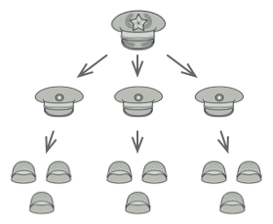
Real-World Analogy
Armies of most countries are structured as hierarchies. An army consists of several divisions; a division is a set of brigades, and a brigade consists of platoons, which can be broken down into squads. Finally, a squad is a small group of real soldiers. Orders are given at the top of the hierarchy and passed down onto each level until every soldier knows what needs to be done.

Slide 44
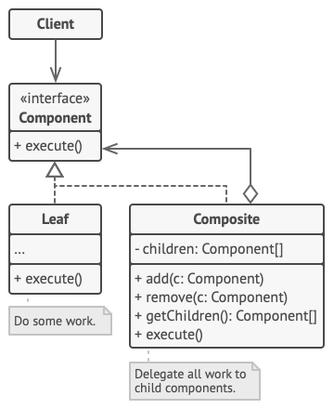
Structure
Applicability
Use the Composite pattern when you have to implement a tree-like object structure.
The Composite pattern provides you with two basic element types that share a common interface: simple leaves and complex containers. A container can be composed of both leaves and other containers. This lets you construct a nested recursive object structure that resembles a tree.
Use the pattern when you want the client code to treat both simple and complex elements uniformly.
All elements defined by the Composite pattern share a common interface. Using this interface, the client doesn’t have to worry about the concrete class of the objects it works with.
Notes:
Pros: You can introduce new element types into the app without breaking the existing code, which now works with the object tree.
Cons: It might be difficult to provide a common interface for classes whose functionality differs too much. In certain scenarios, you’d need to overgeneralize the component interface, making it harder to comprehend.

Slide 45
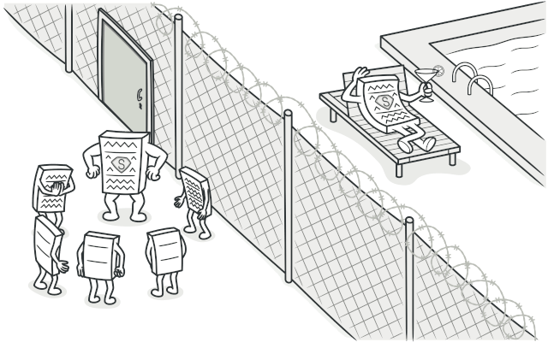
Proxy
Proxy is a structural design pattern that lets you provide a substitute or placeholder for another object. A proxy controls access to the original object, allowing you to perform something either before or after the request gets through to the original object.

Slide 46
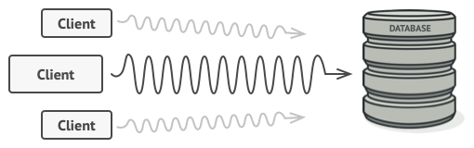
Problem
Why would you want to control access to an object?
Here is an example: you have a massive object that consumes a vast amount of system resources. You need it from time to time, but not always
Notes:
You could implement lazy initialization: create this object only when it’s actually needed. All of the object’s clients would need to execute some deferred initialization code. Unfortunately, this would probably cause a lot of code duplication.
In an ideal world, we’d want to put this code directly into our object’s class, but that isn’t always possible. For instance, the class may be part of a closed 3rd-party library.

Slide 47
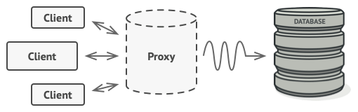
Solution
Notes:
The Proxy pattern suggests that you create a new proxy class with the same interface as an original service object. Then you update your app so that it passes the proxy object to all of the original object’s clients. Upon receiving a request from a client, the proxy creates a real service object and delegates all the work to it. But what’s the benefit? If you need to execute something either before or after the primary logic of the class, the proxy lets you do this without changing that class. Since the proxy implements the same interface as the original class, it can be passed to any client that expects a real service object.

Slide 48
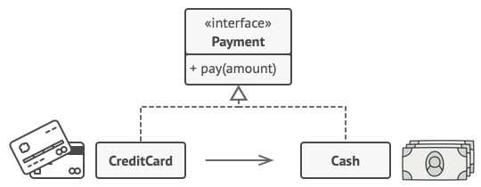
Real-World Analogy
Notes:
A credit card is a proxy for a bank account, which is a proxy for a bundle of cash. Both implement the same interface: they can be used for making a payment. A consumer feels great because there’s no need to carry loads of cash around. A shop owner is also happy since the income from a transaction gets added electronically to the shop’s bank account without the risk of losing the deposit or getting robbed on the way to the bank.

Slide 49
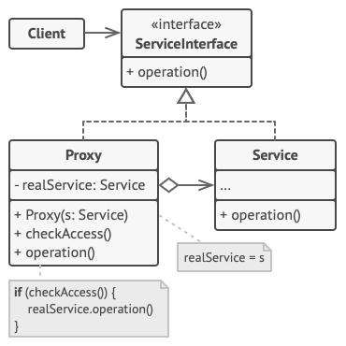
Structure

Slide 50
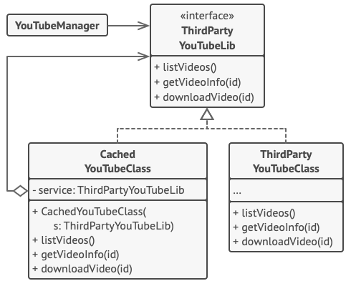
Code example

Slide 51
Behavioural Designs

Slide 52
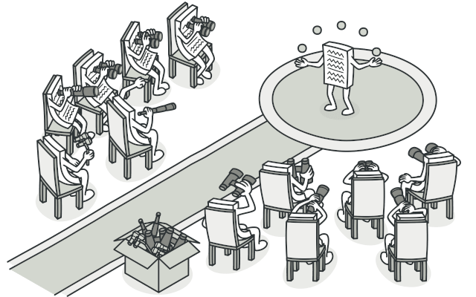
Observer
Observer is a behavioral design pattern that lets you define a subscription mechanism to notify multiple objects about any events that happen to the object they’re observing.

Slide 53
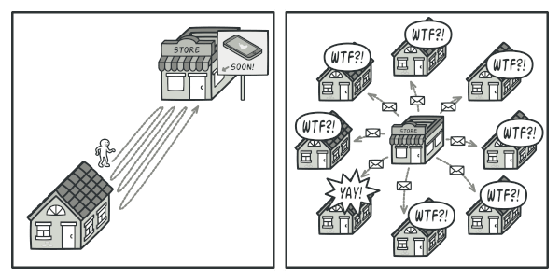
Problem
Imagine that you have two types of objects: a Customer and a Store. The customer is very interested in a particular brand of product (say, it’s a new model of the iPhone) which should become available in the store very soon.
The customer could visit the store every day and check product availability. But while the product is still en route, most of these trips would be pointless.
Notes:
On the other hand, the store could send tons of emails (which might be considered spam) to all customers each time a new product becomes available. This would save some customers from endless trips to the store. At the same time, it’d upset other customers who aren’t interested in new products.
It looks like we’ve got a conflict. Either the customer wastes time checking product availability or the store wastes resources notifying the wrong customers.

Slide 54
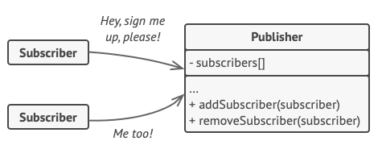
Solution
Notes:
The object that has some interesting state is often called subject, but since it’s also going to notify other objects about the changes to its state, we’ll call it publisher.
All other objects that want to track changes to the publisher’s state are called subscribers.
The Observer pattern suggests that you add a subscription mechanism to the publisher class so individual objects can subscribe to or unsubscribe from a stream of events coming from that publisher. Fear not! Everything isn’t as complicated as it sounds. In reality, this mechanism consists of 1) an array field for storing a list of references to subscriber objects and 2) several public methods which allow adding subscribers to and removing them from that list.

Slide 55
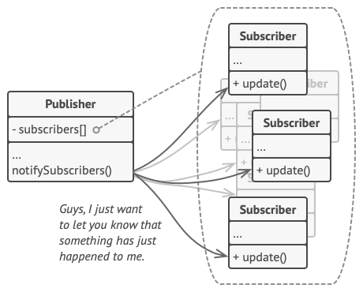
Notes:
That’s why it’s crucial that all subscribers implement the same interface and that the publisher communicates with them only via that interface. This interface should declare the notification method along with a set of parameters that the publisher can use to pass some contextual data along with the notification.
If your app has several different types of publishers and you want to make your subscribers compatible with all of them, you can go even further and make all publishers follow the same interface. This interface would only need to describe a few subscription methods. The interface would allow subscribers to observe publishers’ states without coupling to their concrete classes.

Slide 56

Real World Analogy
Notes:
If you subscribe to a newspaper or magazine, you no longer need to go to the store to check if the next issue is available. Instead, the publisher sends new issues directly to your mailbox right after publication or even in advance.
The publisher maintains a list of subscribers and knows which magazines they’re interested in. Subscribers can leave the list at any time when they wish to stop the publisher sending new magazine issues to them.

Slide 57
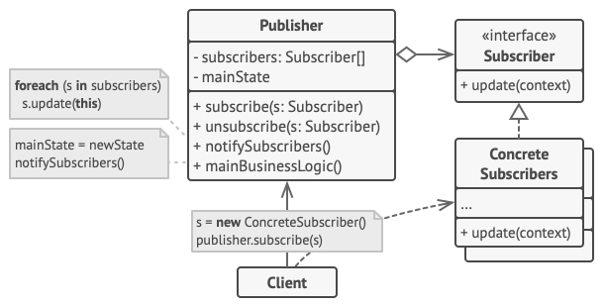
Structure

Slide 58
Resources
https://refactoring.guru/design-patterns

