Slide 1
Spring
{Dev}School Java Edition
08.11.2022

Slide 2
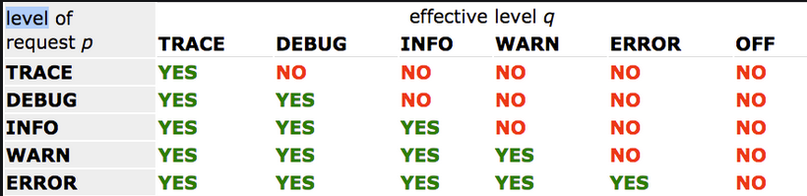
Logging

Slide 3
Few Words
…is the most popular application development framework for enterprise Java.
…is an open source Java platform. It was initially written by Rod Johnson and was first released under the Apache 2.0 license in June 2003.
…is lightweight when it comes to size and transparency. The basic version of Spring framework is around 2MB.

Slide 4
Introduction: Dependency Injection and Inversion of Control
Inversion of Control(IoC) is a PRINCIPLE in software engineering which transfers the control of objects or portions of a program to a container or framework.
Advantages:
decoupling the execution of a task from its implementation
making it easier to switch between different implementations
greater modularity of a program
greater ease in testing a program by isolating a component or mocking its dependencies, and allowing components to communicate through contracts

Slide 5
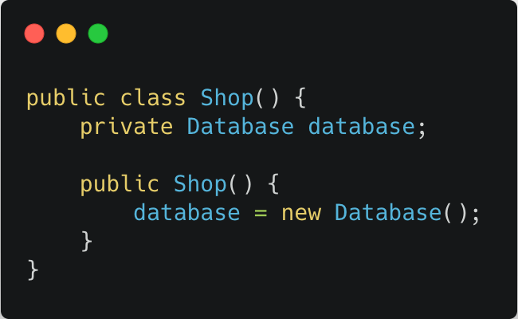
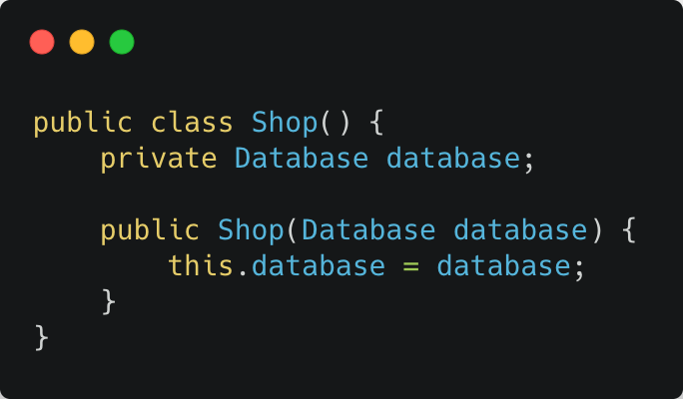
Introduction: Dependency Injection and Inversion of Control
Dependency Injection is a PATTERN we can use to implement IoC, where the control being inverted is setting an object’s dependencies.
Connection objects with other objects, or ‘injecting’ objects into other objects, is done by an assembler rather than by the objects themselves.

Slide 6
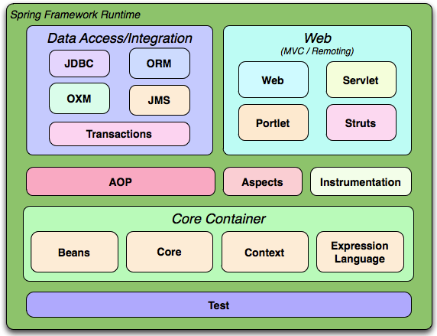
Modules
The Spring Framework consists of features organized into about 20 modules
Notes:
Core Container is the most important module.
Data Access module is the one that is handling everything related with database CRUD operations.
Web provides basic web-oriented integration features.
AOP (aspect oriented programming), allow you to implement method-interceptors and pointcuts to cleanly decouple code.
Test module supports the testing of Spring components with Junit.

Slide 7
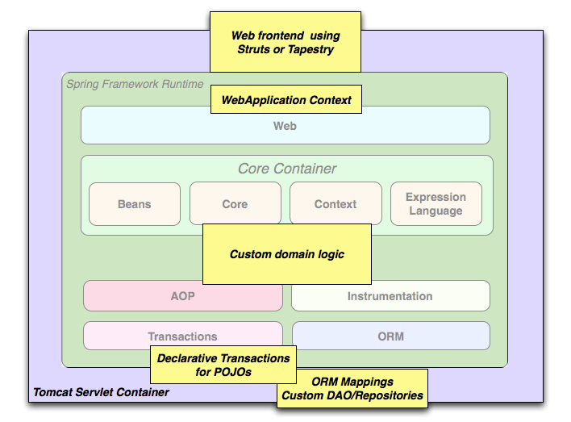
Usage Scenarios
Spring middle-tier using a third-party web framework

Slide 8
SpringBoot
{Dev}School Java Edition
08.11.2022

Slide 9
Few Words
Spring Boot is basically an extension of the Spring framework, which eliminates the boilerplate configurations required for setting up a Spring application.
Spring Boot features:
- Opinionated ‘starter' dependencies to simplify the build and application configuration
- Embedded server to avoid complexity in application deployment
- Metrics, Health check, and externalized configuration
- Automatic config for Spring functionality – whenever possible

Slide 10
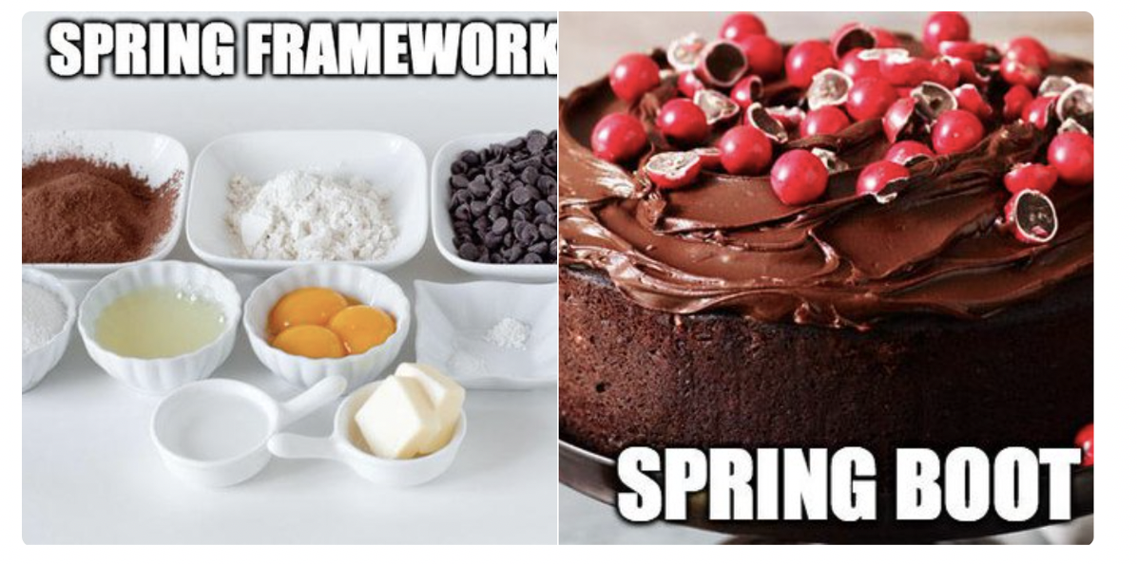
Let’s introduce Spring Boot

Slide 11
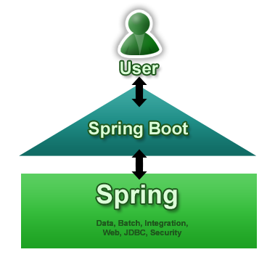
Developer

Slide 12
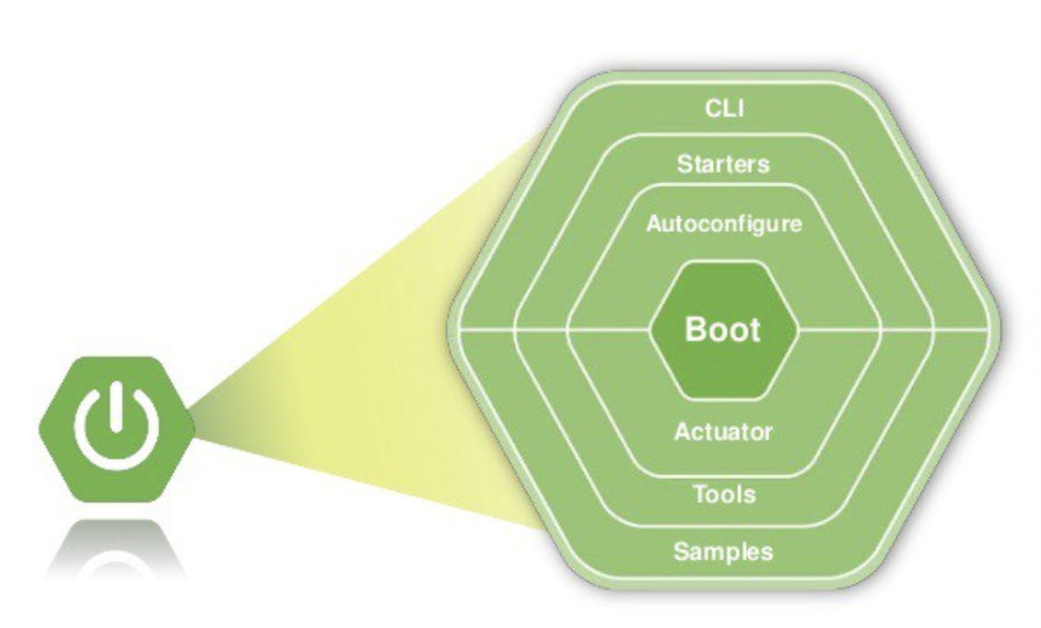
Modules
Notes:
https://www.javatpoint.com/spring-boot-starters

Slide 13
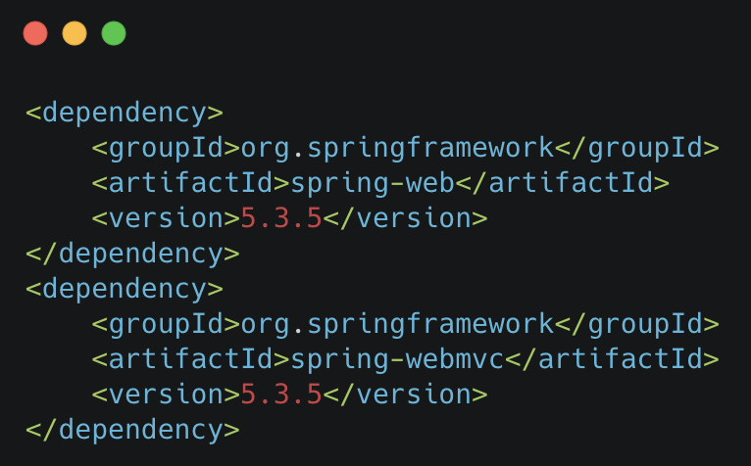
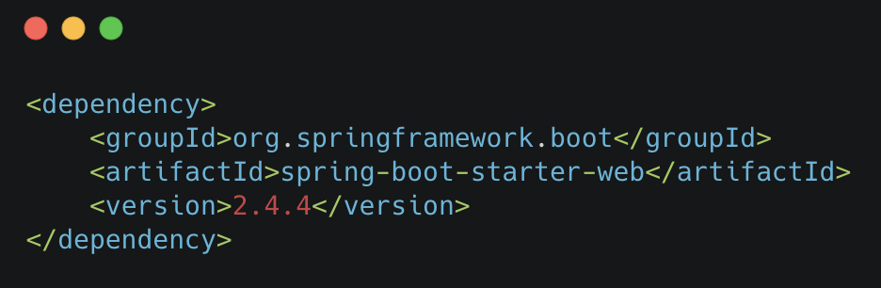
Spring
Spring Boot

Slide 14

Links:
https://www.baeldung.com/spring-vs-spring-boot
https://docs.spring.io/spring-boot/docs/current/reference/htmlsingle/
https://start.spring.io/
https://docs.spring.io/spring-boot/docs/current/reference/html/spring-boot-cli.html
https://www.javatpoint.com/spring-boot-starters
https://www.baeldung.com/spring-profileshttps://bit.ly/3e1wC8q
https://www.baeldung.com/spring-intro
https://www.baeldung.com/spring-core-annotations
https://www.baeldung.com/inversion-control-and-dependency-injection-in-spring
https://martinfowler.com/articles/injection.html

