Slide 1
Identifying Erroneous Data in Image Datasets
A Comparison of Particle Swarm Optimization and Genetic Algorithms
Popescu Matei-Calin

Slide 2
Real Image Datasets can be flawed
Mislabels, occlusions, out-of-distribution samples can slip in
They quietly degrade anything trained on them
Manual sanitizing is impractical on a large scale

Slide 3
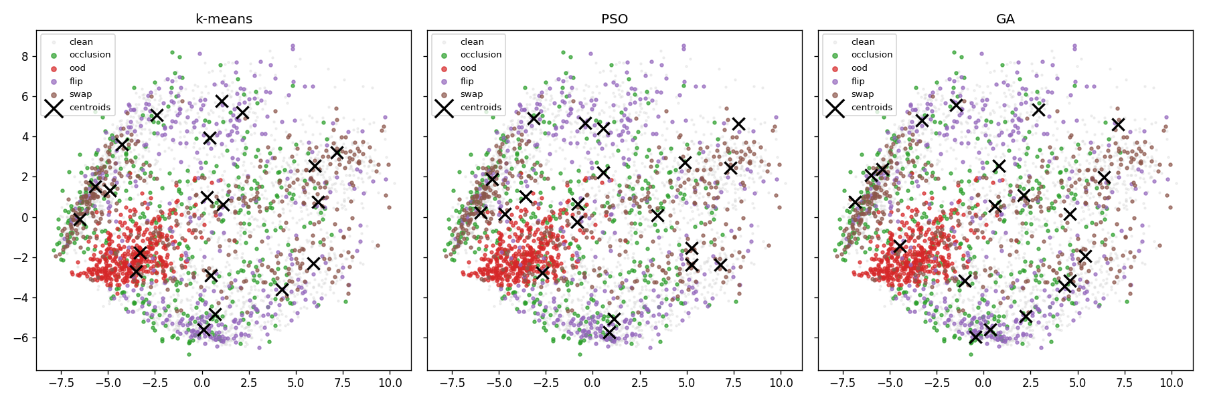
Error Detection as a Clustering Problem
Place K centroids in feature space
Anomaly score each point by distance to nearest centroid
Far from a centroid -> possibly erroneous
PSO, GA, k-means optimize the centroids and get compared

Slide 4
Fashion-MNIST + Injected Errors
10 classes, subsampled to 10000 (for performance reasons)
4 error types at 4% each: 16% erroneous
Occlusion: 10x10 region of zeroed pixels
OOD: Handwritten numbers from MNIST
Random label flipping: labels get flipped with the other classes within Fashion-MNIST
Similar class swapping: T-Shirts with Shirts, Coats with Pullovers, Sandals with Sneakers

Slide 5
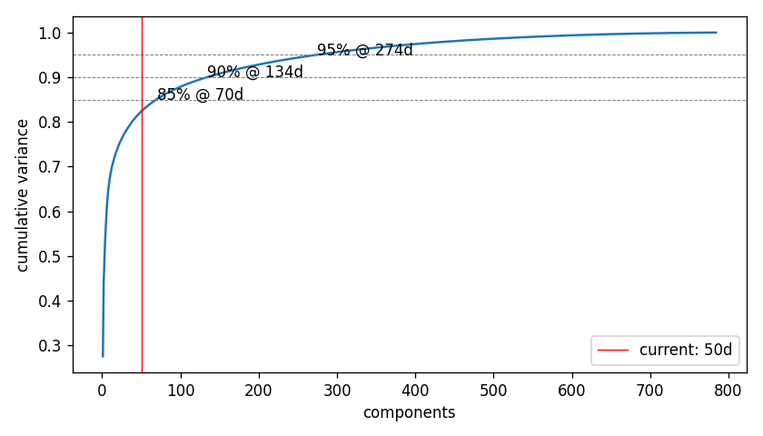
PCA: 784 -> 50 dimensions
Curse of dimensionality
Performance reasons
50 dimensions are the best compromise at 82% variance
Diminishing returns

Slide 6
The objective for all algorithms
Minimize within-cluster sum of squared distances (SSE)
A solution = 20 centroids within the 50-D space
PSO: swarm of 50, high initial exploration, inertia drops at the end for refinement, particles pulled equally to personal and global best
GA: 50 chromosomes, tournament, crossover per centroid, mutation, elitism
k-means: baseline

Slide 7
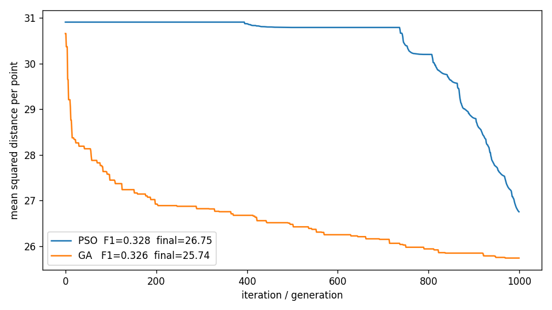
SSE trend for PSO and GA
Both drive SSE down
PSO plateaus, then drops sharply at the end
GA descends sharply first, then steadily
Both sit above k-means mean SSE (< 20)

Slide 8
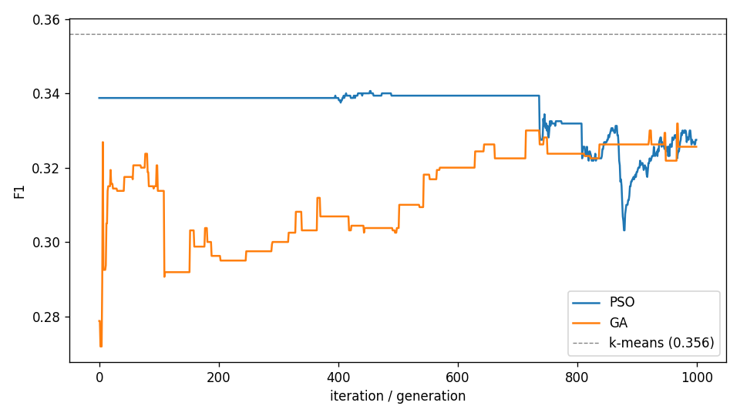
SSE and F1 Divergence

Slide 9
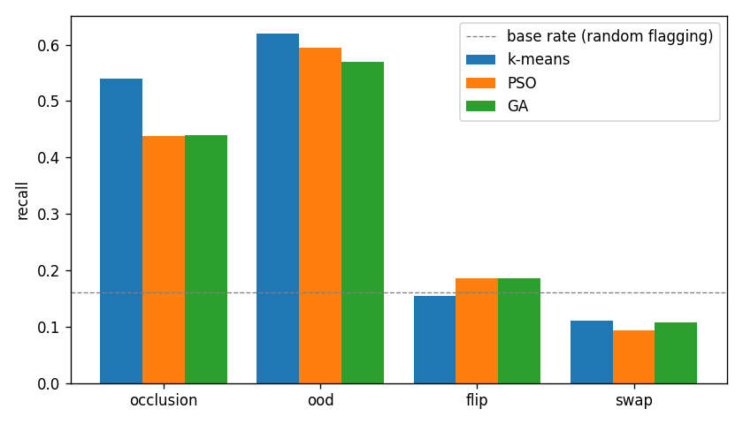
Performance by Error Type

Slide 10
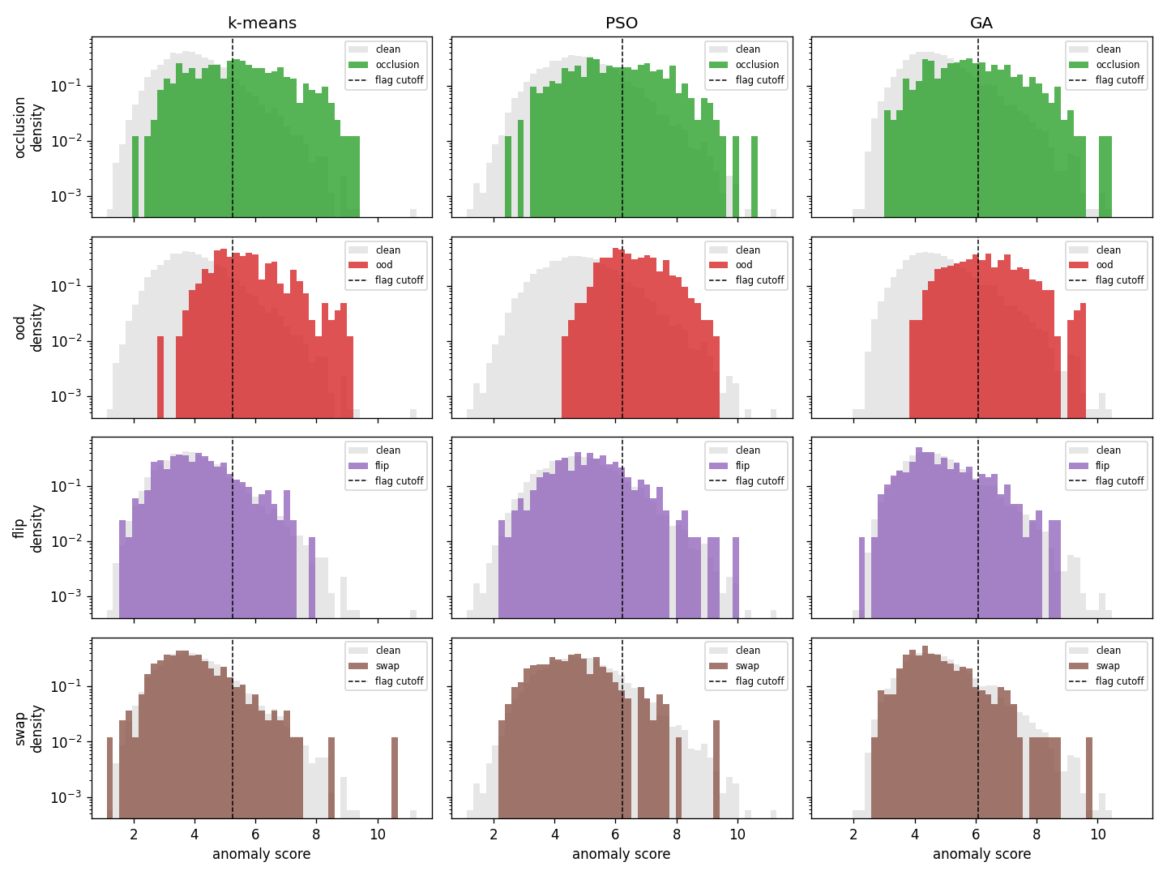
Performance by Error Type

Slide 11
Conclusions
PSO and GA are competitive with k-means but neither beats it
Overoptimizing SSE can negatively impact detection (F1 score)
Limitations: known error size, single small dataset, the algorithms are blind to label errors
Future: better feature space than just PCA (hybrid approach with CNNs?)

