Slide 1
Machine Learning
Dima a Matej

Slide 2

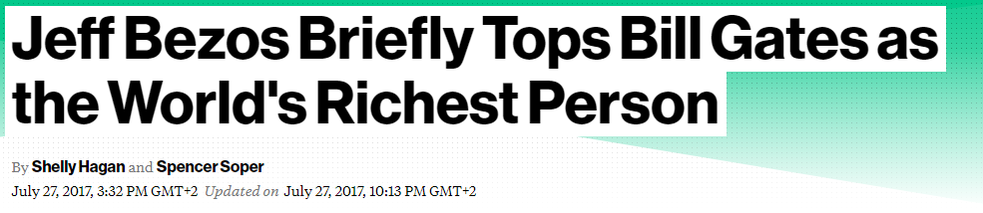
1995
2017

Slide 3
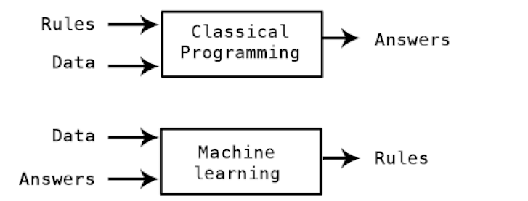
What is ML?

Slide 4
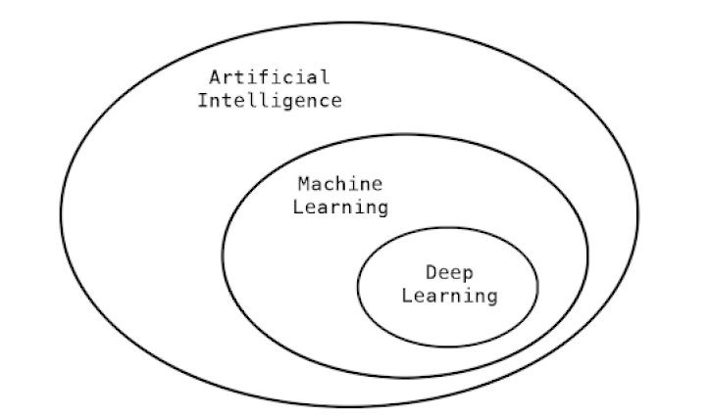
Deep Learning

Slide 5
Deep learning break throughs
Near-human level image classification.
Near-human level speech recognition.
Near-human level handwriting transcription.
Improved machine translation.
Improved text-to-speech conversion.
Digital assistants such as Google Now or Amazon Alexa.
Near-human level autonomous driving.
Improved ad targeting, as used by Google, Baidu, and Bing.
Improved search results on the web.
Answering natural language questions.
Master-level Go playing.

Slide 6
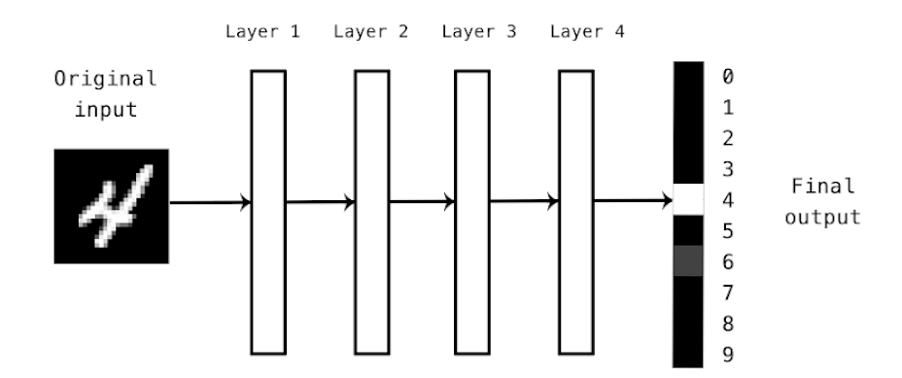
The “deep” in deep learning
Deep neural network for digits classification

Slide 7
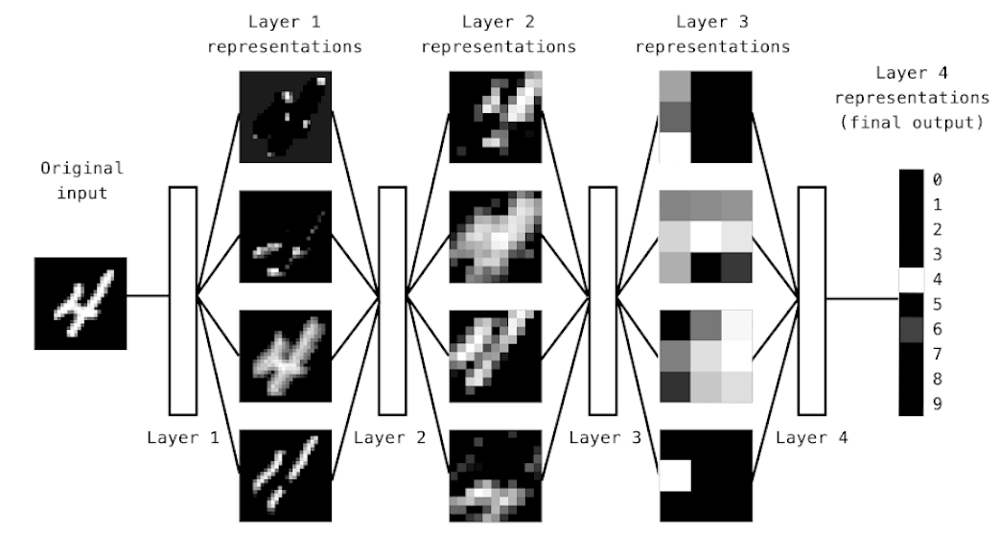
Representations learned by digit classification model

Slide 8
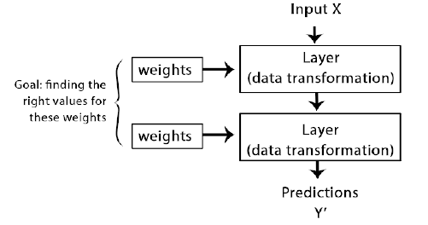
How deep learning works (step 1/3)
Neural network is parametrized by its weights

Slide 9
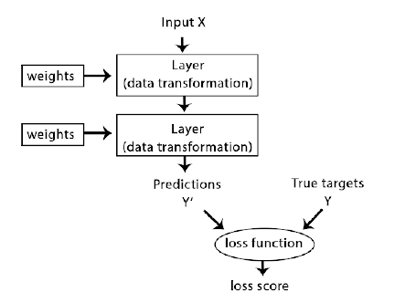
How deep learning works (step 2/3)
A loss function measures the quality of the network’s output

Slide 10
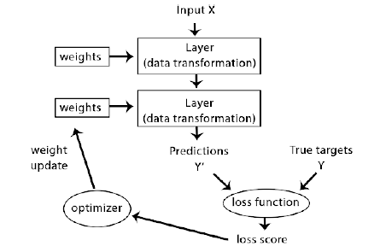
How deep learning works (step 3/3)
The loss score is used as a feedback signal to adjust the weights

Slide 11
Demo
Python + Keras

Slide 12
Data representations for neural networks
Tensors
  Scalars (0D tensors)
  Vectors (1D tensors)
  Matrices (2D tensors)
  3D tensor and higher dimensional tensors
Key attributes
  Number of axes
  Shape
  Data type

Slide 13
Real-world examples of data tensors
Vector data: 2D tensors of shape (samples, features)
Time series data or sequence data: 3D tensors of shape (samples, timestamps, features)
Images: 4D tensors of shape (samples, width, height, channels)
Video: 5D tensors of shape (samples, frames, width, height, channels)

Slide 14
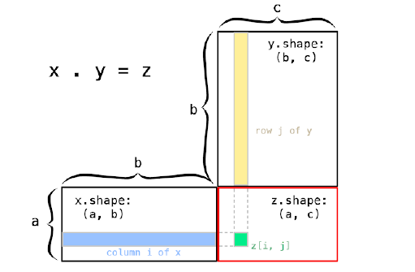
Tensor operations
output = relu(dot(w, input) + b)
  relu(x) is simply max(x, 0)

Slide 15
Gradient based optimization
Repeat as long as needed:
draw a batch of training samples x and corresponding targets y
run the network on x (“forward pass”), obtain predictions y_pred
compute the “loss” of the network on the batch and measure the mismatch between y_pred and y
Update all weights of the network in a way that slightly reduces the loss on this batch

Slide 16
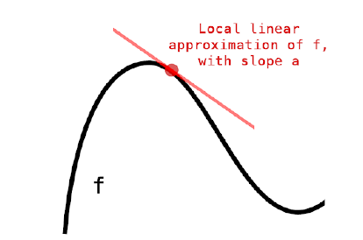
Function Derivative
f(x) = y
derivative of f(x) at point x0 defines sensitivity of change of y to change of x

Slide 17
Derivative of a tensor operation: the gradient
y_pred = dot(W, x)
loss_value = loss(y_pred, y) – x and y are frozen so
loss_value = f(W)
gradient(f)(W0) is a tensor with same shape as W
each coefficient gradient(f)(W0)[i, j] indicates the direction and magnitude of the change in loss_value when modifying W0[i, j]
W1 = W0 - step * gradient(f)(W0)

Slide 18
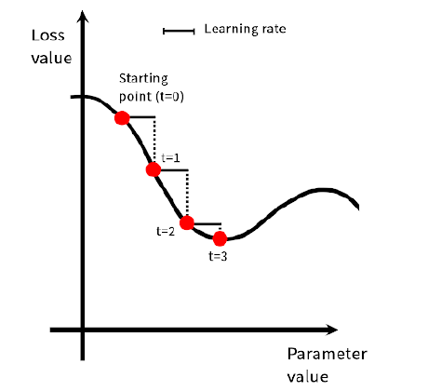
Stochastic gradient descent
For neural networks not possible to find minimum analytically
Repeat as long as needed:
draw a batch of training samples x and corresponding targets y
run the network on x (“forward pass”), obtain predictions y_pred
compute the “loss” of the network on the batch and measure the mismatch between y_pred and y
Update all weights of the network in a way that slightly reduces the loss on this batch
  compute the gradient of the loss with regard to the parameters of the network (“backward pass”)
  move the parameters a little in the direction opposite to the gradient
(minibatch SGD)

Slide 19
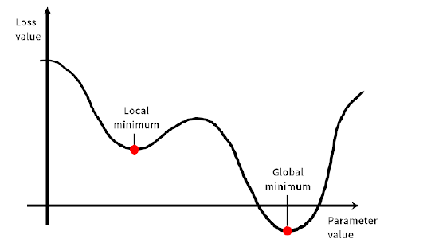
SGD Variants (optimizers)
SGD with momentum, Adagrad, RMSprop

Slide 20
Backpropagation
Neural network consists of many operations chained together
f(W1, W2, W3) = a(W1, b(W2, c(W3)))
Chain rule f(g(x))’ = f’(g(x)) * g’(x)
Backpropagation starts with final loss and works backwards applying the chain rule to compute the contribution that each parameter had in loss value
Thanks God this is handled by Tensorflow ☺

Slide 21
Enough Theory
Demo – Sentiment analysis, Binary Classification

Slide 22
Multi Class Classification
Demo - Reuters

Slide 23
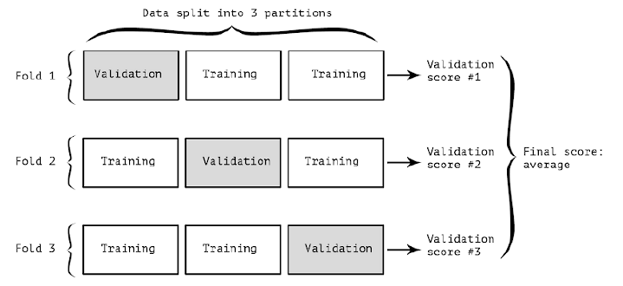
Regression
K- fold validation (3) – when only little training data

Slide 24
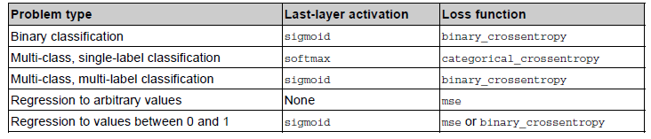
Common problem settings
Last layer activation and loss function

Slide 25
How to start in CIS
Learn (in your free time) and Share (at work)
Find real world use case (Dima may help)
Proof of concept (Hackathon?)
  In small teams
  Evaluate, present, convince business and make it part of our projects

Slide 26
Sources
Deep Learning With Python (Francois Chollet)
Internet (Siraj Raval)

