Slide 1
Pressure &
Partial Pressure
Understanding how pressure changes with depth
and affects the gases you breathe
decotheory.eu
Deco Theory | Educational Use Only

Slide 2
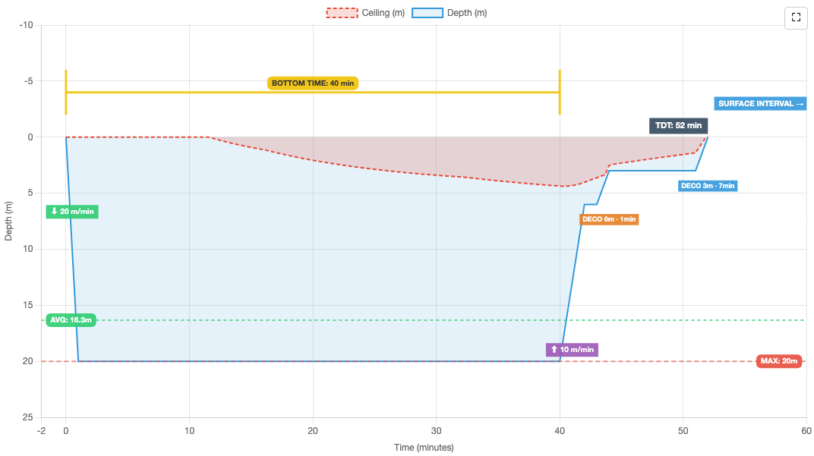
Dive Profile Terminology
A dive profile is a graphical representation of your dive, showing depth over time.
Open in Sandbox →
decotheory.eu
2 / 13

Slide 3
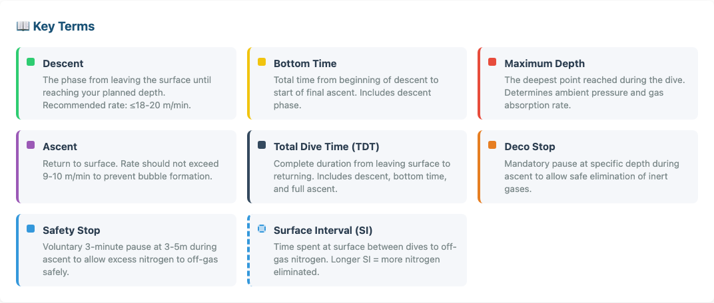
Key Terms
Descent: Surface to planned depth. Rate: ≤18–20 m/min.
Bottom Time: Start of descent to start of final ascent.
TDT: Total Dive Time — entire dive from leaving surface to return.
Safety Stop: Voluntary 3 min at 3–5 m. Deco Stop = mandatory.
decotheory.eu
3 / 13

Slide 4
Total Pressure Underwater
Two sources of pressure:
Depth Total Pressure
Atmospheric pressure
Weight of air above you ≈ 1 bar at sea level
Hydrostatic pressure
Weight of water above you ≈ 1 bar per 10 m
Surface
1 bar
10 m
2 bar
20 m
3 bar
30 m
4 bar
40 m
5 bar
P_amb = 1 + depth/10 (bar)
Each 10 m of seawater adds approximately 1 bar of pressure.
decotheory.eu
4 / 13

Slide 5
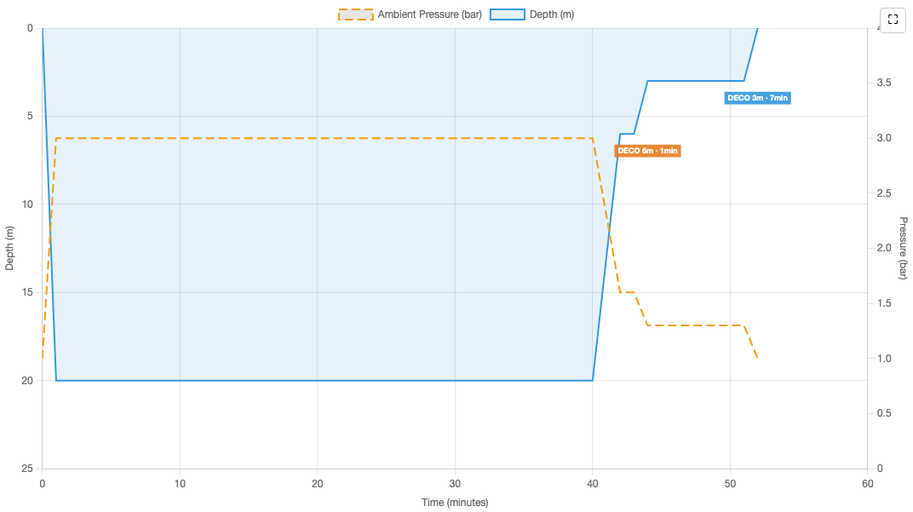
Dive Profile with Total Pressure
Open in Sandbox →
decotheory.eu
5 / 13

Slide 6
Gas Consumption
Why Depth Matters for Gas Supply
Depth Consumption
Boyle-Mariotte's Law: as pressure increases, gas volume decreases proportionally. At depth, each breath draws more gas molecules from your tank.
Surface (1 bar)
20 L/min
10 m (2 bar)
40 L/min
20 m (3 bar)
60 L/min
SAC Rate (Surface Air Consumption) ≈ 20 L/min
30 m (4 bar)
80 L/min
40 m (5 bar)
100 L/min
At depth: Consumption = SAC × Ambient Pressure
Gas Available = V_cylinder × (P_start − P_reserve) | e.g. 12L × (200−50) = 1800 L
Deeper dives consume gas exponentially faster — always plan conservatively!
decotheory.eu
6 / 13

Slide 7
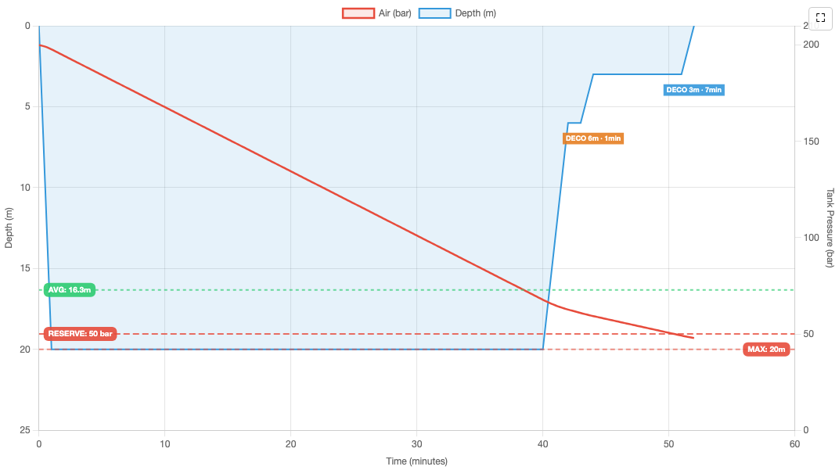
Gas Consumption During Dive
Open in Sandbox →
decotheory.eu
7 / 13

Slide 8
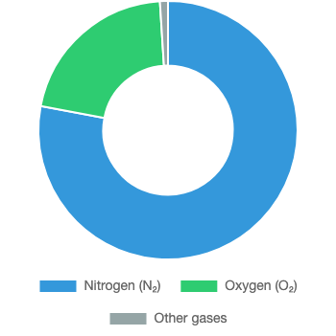
Air Composition
What's in the Air You Breathe?
Nitrogen (N₂) — 78%
Inert gas — does not participate in metabolism
Oxygen (O₂) — 21%
Essential for life, but toxic at high partial pressures
Other gases — 1%
Primarily Argon, CO₂, and trace gases
Nitrox (EAN): More O₂, less N₂ loading. Trimix: Adds helium for deep diving.
decotheory.eu
8 / 13

Slide 9
Dalton's Law of Partial Pressures
The total pressure of a gas mixture equals the sum of the partial pressures of each component gas.
pp_x = f_x × P_amb
pp_x = partial pressure of gas x (bar)
f_x = fraction of gas x (e.g. 0.21 for 21%)
P_amb = ambient pressure = 1 + depth/10
Example: Air at 30 meters (P_amb = 4 bar)
Gas | Fraction | Calculation | Partial Pressure
O₂ | 0.21 | 0.21 × 4 | 0.84 bar
N₂ | 0.79 | 0.79 × 4 | 3.16 bar
Operational: ppO₂ = f_O₂ × P_amb (MOD / gas limits)
Physiological: pp_inert = f_inert × (P_amb − 0.0627) (tissue kinetics, subtracts water vapour)
decotheory.eu
9 / 13

Slide 10
Partial Pressure Limits — Oxygen (ppO₂)
ppO₂ (bar) | Status | Notes
< 0.16 | ⚫ Hypoxia | Loss of consciousness, death
0.16 – 0.50 | 🟢 Normal | Surface breathing range
0.50 – 1.40 | 🟢 Safe for diving | Recommended working limit
1.40 – 1.60 | 🟡 Caution | Deco stops only. Limited exposure.
> 1.60 | 🔴 Danger | High risk of CNS O₂ toxicity
Maximum Operating Depth (MOD)
MOD = (ppO₂max / fO₂ − 1) × 10
Gas | fO₂ | MOD
Air (21%) | 0.21 | 56.7 m
EAN32 | 0.32 | 33.8 m
EAN36 | 0.36 | 28.9 m
EAN40 | 0.40 | 25.0 m
Higher O₂ fraction → shallower MOD
decotheory.eu
10 / 13

Slide 11
Nitrogen Narcosis (ppN₂)
🍸 The "Martini Rule"
ppN₂ (bar) | Depth (Air) | Effects
< 2.4 | < 20 m | Minimal effects
2.4 – 3.2 | 20 – 30 m | Mild euphoria, slight impairment
3.2 – 4.0 | 30 – 40 m | Noticeable impairment
> 4.0 | > 40 m | Severe narcosis. Max rec. limit.
Every 10 m of depth on air ≈ one martini on an empty stomach.
10 m — 1 martini
20 m — 2 martinis
30 m — 3 martinis
40 m — 4 martinis
Nitrox pushes narcosis limit deeper, but oxygen MOD kicks in first — always respect both limits.
Individual susceptibility varies. Cold, stress, and fatigue increase narcosis.
Max depth for ppN₂ = 4.0 bar:
Gas | fN₂ | Max Depth | Note
Air | 0.79 | 40.6 m
EAN32 | 0.68 | 48.8 m | but MOD is 33.8 m!
EAN36 | 0.64 | 52.5 m | but MOD is 28.9 m!
EAN40 | 0.60 | 56.7 m | but MOD is 25.0 m!
decotheory.eu
11 / 13

Slide 12
Oxygen Toxicity
Type | Cause | Symptoms | Relevance
CNS Toxicity | High ppO₂ (>1.6 bar) | Seizures, tunnel vision, twitching | Immediate danger, can cause drowning
Pulmonary Toxicity | Prolonged ppO₂ >0.5 bar | Chest pain, coughing, breathing difficulty | Relevant for long exposures, rebreathers
CNS Symptoms — Remember VENTID-C
V
Visual disturbances (tunnel vision)
I
Irritability , anxiety
E
Ear ringing (tinnitus)
D
Dizziness
N
Nausea
C
Convulsions (the most dangerous)
T
Twitching (especially facial muscles)
⚠️ If you experience any symptoms, signal your buddy and begin ascending immediately.
decotheory.eu
12 / 13

Slide 13
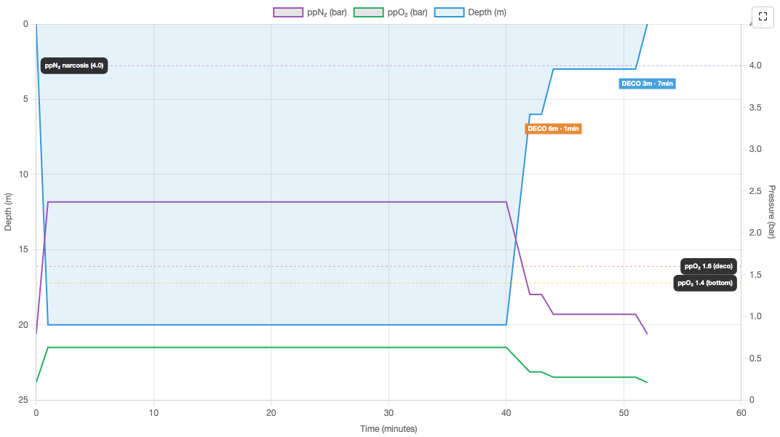
Partial Pressures During Dive
This chart shows how ppO₂ and ppN₂ change throughout the dive profile, relative to safety limits.
Open in Sandbox →
decotheory.eu
13 / 13

