Slide 1
Detection of Real and Artificially Generated Human Faces
UNIVERSITY OF ZAGREB
FACULTY OF ELECTRICAL ENGINEERING AND COMPUTING
Mateja Vuradin, Lucija Prodan, Erika Tomakić, Hana Ujčić, Marta Vidas

Slide 2
Agenda
Introduction
Existing approaches
Data and methods
Models used
Results
GradCAM Visualization
Conclusion

Slide 3
Introduction
Rapid advancements in technologies for generating synthetic images, (e.g. GAN) make it possible to create highly realistic fake images
Significant challenges for authentication systems
Distinction between real and artificially generated faces to prevent unauthorized access
Development and testing of deep learning models that can effectively detect real and artificially generated human faces.

Slide 4
Existing Approaches
Texture Analysis: focuses on the surface details and patterns within an image.
Metadata Analysis: examines the metadata embedded within image files
Forensic Analysis: detects signs of tampering, such as compression artifacts, noise patterns, and irregular lighting

Slide 5
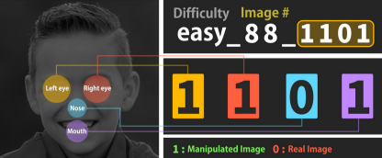
Data and methods
Data: Public dataset from Kaggle with 2041 color images, split into real and artificially generated faces.
Methodology:
Random initialization and pre-trained weights
Data augmentation techniques: flipping, rotating, zooming

Slide 6
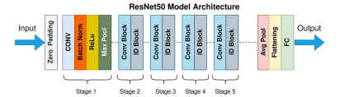
Models used
ResNet50:
Architecture: A deep residual network with 50 layers.
Innovation: Skip connections
Advantages: Achieving high performance in image classification tasks and strong generalization capabilities.

Slide 7
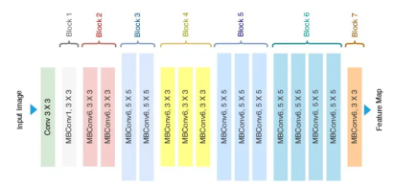
Models used
EfficientNetB3:
Architecture: Compound scaling method to balance network depth, width, and resolution.
Innovation: Efficiently scales up models to improve accuracy while maintaining computational efficiency.
Advantages: Achieves state-of-the-art performance with fewer parameters and lower computational cost compared to other models.

Slide 8
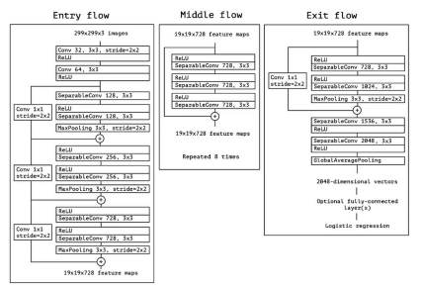
Models used
Xception:
Architecture: An extension of the Inception architecture
Innovation: Factorizing convolutions to increase model efficiency and performance.
Advantages: Delivers excellent results in various image classification and detection tasks by enhancing feature extraction.

Slide 9
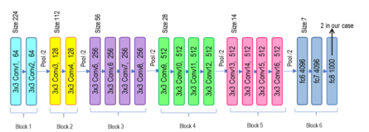
Models used
VGG19:
Architecture: A deep convolutional network with 19 layers, using very small (3x3) convolutional filters throughout.
Innovation: Emphasizes simplicity and depth, with a straightforward and uniform architecture.
Advantages: Provides strong baseline performance and is easy to implement and modify for various applications.

Slide 10
Results

Slide 11
Results
Best Performing Models:
Pre-trained EfficientNetB3:
Accuracy: 80.49%
Strengths: efficient scaling and robust feature extraction capabilities.
Insights: architecture allows for a balanced trade-off between accuracy and computational efficiency.
Pre-trained Xception:
Accuracy: 71.22%
Strengths: depthwise separable convolutions
Insights: Despite being slightly less accurate than EfficientNetB3, Xception performed consistently well across various metrics.

Slide 12
Results
Underperforming Model:
VGG19:
Accuracy: 50%
Limitations: Struggled with the complexity of distinguishing between real and fake faces
Insights: Highlighted the need for more advanced architectures when dealing with high complexity tasks like fake face detection.

Slide 13
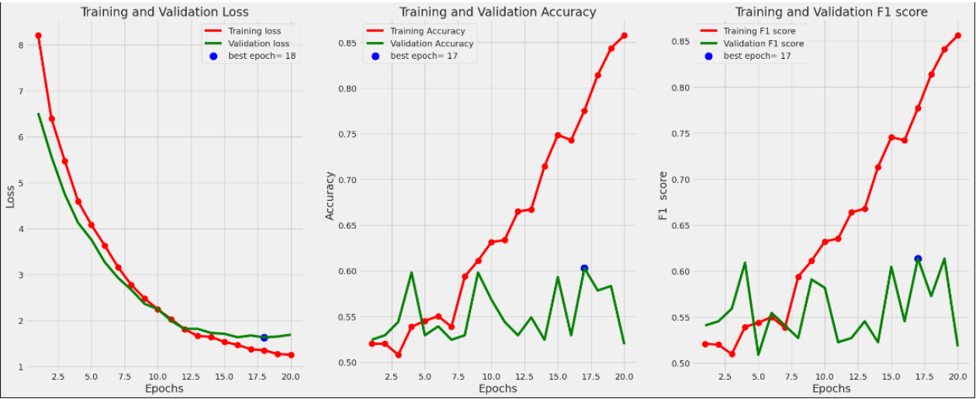
Results: ResNet50

Slide 14
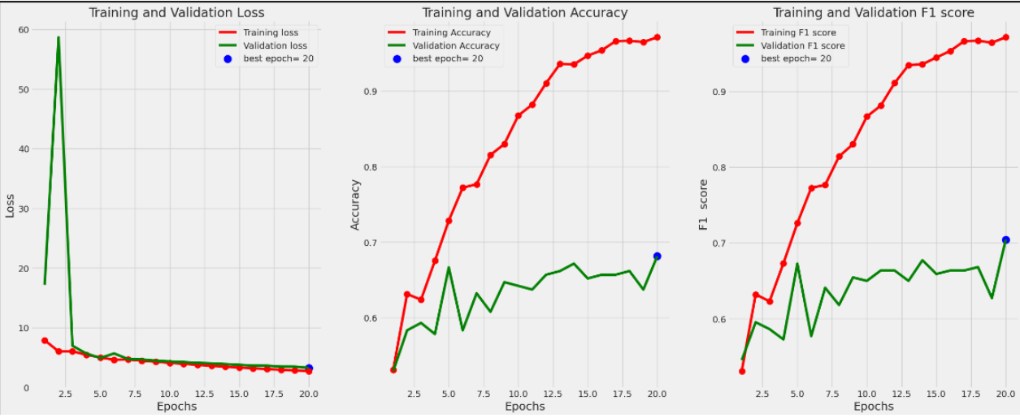
Results: ResNet50 (pretrained)

Slide 15
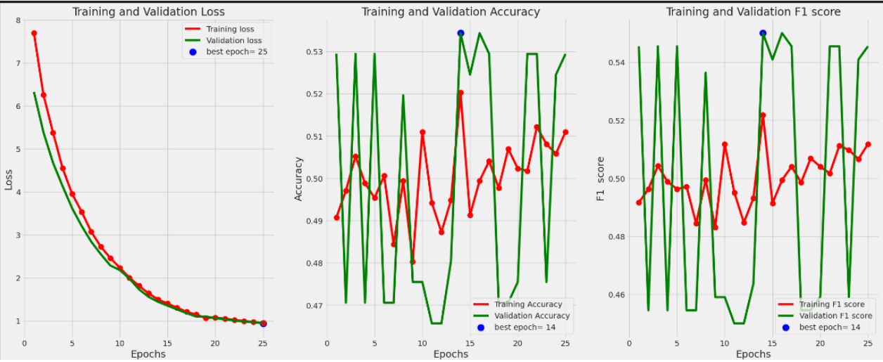
Results: EfficientNet

Slide 16
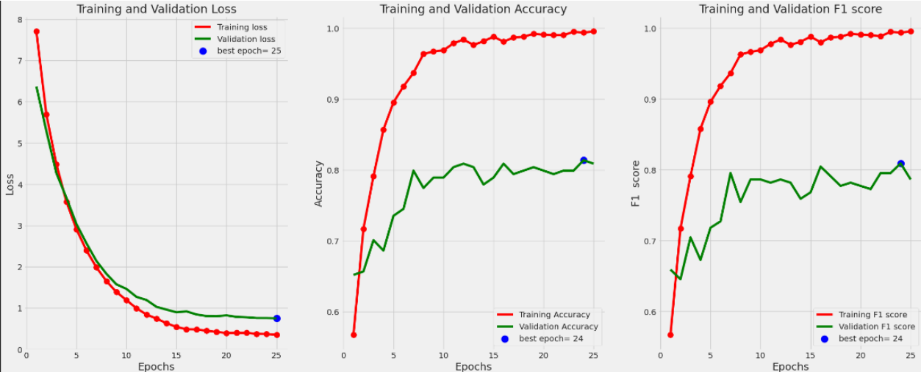
Results: EfficientNet (pretrained)

Slide 17
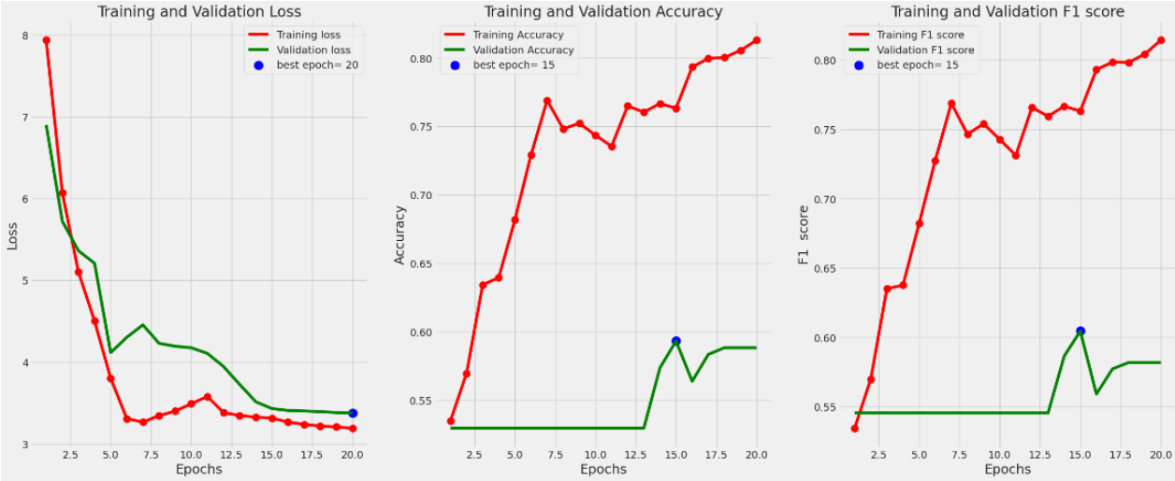
Results: Xception

Slide 18
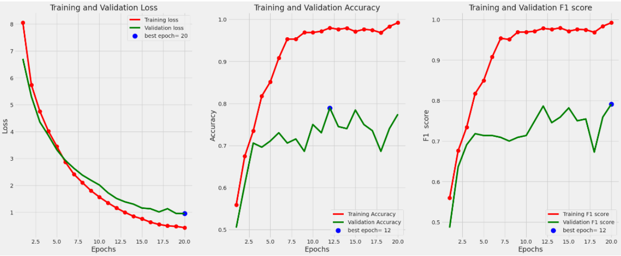
Results: Xception (pretrained)

Slide 19
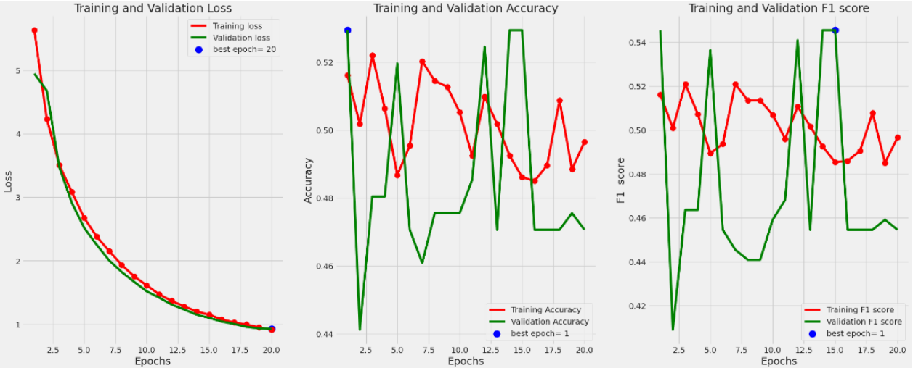
Results: VGG19

Slide 20
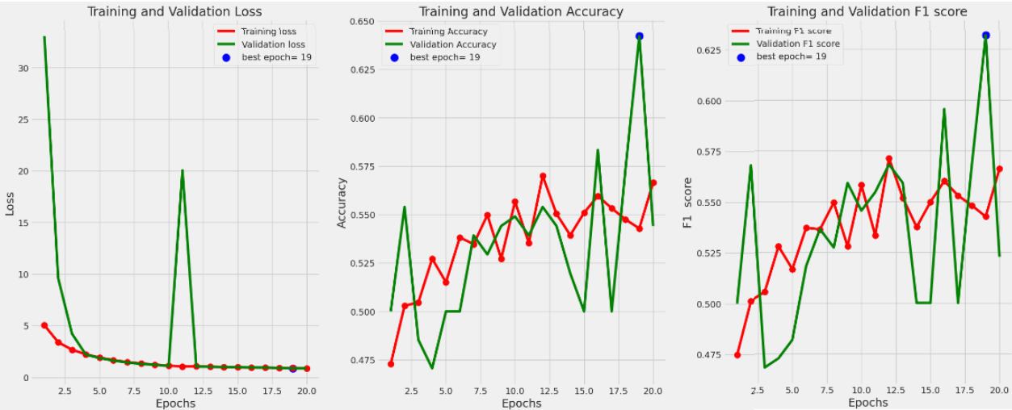
Results: VGG19 (pretrained)

Slide 21
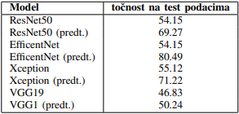
Results
Comparison with Existing Solutions
EfficientNetB3: Comparable to literature with accuracy above 80%.
Xception: Consistently performs well in detecting fake faces, with ~96% accuracy in literature.
VGG19: Underperforms in this study compared to 96% accuracy in other studies

Slide 22
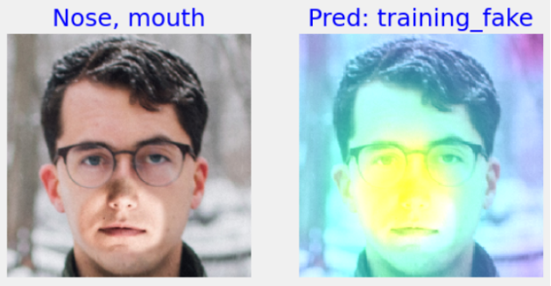
GradCAM Visualization
Purpose:
To interpret and understand
model decisions.
Findings:
Models focus on key regions
such as eyes, nose, and mouth
The model accurately detects a fake face, primarily considering the mouth and nose area.

Slide 23
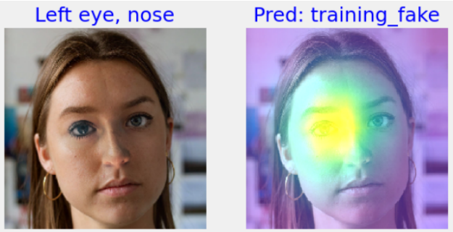
GradCAM Visualization
Purpose:
To interpret and understand
model decisions.
Findings:
Models focus on key regions
such as eyes, nose, and mouth
The model accurately detects a fake face, with the left eye contributing the most to the decision.

Slide 24
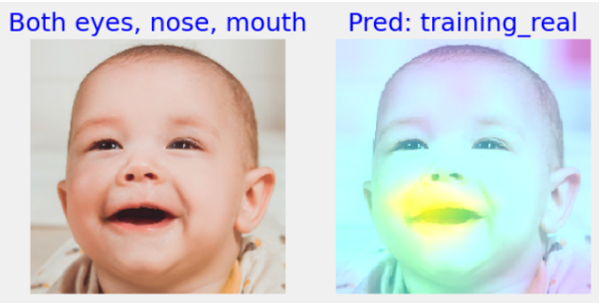
GradCAM Visualization
Purpose:
To interpret and understand
model decisions.
Findings:
Models focus on key regions
such as eyes, nose, and mouth
The model incorrectly labels the image as real

Slide 25
Conclusion
This study demonstrated that deep learning models, particularly those using pre-trained weights, are highly effective at detecting artificially generated human faces.
EfficientNetB3 and Xception models, with their advanced architectures, achieved the highest accuracies.
The use of pre-trained weights significantly enhanced performance, underscoring the value of transfer learning.
Future work will focus on further optimizing these models and testing them on more diverse datasets to improve robustness and accuracy.

Slide 26
Thank you
Mateja Vuradin mateja.vuradin@fer.hr
Lucija Prodan lucija.prodan@fer.hr
Erika Tomakić erika.tomakic@fer.hr
Hana Ujčić hana.ujcic@fer.hr
Marta Vidas marta.vidas@fer.hr

