Slide 1


Slide 2


Slide 3
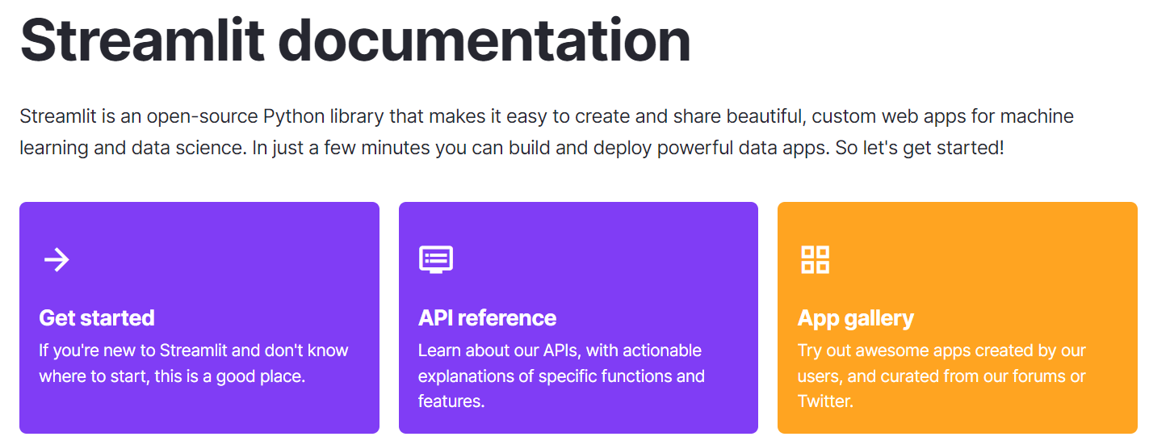

Slide 4
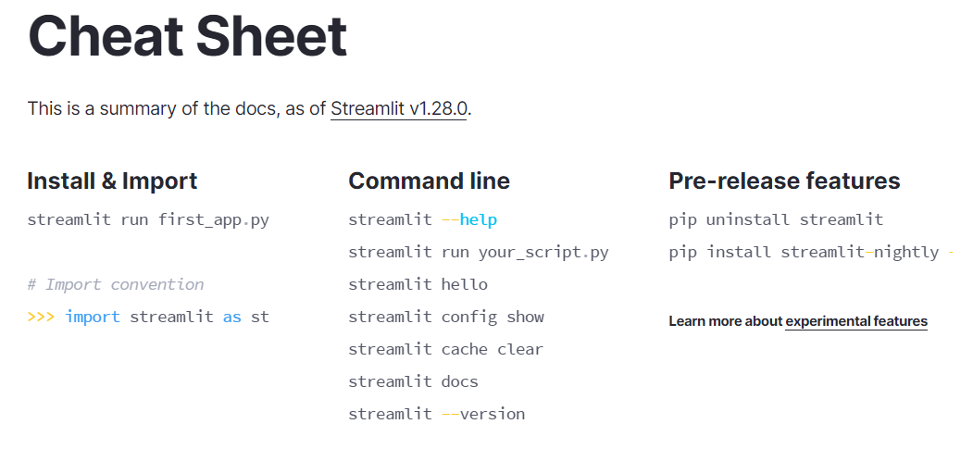

Slide 5
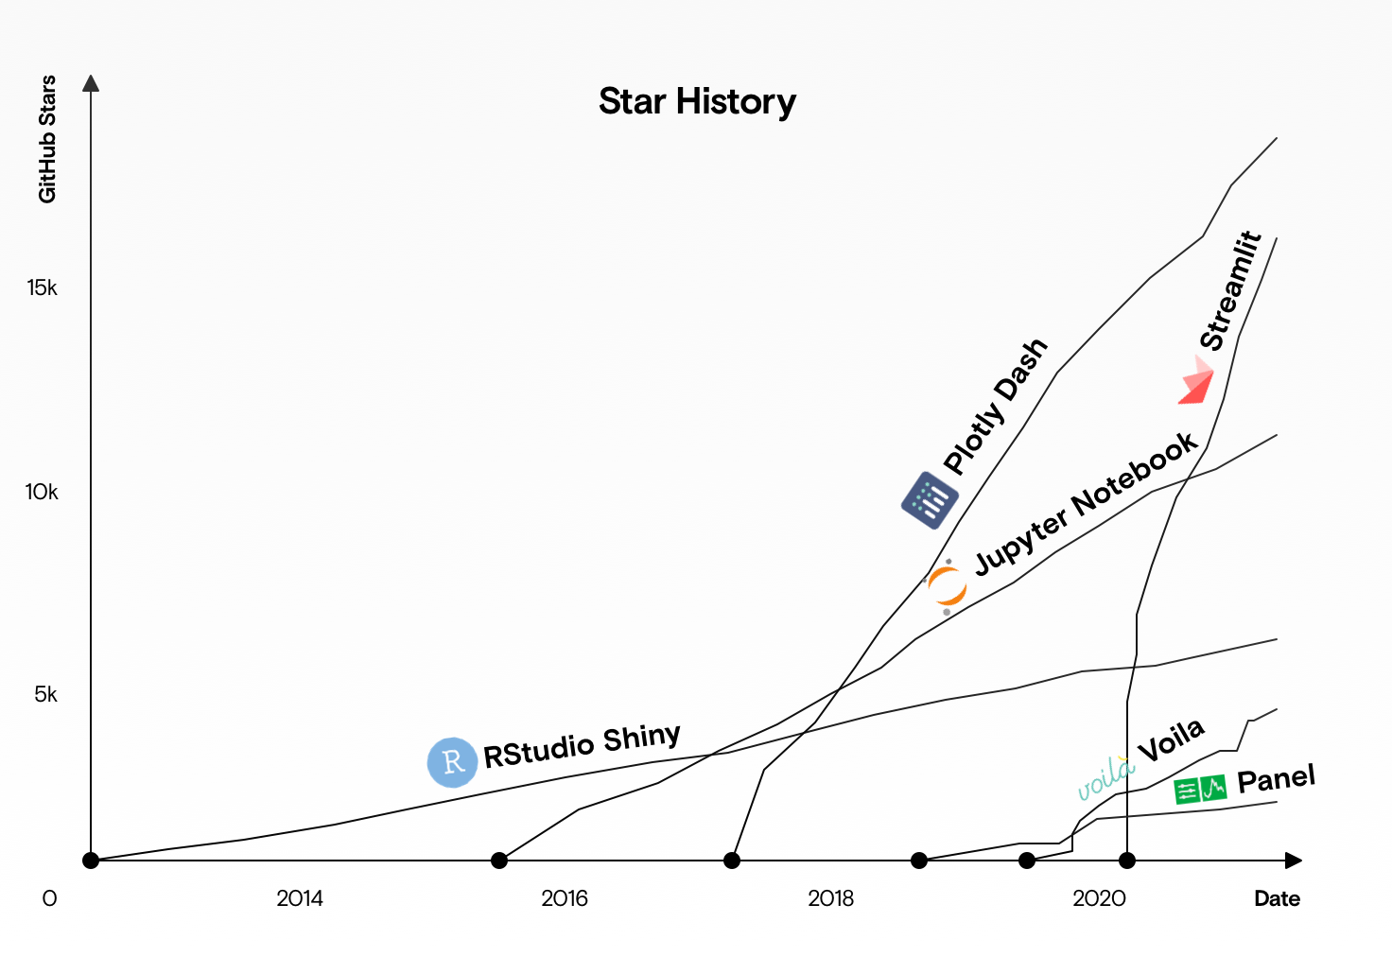

Slide 6
Streamlit Examples
https://github.com/streamlit/snowflake-usage-app
https://github.com/streamlit/demo-uber-nyc-pickups/tree/main
https://github.com/streamlit/demo-deepdream
https://github.com/streamlit/streamlit-buffett
https://github.com/streamlit/example-app-bert-keyword-extractor

Slide 7
Demo Time

