Slide 1
Homework 2 -
ER Modeling & Schema Design
Sweksha Sinha

Slide 2
Overview
Learning objectives -
Understanding the application data
ER modelling and schema design
Creating schema and loading data to SQLite
Data provided
Implementing the sub-tasks
Deliverables

Slide 3
Data given
In ebay_data, 40 JSON files each containing 500 auctions and items_schema.txt
For experimentation, look at ebay_data/items-0.json
JSON has types number, strings, bool, null, array and objects(key-value)
JSON schema file ebay_data/items_schema.txt
Key to understanding application constraints
Which fields are unique? Which fields can be null?
Data snapshot at a single point in time.

Slide 4
ER diagram (Task B)
To simplify schema design by visual representation
Figure out the entity sets and their attributes
Establish 1:1/ M:1/ M:M relationships between ES
Understand key constraints from items_schema.txt
Must indicate primary keys in ER diagram
Don’t exclude seemingly redundant JSON fields
Follow lecture notation; Hand-drawn or s/w generated

Slide 5
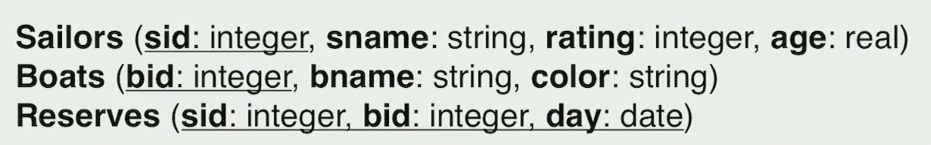
Schema design (Task B)
Relational schema definitions in text form
Evaluate what relationships require a separate table
Include attributes and primary keys in the schema.
No one correct solution!

Slide 6
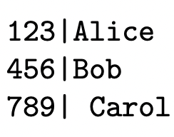
Data transformation Script (Task C)
Transform the JSON data into SQLite load files (.dat extension)
Understand ‘Bulk-Loading Data into SQLite Databases’ pdf
Implement parseJson() in supporting_material/skeleton_parser.py
Open/close ‘n’ .dat files if your schema has ‘n’ tables outside the ‘items’ loop
Iterate over each item and append the JSON fields relevant to each table in their respective files separated by ‘|’
Handle null values by loading some stand-in value for null
Dollar value and Date/time conversions helper functions
Remove duplicate tuples - either in python script or Unix commands
Experiment with items-0.json first; Acceptable code runtime!
Notes:
items = loads(f.read())['Items'] # creates a Python dictionary of Items for the supplied json file

Slide 7
Automation via runParser.sh (Task C)
Automate running the parser python script and generation of .dat files
runParser.sh - Invokes parser over the full data set
python my_parser.py ebay_data/items-*.json
If removing duplicate tuples via Unix commands (Sort/uniq), add in runParser.sh
Only runParser.sh will be run.
Notes:
sort -u items.dat -o itemsUnique.dat

Slide 8
Loading data into SQLite (Task D)
Create create.sql to remove old tables and create new tables with the decided schema
drop table if exists Item;
create table Item ( .... ); - Attributes with types, PK, FK
Create load.txt to load data from .dat files created in Task C into the empty tables created using create.sql
.separator |
.import items.dat Items
UPDATE Items SET … WHERE … -- Replace all token ‘NULL‘ values with null
.import auctionuser.dat AuctionUser
(Format - .import <loadFile> <tableName>)

Slide 9
Validation via queries(Task E)
Run all scripts to create tables and load data(start small!)
run runParser.sh
sqlite3 db_name < create.sql
sqlite3 db_name < load.txt
Once confident, load all 40 json files
Write SQL queries for the 7 tasks and validate with the solutions provided.

Slide 10
Deliverables
ER diagram and schema definitions in design.pdf
{your_parser_name}.py
runParser.sh
create.sql
load.txt
query1.sql to query7.sql - total 7 .sql files

