Slide 1
DDD in Poker
Towards a(n even) more disciplined approach

Slide 2
Agenda
Why we need a more disciplined approach
Lessons learned in Poker in the last 3 years
What we still miss
How can we improve
Hexagonal Architecture

Slide 3
Qualms - the reason to be here now
no practical books
no guidelines
no tutoring of newcomers
still a lot of "iffy" stuff (ACLs, layers, aggregate design...)
no tools to help/enforce good practices
Scattered bits of wisdom – no common knowledge-base

Slide 4
Lessons learned in Poker - 1
fairly decent layering (app, domain, infrastructure) → separation of concerns
use of DDD patterns
  Aggregates → rich domain model, transactional consistency boundaries
  Repositories → persistence independence
multiple Bounded Contexts - distributed architecture

Slide 5
Lessons learned in Poker - 2
ACLs
  for messaging layer → keeps the Domain agnostic of the communication infrastructure
  for persistence → makes rolling releases possible
BDD - gives us high level of confidence, very stable codebase
We've got more mature, coding patterns have emerged (naming conventions, packaging, Cucumber tests, common libraries for locking, Mongo, tests...)

Slide 6
What we could do better
Layering - common mistakes
Example 1 - domain logic in app and infrastructure layer
Example 2 - violation of DIP: calling infrastructure/app from domain
Example 3 - using messages in app layer
Root of evil: no general understanding about DDD layering
  How to structure the layers?
  What are the benefits? (testability, separation of concerns, ...)
  Where are the responsibility boundaries between layers?

Slide 7
What we could do better
ACLs - what everyone loves to hate - 1
Project | LOC ratio of ACL (%) | Project size (Number of files)
Tracker System | 17 | 497
Gamification System | 22 | 321
Poker Games System | 28 | 1249
Poker Fulfilment System | 28 | 266
Poker Academy System | 30 | 182
Poker Player Profile System | 31 | 377
Poker Tournament | 43 | 1423
Poker Reporting System | 48 | 503
Poker Cashier System | 48 | 349
> 30% of the code base are in ACLs → tremendously diminishes productivity
  a new field in domain → half a day work

Slide 8
What we could do better
ACLs - what everyone loves to hate - 2
Maybe using one too many (between app and domain) → gives us flexibility we don't need
no really good approach for mapping persistence objects to/from domain objects
  writing assemblers for each domain class (very tedious) ↔ some reflection-based approach
  Setters-getters problem → exposing internals of rich DOs
the benefits are not obvious (esp for newcomers)

Slide 9
What we could do better
Code quality - 1
We are very good on large scale (small, independent, asynchronously communicating components → infinitely scalable architecture) ↔ a bit messy on the individual components' level
Average Component Dependency
(Spring's code base's is 3.3%)
Poker Stats System | 8 | Tournament Director System | 28
Poker Player Profile System | 17 | Poker Games System | 30
Poker Buddies System | 20 | Tracker Core | 41
Gamification Service | 25 | Gamification System | 50
Tournament Program System | 27 | Poker Academy System | 57
ACD: how many packages does an average package depend on = what is the effect of changing one package

Slide 10
What we could do better
Code quality - 2
High ACD
Cyclic dependencies
no packaging guidelines
no sub-domains, no vertical slices → small balls of mud
no tools to help/enforce good practices – best would be breaking the build

Slide 11
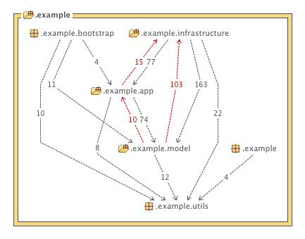

Slide 12
What we could do better
Code quality – 3
Example: definitions of submodules – experiment in PPPS
# Map submodules to packages
subdmodule-definitions:
CORE: [domain.core]
VOUCHER: [domain.voucher, app.client.voucher]
JOURNEY: [domain.journey]
GIFTING: [domain.gifting, app.client.gifting]
BONUS: [domain.bonus]
PURCHASE: [domain.purchase, app.client.purchase]
# Define dependencies between submodules
subdmodule-dependencies:
CORE: []
VOUCHER: [CORE]
JOURNEY: [CORE, VOUCHER]
GIFTING: [CORE, VOUCHER]
BONUS: [CORE]
PURCHASE: [CORE, JOURNEY]
Violation breaks the build

Slide 13
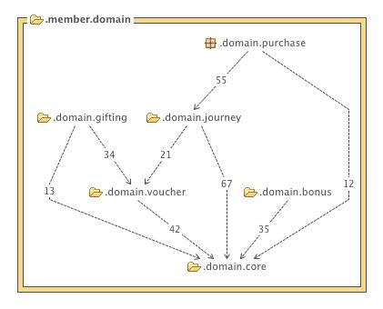

Slide 14
Missing guidelines – examples - 1
Domain Services
  when to use one? Types? Location of implementation ↔ interface?
Structuring Application Layer
  One big facade? One app service per use-case? One per use-case group?
Designing aggregates
  transactional consistency boundaries, invariants
  How many aggregate can change in transaction? eventual vs transactional consistency
  How can aggregates refer to each other - by id or by reference?

Slide 15
Missing guidelines – examples - 2
Cucumber tests - via messaging vs against app services
Microkernels – direct use or needs wrapping around?
Event dispatching - currently ACL “overuse”:
  Incoming: action → infrastructure → app → domain
  Outgoing: event ← infrastructure ← app ← domain

Slide 16
How to get there
Collect what we have learnt in 3 years and distill it into written guidelines
Tutoring new members
Gamesys blog
Reference project
Workshops
Tools to enforce good practices (best if embedded in build process)

Slide 17
Hexagonal Architecture
(Ports and Adapters architecture)
Elegant and simple way to organize and describe the architecture
Makes the benefits of onion-layering (as opposed to traditional vertical layering) obvious
we are already doing it

Slide 18
Hexagonal Architecture
(Ports and Adapters architecture)
Example: Poker Buddies System
Scenario: When the player logs in, the app sends notifications to all her online buddies
Flow:
  CP sends a SessionCreatedEvent to PBS
  PBS stores the session
  PBS queries Facebook for the friends
  PBS sends out notifications to the online friends

Slide 19


External Driven Port
Driven Adapter – an assembler
Internal Driven Port –
a method on app service
Internal Driving Port – domain interface
Driving Adapter – impl. in Infrastructure
External Driving Port
The Use-case flow
SessionCreatedEvent arrives
Get FB friends
Store online player session
Send out notifications
Message Bus
FB
JMS
FB
HZ
DB
2
REST
App/
Domain
Benefits
Extendable
Testable – fake adapters
Easy to describe
1
HZ
3
Mongo
Mongo
DB
4
Infrastructure
JMS
Port – where the component interacts with external world
Adapter – attached to a port, translates
Message
Bus

Slide 20
External Driven Port
Driven Adapter – an assembler
Internal Driven Port –
a method on app service
Internal Driving Port – domain interface
Driving Adapter – impl. in Infrastructure
External Driving Port
The Use-case flow
SessionCreatedEvent arrives
Get FB friends
Store online player session
Send out notifications
Message Bus
FB
JMS
FB
HZ
DB
2
REST
App/
Domain
Benefits
Extendable
Testable – fake adapters
Easy to describe
1
HZ
3
Mongo
Mongo
DB
4
Infrastructure
JMS
Port – where the component interacts with external world
Adapter – attached to a port, translates
Message
Bus

