Slide 1
Sum of Squares in Lean
Using Lean 3.0
Made by Gal Lebel and Alex Baucke (and Flo, TBH) on July 25th, 2023

Slide 2
> Contents
Theorem Definition
Propositional Logic
Introducing the statement to be proved.
A simple example
Contraposition
Logical fallacies
Proof
Example in ℂ
Proving the equivalence
→
←
Contraposing the statement in ℂ
Notes:
2 mins

Slide 3
Theorem Definition

Slide 4
[1/2] Statement
The two statements are equivalent:
If a sum of squares is 0, then all the elements of that sum are 0.
-1 is not a sum of squares in ℝ
Notation: List = Set, but allows multiplicity
Note: We do not want to show that a) or b) is actually true!

Slide 5
[2/2] Statement
So now we would like to formalize the statements using mathematical notations
If a sum of squares is 0, then all the elements of that sum are 0. ∀ L : List ℝ, x_{i} ∈ L : ∑_{i…n}x_{i}² = 0 => x_{i} = 0 ∀x_{i} ∈ L
-1 is not a sum of squares in ℝ ∀ L : List ℝ, x_{i} ∈ L : ∑_{i…n}x_{i}² ≠ -1
And we can write those together in an equivalence relation a) ↔ b) as follows :
∀ L : List ℝ, x_{i} ∈ L : ∑_{i…n}x_{i}² = 0 => x_{i} = 0 ∀x_{i} ∈ L ↔ ∑_{i…n}x_{i}² ≠ -1

Slide 6
Propositional Logic - Example

Slide 7
[1/1] Propositional Logic - Example
Given the following statements
Q : The weather is nice
P : I’m at the zoo
We can express the relation between Q and P like this:
Q → P (If the weather is nice, I’m at the zoo)
The contraposition of this would be:
Q → P = ¬P → ¬Q (If I’m not at the zoo, the weather is bad)
( And not Q → P = ¬Q → ¬P (If the weather is bad, I’m not at the zoo) )

Slide 8
Proof of the Sum of Squares Theorem

Slide 9
[1/4] Proof
We will start the proof of a) ↔ b) by proving the ‘→’ - direction: b) → a).
We do a proof by contraposition, meaning we show that ¬a) → ¬b) is true.
First, let’s negate the two statements:
¬( ∀ L : List ℝ, x_{i} ∈ L : ∑_{i…n}x_{i}² = 0 → ∀ x_{i} ∈ L : x_{i} = 0 ∃ L : List ℝ, x_{i} ∈ L : ∑_{i…n}x_{i}² = 0 → ∃ x_{i} ∈ L : x_{i} ≠ 0 = ¬a)
¬( ∀ L : List ℝ, x_{i} ∈ L : ∑_{i…n}x_{i}² ≠ -1 ) ∃ L : List ℝ, x_{i} ∈ L : ∑_{i…n}x_{i}² = -1 = ¬b)

Slide 10
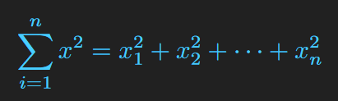

[2/4] Proof
We show ¬a) → ¬b):
Assume ¬a).
Let L be a list over ℝ whose sum of squares is equal to 0 and without loss of generality, let x₁ ≠ 0. Then :
We can now divide all the terms by and continue with the equality, because division of 0 by any number is still equal to zero.
= 0

Slide 11
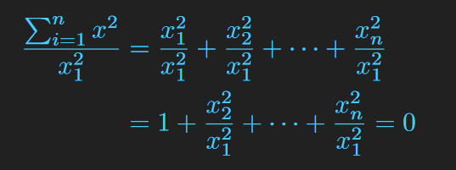
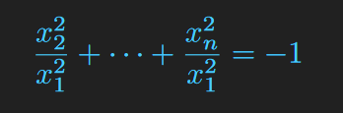
[3/4] Proof
So now we have:
By adding (-1) to both sides, we get :
Which confirms our initial assumption ¬a)
Thus we have proven b) → a)

Slide 12
[4/4] Proof
We will now proceed to show the ‘←’ - direction : a)→ b) of a) ↔ b).
∃ L : List ℝ, x_{i} ∈ L : ∑_{i…n}x_{i}² = 0 → ∃ x_{i} ∈ L , x_{i} ≠ 0 = ¬a)
∃ L : List ℝ, x_{i} ∈ L : ∑_{i…n}x_{i}² = -1 = ¬b)
We will prove the contraposition ¬b) → ¬a).
Assuming ¬b), we want to show ¬a).
From our assumption of ¬b), let L be that list.
By appending 1 to L, the sum of squares of { 1 :: L } must be now 0.

Slide 13
Example in ℂ

Slide 14
[1/1] Example in ℂ
The lean proof of the equivalence holds for any field with decidable equalities.
Since ℂ is such a field, we can show that the equivalence still holds:
¬a) ↔ ¬b)
∃L : List ℝ, x_{i} ∈ L : ∑_{i…n}x_{i}² = 0 → ∃ x_{i} ∈ L : x_{i} ≠ 0 ↔ ∃ L : List ℝ, x_{i} ∈ L : ∑_{i…n}x_{i}² = -1
To show ¬b), we can choose L := { i },{ -i },{ 1/i }, or { 1/-i }, giving us a sum of squares = -1.
Since ¬a) must hold as well, we construct L2 := { 1 :: L } i.e. 1 appended to L.
Since 1 ∈ L2 and the sum of squares of L2 is 0 by construction, we have found a list that satisfies ¬a) as well.
Therefore, a) ↔ b) remains (negatively) equivalent in ℂ

Slide 15
Ty for your time 🤡
Any Questions?
Resources for further reading:
https://leanprover-community.github.io/mathlib_docs/

