Slide 1

What is memory safe and why Linux needs to be memory safe
Presenter : Mateo
The ELUG Event

Slide 2
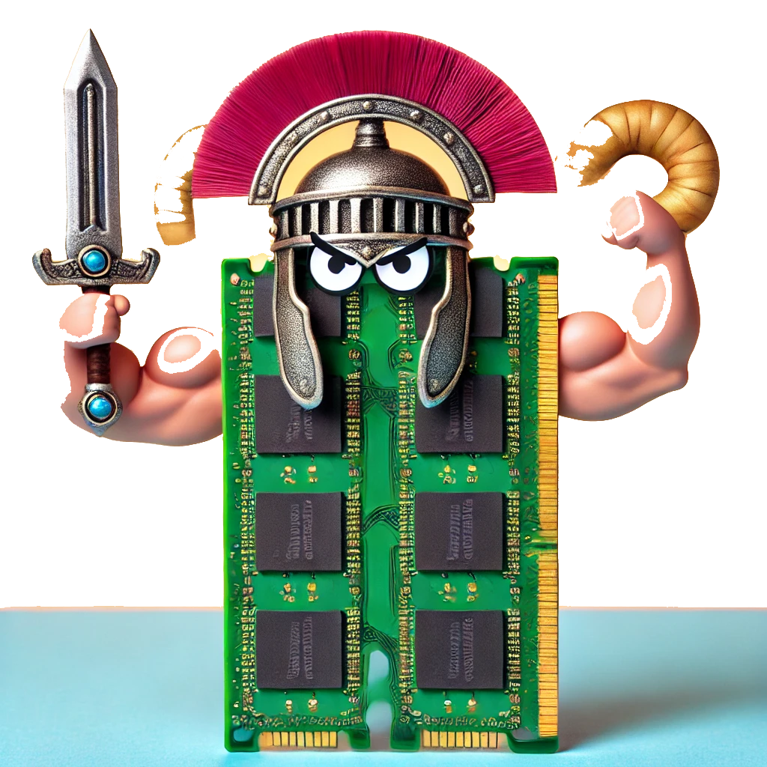
What is memory safe ?

Slide 3
A memory-safe program:
Accesses control
Free controller
Resource management

Slide 4
Accesses control
#include <iostream>
using namespace std;
int main() {
int* ptr = new int(5);
delete ptr; // free the memory
cout << *ptr << endl; // use after free
return 0;
}

Slide 5
Garbage value

Slide 6
Memory management
#include <iostream>
#include <cstring>
using namespace std;
int main() {
char buffer[10];
cout << "Enter a string: ";
cin >> buffer; //buffer overflow
cout << "You entered: " << buffer << endl;
return 0;
}

Slide 7
Crash , Garbage value

Slide 8
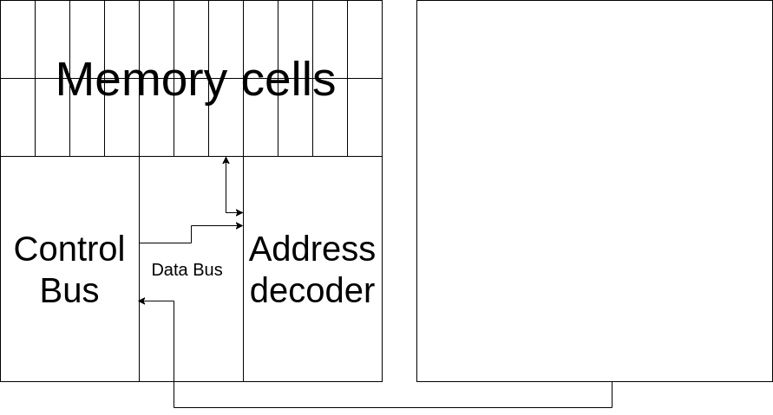
Ram diagram
CPU

Slide 9
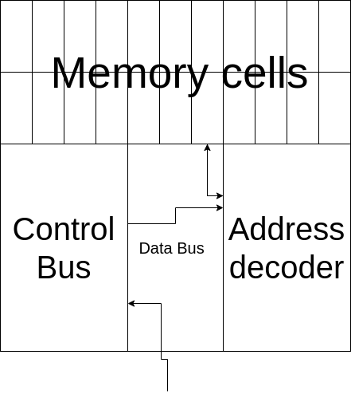
Zoom

Slide 10
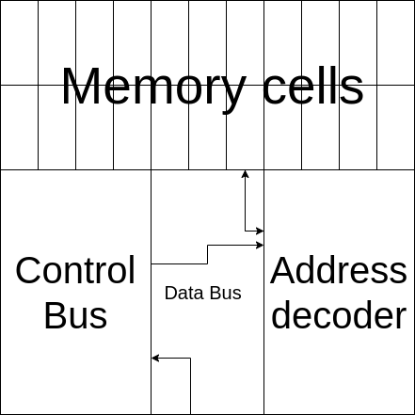
Control Bus
Wrong command(Read/Write)
Ex.Use after Free

Slide 11
Address Decoder
Out of range Access

Slide 12
Memory cells
Memory address space
ex. Buffer overflow

Slide 13
Unsafe issues
Security
Stability
Resource management

Slide 14
Big issues for unsafe languages
Buffer overflow
Use after-free
Memory leak
Stack smashing

Slide 15
Buffer overflow
#include <iostream>
using namespace std;
int main() {
char buffer[10];
int secret = 42;
cout << "Enter some text: ";
cin >> buffer;
cout << "You entered: " << buffer << endl;
cout << "Secret value: " << secret << endl;
return 0;
}

Slide 16


OUTPUT

Slide 17
Use after-free
#include <iostream>
using namespace std;
int main() {
int* ptr = new int(42);
cout << "Value: " << *ptr << endl;
delete ptr;
cout << "After free: " << *ptr << endl;
return 0;
}

Slide 18



OUTPUT

Slide 19
Memory leak
#include <iostream>
using namespace std;
void leak() {
int* ptr = new int(42);
}
int main() {
while (true) {
leak();
}
return 0;
}

Slide 20

OUTPUT

Slide 21
Stack smashing
#include <iostream>
using namespace std;
void tester() {
cout << "Hey you on tester" << endl;
}
void vulnerable() {
char buffer[10];
cout << "Enter some text: ";
cin >> buffer;
}
int main() {
vulnerable();
cout << "Back to main!" << endl;
return 0;
}

Slide 22
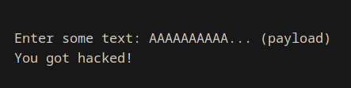
OUTPUT
Function Data | Return address

Slide 23
Solutions for Security Issues
1 – Using memory safe Language
2 – Memory safe tools and libraries
3 – Static and Dynamic Analysis

Slide 24
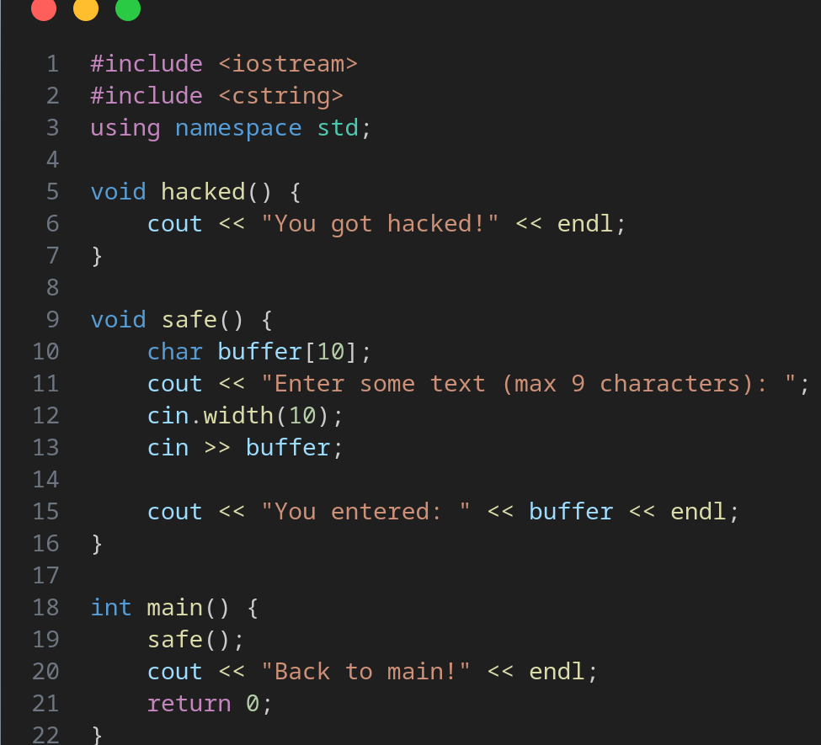
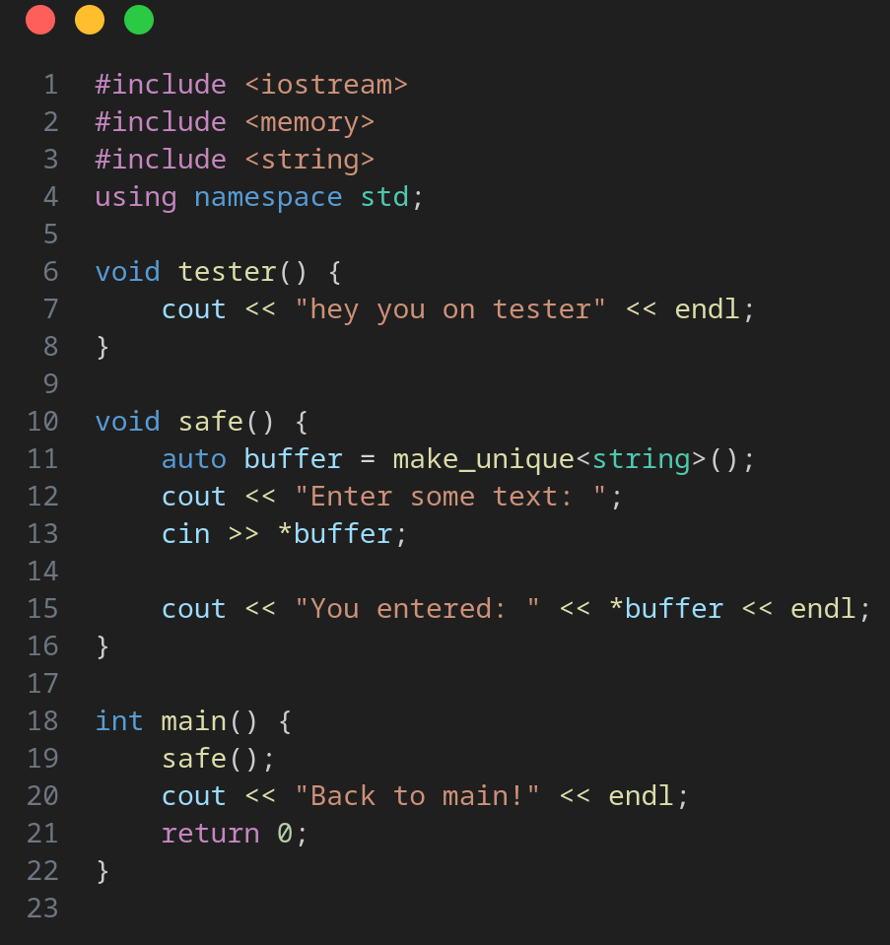
Use modules in c/c++

Slide 25
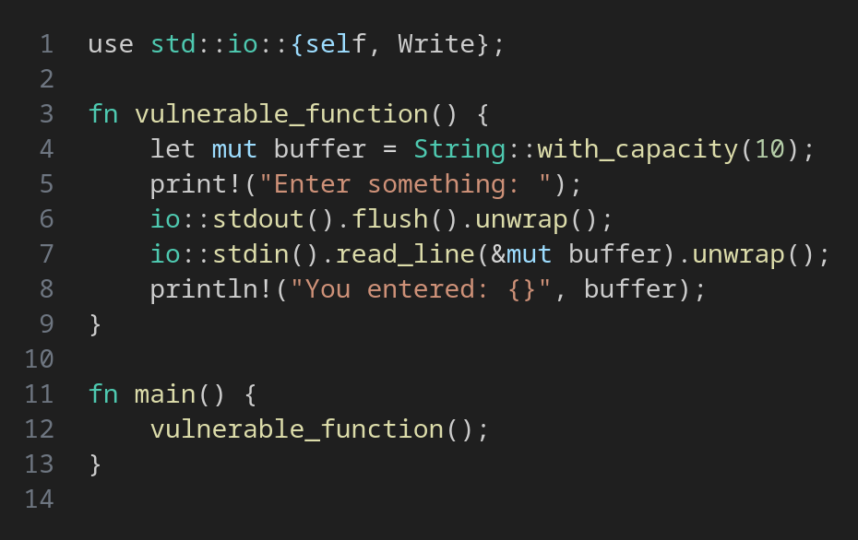
Solution on this code for issues with rust

Slide 26
Why Linux Should Be Memory Safe

Slide 27
Challenges of Transitioning Linux to Rust
1. Compatibility with Existing Code
2. Performance Considerations
3. Learning Curve
4. Community Resistance

Slide 28
If Linux Does Not Transition to Rust

Slide 29
Sources :
https://www.rust-lang.org/
https://www.kernel.org/doc/html/latest/
https://en.wikipedia.org/wiki/Memory_safety
http://valgrind.org/docs/
https://duckboard.net/rust_in_linux/?utm_source=chatgpt.com

Slide 30
Thanks for your time

