Slide 1
CS-205
Declarative Programming
Lectures: Tuesdays and Thursdays, via zoom, scheduled via CANVAS.
Practicals:
Fridays, group allocation to follow.
Assessment:
70% Exam, 30% 2 Assignments +
Lab exercises and attendance.
Info: see canvas, completed step by step.

Slide 2
Declarative Programming
Part 1: Functional Programming
Part 2: Logic Programming
Learning outcomes:
Students will be able to specify and write programs in functional and logic programming languages.
They will be able to develop solutions to algorithmic problems using declarative rather than procedural concepts.

Slide 3
Literature for Part I:
Graham Hutton: Programming in Haskell, Cambridge University Press, 2007.
Learn You a Haskell for Great Good! http://learnyouahaskell.com
Further reading will be given on Canvas.
2

Slide 4
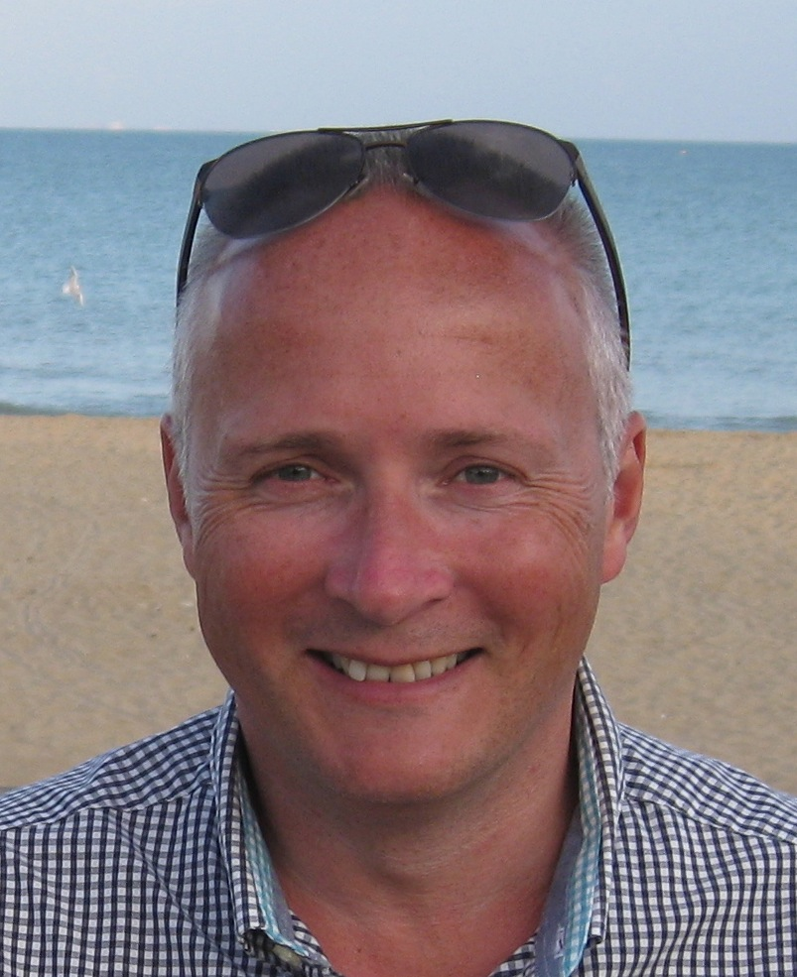
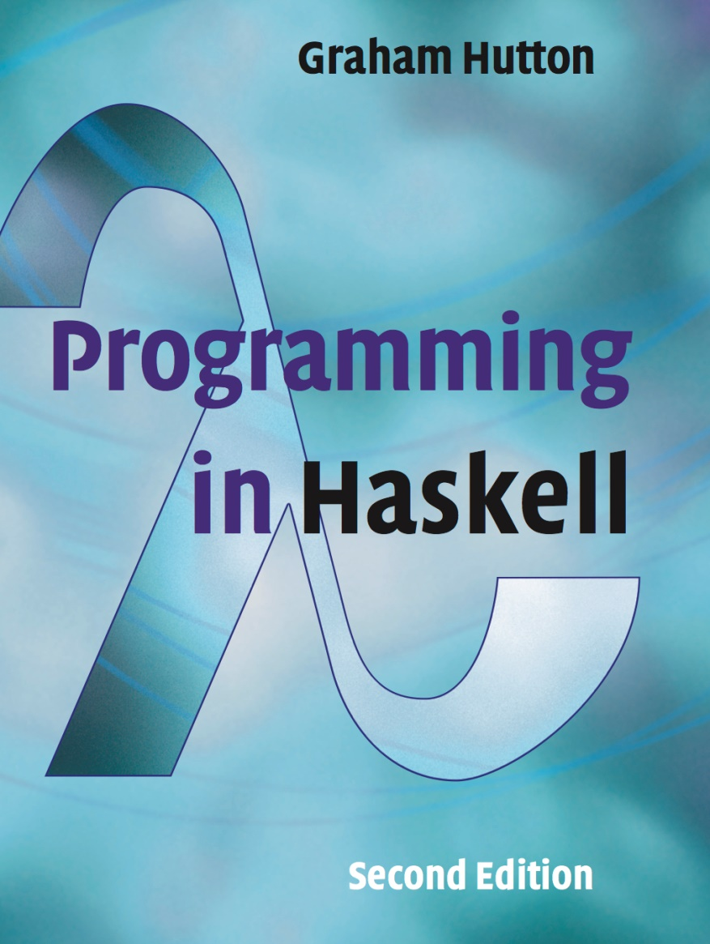
Thanks to Graham Hutton for allowing us to use and modify his slides https://www.cs.nott.ac.uk/~pszgmh/

Slide 5

PROGRAMMING IN HASKELL
Chapter 1 - Introduction

Slide 6
The Software Crisis
How can we cope with the size and complexity of modern computer programs?
How can we reduce the time and cost of program development?
How can we increase our confidence that the finished programs work correctly?

Slide 7
Programming Languages
One approach to the software crisis is to design new programming languages that:
Allow programs to be written clearly, concisely, and at a high-level of abstraction;
Support reusable software components;
Encourage the use of formal verification;

Slide 8

Permit rapid prototyping;
Provide powerful problem-solving tools.
Functional languages provide a particularly elegant framework in which to address these goals.

Slide 9
What is a Functional Language?
Opinions differ, and it is difficult to give a precise definition, but generally speaking:
Functional programming is style of programming in which the basic method of computation is the application of functions to arguments;
A functional language is one that supports and encourages the functional style.

Slide 10
Example
Summing the integers 1 to 10 in Java:
total = 0;
for (i = 1; i ≤ 10; ++i)
total = total+i;
The computation method is variable assignment.

Slide 11
Example
Summing the integers 1 to 10 in Haskell:
sum [1..10]
The computation method is function application.

Slide 12
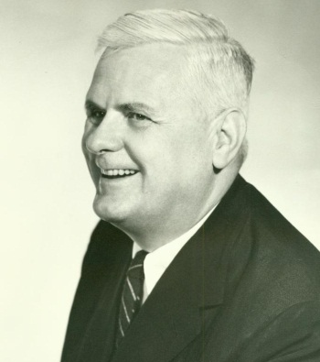
Historical Background
1930s:
Alonzo Church develops the lambda calculus, a simple but powerful theory of functions.

Slide 13
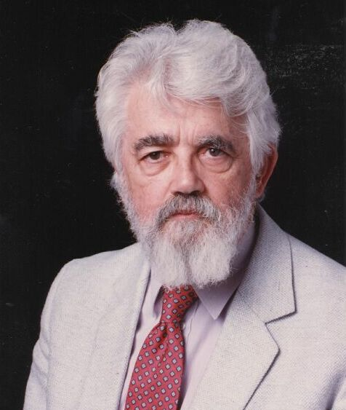
Historical Background
1950s:
John McCarthy develops Lisp, the first functional language, with some influences from the lambda calculus, but retaining variable assignments.

Slide 14
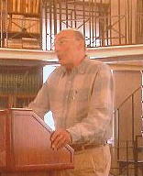
Historical Background
1960s:
Peter Landin develops ISWIM, the first pure functional language, based strongly on the lambda calculus, with no assignments.

Slide 15
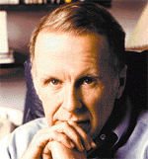
Historical Background
1970s:
John Backus develops FP, a functional language that emphasizes higher-order functions and reasoning about programs.

Slide 16
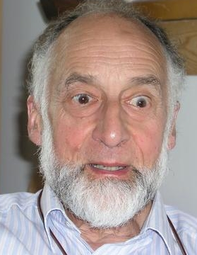
Historical Background
1970s:
Robin Milner and others develop ML, the first modern functional language, which introduced type inference and polymorphic types.

Slide 17

Historical Background
1970s - 1980s:
David Turner develops a number of lazy functional languages, culminating in the Miranda system.

Slide 18
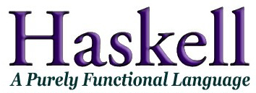
Historical Background
1987:
An international committee of researchers initiates the development of Haskell, a standard lazy functional language.

Slide 19
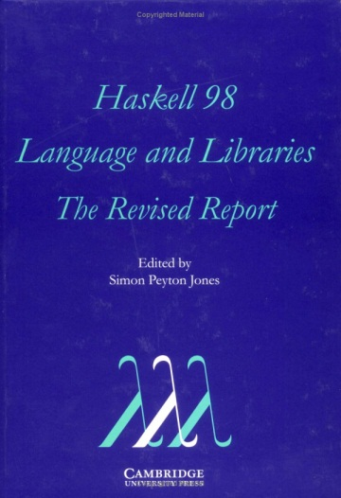
Historical Background
2003:
The committee publishes the Haskell 98 report, defining a stable version of the language.

Slide 20
Industrial Applications
Recommended is to have a look at:
wiki.haskell.org/Haskell_in_industry

Slide 21
A Taste of Haskell
f [] = []
f (x:xs) = f ys ++ [x] ++ f zs
where
ys = [a | a ← xs, a ≤ x]
zs = [b | b ← xs, b > x]
?

Slide 22
Here two simpler programs:
double :: Int -> Int
double x = x + x

Slide 23
Here two simpler programs:
average :: Float -> Float -> Float
average x y = (x + y) / 2

Slide 24
Videos on FP
John Hughes: Why functional programming matters https://www.youtube.com/watch?v=XrNdvWqxBvA
See also the paper with the same title (on canvas)
Erik Mejer: Fundamentalist Functional Programming https://www.youtube.com/watch?v=UuamC0T3hv8
What can go wrong in non-functional languages
and how Haskell puts it right.
Simon Peyton Jones: Haskell is useless https://www.youtube.com/watch?v=iSmkqocn0oQ Entertaining conversation with Erik Meijer about unsafe and useless programming languages and how they can become safe and useful.

