Slide 5


Slide 10
Thank You

Slide 11







OpenSearch by the Numbers
131
90+
21
GitHub
repositories
New releases
since launch
More than
Project partners
1,400,000
3,637
More than
950,000,00
Monthly page views for opensearch.org
Members
Project downloads
of public Slack workspace
600,000+
6,855
1,000
43
Members
Non-AWS
Repository
maintainers
forum views
per month
Contributors
to project code
of User Forums

Slide 12














Thank You OpenSearch Software Foundation Members!

Slide 13





Thank You
Forum
Events
Blog
Github
Slack

Slide 14
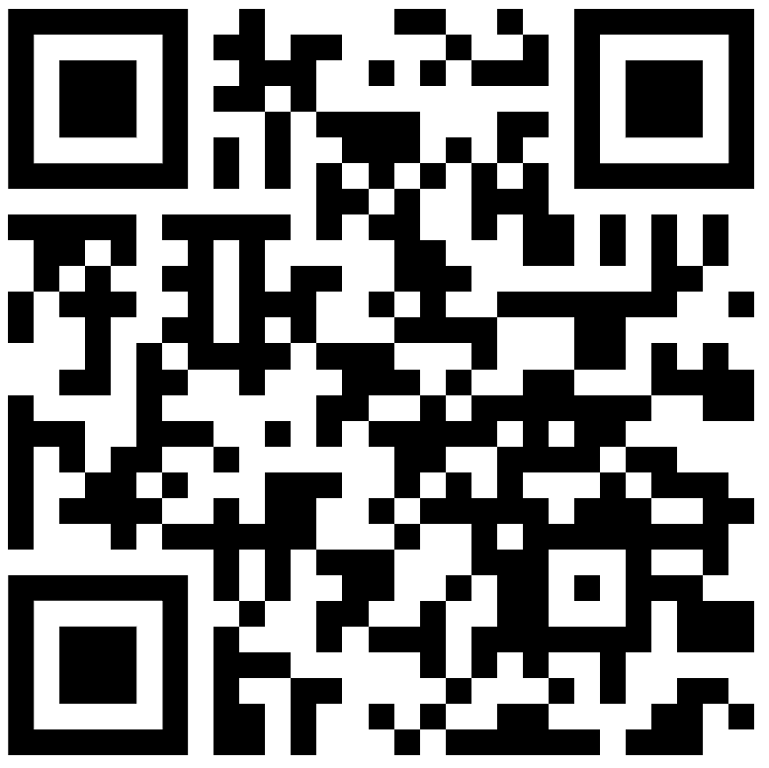
Thank You
Forum
Events
Blog
Github
Slack

Slide 15

Builders Wanted!

