Slide 1
Momentum Views in a Black-Litterman Portfolio
Project 4 · Quantitative Finance
30 stocks, February 2017 – December 2025

Slide 2
What we did
1. Each month, rank the 30 stocks by their return over the past year
2. Start from the market portfolio (each stock at its market-cap weight)
3. Tilt toward last year’s winners and away from the losers
4. Let Black-Litterman decide how big that tilt should be

Slide 3
Design choices
 | What we chose | Why
Universe | Our 30 large US stocks, 2016–2025 | Same data as Projects 1–3
Signal | Past 12-month return, skipping the last month; monthly | Standard momentum; the last month tends to reverse
Prior | Returns implied by market-cap weights | With no view, we simply hold the market
View | Top 10 beat bottom 10 by about 5% a year | Bigger when winners and losers are far apart
τ | 1/60 | Trust the prior like 5 years of monthly data
Ω | As uncertain as the prior: the view gets half weight | The signal is noisy
Constraints | Long-only, at most 25% per stock | No extreme bets
Transaction costs | 0.1% of every trade | Realistic cost of trading

Slide 4
Two benchmarks
Market-cap benchmark
Hold the 30 stocks at their market-cap weights and never trade. This is what we would own with no views at all.
Naive momentum
The classic Jegadeesh-Titman strategy (Lecture 5): buy the top 10% of stocks by past return and short the bottom 10%, equal weights. With 30 stocks that is 3 long and 3 short.
“Naive” because it bets fully on the signal and ignores risk, correlations and market weights.

Slide 5
Results: close to the market, much better than naive momentum
After trading costs, per year | Our portfolio | Market | Naive momentum
Return | 17.8% | 19.0% | 2.0%
Volatility | 20.2% | 19.7% | 32.7%
Sharpe ratio | 0.80 | 0.87 | 0.22
Worst fall from a peak | −29% | −29% | −60%
Trading (turnover) | 201% | 0% | 357%

Slide 6
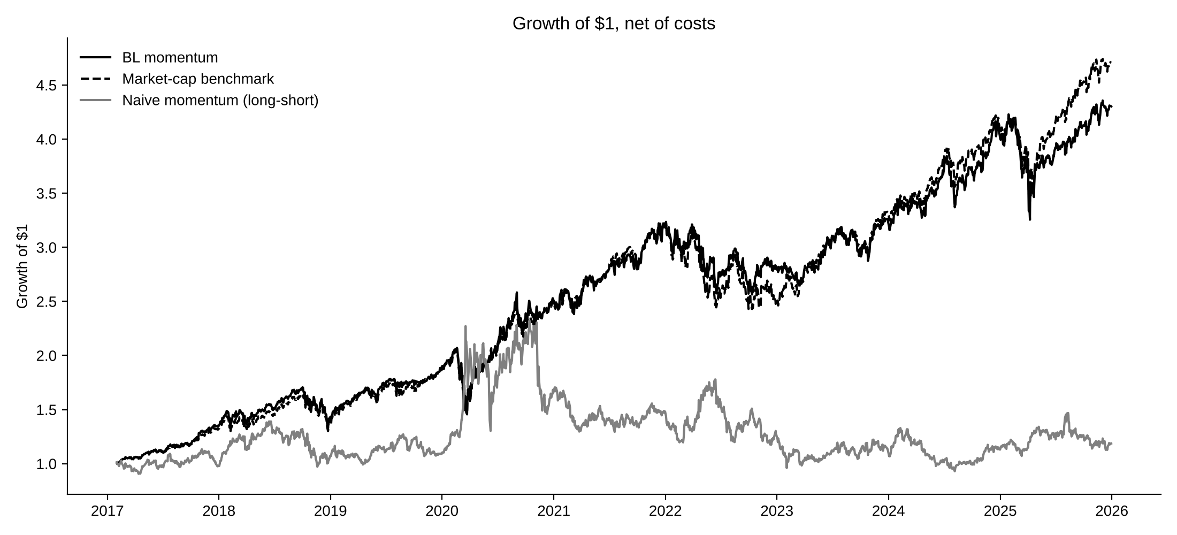
Growth of $1

Slide 7
Momentum worked on average, but crashed at turning points
Year | Ours | Market | Gap
2017 (from Feb) | 34.2% | 31.5% | +2.7
2018 | 6.6% | 6.5% | +0.1
2019 | 30.5% | 34.2% | −3.6
2020 | 34.5% | 32.4% | +2.1
2021 | 26.7% | 29.0% | −2.3
2022 | −11.4% | −21.5% | +10.1
2023 | 15.5% | 31.8% | −16.3
2024 | 23.2% | 23.0% | +0.2
2025 | 7.2% | 15.2% | −8.0
Winners did beat losers: 23% vs 15% a year on average
2022: momentum favored energy, healthcare and staples as tech fell, and we lost 10 points less than the market
2023: the 2022 losers (Amazon, Google, Microsoft) rebounded, and we trailed by 16 points
Naive momentum’s worst month: −25% in November 2020, when the COVID losers it was short surged on vaccine news
This is the momentum crash from Lecture 5: past losers rally hard when the market turns

Slide 8
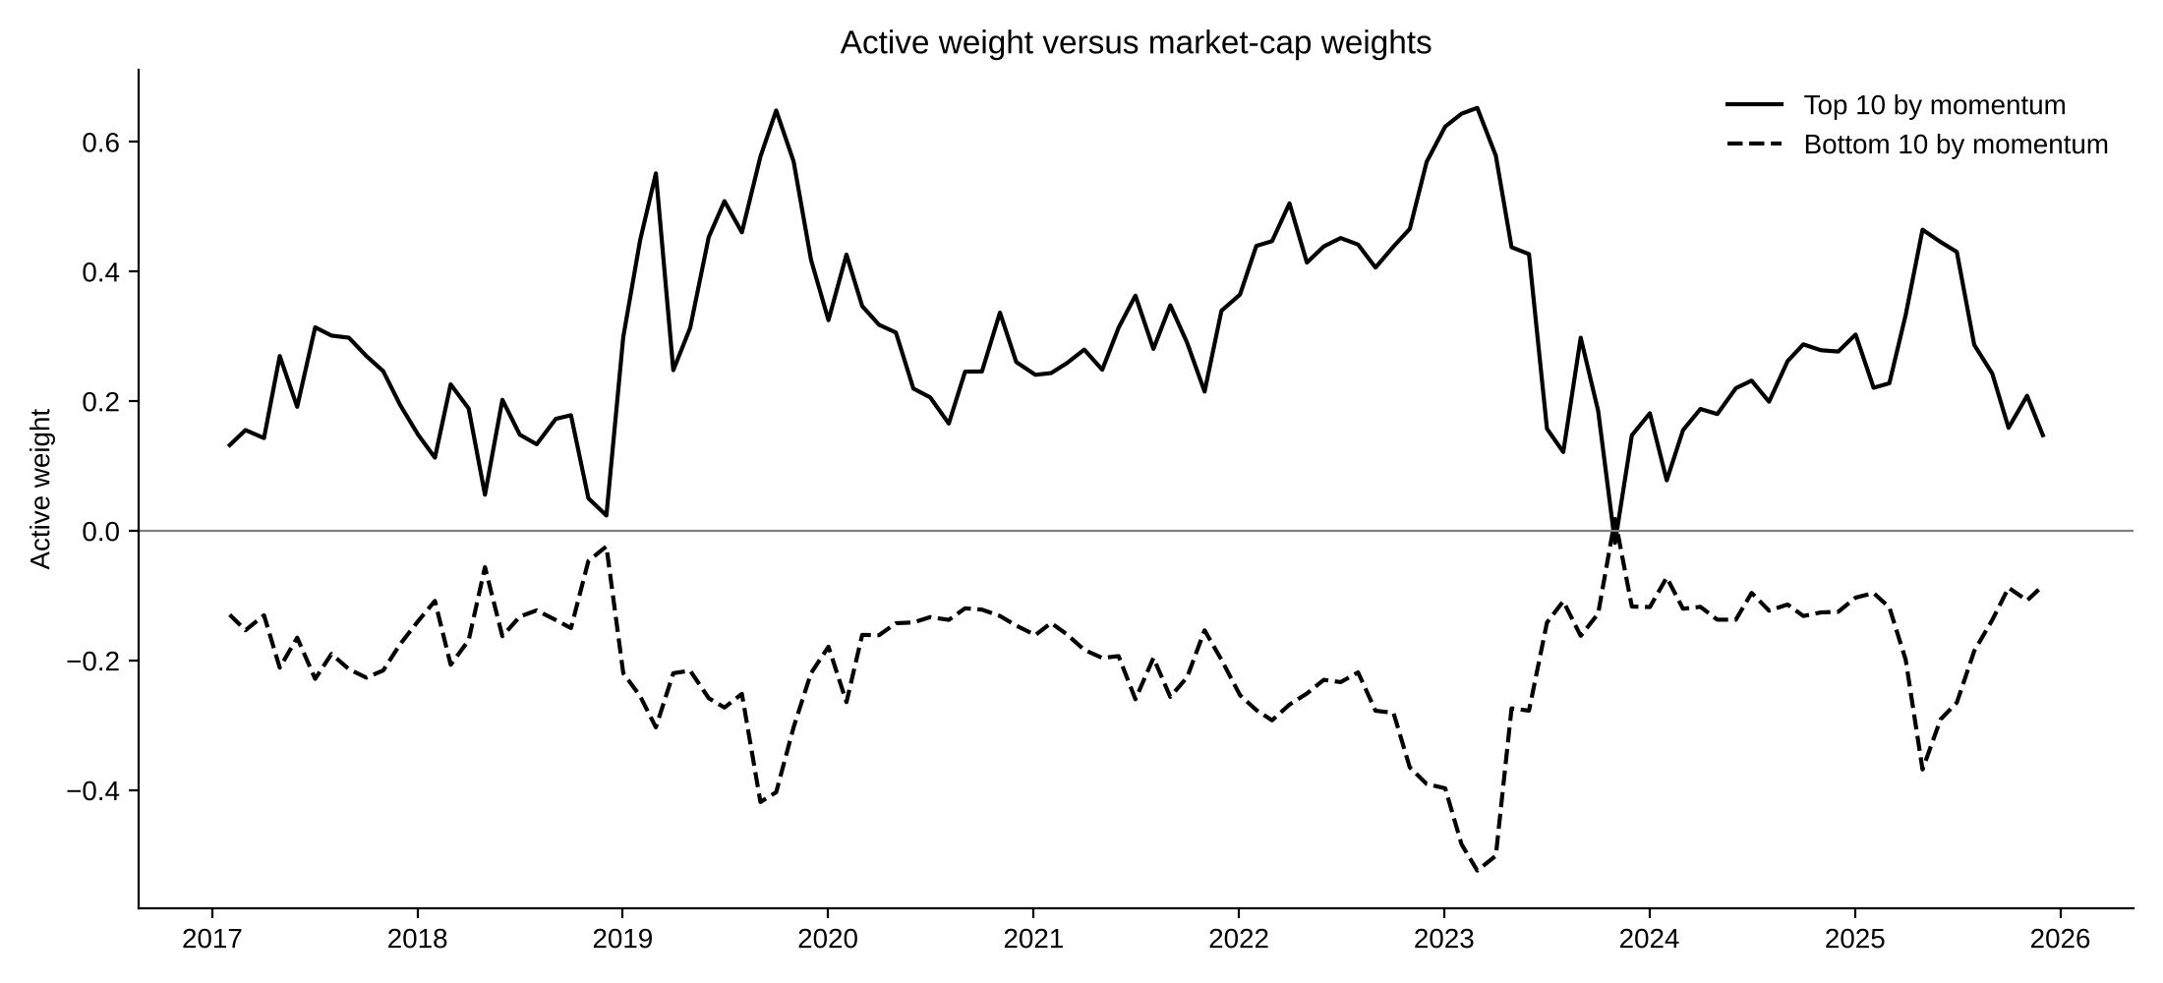
What Black-Litterman added: a controlled tilt
+30%
extra weight in the 10 best momentum stocks, on average
−29%
worst fall, about the same as the market (naive momentum: −60%)
More confidence in the view means a bigger tilt; here it lowered returns slightly (17.8% → 17.3% at 4× confidence)

Slide 9
Conclusions
1. The momentum effect was there: winners beat losers by about 9 points a year. But naive momentum kept only 2% a year, because 33% volatility and crashes ate the gains
2. Black-Litterman turned the same signal into a market-like portfolio: same risk, and a worst fall of −29% instead of −60%
3. We still trailed the market, mostly at turning points such as 2023, when last year’s losers came back
4. Black-Litterman decides how much to bet on a view; it cannot make the view better. A natural next step is to trust momentum less when it is volatile (volatility scaling, Lecture 5)

