Slide 1
Estimating Covariance Matrices with Factors
Project 3 · Quantitative Finance
30 stocks, daily returns, 2016–2025

Slide 2
Method: replace the sample matrix with a six-factor structure
Regress each stock's daily excess return on Mkt-RF, SMB, HML, RMW, CMA and Mom (Ken French Data Library)
Covariance matrix: Σ = B Ω B′ + D, with betas B, factor covariance Ω and diagonal residual variances D
Minimum-variance portfolio: w = Σ⁻¹1 / 1′Σ⁻¹1, short sales allowed
Concentration measured by the maximum weight and the effective number of positions 1 / Σ w²
465
free parameters in the sample matrix
231
in the factor model (betas, factor moments, residual variances)

Slide 3
Full sample: the factor MVP is not less concentrated
 | Sample | Factor
Annualized volatility | 13.1% | 14.8%
Annualized return | 12.2% | 8.6%
Maximum weight | 16.3% | 17.7%
Minimum weight | -7.6% | -8.7%
Effective number of positions | 5.87 | 5.55
Short positions | 14 | 10
Effective N is 5.6 for the factor MVP vs 5.9 for the sample MVP, and its largest position is bigger
The sample MVP has lower realized volatility, as it must: it is the exact minimizer of variance on this same data
The factor MVP has fewer short positions (10 vs 14)

Slide 4
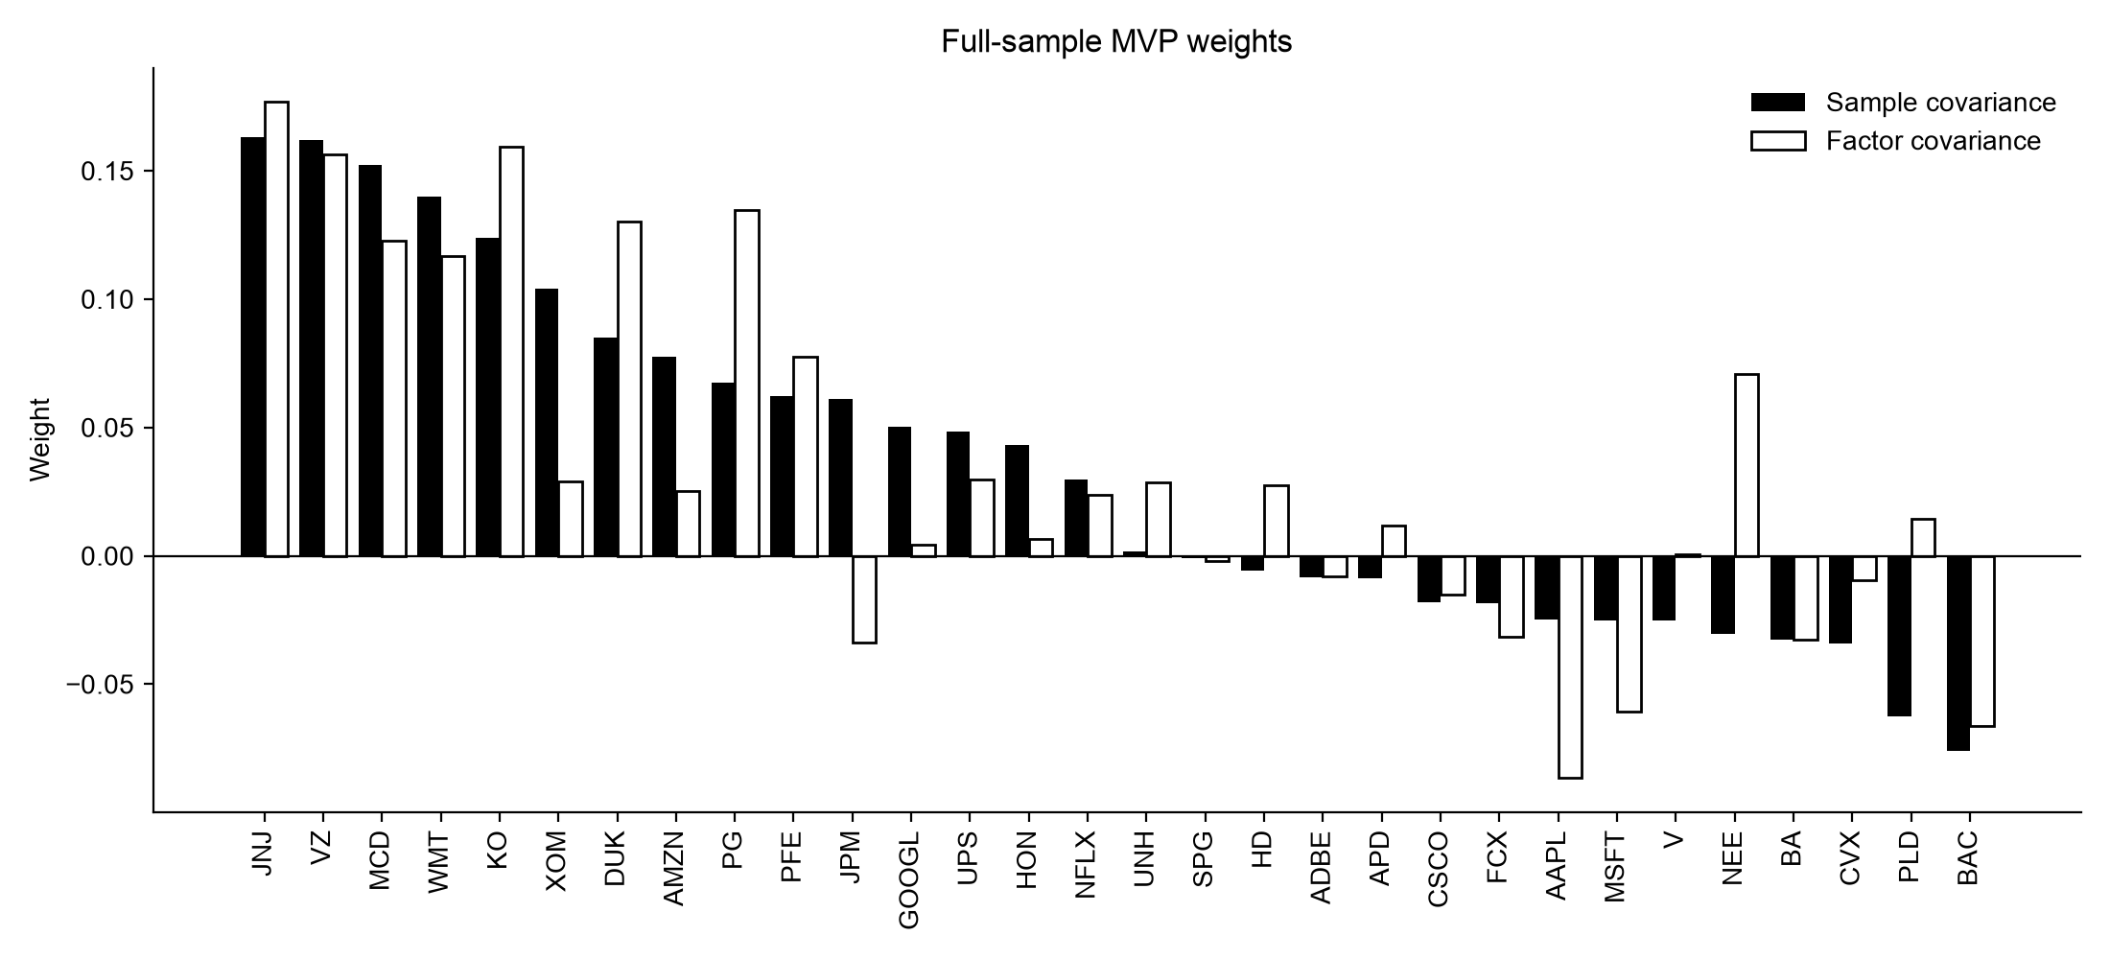
The factor MVP piles into staples and utilities
Factor MVP: KO 15.9%, PG 13.5%, DUK 13.0%, NEE 7.1% (sample MVP: 12.4%, 6.8%, 8.5%, −3.1%)

Slide 5
Why: six style factors miss industry co-movement
Pair | Residual correlation
XOM – CVX | 0.65
NEE – DUK | 0.63
JPM – BAC | 0.53
KO – DUK | 0.46
PG – KO | 0.44
PG – DUK | 0.40
JNJ – PFE | 0.37
The factors explain only 44% of daily stock variance on average (R² from 0.20 for VZ to 0.78 for BAC)
The model sets every residual correlation to zero, but same-industry pairs still move together
So it treats KO, PG, DUK and NEE as independent and overweights them together
Industry factors (the optional extension) target exactly this gap

Slide 6
Out of sample: the sample matrix still has lower volatility
Monthly rebalancing from Feb 2018; each month both matrices are estimated using only data before the rebalancing date
 | Sample expanding | Factor expanding | Sample 1-year | Factor 1-year | Equal weight
Annualized volatility | 15.5% | 16.6% | 15.3% | 15.4% | 18.4%
Annualized return | 8.8% | 6.3% | 7.9% | 4.9% | 15.2%
Sharpe ratio | 0.36 | 0.20 | 0.31 | 0.13 | 0.62
Average effective N | 5.3 | 5.4 | 4.4 | 6.0 | 30.0
Average max |weight| | 20.6% | 19.8% | 27.9% | 23.7% | 3.3%
Average monthly turnover | 7.4% | 6.0% | 30.3% | 17.3% | 2.3%

Slide 7
Estimation error shrinks the sample matrix's advantage
Volatility, Feb 2018 – Dec 2025 | Sample | Factor | Gap
Full-sample weights (look-ahead) | 14.1% | 15.8% | 1.8 pp
Out of sample, expanding window | 15.5% | 16.6% | 1.1 pp
Out of sample, 1-year window | 15.3% | 15.4% | 0.0 pp
Expected: in-sample volatility is optimistic, and more so for the 465-parameter matrix that fits noise
Found: out of sample, volatility rises 1.5 pp for the sample MVP and 0.8 pp for the factor MVP
With an expanding window there is enough data for the sample matrix (T/N from 17 to 84), so it still wins; with a 1-year window the gap disappears

Slide 8
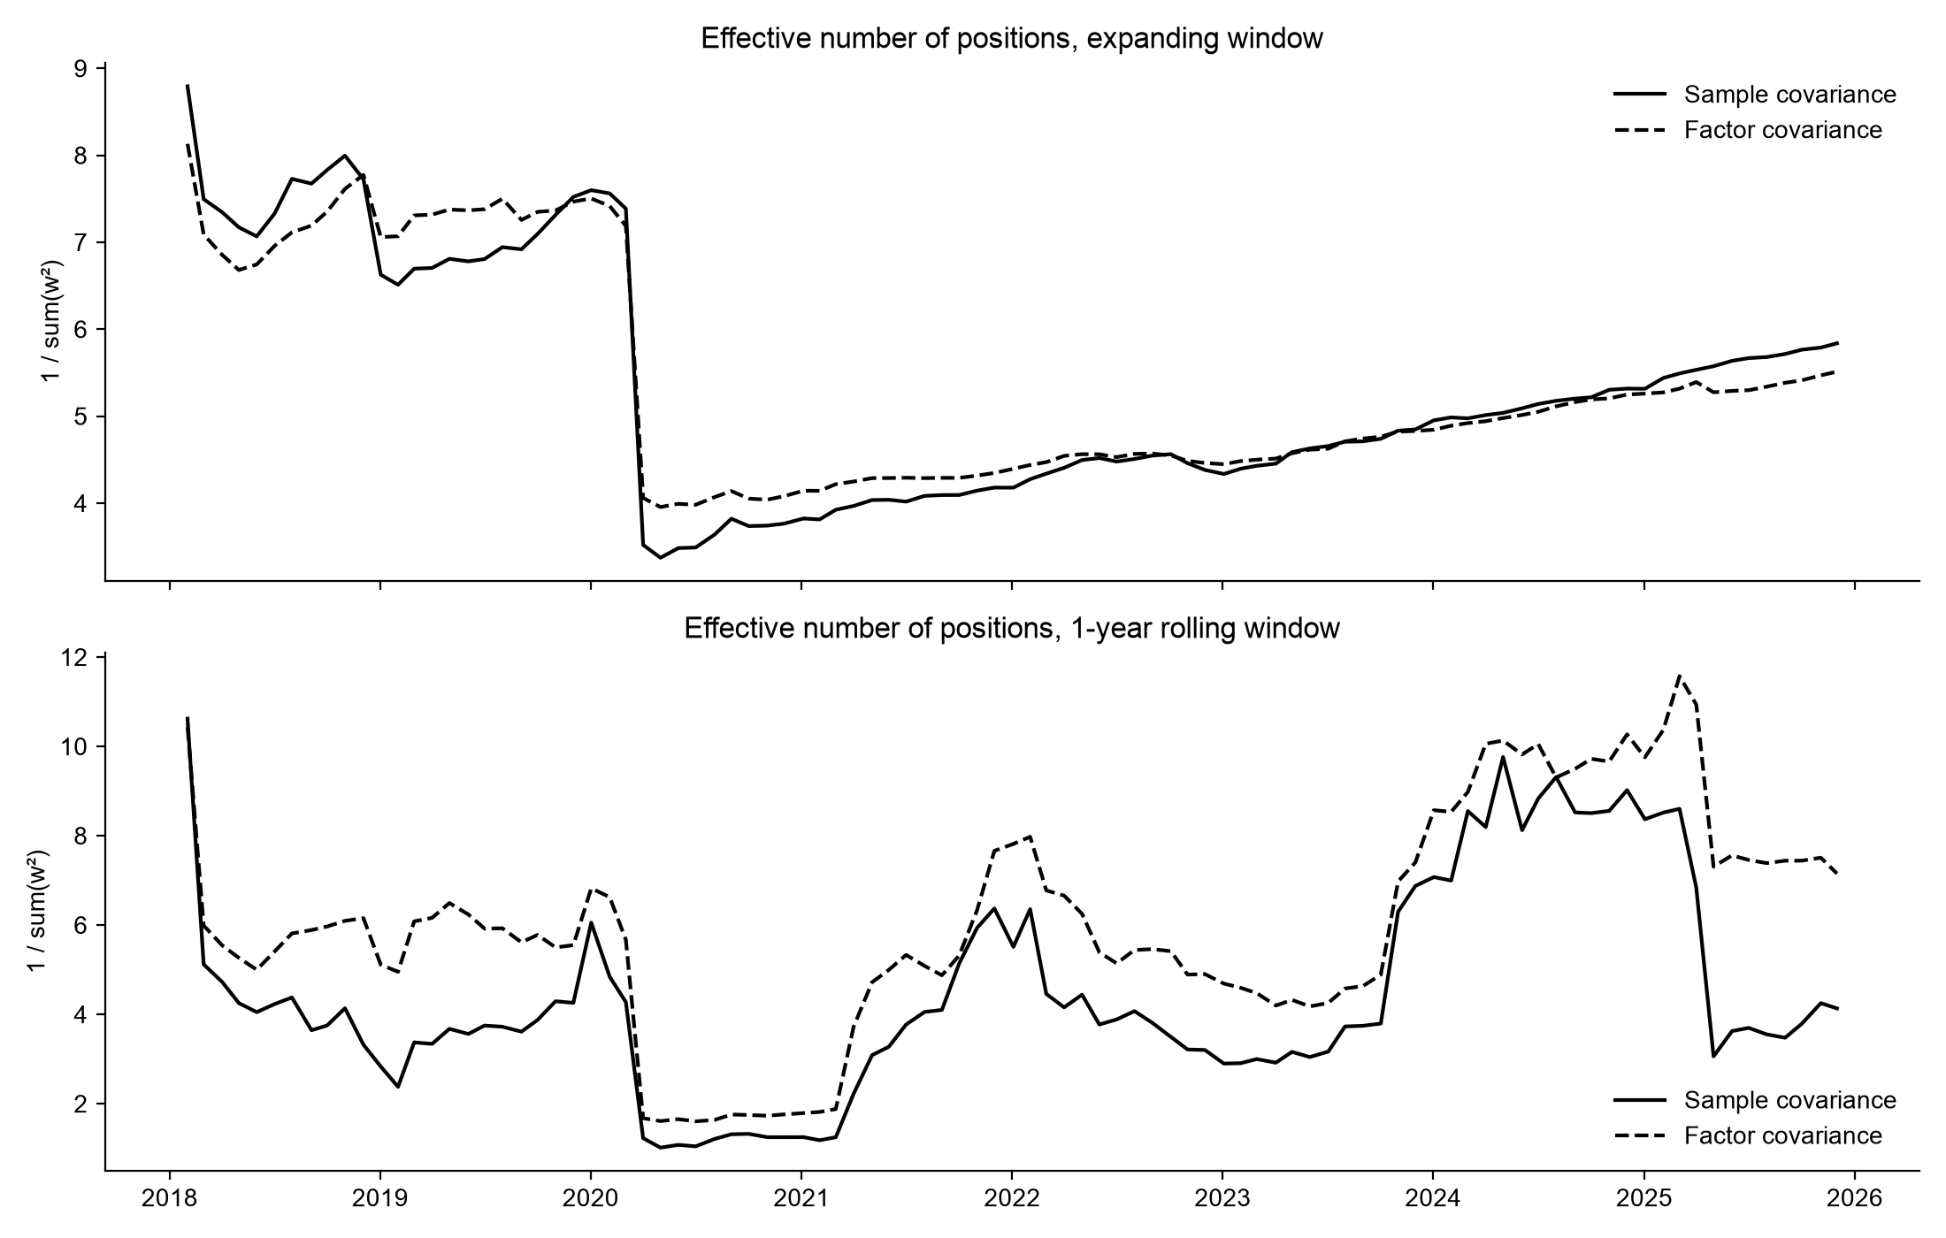
With a short window, factors keep weights diversified and stable
6.0 vs 4.4
average effective N, factor vs sample, 1-year window
17% vs 30%
average monthly turnover, factor vs sample, 1-year window

Slide 9
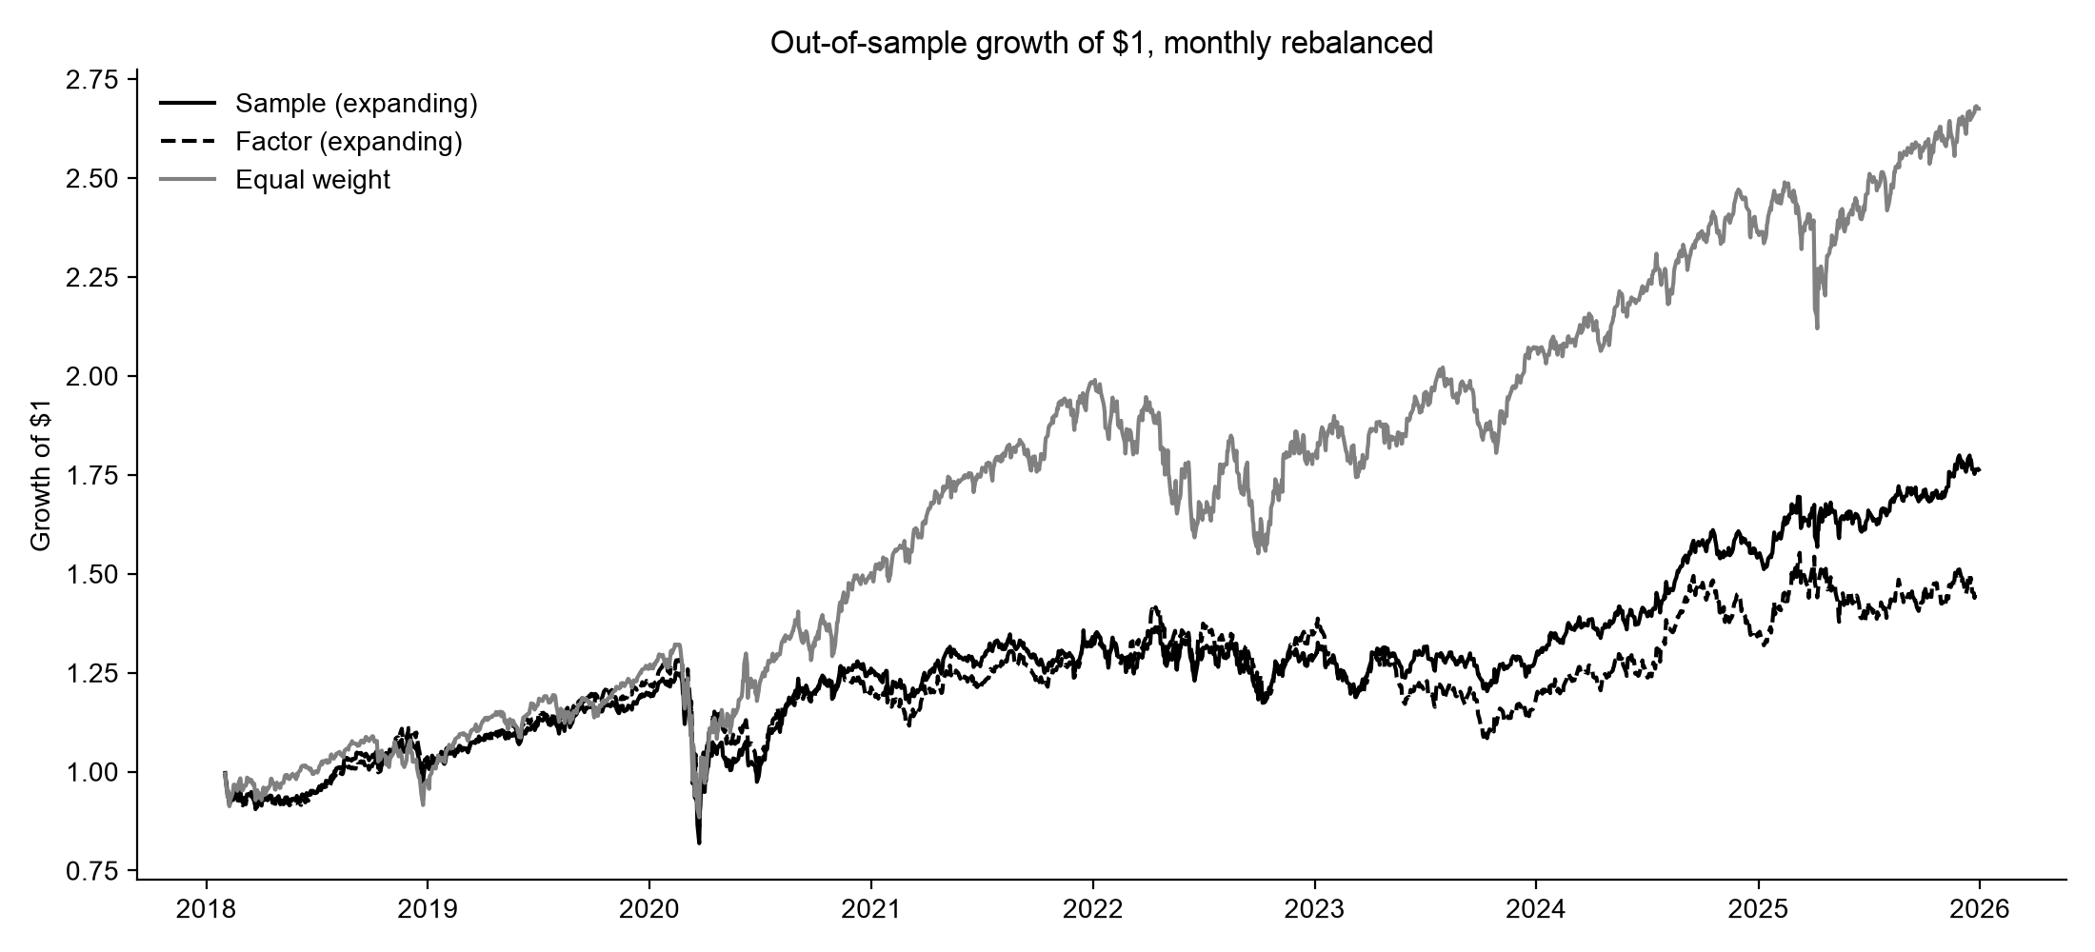
Both MVPs cut risk relative to equal weight, at a cost in return
15.5%
volatility, sample MVP (expanding) vs 18.4% for equal weight
8.8%
annual return, sample MVP vs 15.2% for equal weight

Slide 10
Conclusions
1. Full sample: the factor MVP is not less concentrated (effective N 5.6 vs 5.9), and its volatility is higher by construction
2. Six style factors leave industry co-movement in the residuals, which the model treats as diversifiable
3. Out of sample, the sample matrix's volatility advantage shrinks from 1.8 pp to 1.1 pp (expanding window) and to zero (1-year window)
4. When estimation error matters most, the factor matrix gives the same risk with more diversified, lower-turnover weights
5. Next step: add the 5 industry factors to capture the missing correlation

