Slide 1
Data Structure for efficient
indexing of files
Mateo Restrepo Sierra
Nicolas Restrepo López
Medellín, Date of the oral presentation

Slide 2
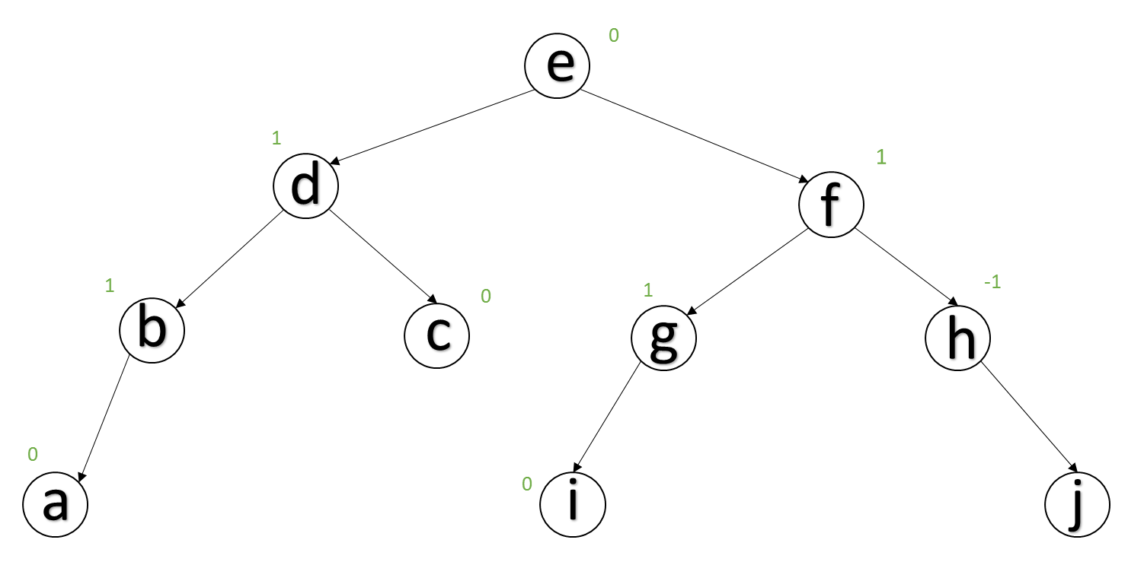
Data Structure design
Figure 1: this is a simple example of an AVL tree. the numbers above the tree are the balanced factor

Slide 3
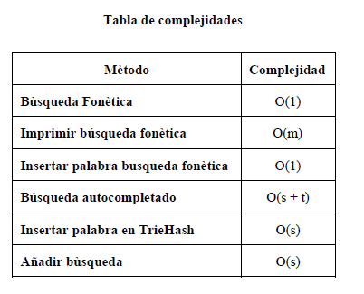
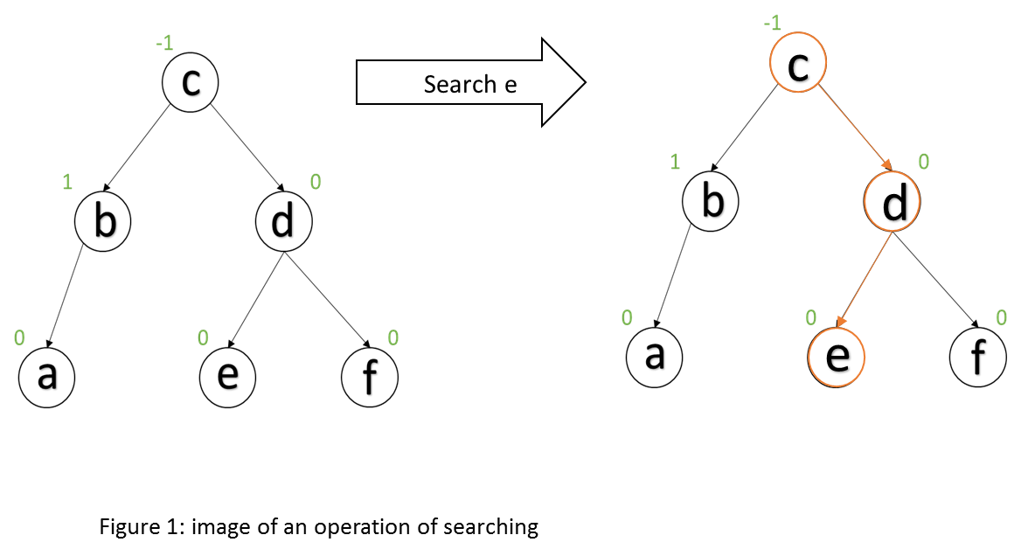
Data Structure Operations
Figure 2: image of an operation of searching
Tabla 1: Complejidad de las operaciones
de la estructura de datos

Slide 4
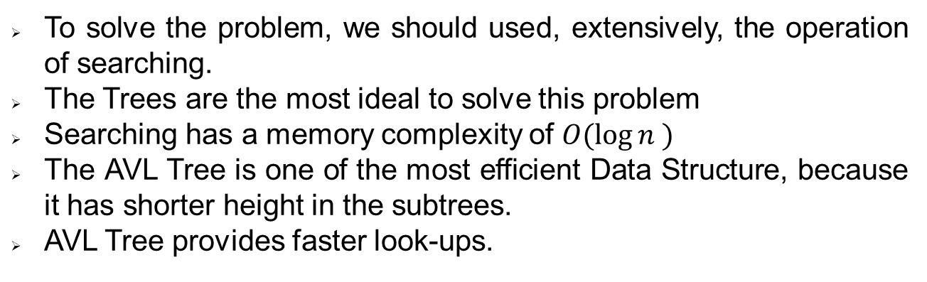
Design Criteria of the Data Structure
To solve the problem, we should used, extensively, the operation of searching.
The Trees are the most ideal to solve this problem
Searching has a memory complexity of $O(\log{n )}$
The AVL Tree is one of the most efficient Data Structure, because it has shorter height in the subtrees.
AVL Tree provides faster look-ups.

Slide 5
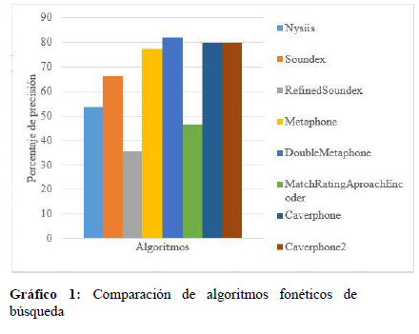
Time and Memory Consumption

Slide 6
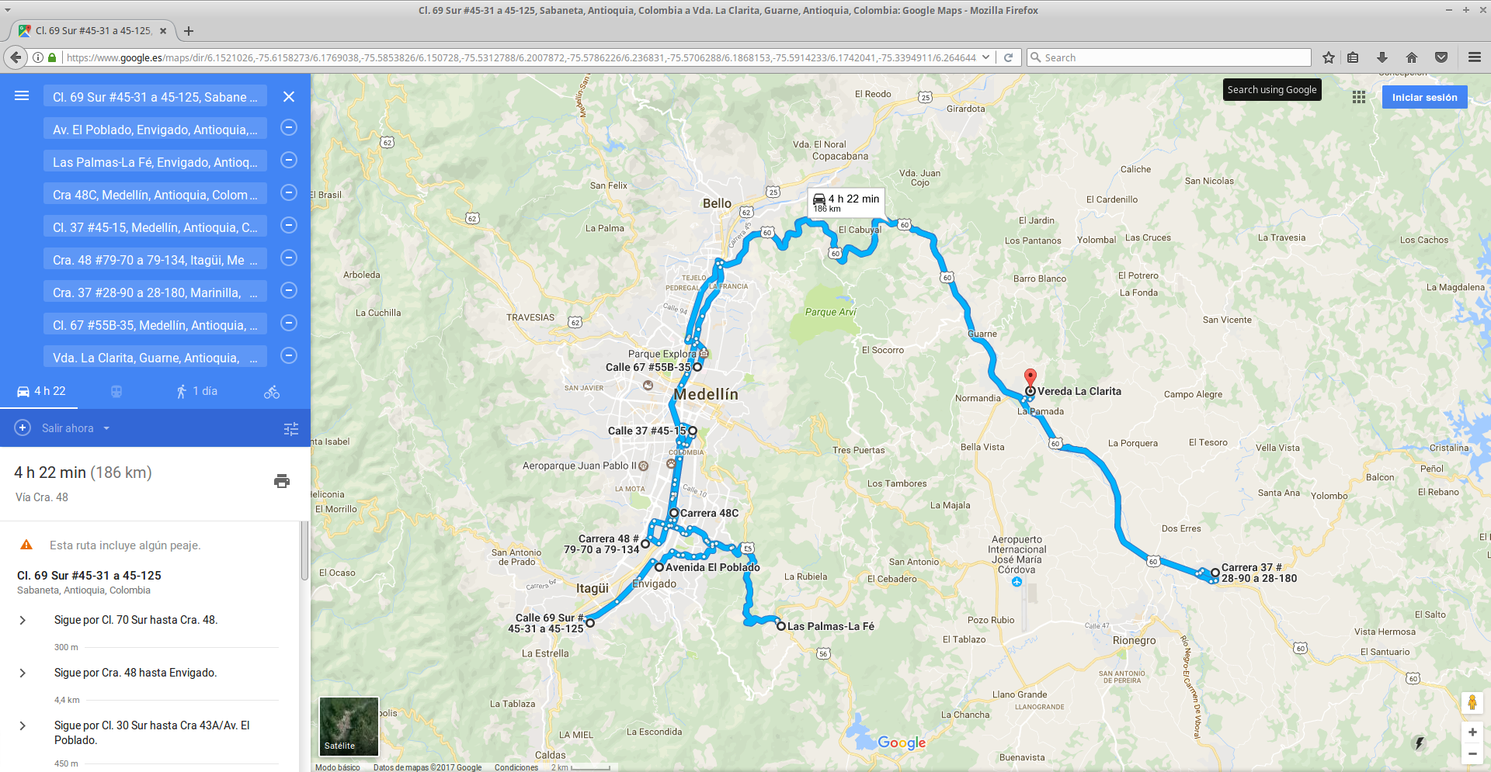
Implementation
Gráfico 4: Sistema de planificación óptima de domicilios

Slide 7
Report in arXiv
Keep this title
C. Patiño-Forero, M. Agudelo-Toro, and M. Toro. Planning system for deliveries in Medellín. ArXiv e-prints, Nov. 2016. Available at: https://arxiv.org/abs/1611.04156
Insert the URL and information of your report accepted in arXiv.

