Slide 1
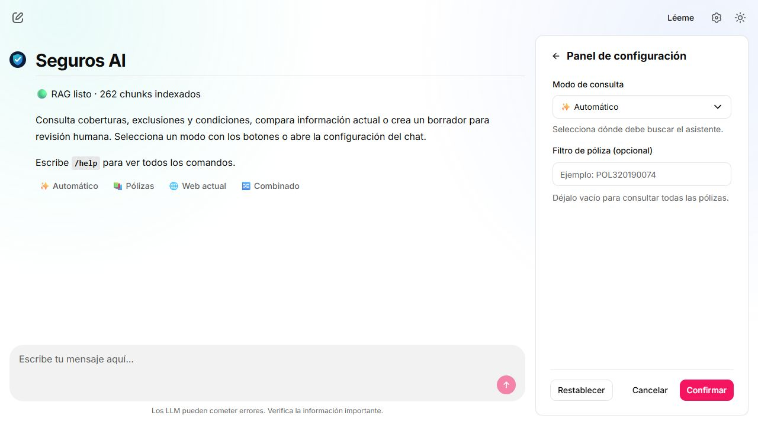
FINAL PROJECT · ANYONE AI
Insurance Policy
RAG Assistant
Grounded policy answers, current web context, and review-only policy drafts.
Mateo Salgado · Project Lead
Final demo · API 0.5.0
01
Notes:
Open with the user problem: insurance policies are long, regulated documents. The product retrieves evidence first, then generates a traceable answer instead of asking an LLM to rely on memory.
[Sources]
- README.md
- docs/qa/screenshots/11-frontend-home.png
[/Sources]

Slide 2
CORPUS AND INGESTION
A small, audited corpus became a reusable evidence layer
Offline processing extracts every page, profiles quality, creates deterministic chunks, embeds them once, and persists the index locally.
9
267
81,698
262
audited PDF policies
pages processed
words extracted
indexed chunks
0 extraction failures
The runtime reuses this snapshot—no repeated S3 download or re-indexing during the demo.
02
Notes:
Explain that S3 is only the source. The demo does not read PDFs on every question. It uses a deterministic Qdrant index built from nine audited PDFs, which makes responses faster and reproducible.
[Sources]
- README.md
- docs/architecture.md
- docs/eda-summary.md
[/Sources]

Slide 3
ARCHITECTURE · C4
C4 separates scope, deployment, and code
C1 · CONTEXT
Who uses the system and which external services matter
Insurance user
→
Policy RAG Assistant
→
Anyone AI S3
→
OpenAI API
C2 · CONTAINERS
What runs and stores data
Chainlit UI
→
FastAPI 0.5.0
→
Qdrant store
→
Evaluation scripts
C3 · COMPONENTS
How a query is routed and answered
Router
→
Policy RAG
→
Web search
→
Draft service
03
Notes:
Use the 90-second architecture explanation. Context: users depend on our assistant, S3, and OpenAI. Containers: Chainlit calls FastAPI; Qdrant persists policy vectors; Python scripts build and evaluate the index. Components: the router chooses policies, web, combined, or draft generation. This separation shows system boundaries without mixing deployment details with code internals.
[Sources]
- README.md#c4-model
- docs/architecture.md
- docs/demo.md
[/Sources]

Slide 4
RUNTIME QUERY FLOW
One stable API contract supports every route
1 · REQUEST
2 · EVIDENCE
3 · ANSWER
Chainlit sends question, mode and optional policy ID over POST or SSE.
FastAPI routes to Qdrant, web search, or both; drafts retrieve source policies.
OpenAI generates a cited response; metadata returns route, model, chunks and latency.
POLICIES
WEB
COMBINED
DRAFT
04
Notes:
Emphasize the stable API contract: answer, sources, and metadata. Policies is grounded in local PDFs; web uses current public information; combined runs both sources; draft creates a review-only document. SSE progressively streams progress and text to the UI.
[Sources]
- src/insurance_chatbot/api.py
- src/insurance_chatbot/service.py
- frontend/app.py
- README.md
[/Sources]

Slide 5
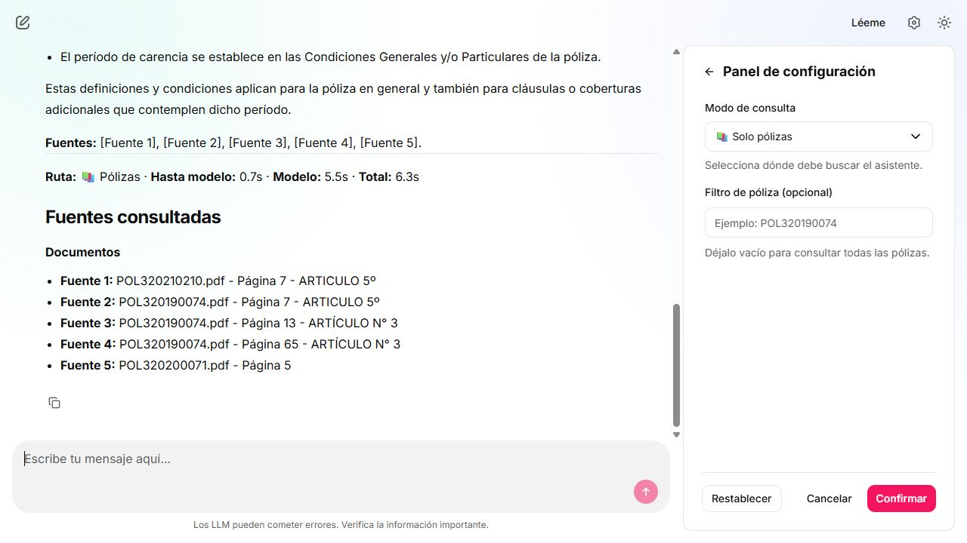
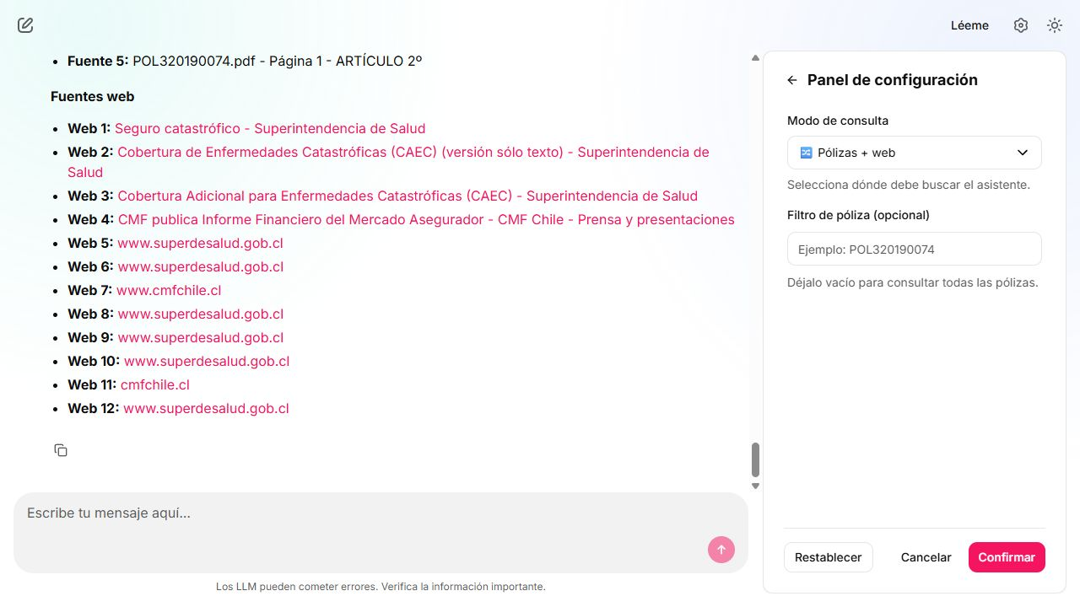
PRODUCT EVIDENCE
The UI exposes route, evidence, and timing
POLICIES · scoped evidence
COMBINED · policy + current web
05
Notes:
Show that the UI is designed for inspection. Users can choose a mode, scope to a policy, watch streaming progress, open PDF or web sources, and see timing labels. The combined route clearly separates policy evidence from current web information.
[Sources]
- docs/qa/screenshots/12-policies-final.png
- docs/qa/screenshots/14-combined-final.png
- docs/qa/integration_status.md
[/Sources]

Slide 6
EVALUATION
Three metric families answer three different quality questions
RETRIEVAL
RAGAS
LATENCY
Did we retrieve the right chunks?
Is the answer relevant and grounded?
Where does response time go?
Hit@5 1.0000
Answer 0.7053
To model 0.48 s
Recall@5 0.9341
Context 0.9792
Model 4.41 s
MRR 0.8078
Overall 0.8422
Total 4.89 s
52 curated cases · 43 labeled
12-case cost-controlled baseline
Means across 12 baseline queries
0.60 is our internal RAGAS health threshold—not a universal industry standard.
06
Notes:
Do not mix the metrics. Retrieval evaluates ranked chunks against manually assigned relevant chunk IDs. RAGAS judges semantic answer and context relevance. Latency decomposes preprocessing, model time, and total backend time. The 0.60 threshold is an internal operating rule, and 12 RAGAS questions are a baseline—not a definitive benchmark.
[Sources]
- docs/evaluation.md
- data/evaluation/retrieval_baseline.json
- data/evaluation/ragas_baseline.json
- data/evaluation/latency_baseline.json
[/Sources]

Slide 7
QA CERTIFICATION
The release candidate passed every technical gate
74
2 / 2
0
6
automated tests passed
containers healthy
error lines in final log scan
real flows captured
FLOW
EVIDENCE
OBSERVED TOTAL
Policies
5 PDF sources
10.82 s
Web (Chile)
12 web sources
12.77 s
Combined
17 total sources
15.89 s
Draft
6 source chunks
13.33 s
SSE
129 progress/token events
completed
07
Notes:
This is the technical sign-off. A clean Docker rebuild produced healthy API and frontend containers. The full test suite passed. Real policies, web, combined, auto, draft, and SSE flows were exercised. The observed timings are measurements, not an SLA.
[Sources]
- docs/qa/test_execution_log.md
- docs/qa/qa_checklist.md
- docs/qa/screenshots/
[/Sources]

Slide 8
RELEASE CANDIDATE
The MVP is ready for
a traceable live demo
Known limits
RAGAS uses a 12-case baseline
Web mode depends on Internet and OpenAI
Policy drafts require human/legal review
Observed latency is not a service-level guarantee
What is complete
• Local policy RAG with citations
• Web and combined routes
• SSE frontend and review-only drafts
• Repeatable retrieval, RAGAS and latency evaluation
Backup demo: policies mode with POL320190074
Next action: rehearse the ten-minute handoff and freeze the tagged build.
08
Notes:
Close by resolving the opening problem: the assistant now answers from evidence, shows its sources, and remains honest about limitations. The only remaining work is the human rehearsal. If Internet fails, demonstrate policies mode with POL320190074; the local Qdrant index remains available.
[Sources]
- docs/team-closeout.md
- docs/demo.md
- docs/qa/known_issues.md
[/Sources]

