Slide 1
Chapter 1 Binary Systems
Pooja Thakkar
Assistant Professor, CE/IT
U. V. Patel College of Engineering(UVPCE), Ganpat University

Slide 2
Outline of Chapter 1
Digital Computers and Digital Systems
Binary Numbers
Number-base Conversions
Octal and Hexadecimal Numbers
Complements
Signed Binary Numbers
Binary Codes
Binary Storage and Registers
Binary Logic

Slide 3
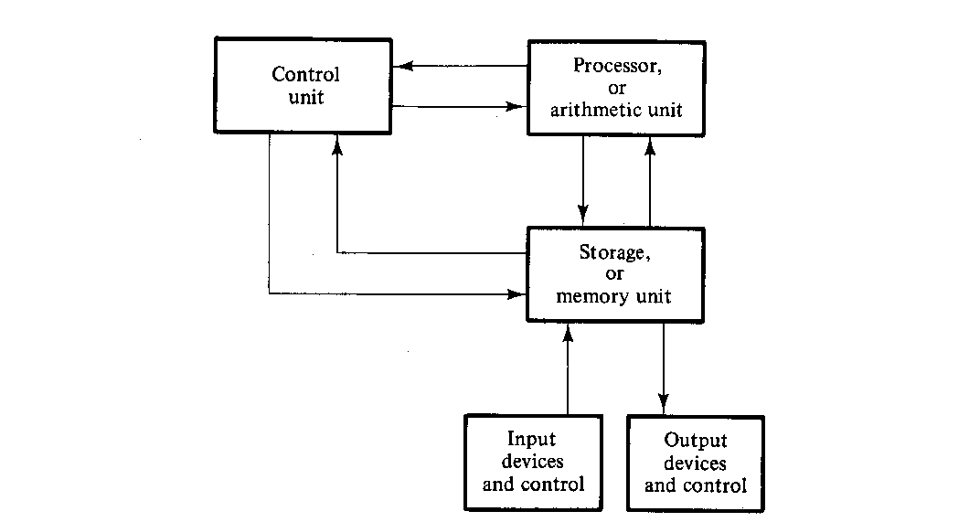
Block Diagram of Digital Computer

Slide 4
Binary Digital Signal
A digital signal is a signal that is being used to represent data as a sequence of discrete values
These values are binary values
Binary values are represented abstractly by:
0 and 1
False (F) and True (T)
Low (L) and High (H)
On and Off

Slide 5
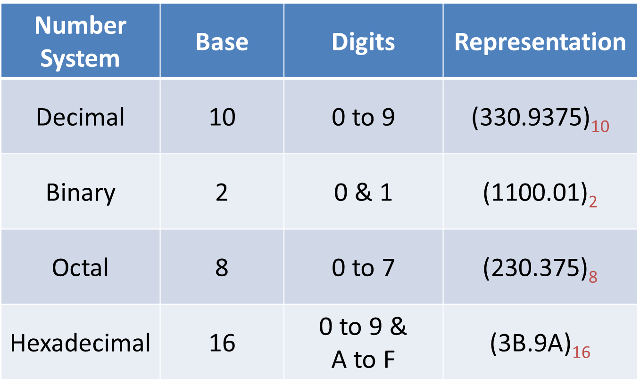
Number Systems

Slide 6
Number Base Conversions
Decimal to Binary
Decimal to Octal
Decimal to Hexadecimal
Binary to Decimal
Octal to Decimal
Hexadecimal to Decimal
Binary to Hexadecimal
Hexadecimal to Binary
Binary to Octal
Octal to Binary
Octal to Hexadecimal
Hexadecimal to Octal

Slide 7


Decimal to Binary
${(13)}_{10}$
$${=(1101)}_{2}$$
2
13
1
2
6
0
2
3
1
1

Slide 8




Decimal to Binary
$\text{(10}\text{.25}\text{)}\text{10}$
$${= (1010.01)}_{2}$$
2
0
 | 10
2
5
1
$${{(10)}_{10}= (1010)}_{2}$$
2
2
0
1
Fractional Part:
0.25 * 2 = 0.50
0.50 * 2 = 1.00
$$\text{(}\text{0}\text{.25}\text{)}\text{10}{= (0.01)}_{2}$$

Slide 9



Decimal to Binary
(32$\text{)}\text{10}$
(52.25$\text{)}\text{10}$
$${= (100000)}_{2}$$
$${= (110100.01)}_{2}$$

Slide 10
Decimal to Binary
2³
2²
2¹
2⁰
2³
2²
2¹
2⁰
0
1
2
3
4
5
6
7
8
9
10
11
12
13
14
15
0000
1000
0001
1001
0010
1010
0011
1011
0100
1100
0101
1101
0110
1110
0111
1111

Slide 11
Decimal to Octal
(105)₁₀
= (151)₈
8
1
 | 105
8
13
5
1

Slide 12

Decimal to Octal
(10.25)₁₀
= (12.2)₈
8
2
 | 10
1
(10)₁₀ = (12)₈
Fractional Part:
0.25*8 = 2.00
$$\text{(}\text{0.25}\text{)}\text{10}{= (0.2)}_{8}$$

Slide 13
Decimal to Octal
(37)₁₀
(255.5)₁₀
= (45)₈
= (377.4)₈

Slide 14
Decimal to Hexadecimal
(86)₁₀
= (56)₁₆
0 to 9 & A to F
16
6
 | 86
5

Slide 15
Decimal to Hexadecimal
(193)₁₀
= (C1)₁₆
10 | A
11 | B
12 | C
13 | D
14 | E
15 | F
16
1
 | 193
12

Slide 16
Decimal to Hexadecimal
= (4F7.5EB8..)₁₆
(1271.37)₁₀
Fractional Part:
0.37*16 = 5.92
0.92*16 = 14.72
0.72*16 = 11.52
0.52*16 = 8.32…
16
7
 | 1271
16
79
15
4
(1271)₁₀ = (4F7)₁₆
(0.37)₁₀ = (5EB8..)₁₆

Slide 17
Decimal to Hexadecimal
(37)₁₀
(255.5)₁₀
= (25)₁₆
= (FF.8)₁₆

Slide 18
Binary to Decimal
(1101)₂
= 1 x 2³ + 1 x 2² + 0 x 2¹ + 1 x 2⁰
= 8 + 4 + 0 + 1
= (13)₁₀
1
1
0
1
2³
2²
2¹
2⁰

Slide 19
Binary to Decimal
(1010.01)₂
= 1x2³ + 0x2² + 1x2¹ + 0x2⁰ + 0x2⁻¹ + 1x2⁻²
= 8 + 0 + 2 + 0 + 0 + 0.25
= (10.25)₁₀
1
0
1
0
0
1
2³
2²
2¹
2⁰
2⁻¹
2⁻²

Slide 20
Binary to Decimal
(10101)₂
(1111.11)₂
= (21)₁₀
= (15.75)₁₀

Slide 21
Octal to Decimal
(37)₈
= 3 x 8¹ + 7 x 8⁰
= 24 + 7
= (31)₁₀
3
7
8¹
8⁰

Slide 22
Octal to Decimal
(12.2)₈
= 1 x 8¹ + 2 x 8⁰ +2 x 8⁻¹
= 8 + 2 + 2(0.125)
= (10.25)₁₀
1
2
2
8¹
8⁰
8⁻¹

Slide 23
Octal to Decimal
(76)₈
(41.26)₈
= (62)₁₀
= (33.34375)₁₀

Slide 24
Hexadecimal to Decimal
(12A)₁₆
= 1 x 16² + 2 x 16¹ + 10 x 16⁰
= 256 + 32 + 10
= (298)₁₀
1
2
10
16²
16¹
16⁰

Slide 25
Hexadecimal to Decimal
(AD2.4)₁₆
= 10 x 16² + 13 x 16¹ + 2 x 16⁰ + 4 x 16⁻¹
= 2560 + 208 + 2 + 0.25
= (2770.25)₁₀
10
13
2
1
16²
16¹
16⁰
16⁻¹

Slide 26
Hexadecimal to Decimal
(76)₁₆
(4A.26)₁₆
= (118)₁₀
= (74.1484375)₁₀

Slide 27
Octal to Binary
(67)₈
(25)₈
(42.254)₈
= ( )₂
110
111
= ( )₂
= (10101)₂
010
101
010
101
100
= ( . )₂
100
010
= (100010.0101011)₂

Slide 28
Binary to Octal
= ( )₈
7
5
(111101)₂
(11101)₂
(1101101.11011)₂
= (011101)₂
= ( )₈
3
5
= (001101101.110110)₂
= (155.66)₈

Slide 29
Hexadecimal to Binary
1000
(F8)₁₆
(A21.A4)₁₆
(12.4)₁₆
= ( )₂
1111
0010
0001
= ( . )₂
1010
1010
0100
= (101000100001.101001)₂
0010
= ( . )₂
0001
0100
= (10010.01)₂

Slide 30
Binary to Hexadecimal
0011
0010
( )₂
1111
(1101101101111.01001011)₂
= (F32)₁₆
0001
0010
( . )₂
1001
1001
1100
= (912.9C)₁₆
= (0001101101101111.01001011)₂
= (1B6F.4B)₁₆

Slide 31
Hexadecimal to Octal
= (10100001)₂
Hexadecimal to Binary
(A1)₁₆
(F2.01)₁₆
= (010100001)₂
= (241)₈
Binary to Octal
= (11110010 . 00000001)₂
= (011110010 . 000000010)₂
= (362.002)₈

Slide 32
Octal to Hexadecimal
= (101111011)₂
Octal to Binary
(573)₈
(1.01)₈
= (000101111011)₂
= (17B)₁₆
Binary to Hexadecimal
= (001.000001)₂
= (0001.00000100)₂
= (1.04)₁₆

Slide 33
Number Base Conversions
Decimal to Binary
Decimal to Octal
Decimal to Hexadecimal
Binary to Decimal
Octal to Decimal
Hexadecimal to Decimal
Binary to Hexadecimal
Hexadecimal to Binary
Binary to Octal
Octal to Binary
Hexadecimal to Octal
Octal to Hexadecimal

Slide 34
Arithmetic Operations on Binary Numbers
Binary Addition
Binary Subtraction
Binary Multiplication
Binary Division

Slide 35
Binary Addition
1 1 0 1 1 1
+ 1 0 1 0 1 0
A | B | Carry | Sum
0 | 0 | 0 | 0
0 | 1 | 0 | 1
1 | 0 | 0 | 1
1 | 1 | 1 | 0

Slide 36
Binary Addition
1 1 1 1 0 1
+ 1 0 1 1 1
1 1 1 1 1 1
+ 1 1 1 0 1 1

Slide 37
Binary Addition
1 1 1 . 1 0 1
+ 1 1 0 . 1 1 1
1 0 1 1 0 1 . 1 0 1
+ 1 1 1 0 1 . 1 0 1

Slide 38
Binary Subtraction
1 1 0 0 1
- 1 0 1 0 1
A | B | Difference | Borrow
0 | 0 | 0 | 0
0 | 1 | 1 | 1
1 | 0 | 1 | 0
1 | 1 | 0 | 0

Slide 39
Binary Subtraction
1 0 0 1 1 0 1
- 1 0 1 1 1
1 0 0 1 0 1
- 1 1 0 1 0

Slide 40
Binary Subtraction
1 1 1 . 0 1
- 1 0 1 . 1 0
1 0 0 1 1 0 1 . 0 1 0
- 1 1 0 1 0 1 . 1 1 1

Slide 41
Binary Multiplication
1 0 1 1 1
* 1 0 1 0
1 0 1 1 1 0 0 0
0 0 0 0 0 0 0
1 0 1 1 1 0
0 0 0 0 0
A | B | Multiply
0 | 0 | 0
0 | 1 | 0
1 | 0 | 0
1 | 1 | 1
1
1
1
0
0
1
1
0

Slide 42
Binary Multiplication
1 1 0 1 1
* 1 0 1
1 0 1 1 0 1
* 1 1 0 1

Slide 43
Binary Division
1
1
1
1 0 0
1 1 1 1 1
1 0 1
1 0 0 1 0 1 1 1
1 0 0
0 1 1
1
1 0 0
0 1 1
1
1 0 0
0 1 1

Slide 44
Complements
There are two types of complements for each base-r system:
Diminished radix complement - (r-1)’s Complement
Radix complement - r’s Complement

Slide 45
1’s Complement
00100 →
10010111 →
100101.010 →

Slide 46
2’s Complement
1101101 →
10101 →
1001001.01 →
101.101 →

Slide 47
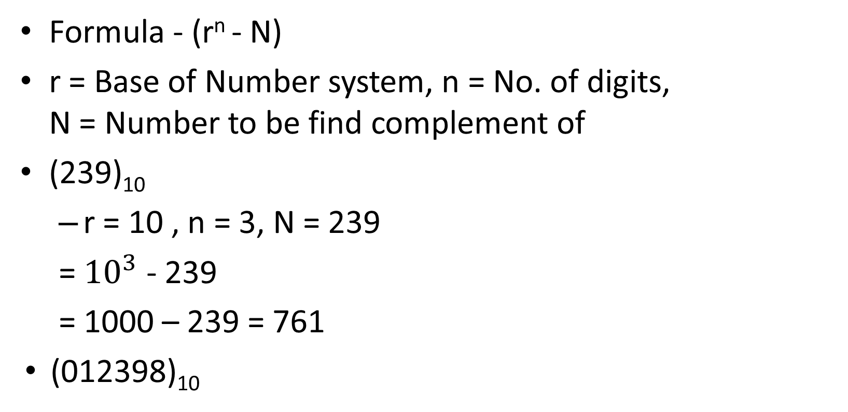
10’s Complement
Formula - (r^{n} - N)
r = Base of Number system, n = No. of digits, N = Number to be find complement of
(239)₁₀
r = 10 , n = 3, N = 239
= ${10}^{3}$ - 239
= 1000 – 239 = 761
(012398)₁₀

Slide 48
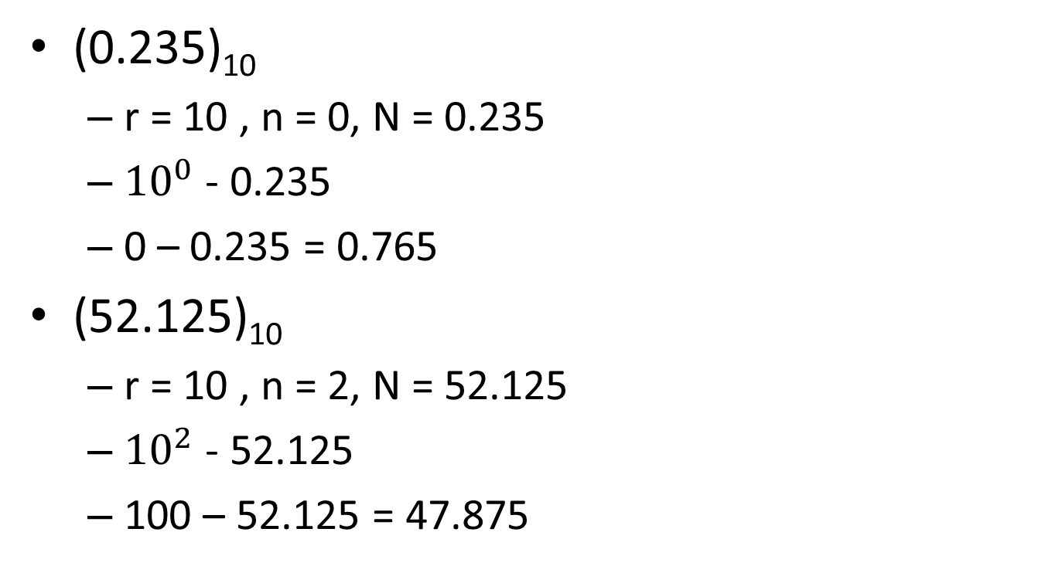
10’s Complement
(0.235)₁₀
r = 10 , n = 0, N = 0.235
${10}^{0}$ - 0.235
0 – 0.235 = 0.765
(52.125)₁₀
r = 10 , n = 2, N = 52.125
${10}^{2}$ - 52.125
100 – 52.125 = 47.875

Slide 49
9’s Complement
Formula - (r^{n} – r^{-m}) – N
r = Base, n = int no. of digits, m = float no. of digits, N = Number
(239)₁₀
r = 10, n = 3, m = 0, N = 239
(10³ – 10⁻⁰ – 239)
1000 – 1 – 239 = 760
(521)₁₀

Slide 50
9’s Complement
(37.135)₁₀
r = 10, n = 2, m = 3, N = 37.135
(10² - 10⁻³ - 37.135)
100 - 0.001 - 37.135 = 62.864
(0.375)₁₀

