Slide 1
Chapter 8 Registers & Counters

Slide 2
Binary Storage and Registers
A binary cell
Two stable state and is capable of storing one of the two states.
Store one bit of information
Examples: flip-flop circuits
A register
A group of binary cells
A n bit register has a group of n flip-flops and gates fro data processing
A register with n cells can store any discrete quantity of information that contains n bits.
Register Transfer
A transfer of the information stored in one register to another.
One of the major operations in digital system.
n cells
2^{n} possible states

Slide 3
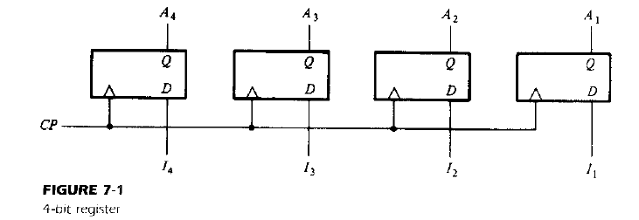
Registers

Slide 4
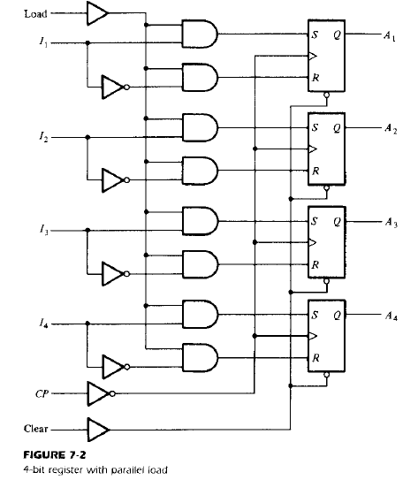
Register with Parallel Load
Transfer of new information into a register is called as ‘Loading’ the register.
If all bits are loaded simultaneously with single CP, its parallel Loading.
Load = 0,
S=0, R=0, No change
Load = 1,
Input I specify what is loaded In register
I = 1 then S=1, R=0
I = 0 then S=0, R=1
Clear = 1,
Flip flop is cleared

Slide 5
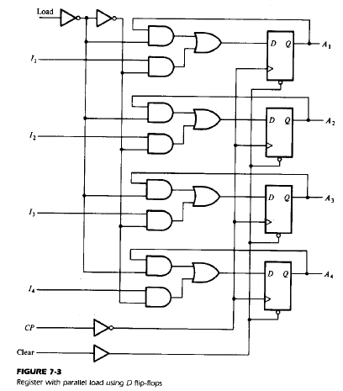
Register with Parallel Load
Load = 0,
Previous stage is loaded, Hence No change
Load = 1,
Input I is transferred to the register

Slide 6
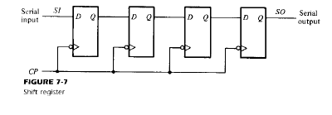
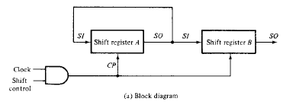
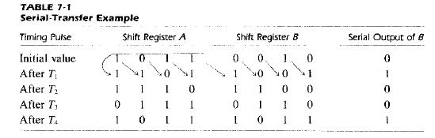
Shift Register

Slide 7
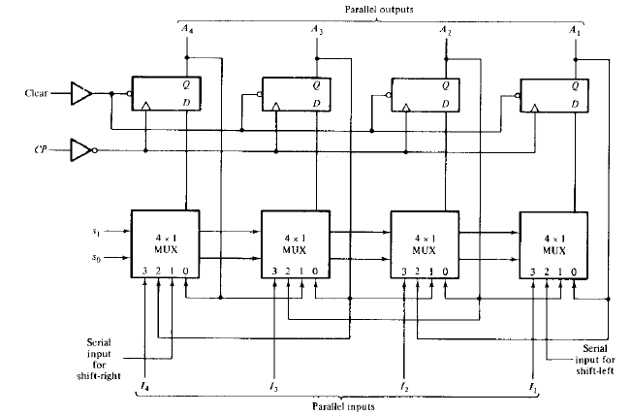
4-Bit Bidirectional Shift Register with Parallel Load

Slide 8
Counter
Sequential circuit that goes through a prescribed sequence of states upon the application of input pulse
Counter is the widest application of flip-flops.
It is a group of flip-flops with a clock signal applied.
Counters are of two types.
Asynchronous or ripple counters.
Synchronous counters.

Slide 9
Asynchronous/Ripple Counter
In asynchronous counter we don’t use universal clock, only first flip flop is driven by main clock and the clock input of rest of the following flip flop is driven by output of previous flip flops.

Slide 10
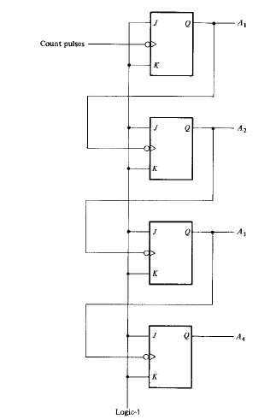
4-Bit Binary Ripple Counter

Slide 11
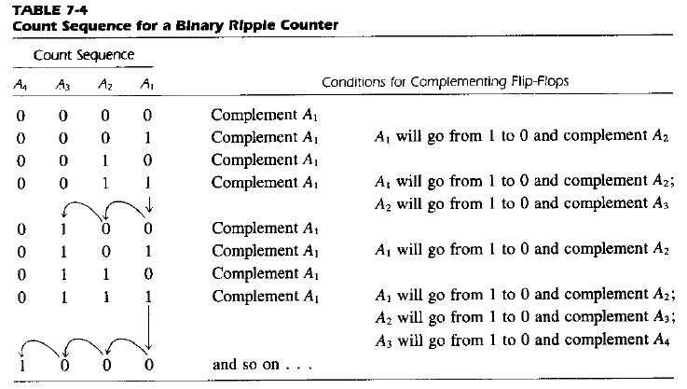
4-Bit Binary Ripple Counter

Slide 12
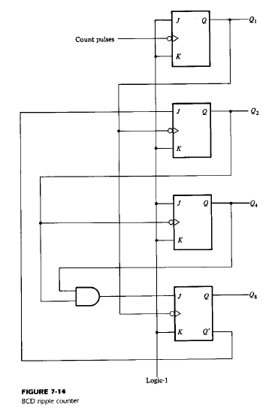
BCD Ripple Counter

Slide 13
Synchronous Counter
Unlike the asynchronous counter, synchronous counter has one global clock which drives each flip flop so output changes in parallel.

Slide 14
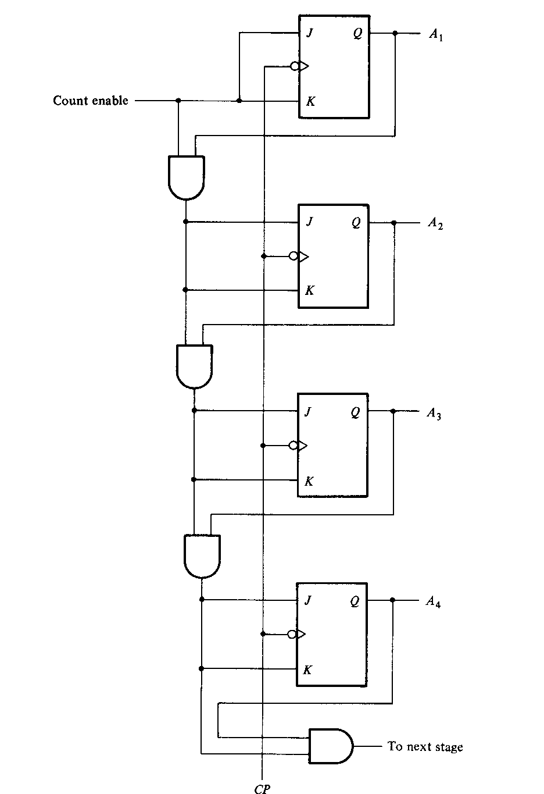
4 Bit Synchronous Binary Counter

Slide 15
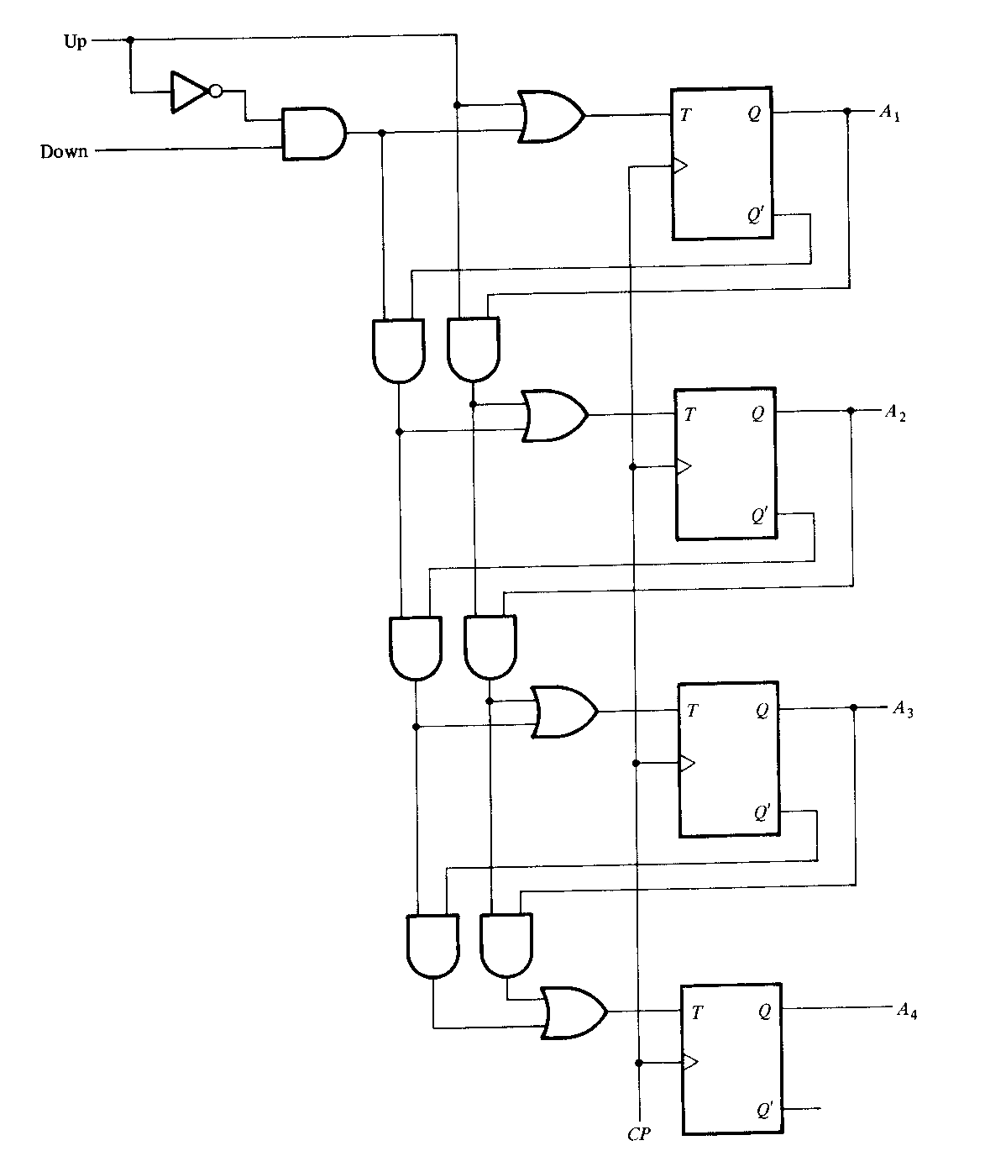
4 Bit Binary Up Down Counter

