Slide 1
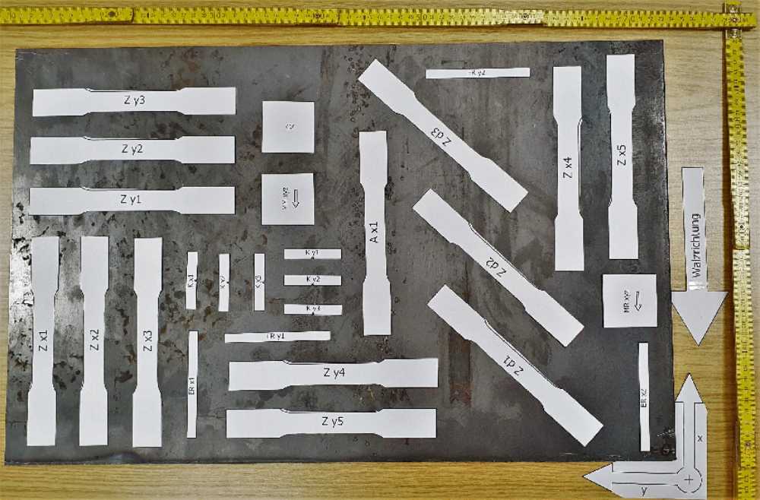

Slide 2
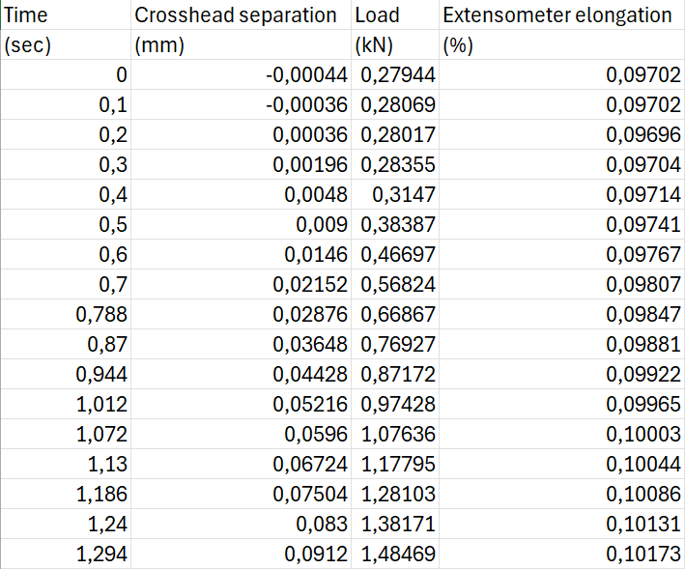
Tensile Test: Primary Data
Zd2.csv
…

Slide 3
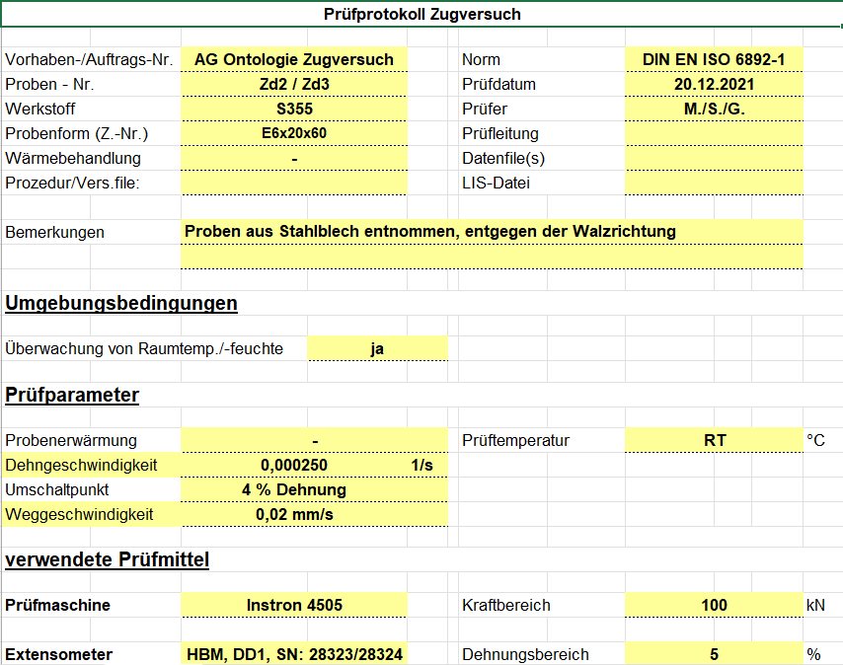
Tensile Test: Secondary Data
Versuchsprotokolle für
  RT Zx
  RT Zy
  RT Zd
  Pyxcel

Slide 4
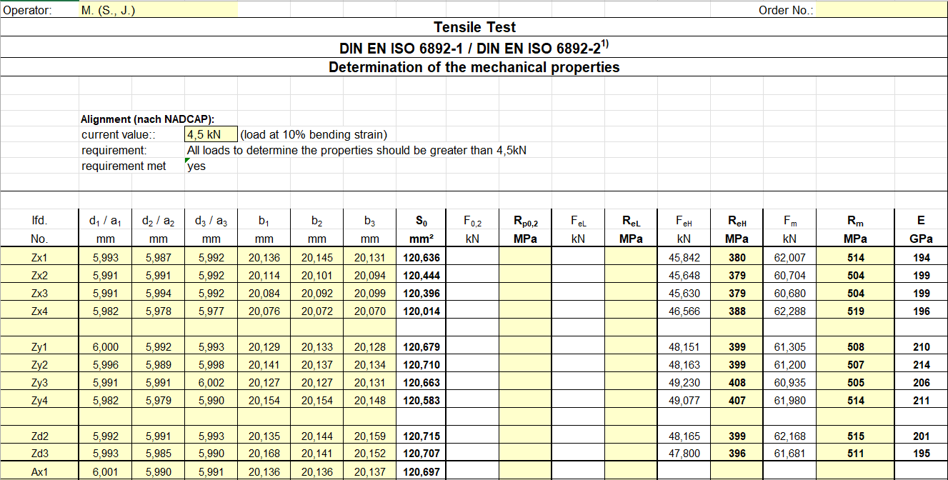
Tensile Test: Secondary Data
tensile_test_results.xslx

Slide 5
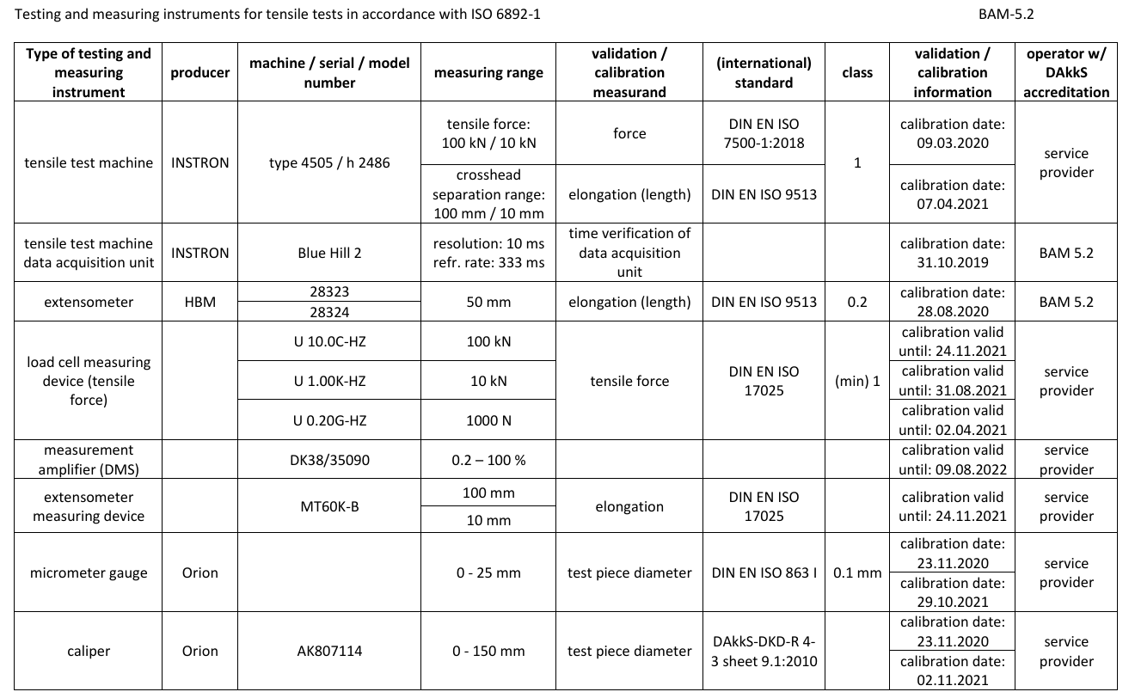
Tensile Test: Metadata

Slide 6
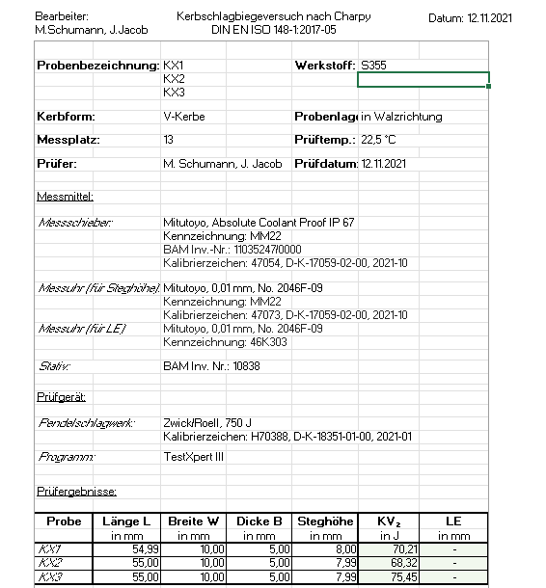
Charpy Test: Primary Data
KX, KY

Slide 7
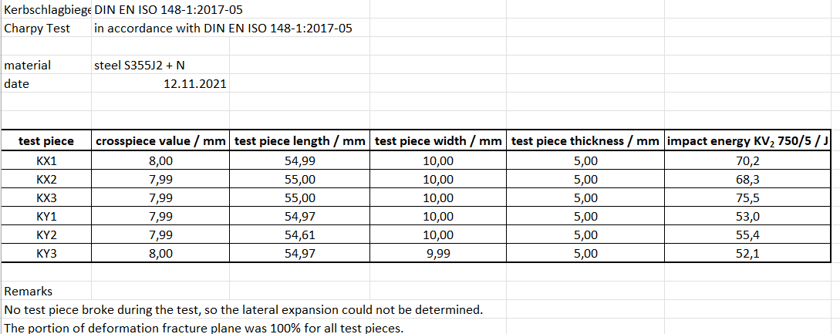
Charpy Test: Secondary Data
Charpy_test_results.xlsx

Slide 8
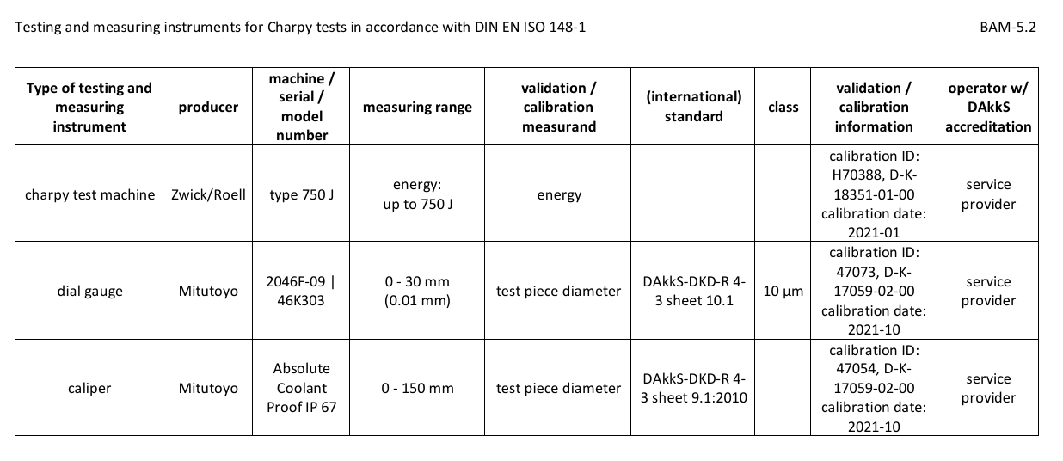
Charpy Test: Metadata

Slide 9
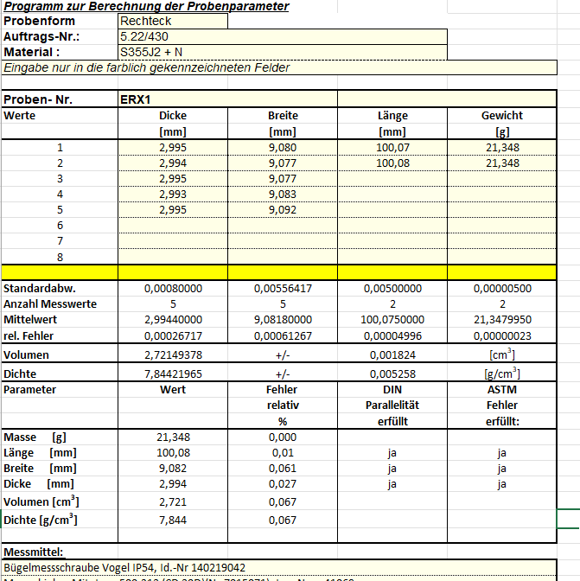
Sonic Resonance Test: Primary Data
ERX1, ERX2, ERY1, ERY2

Slide 10
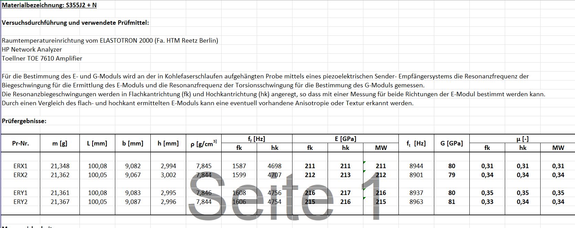
Sonic Resonance Test: Secondary Data
Results_sonic_resonance_test.xlsx

Slide 11
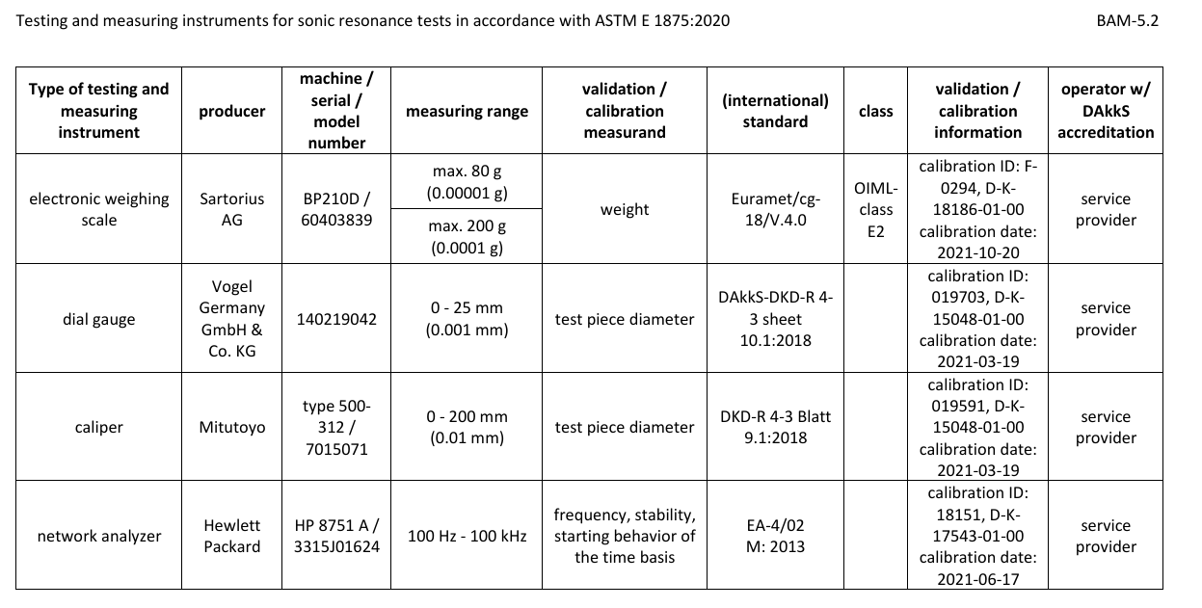
Sonic Resonance Test: Metadata

