Slide 1


PMD Ontology Hackathon
Hackathon 3
2025-10-13 to 2025-10-15
Bundesanstalt für Materialforschung und -prüfung (BAM), Unter den Eichen 87, 12205 Berlin

Slide 2

Agenda | Monday, October 13, 2025
12:00 PM | Registration and Get Together
1:00 PM | Welcoming / Motivation (BAM / HAP „Semantic Interoperability“ lead)
 | Introduction Round (all) Fixing the Agenda | Find Working Groups
2:00 PM | Coffee Break
2:15 PM | Introduction to PMDco (all) | Structure, Concepts, Releases
3:15 PM | Coffee Break
3:30 PM | Group Sessions
 | Topic 1: Modelling of Materials on different scales¹
 | Topic 2: Modelling of Processes²
 | Topic 3: MSE Glossary / Taxonomy³
 | Topic 4: Use Case⁴
 | Topic 5: Intro to Ontologies⁵
 | Topic 6: Improvement of Documentation
6:00 PM | Presentation of first results (all)
7:30 PM | End of the day
Hackathon 3
2

Slide 3
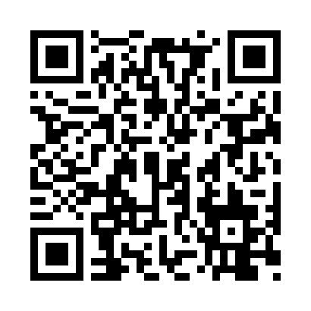
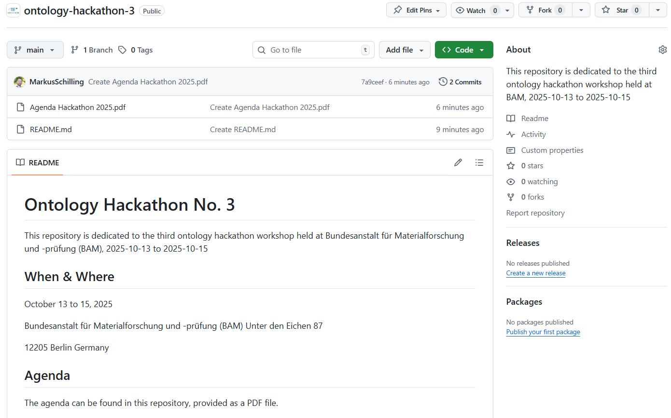
GitHub Repository
https://github.com/materialdigital/ontology-hackathon-3
Hackathon 3
3

Slide 4

Agenda | Tuesday, October 14, 2025
9:00 AM | Welcome
9:30 AM | Parallel Group Sessions
right corner → | Topic 1: Modelling of Materials on different scales
plenum · | Topic 2: Modelling of Processes
upstairs ↑ | Topic 3: MSE Glossary / Taxonomy + Use Case
left corner ← | Topic 4: Documentation
11:30 AM | Plenum: Show your pull requests
12:15 PM | Group Picture
12:30 PM | Lunch @ BAM Canteen
1:40 PM | Plenum: Show your pull requests
3:00 PM | Continued Sessions
 | Expert Round Discussion
3:30 PM | Coffee Break
4:00 PM | Continued Sessions
4:45 PM | Coffee Break
5:00 PM | Plenum: Presentation of results from Group Sessions
7:00 PM | Dinner @ Asami XI, Birkbuschstraße 11, 12167 Berlin
Hackathon 3
4

Slide 5
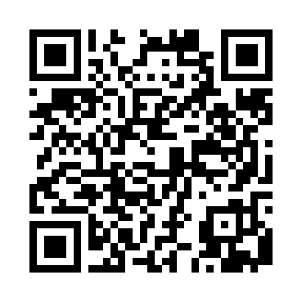

Agenda | Wednesday, October 15, 2025
9:00 AM | Teamwork
Plenum | Expert Round | Fixation of results | Deliverables
 | What’s Next? → Long-Term Strategy
 | Coffee Break
11:15 AM | Wrap up
12:30 PM | End of Hackathon
Material
Notes
HackMD
GitHub Repo
https://hackmd.io/@nd_ksvfTTISd9bwYNERWLw/BJFXq_5Tlx
https://github.com/materialdigital/ontology-hackathon-3
Hackathon 3
5

Slide 6

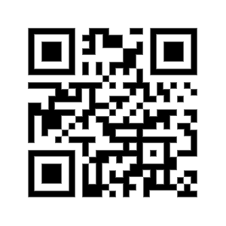


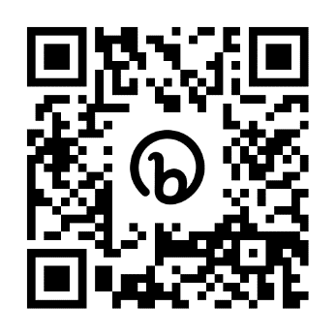








Contact
PMD Project Team
Contact and join us!
info@material-digital.de
PMD Core Ontology (PMDco)
Hackathon 3
6

