Slide 1


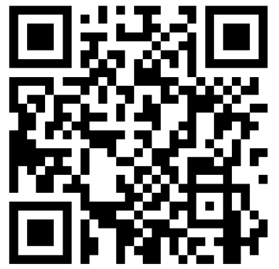
PMD Ontology Hackathon
Hackathon 3
2025-10-13 to 2025-10-15
Bundesanstalt für Materialforschung und -prüfung (BAM), Unter den Eichen 87, 12205 Berlin
BAM - Wifi

Slide 2

Agenda | Monday, October 13, 2025
12:00 PM | Registration and Get Together
1:00 PM | Welcoming / Motivation (BAM / HAP „Semantic Interoperability“ lead)
 | Introduction Round (all) Fixing the Agenda | Find Working Groups
2:00 PM | Coffee Break
2:15 PM | Introduction to PMDco (all) | Structure, Concepts, Releases
3:15 PM | Coffee Break
3:30 PM | Group Sessions
 | Topic 1: Modelling of Materials on different scales¹
 | Topic 2: Modelling of Processes²
 | Topic 3: MSE Glossary / Taxonomy³
 | Topic 4: Use Case⁴
 | Topic 5: Intro to Ontologies⁵
 | Topic 6: Improvement of Documentation
6:00 PM | Presentation of first results (all)
7:30 PM | End of the day
Hackathon 3
2

Slide 3
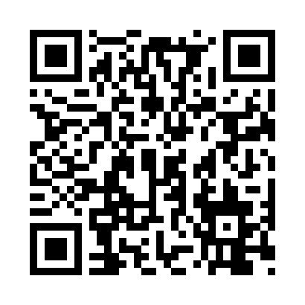
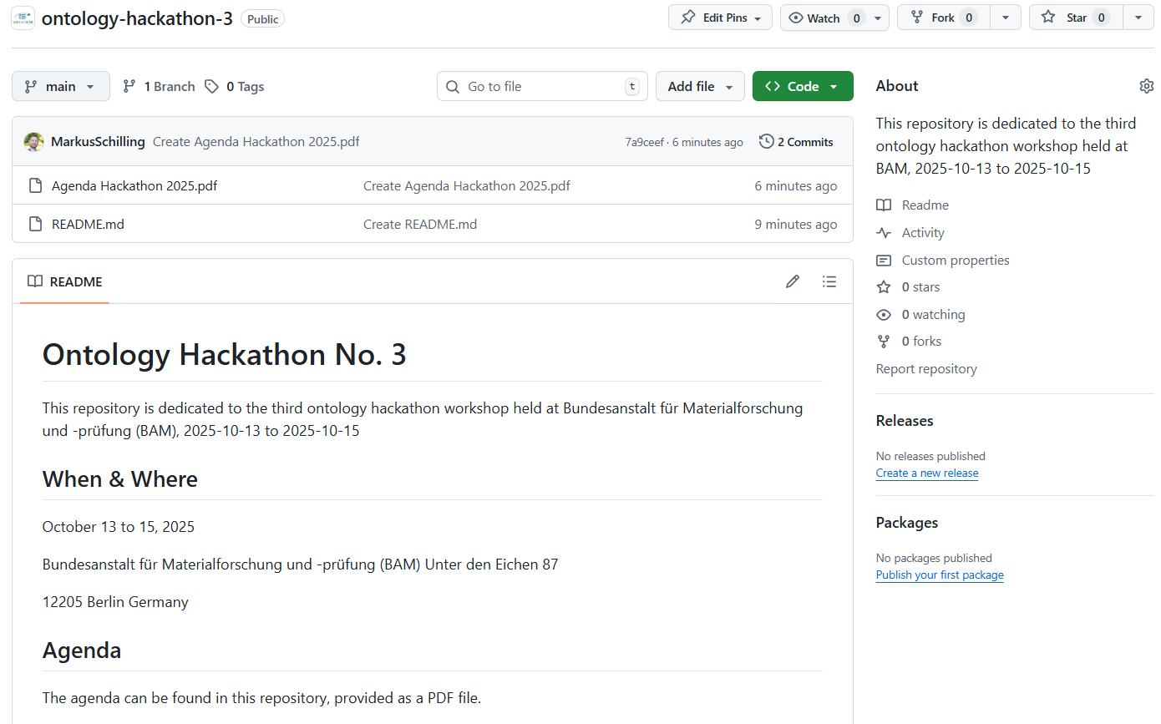

GitHub Repository
https://github.com/materialdigital/ontology-hackathon-3
Hackathon 3
3

Slide 4

Agenda | Tuesday, October 14, 2025
9:00 AM | Parallel Group Sessions
 | Topic 1: Modelling of Materials on different scales¹
 | Topic 2: Modelling of Processes²
 | Topic 3: MSE Glossary / Taxonomy³
 | Topic 4: Use Case⁴
11:45 AM | Group Picture
12:00 PM | Lunch @ BAM Canteen
1:00 PM | Continued Sessions
 | Expert Round Discussion
3:00 PM | Coffee Break
3:15 PM | Continued Sessions
4:45 PM | Coffee Break
5:00 PM | Plenum: Presentation of results from Group Sessions
7:00 PM | Dinner @ restaurant “Asami XI” † (at own cost)
† Asami XI, Birkbuschstraße 11, 12167 Berlin
Hackathon 3
4

Slide 5
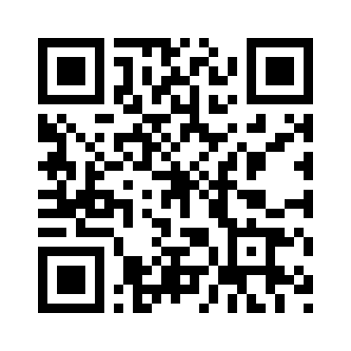

Agenda | Wednesday, October 15, 2025
9:00 AM | Teamwork
 | Paper Planning
 | What’s Next? → Long-Term Strategy → Set up future (online) meetings
11:00 AM | Coffee Break
11:15 AM | Wrap up
12:30 PM | End of Hackathon
Material
Notes
HackMD
GitHub Repo
Hackathon 3
5

Slide 6

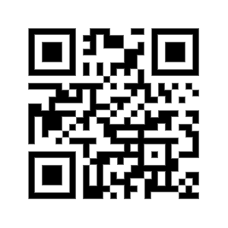


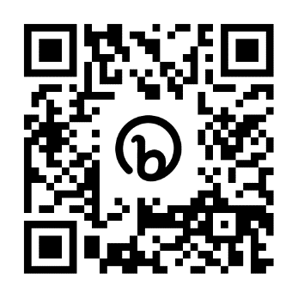







Contact
PMD Project Team
Contact and join us!
info@material-digital.de
PMD Core Ontology (PMDco)
Hackathon 3
6

