Slide 1
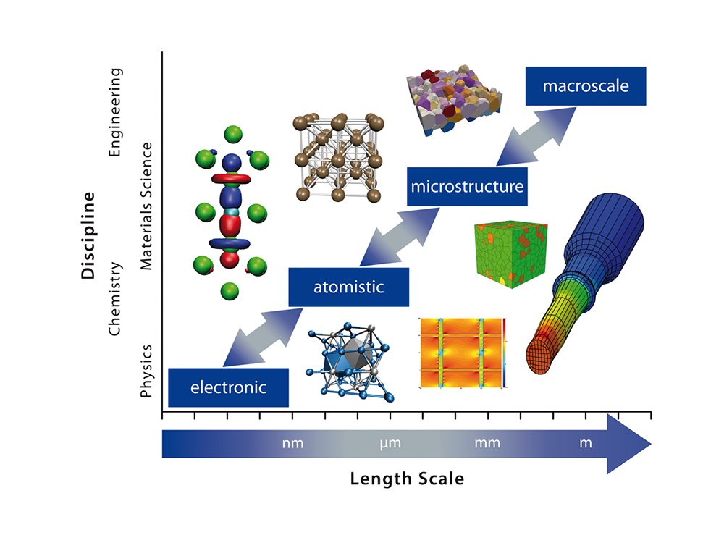
MLL213: Materials Modelling
Prof N S Harsha Gunda
Department of Materials Science and Engineering
IIT Delhi
Office: 306H, Academic Complex West
Email: gnsharsha@iitd.ac.in

Slide 2
Why should we care for materials modelling?
Reduction of experiments and material development timeframe
Theoretical models have often beat experiments in discovery.
It is the only way to understand basic fundamental physics.
Develop advanced models to accurately predict many material properties of interest
Its cool ☺

Slide 3
What will you get out of this course?
Introduction to various methods and techniques used to model material properties
Learn to do scientific computing using Python.
Use various proprietary software for simulating materials*
Have fun of course!!!
* As time permits

Slide 4
Topics Covered
Basics of Python Coding
Scientific computing using Python
Energy Minimization (Simulated Annealing)
Phase Diagram Construction
Finite Difference Modeling
AI/ML property prediction
Atomistic Calculations* (MD & DFT)
* As time permits

Slide 5
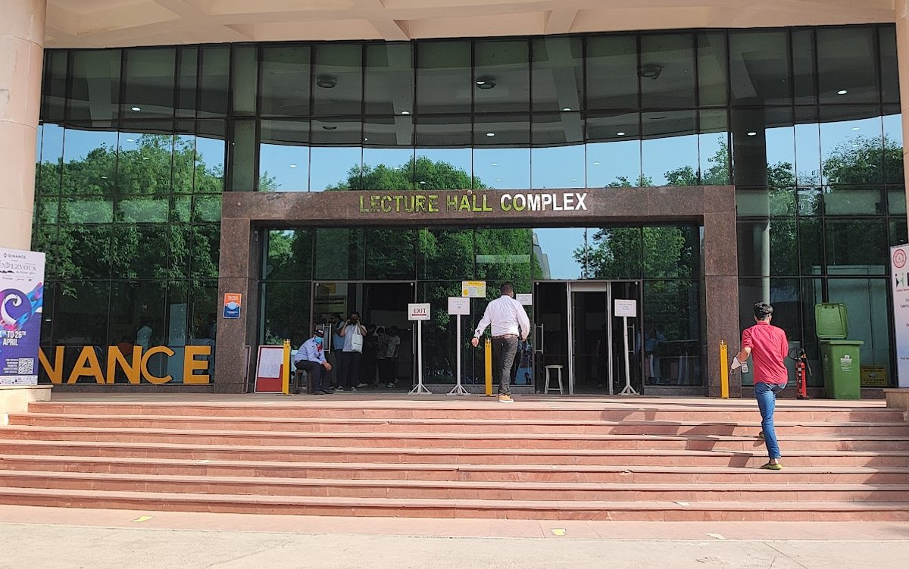
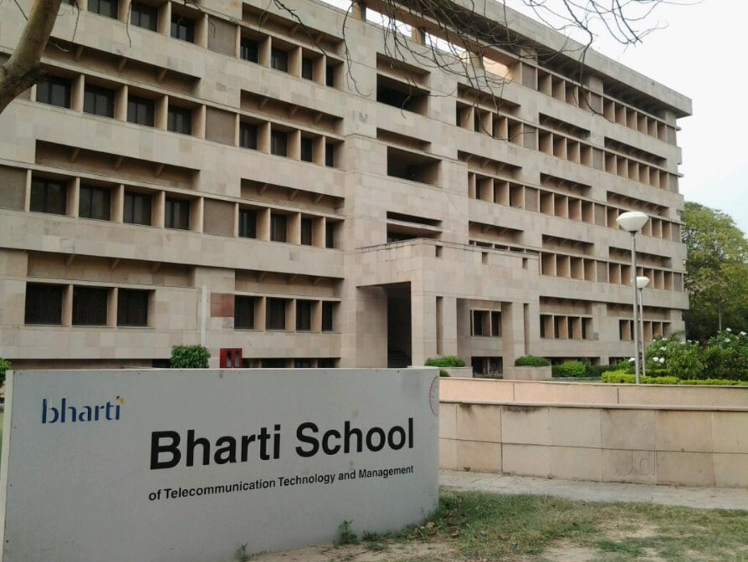
Class schedule
MLL213 has 1 – 0 – 4 type structure
1 hr of lectures and 4 hrs of interactive sessions per week.
Lecture:
F slot - Every Thursday at 11 AM
Covers the theory aspects of the modeling.
Lectures at LHC 604
Practical sessions:
Tuesday and Friday from 2 to 4 PM.
Hands-on session of coding
At Bharathi building room 305

Slide 6
Course Policy
Grading:
Term project 15 %
Labs & Assignments 20 %
Mid-term exam 30 %
Final Exam 35%
Attendance:
One grade down if attendance is less than 75 %
No Re-major if attendance is less than 50 %

Slide 7
Labs & Assignments: (20% of the total)
  Six lab assignments in total. Due at the end of the practical session.
  Three/Four assignments with one-week due dates (I will not give solutions)
  Need to submit codes that execute without errors.
  Very useful for exams
Exams: (30% + 35% for mid/end sem)
  Coding challenges inspired by interactive sessions
  Open book (even ChatGPT most probably)
  Access to assignments and internet for debugging

Slide 8
Term Project
Includes Literature review, Presentation & 2/3-page report.
Random distribution of class into groups of 4 (10 groups).
Grading (15 %)
  Presentation (5 %)
  Paper (5 %)
  Effort* (5 %)
Tentative Dates: I will provide details soon
Bonus points if you implement the whole/part of the work selected.
Penalty if you didn’t contribute equally to the project.

Slide 9
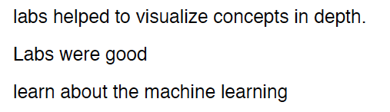
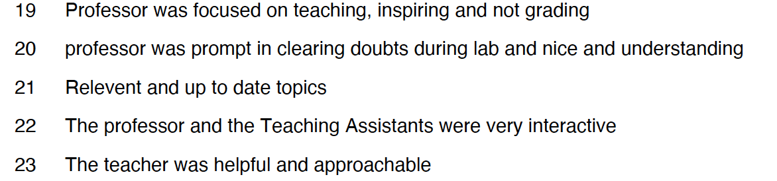
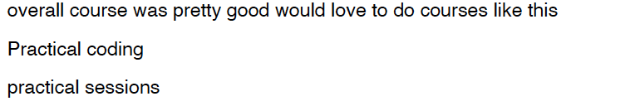
Previous Class Reviews!!!
The Good
The Bad

Slide 10

Previous Class Reviews!!!
The Ugly

Slide 11
Reference books and links
Introduction to Computational Materials Science by Richard Lesar, Cambridge University Press, 2013
Computational materials science: an introduction by June Gunn Lee, Second edition, Boca Raton: CRC Press, Taylor & Francis, 2017.
Computational materials engineering: an introduction to microstructure evolution by Koenraad G. F. Janssens et al., Elsevier Academic Press, Oxford, 2007
Modeling and simulation in Python by Jason M. Kinser, First edition, Boca Raton, FL, CRC Press, 2022.
Python Learning Resource: https://www.w3schools.com/python/default.asp
YouTube videos: https://youtu.be/7wnove7K-ZQ?si=fMOTc2L9LRMQ5n8G | Python in 100 days
https://stackoverflow.com/
https://openai.com/index/chatgpt/
All the content required for the course will be uploaded on Moodle

Slide 12
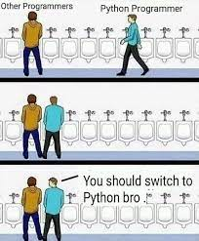
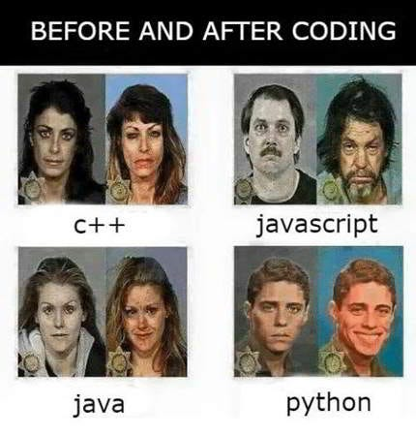

Slide 13
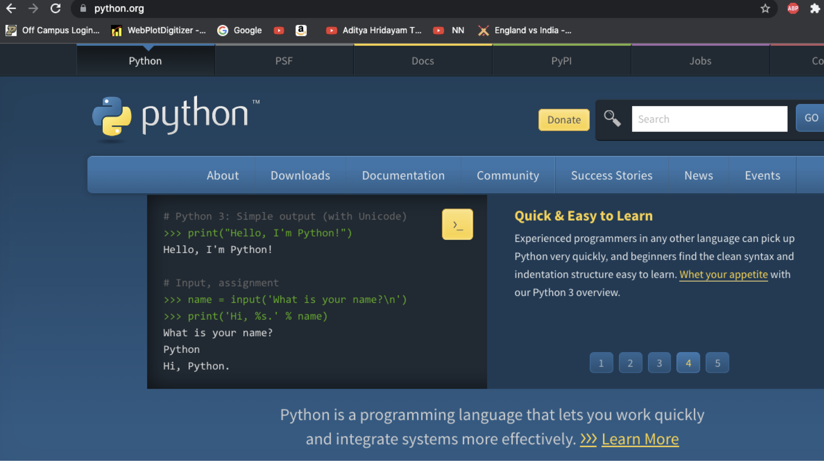
Python

Slide 14

Anaconda Installation

Slide 15
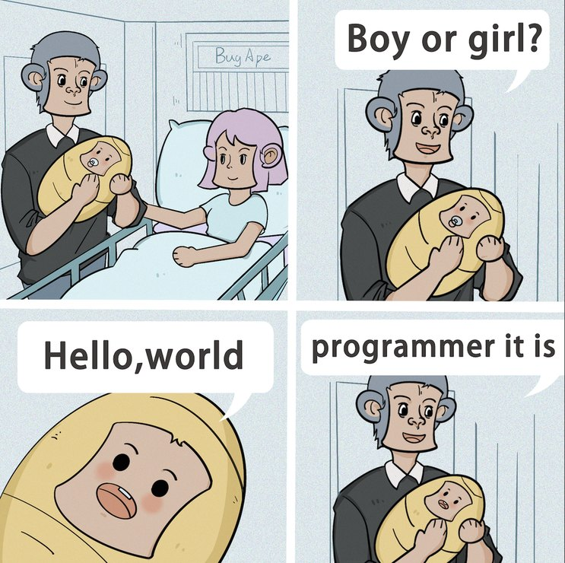
Let’s do some Coding

