Slide 1

DFT in practice: from simple to advanced functionals
Nicola Colonna¹ & Iurii Timrov²
¹Paul Scherrer Institute and NCCR-Marvel
²EPFL and NCCR-Marvel

Slide 2
Outline
Brief recap on KS-DFT. KS equations, common approximations to the xc energy functional, KS in practice
Exercise 0. Standard DFT: PBE band structure of FCC Silicon
Exercise 1-2. Hybrid DFT: electronic structure of FCC Silicon
Exercise 3-4. Meta-GGA: electronic structure of FCC Silicon and BCC Iron using SCAN

Slide 3


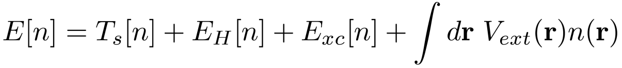
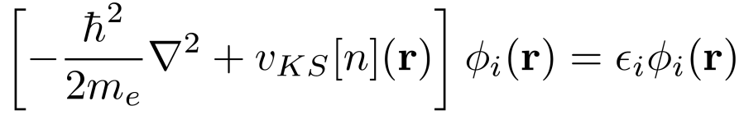
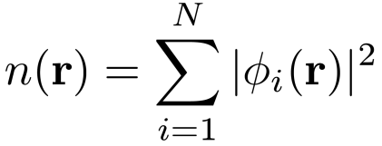
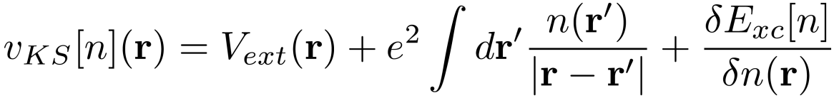
Kohn-Sham DFT
KS MAPPING
electrons
Kohn-Sham particles
interaction
(non-interacting)
external potential
effective potential

Slide 4
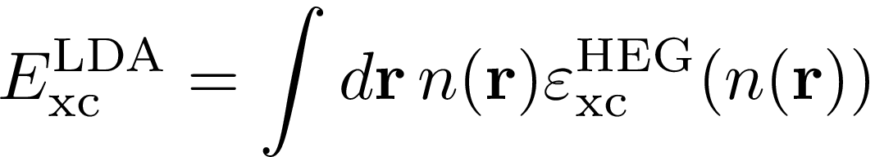
The exchange and correlation energy functional
LDA: The xc energy density of the inhomogeneous system in r is locally approximated with that of a homogeneous electron gas with density n(r)

Slide 5
The exchange and correlation energy functional
LDA: The xc energy density of the inhomogeneous system in r is locally approximated with that of a homogeneous electron gas with density n(r)
GGA: include the dependence on the gradient of the density

Slide 6
The exchange and correlation energy functional
LDA: The xc energy density of the inhomogeneous system in r is locally approximated with that of a homogeneous electron gas with density n(r)
GGA: include the dependence on the gradient of the density
Meta-GGA: include the dependency on the laplacian of the density and kinetic energy density

Slide 7
The exchange and correlation energy functional
LDA: The xc energy density of the inhomogeneous system in r is locally approximated with that of a homogeneous electron gas with density n(r)
GGA: include the dependence on the gradient of the density
Meta-GGA: include the dependency on the laplacian of the density and kinetic energy density
Hybrid functionals: include a fraction of Fock exchange

Slide 8
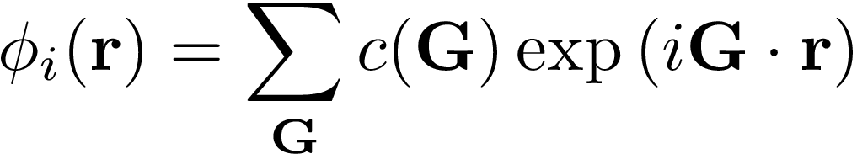
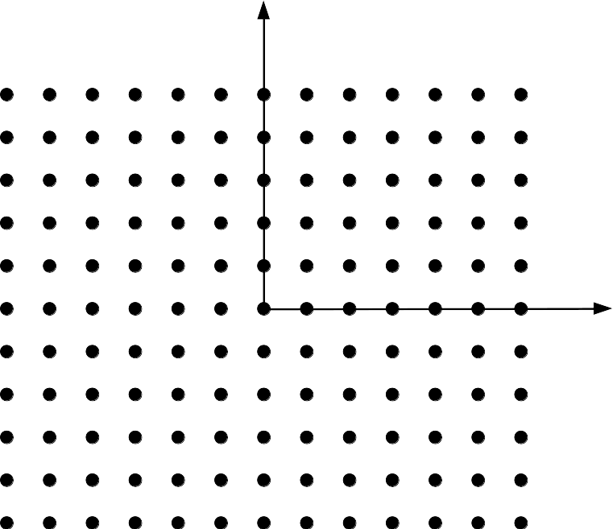
KS-DFT in practice: PW and PP
Wavefunctions are represented in Plane Waves (PW)
Only Fourier components compatible with the periodicity of the lattice G=n₁b₁+n₂b₂
G_{y}
G_{x}

Slide 9
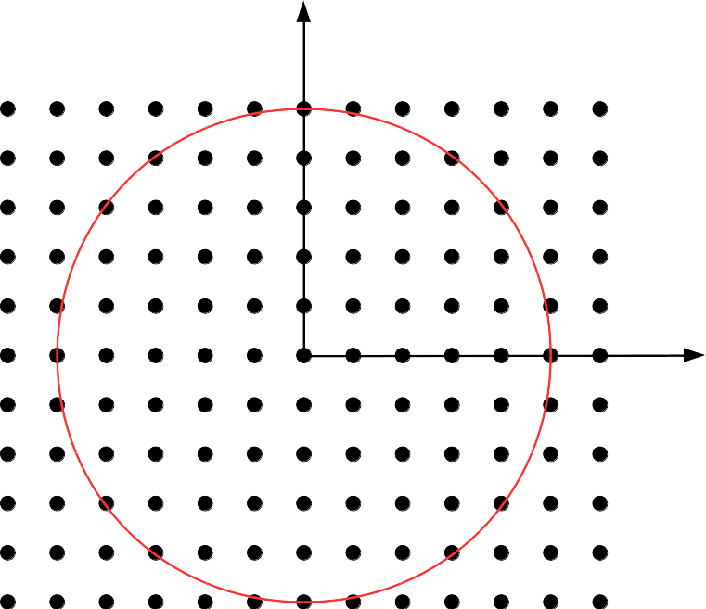
KS-DFT in practice: PW and PP
Wavefunctions are represented in Plane Waves (PW)
Only Fourier components compatible with the periodicity of the lattice G=n₁b₁+n₂b₂
All G vectors with norm smaller than |G|_{max}
|G|_{max} defined by setting a cutoff on the kinetic energy E_{cut} = ħ²/2π |G|²_{max}
G_{y}
G_{max}
G_{x}

Slide 10
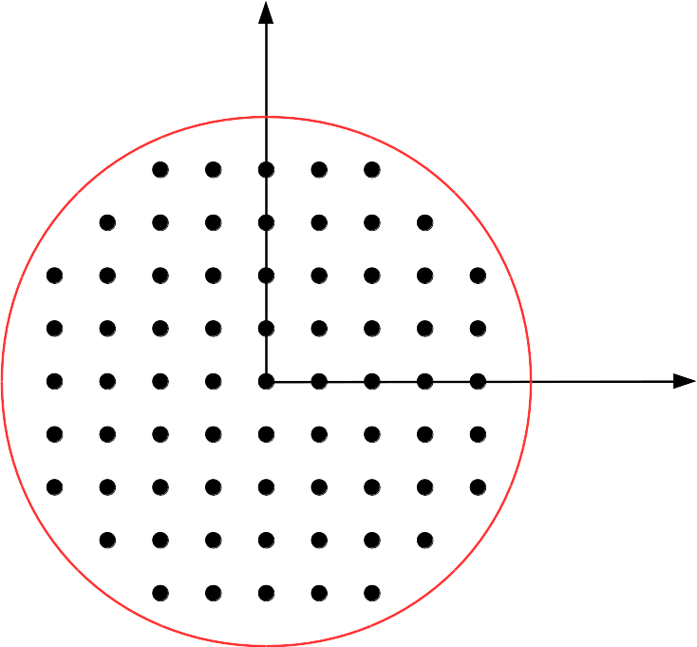
KS-DFT in practice: PW and PP
Wavefunctions are represented in Plane Waves (PW)
Only Fourier components compatible with the periodicity of the lattice G=n₁b₁+n₂b₂
All G vectors with norm smaller than |G|_{max}
|G|_{max} defined by setting a cutoff on the kinetic energy E_{cut} = ħ²/2π |G|²_{max}
ecutwfc: QE Input parameter for E_{cut}
G_{y}
G_{max}
G_{x}

Slide 11
KS-DFT in practice: PW and PP
In a periodic system KS states are Bloch functions
G_{y}
Only Fourier components compatible with the periodicity of the primitve cell G=n₁b₁+n₂b₂
k belong to the Brillouin zone ( )
All G vectors such that ħ²/2π |k+G|² < E_{cut}
Many properties requires integration over the k-points -> BZ sampling (K_POINTS card)
G_{max}
G_{x}

Slide 12
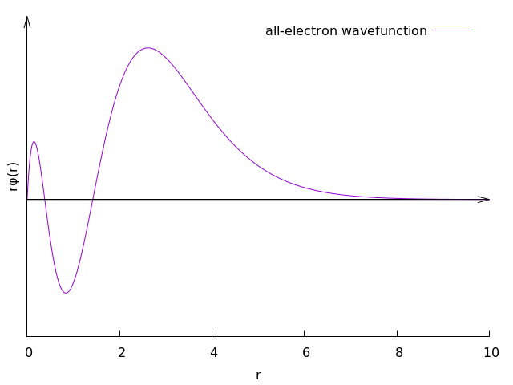
KS-DFT in practice: PW and PP
The use of pseudo-potentials allows to ignore chemically inert core electrons and make PW calculation feasible
Strong oscillations close to the nuclei: large number of PW needed

Slide 13
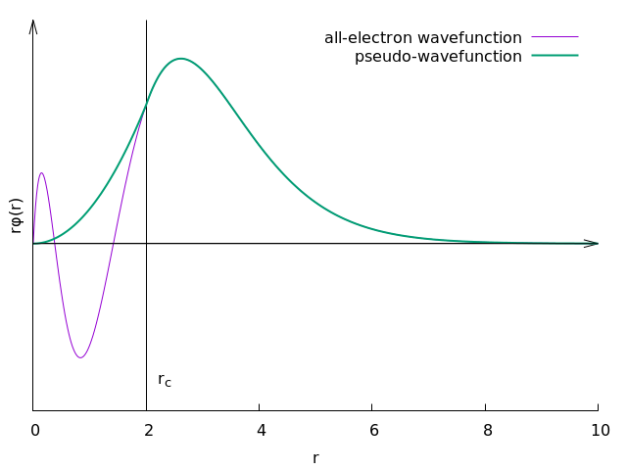
KS-DFT in practice: PW and PP
The use of pseudo-potentials allows to ignore chemically inert core electrons and make PW calculation feasible
Strong oscillations close to the nuclei: large number of PW needed
Replace the coulombic potetial with a pseudo-potential that produces smooth pseudo-wavefunctions
Different recepies: Norm-conserving, Ultra-soft, Projector-augmented-wave (PAW)

Slide 14
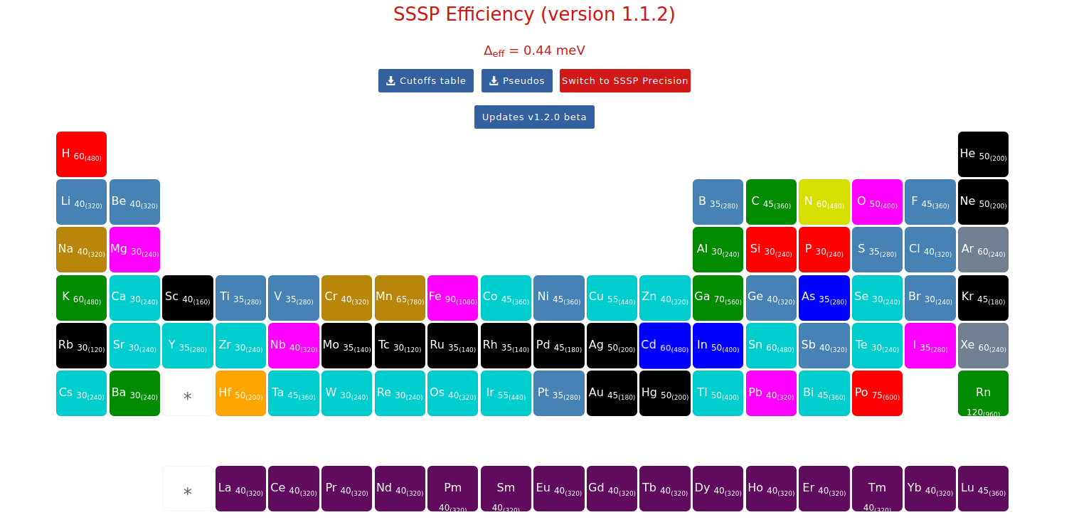
Where to find PPs
Standard solid-state pseudopotentials (SSSP):
https://www.materialscloud.org/discover/sssp/table/efficiency

Slide 15
Where to find PPs
Standard solid-state pseudopotentials (SSSP):
https://www.materialscloud.org/discover/sssp/table/efficiency
Quantum Espresso Website:
https://www.quantum-espresso.org/pseudopotentials/
Optimized Norm-Conserving Vanderbilt (ONCV): SG15
http://www.quantum-simulation.org/potentials/sg15_oncv/
Optimized Norm-Conserving Vanderbilt (ONCV): pseudo-dojo
http://www.pseudo-dojo.org/

Slide 16
Outline
Brief recap on KS-DFT. KS equations ad common approximations to the xc energy functional, KC in practice
Exercise 0. Standard DFT: PBE band structure of FCC Silicon
Exercise 1-2. Hybrid DFT: electronic structure of FCC Silicon
Exercise 3-4. Meta-GGA: electronic structure of FCC Silicon and BCC Iron using SCAN

Slide 17
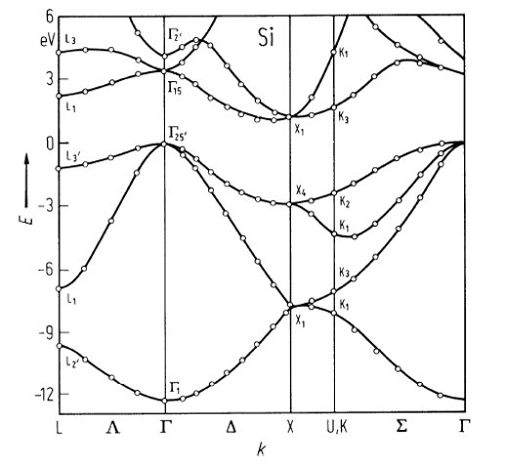
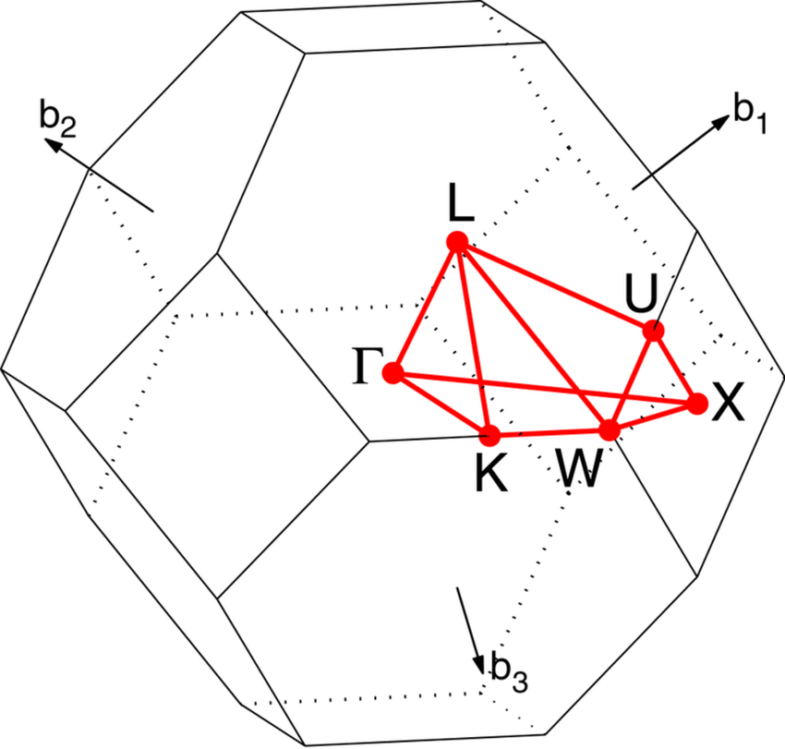
FCC Silicon
Goal of exercise0
z
a₁
y
a₂
a₃
a₀

Slide 18
Silicon PBE electronic structure: SCF calculation
&control
calculation='scf'
prefix='Si'
pseudo_dir = '../../files/pseudo'
outdir='./out'
/
&system
ibrav = 2, celldm(1) = 10.262,
nat = 2, ntyp = 1,
ecutwfc = xxx ,
/
&electrons
conv_thr = 1.d-8
/
ATOMIC_SPECIES
Si 28.086 Si.pbe_PseudoDojo.UPF
ATOMIC_POSITIONS {alat}
Si 0.00 0.00 0.00
Si 0.25 0.25 0.25
K_POINTS {automatic}
XXX YYY ZZZ 0 0 0
Self-consistent field calculation
Directory conatining the PPs
Temporary files re stored here
Specify here the crystal structure:
FCC, alat=10.20 Bohr, 2 Si atoms
Cutoff for the Wave-Functions
Convergence threshold for the SCF problem
z
Pseudopotetial file
a₁
y
a₂
Atomic positions
a₃
a₀
BZ sampling
https://www.quantum-espresso.org/Doc/INPUT_PW.html

Slide 19
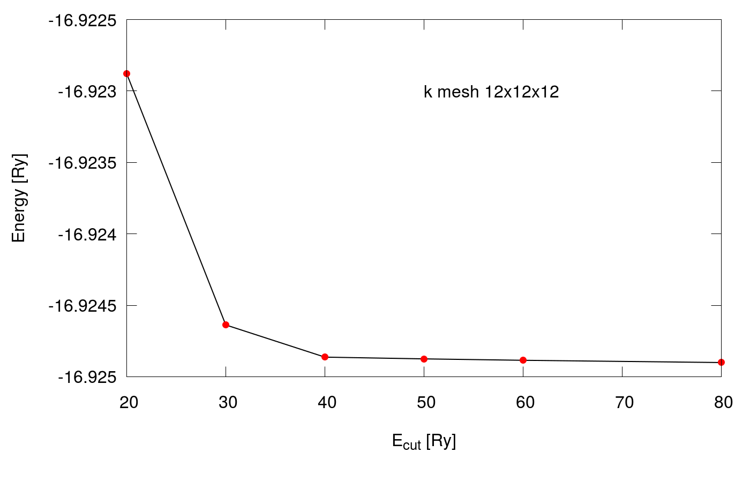
Convergence wrt ecut: total energy

Slide 20
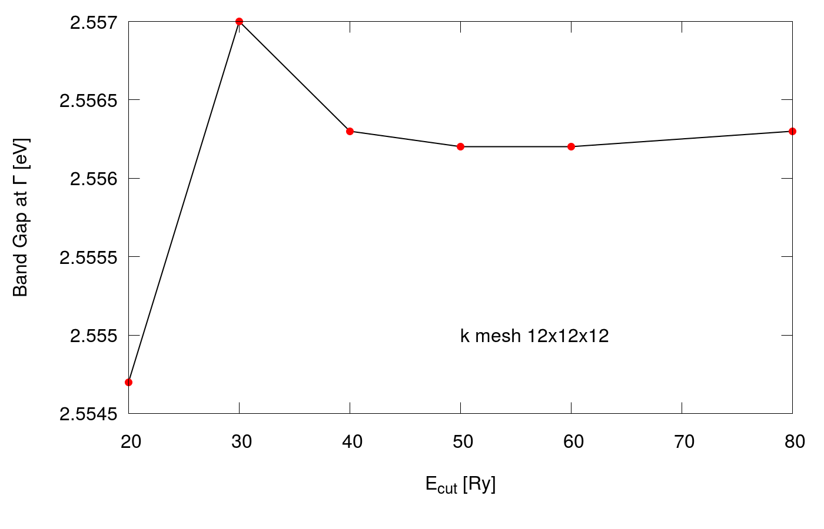
Convergence wrt ecut: direct band gap

Slide 21
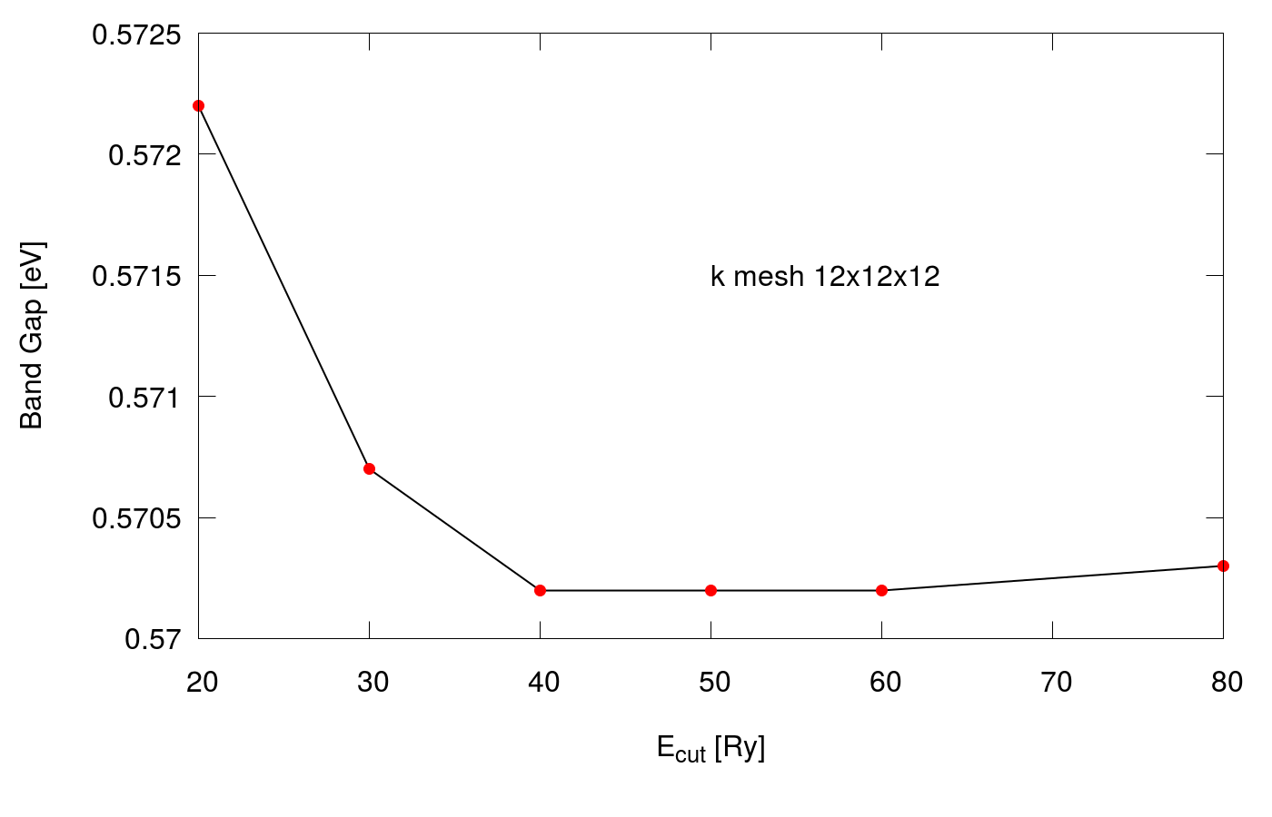
Convergence wrt ecut: indirect band gap

Slide 22
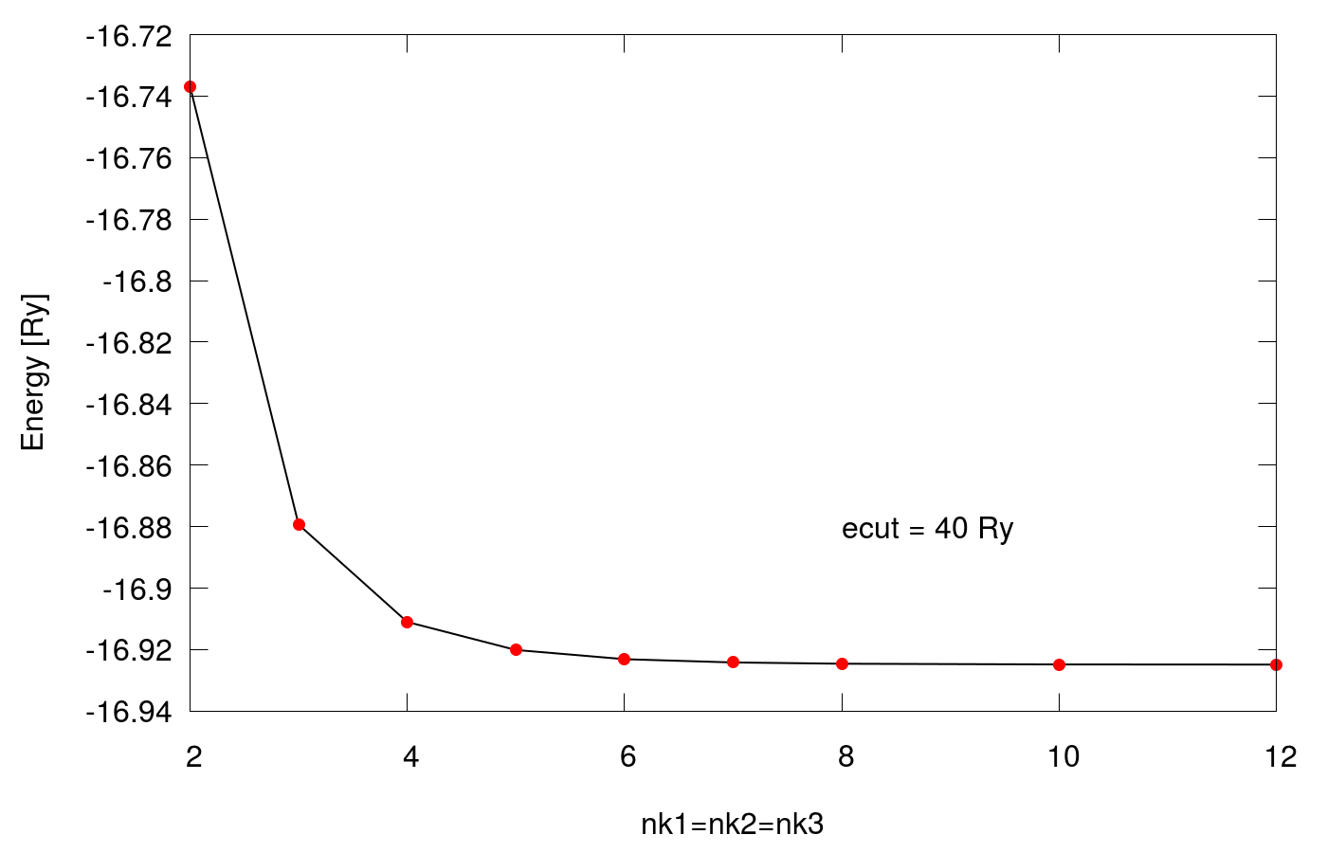
Convergence wrt K_POINTS: total energy

Slide 23
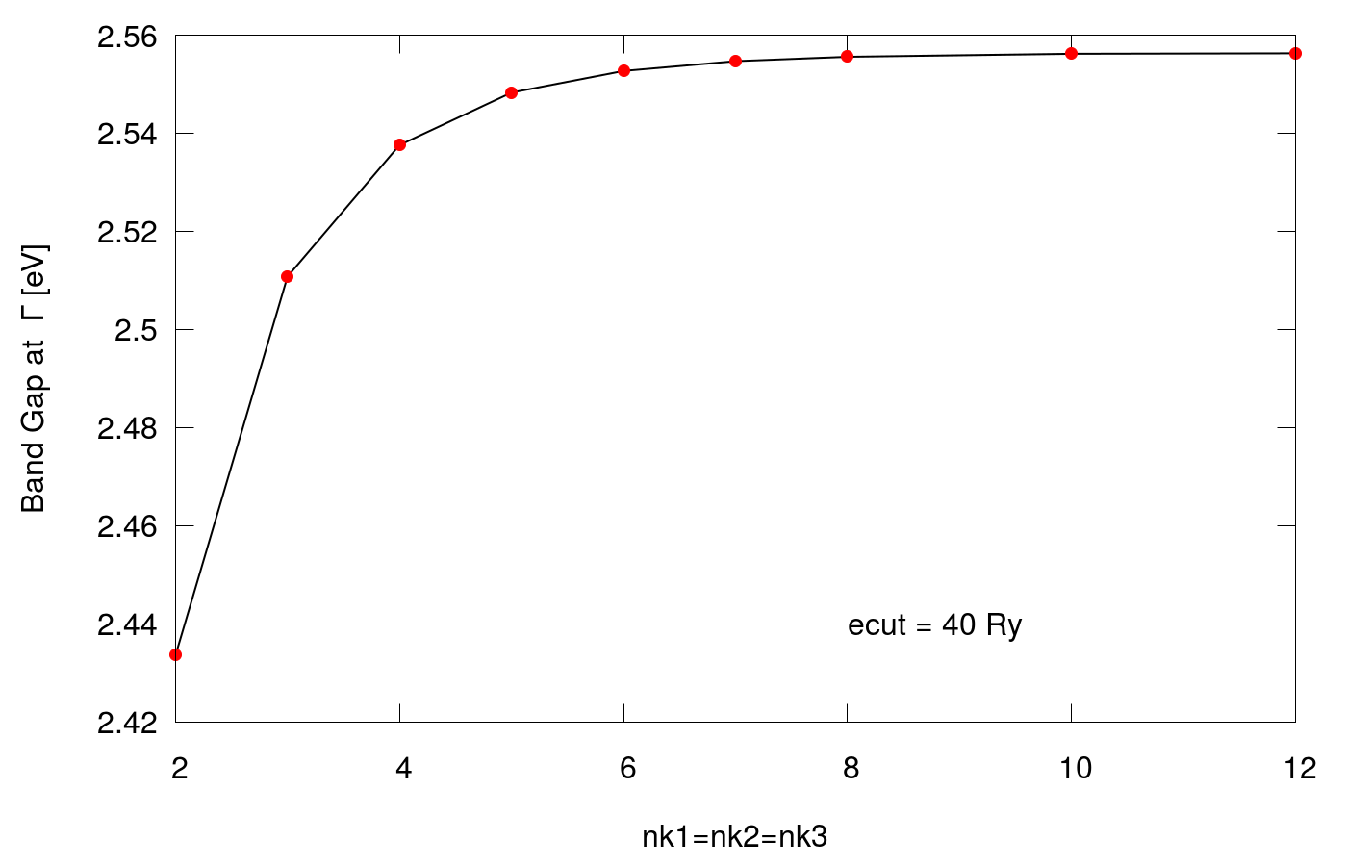
Convergence wrt K_POINTS: direct band gap

Slide 24
Check-out the git repo
The hands-on materials are available at github
Clone the repository (or Download it):
git clone https://github.com/materialscloud-org/hubbard-koopmans-2022
Go to the exercise0 folder
cd hubbard-koopmans-2022/Day1/exercise0

Slide 25
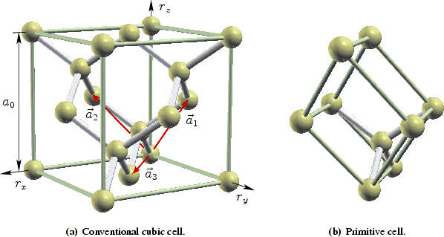
Silicon PBE electronic structure: SCF calculation
Converged value for the Wave-Functions cutoff
&control
calculation='scf'
prefix='Si'
outdir='./out'
/
&system
ibrav = 2, celldm(1) = 10.20,
nat = 2, ntyp = 1,
ecutwfc = 40 ,
/
&electrons
conv_thr = 1.d-8
/
ATOMIC_SPECIES
Si 28.086 Si.pbe_PseudoDojo.UPF
ATOMIC_POSITIONS {alat}
Si 0.00 0.00 0.00
Si 0.25 0.25 0.25
K_POINTS {automatic}
12 12 12 0 0 0
Converged value for the
BZ sampling
https://www.quantum-espresso.org/Doc/INPUT_PW.html

Slide 26
Silicon PBE electronic structure: BANDS calculation
&control
calculation='bands'
...
/
&system
...
/
&electrons
...
/
ATOMIC_SPECIES
...
ATOMIC_POSITIONS {alat}
...
K_POINTS {crystal_b}
5
0.50000 0.50000 0.50000 20 ! L
0.00000 0.00000 0.00000 20 ! G
0.50000 0.00000 0.50000 20 ! X
0.37500 0.37500 0.75000 20 ! K
0.00000 0.00000 0.00000 0 ! G
"Bands" calculation
Number of special k-points provided
Coordinates of the special k-points and number of addditional points QE generates between two adiacent special k-points.
https://www.quantum-espresso.org/Doc/INPUT_PW.html

Slide 27
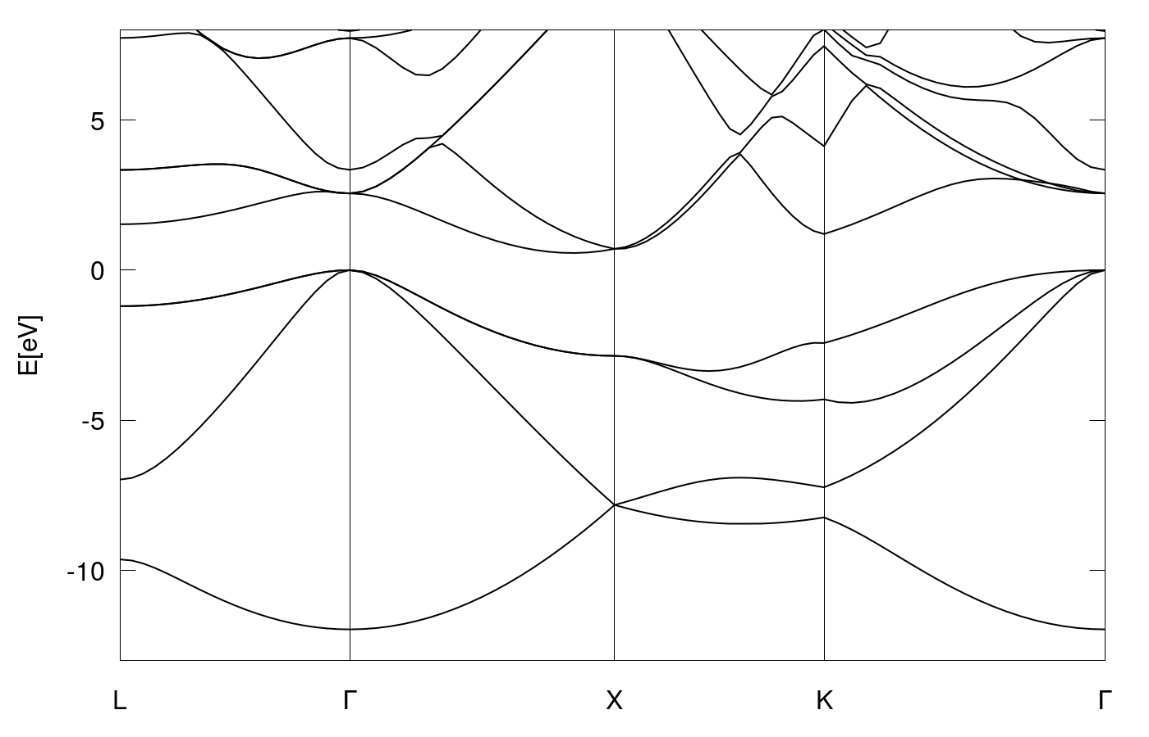
PBE Silicon band structure

Slide 28
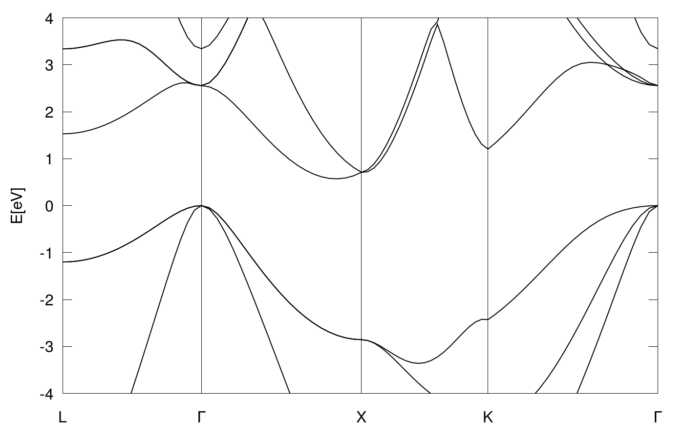
PBE Silicon band structure
E_{g}^{direct} = 2.56 eV
E_{g}^{indirect} = 0.57 eV
 | indirect | direct
E_{g} Exp.​ | 1.17​ | 3.35​

Slide 29
Outline
Brief recap on KS-DFT. KS equations, common approximations to the xc energy functional, KS in practice
Exercise 0. Standard DFT: PBE electronic structure of FCC Silicon
Exercise 1-2. Hybrid DFT: electronic structure of FCC Silicon
Exercise 3-4. Meta-GGA: electronic structure of FCC Silicon and BCC Iron using SCAN

Slide 30
Hybrid functionals
Mix a fraction of exact-exchage from HF theory with semi-local exchage
3-paramenters: combination of x-HF, x-B88(xGGA), c-LYP(cGGA) and xc-LDA
Fitted on thermochemical data: a₀ = 0.20, a_{x}=0.72, a_{c}=0.81
[Becke et al. JCP 98, 5648 (1993), Stephens et al. J. Phys. Chem. 98, 11623 (1994)]

Slide 31
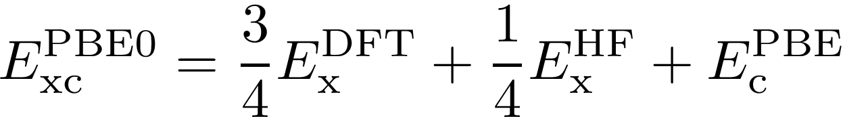
Hybrid functionals
Mix a fraction of exact-exchage from HF theory with semi-local exchage
3-paramenters: combination of x-HF, x-B88(xGGA), c-LYP(cGGA) and xc-LDA
Fitted on thermochemical data: a₀ = 0.20, a_{x}=0.72, a_{c}=0.81
[Becke et al. JCP 98, 5648 (1993), Stephens et al. J. Phys. Chem. 98, 11623 (1994)]
Simplification: a_{x}=(1-a₀), a_{c}=1. Only 1 mixing parameter [Becke et al. JCP 104, 1040 (1996)]
Comparison with 4° order perturbation theory: a₀ = 1/4: PBE0 [Perdew et al. JCP 105, 9982 (1996)]

Slide 32
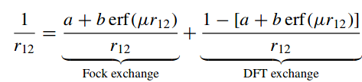
Range-separated Hybrid functionals
Basic Idea: split the electron-electron interaction in short and long range
Long-Range
Range-separation
parameter
Short-Range
b= 0 -> Conventional hybrid functional. E.g. b = 0 and a = 0.25 -> PBE0
a = -b = 0.25 and µ = 0.106 bohr⁻¹ -> HSE
a+b=1 -> correct asymptotic (1/r) in finite systems
a+b=1/ε -> correct asymptotic (1/εr) in extended systems
µ can be tuned to satisfy the IP theorem (Optimal tuning) [Lecture by Prof. Kronik]

Slide 33
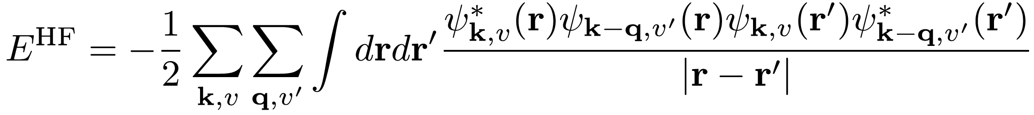
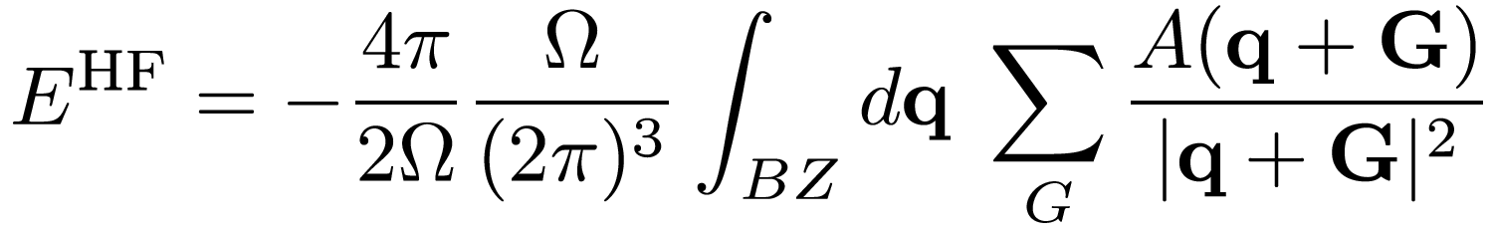
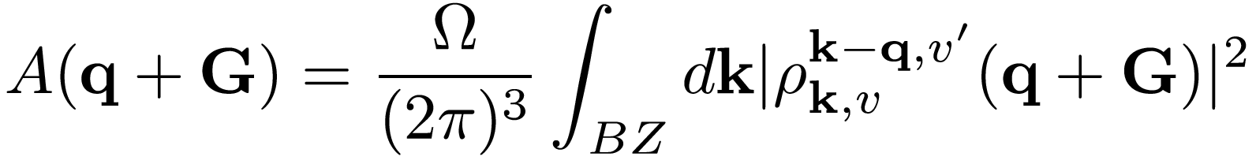
Exact-exchange energy
In Reciprocal space:
Integration over the BZ: nqx1, nqx2, nqx3
Need to be compatible
with the k mesh
PW expansion
ecutfock
Equal to ecutrho by default.
Can be reduced (but not below ecutwfc)
Integrable divergence for q+G->0
exxdiv_treatment=‘gygi-baldereschi’
x_gamma_extrapolation = .true.

Slide 34
Silicon PBE0 electronic structure: SCF calculation
&control
...
/
&system
...
input_dft = "pbe0"
nqx1 = XXX, nqx2 = XXX, nqx3 = XXX
exxdiv_treatment = "gb"
x_gamma_extrapolation = .true.
ecutfock = YYY
exx_fraction = ZZZ
screening_parameter = WWW
/
&electrons
...
/
ATOMIC_SPECIES
...
ATOMIC_POSITIONS {alat}
...
K_POINTS {automatic}
12 12 12 0 0 0
Specify which hybrid functional: PBE0/B3LYP/HSE
You can change the fraction of EXX and/or the
range separation parameter.
https://www.quantum-espresso.org/Doc/INPUT_PW.html

Slide 35
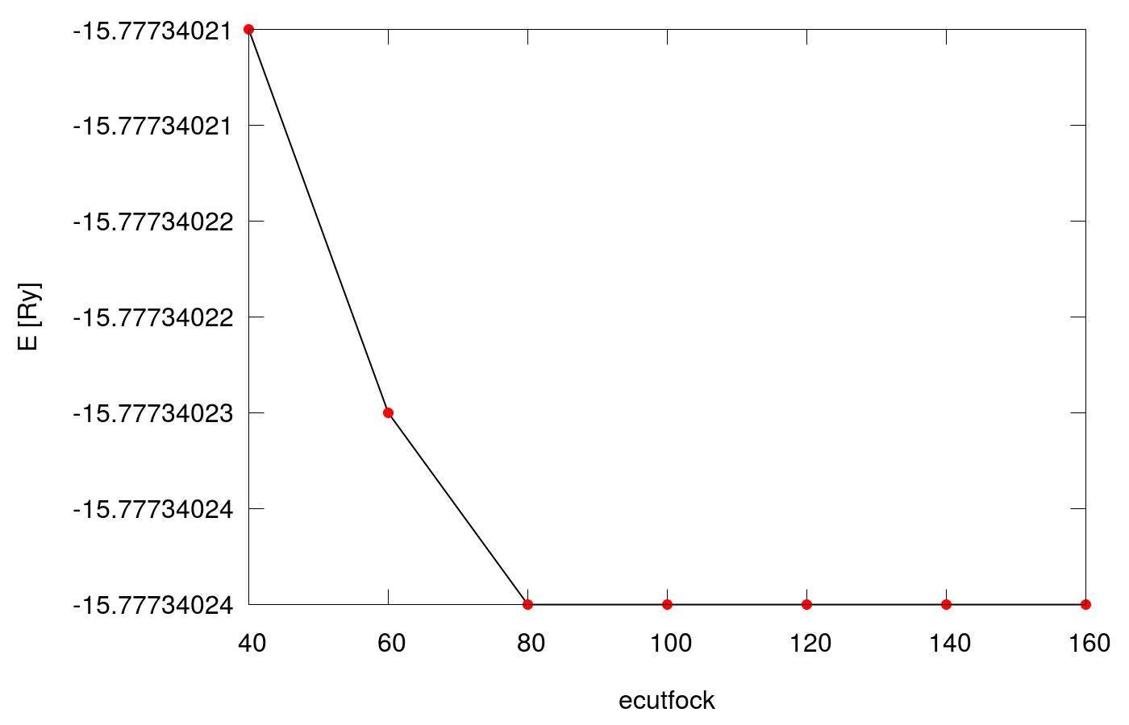
PBE0 energy convergence wrt ecutfock

Slide 36
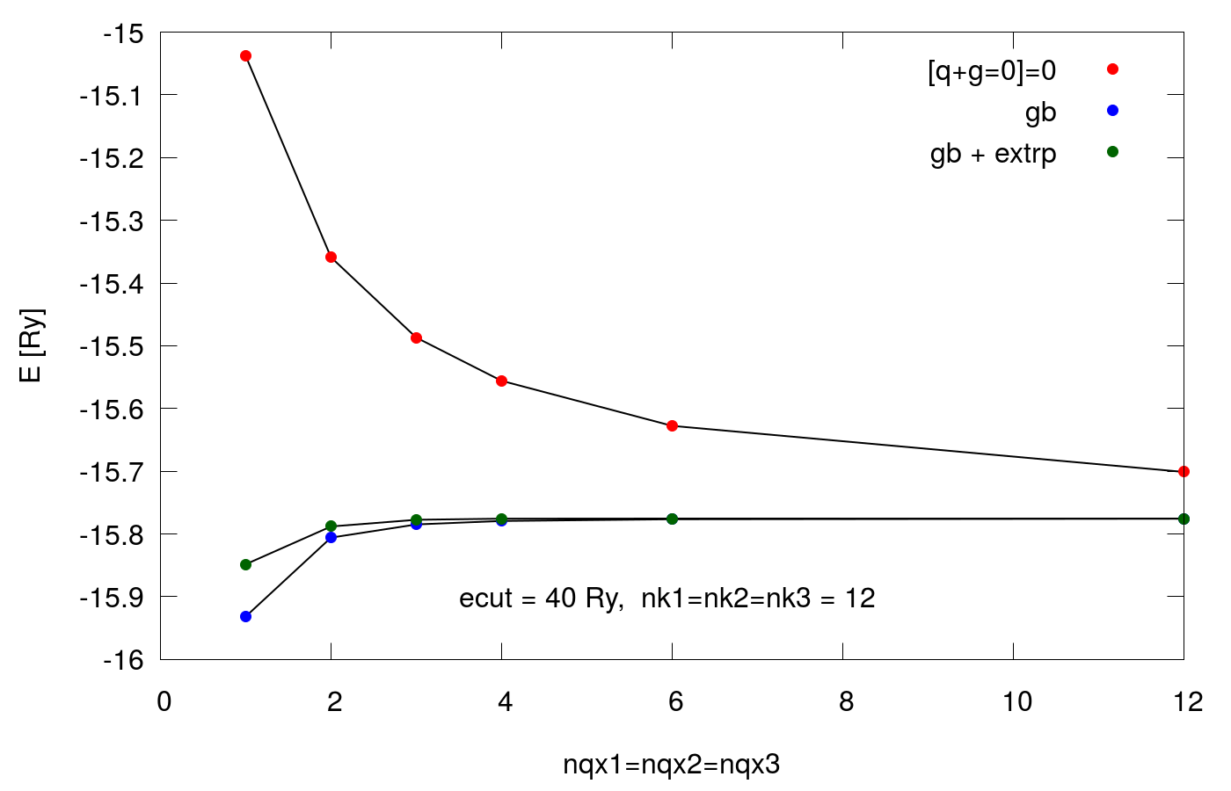
PBE0 energy convergence wrt nqx

Slide 37
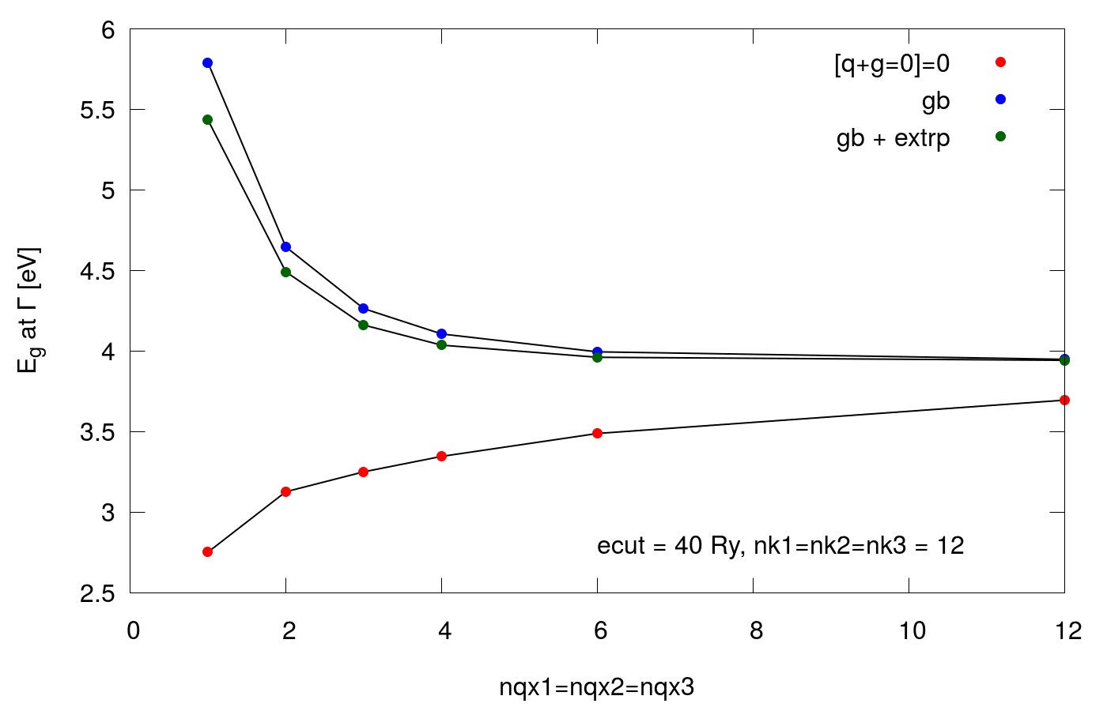
PBE0 direct band Gap convergence wrt nqx

Slide 38
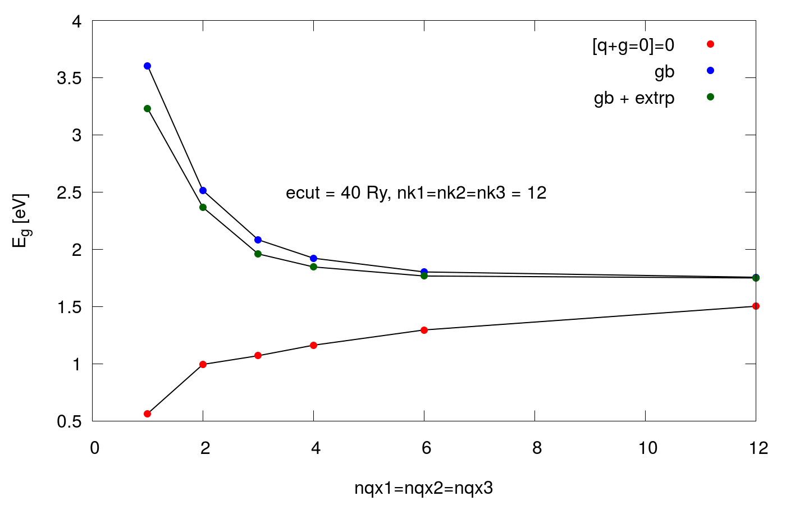
PBE0 indirect band Gap convergence wrt nqx

Slide 39
Outline
Brief recap on KS-DFT. KS equations, common approximations to the xc energy functional, KS in practice
Exercise 0. Standard DFT: PBE electronic structure of FCC Silicon
Exercise 1-2. Hybrid DFT: electronic structure of FCC Silicon
Exercise 3-4. Meta-GGA: electronic structure of FCC Silicon and BCC Iron using SCAN

Slide 40
Check-out the git repo
Go to the exercise1 folder
cd hubbard-koopmans-2022/Day1/exercise1

Slide 41
Silicon PBE0 electronic structure: SCF calculation
&control
...
/
&system
...
input_dft = "pbe0"
nqx1 = 4, nqx2 = 4, nqx3 = 4
exxdiv_treatment = "gb"
x_gamma_extrapolation = .true.
ecutfock = 40
/
&electrons
...
/
ATOMIC_SPECIES
...
ATOMIC_POSITIONS {alat}
...
K_POINTS {automatic}
12 12 12 0 0 0
Converged parameters for nqx
Converged value for ecutfock

Slide 42
Nested self-consistent loop
Outer-loop
Normal scf (LDA or similar) is performed
Hybrid functional is switched. V^{HF} is calculated using the current best wfcs
A new scf is performed keeping V^{HF} fixed
Exchange error (dexx) is computed
If dexx > thr the procedure is repeated from 1.
Update V^{HF}
Energy converged?
Inner-loop
Converge ρ(r) with fixed V^{HF}
NO
YES
JOB DONE

Slide 43
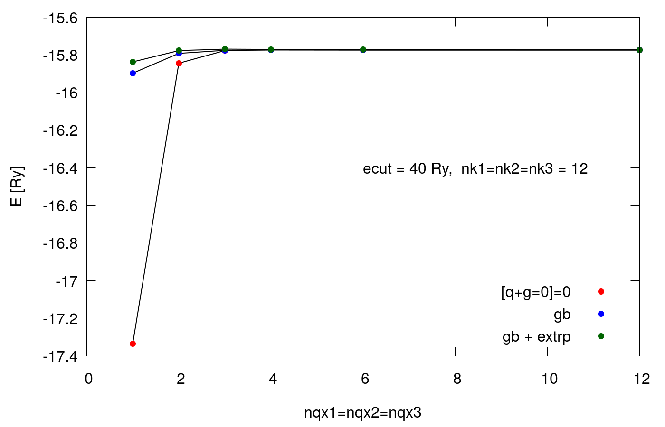
HSE energy convergence wrt nqx

Slide 44
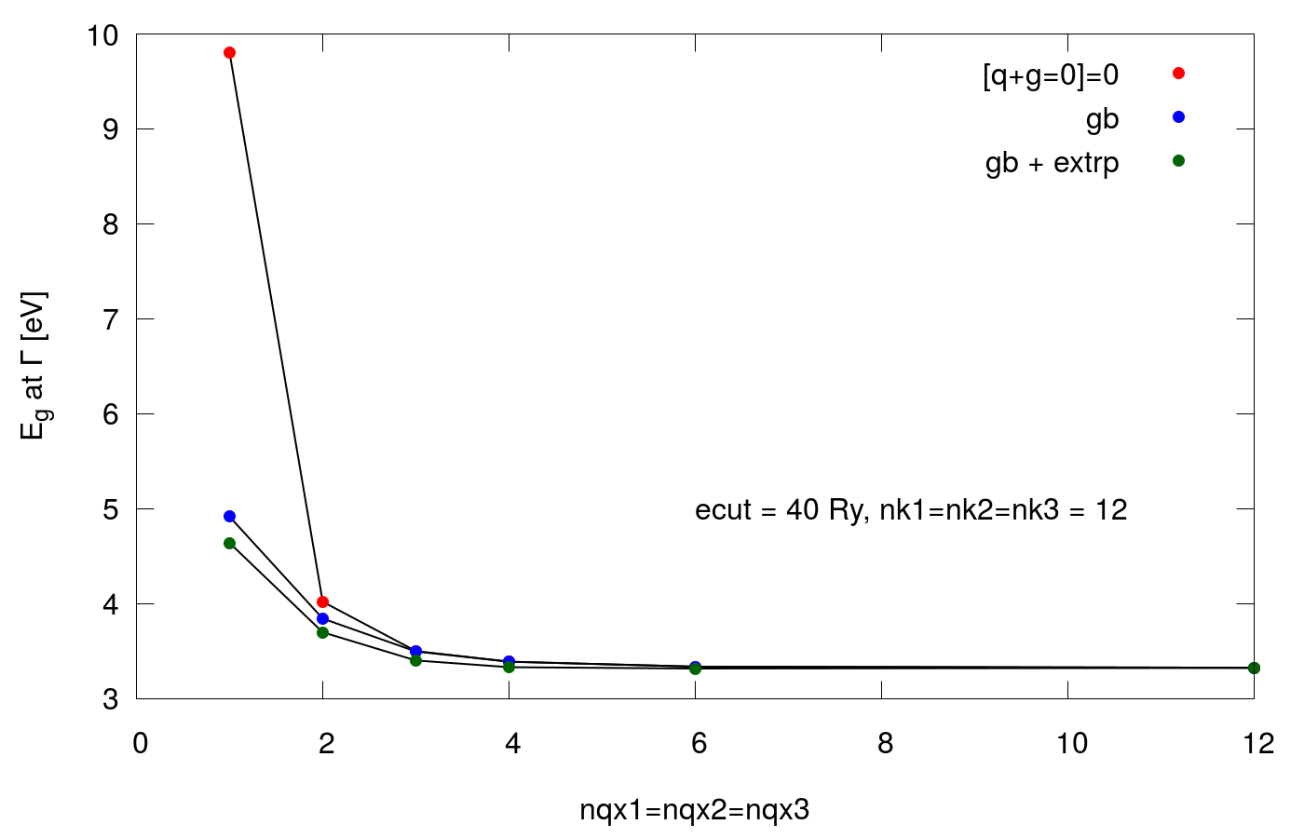
HSE direct band Gap convergence wrt nqx

Slide 45
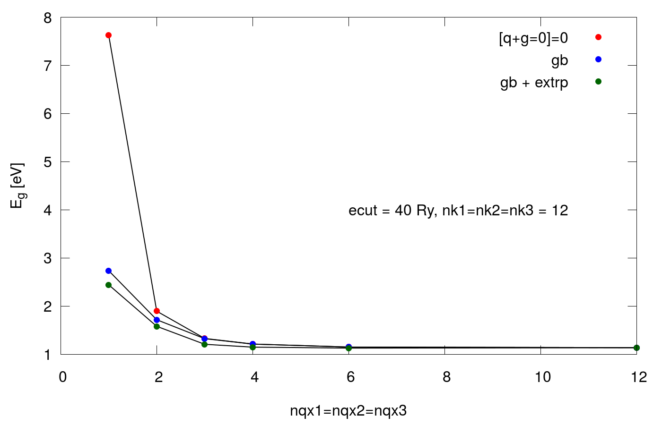
HSE indirect band Gap convergence wrt nqx

Slide 46
Silicon HSE electronic structure: SCF calculation
&control
...
/
&system
...
input_dft = "hse"
nqx1 = 4, nqx2 = 4, nqx3 = 4
exxdiv_treatment = "gb"
x_gamma_extrapolation = .true.
ecutfock = 40
/
&electrons
...
/
ATOMIC_SPECIES
...
ATOMIC_POSITIONS {alat}
...
K_POINTS {automatic}
12 12 12 0 0 0
Converged parameters for nqx
Converged value for ecutfock

Slide 47
Silicon band Gap: summary
ecut = 40 Ry, k mesh: 12x12x12
ecutfock = 40 Ry, q mesh: 4x4x4
Functional​ | indirect Gap​ | Direct Gap | Band width
PBE | 0.57 | 2.56 | 11.96
PBE0​ | 1.85 | 4.04 | 13.32
HSE​ | 1.15 | 3.33 | 13.26
Exp. | 1.17 | 3.35 | 12.5

Slide 48
Hybrids: how do they perform
Atomization energies
Functional​ | MAE(G2)​ | MAE(G2-1) | Max AE(G2) | Max AE(G2-1)
LDA | 83.7 | 36.4 | 216 | 84
PBE​ | 17.1 | 8.6 | 52 | 26
BLYP | 7.1 | 4.7 | 28 | 15
B3LYP | 3.1 | 2.4 | 20 | 10
PBE0 | 4.8 | 3.5 | 24 | 10
Mean Absolute Error (MAE) in Kcal/mol for the G2 (148 molecules)
and G2-1( (55 molecules) sets.
Curtiss et al. JCP 106, 1063 (1997); Scuseria et al. JCP 110, 5029 (1999)

Slide 49
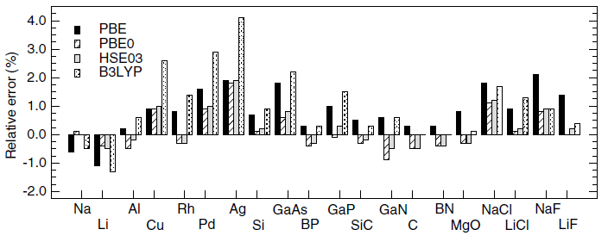
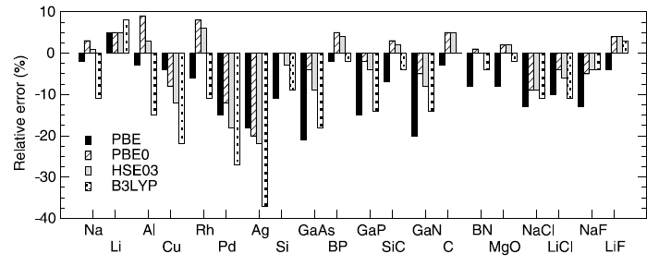
Hybrids: how do they perform
Lattice constants of solids
​ | PBE | PBE0 | HSE | B3LYP
MRE | 0.8 | 0.1 | 0.2 | 1.0
MARE | 1.0 | 0.5 | 0.5 | 1.2
No-metals
MRE | 1.0 | 0.0 | 0.1 | 0.8
MARE | 1.0 | 0.4 | 0.5 | 0.8
Bulk modulus of solids
​ | PBE | PBE0 | HSE | B3LYP
MRE | -9.8 | -1.2 | -3.1 | -10.2
MARE | 9.4 | 5.7 | 6.4 | 11.4
No-metals
MRE | -10.4 | -0.7 | -1.8 | -6.8
MARE | 10.4 | 3.8 | 4.6 | 7.4
Marsman et al. J. Phys: Condens. Matter 20, 064201 (2008)

Slide 50
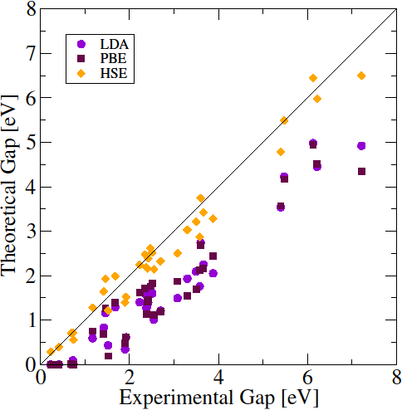
Hybrids: how do they perform
Band gaps
Improved band gaps for semiconducting system HSE correctly predict semiconducting behavior in systems where LDA/GGA predicts a metal
Error (in eV) for 40 simple and binary semiconductors and insulators
​ | LDA | PBE | HSE
ME | -1.14 | -1.13 | -0.17
MAE | 1.14 | 1.13 | 0.26
Heyd et al. JCP 123, 174101 (2005)

Slide 51
Caveat
More expensive than standard DFT (time- and memory-wise)
No hybrid PP. Use always a PP generated with the same local functional as the one used in the hybrid functional definition (e.g. use PBE PPs for PBE0 calculations)
NLCC not well defined. Avoid PPs with NLCC
Might need to explicitly include semi-core states electrons in the valence
Calculations with US and PAW PPs typically slower that those with NC PPs
Not all the features are implemented for US and PAW PPs
Wannier interpolation to get the entire band structure (see hnds-on later today)

Slide 52
Outline
Brief recap on KS-DFT. KS equations, common approximations to the xc energy functional, KS in practice
Exercise 0. Standard DFT: PBE electronic structure of FCC Silicon
Exercise 1-2. Hybrid DFT: electronic structure of FCC Silicon
Exercise 3-4. Meta-GGA: electronic structure of FCC Silicon and BCC Iron using SCAN

Slide 53
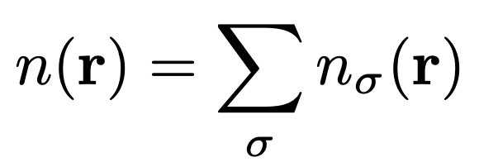
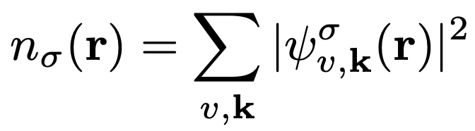
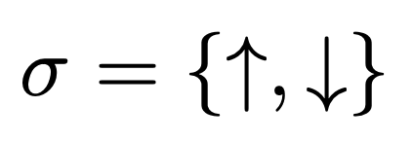
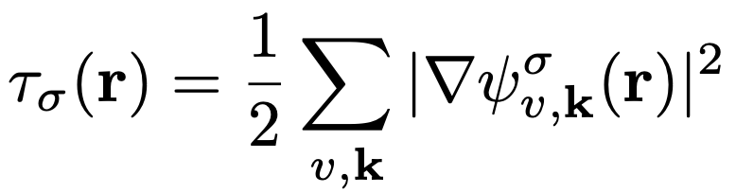
Meta-GGA
total charge density
spin-charge density
kinetic energy density

Slide 54
Plethora of meta-GGA functionals
MVS
BR89
r²SCAN
TPSS
SCAN
MGGA_MS2
rSCAN
TASK
revTPSS
HLE17
TM
SCAN-L

Slide 55
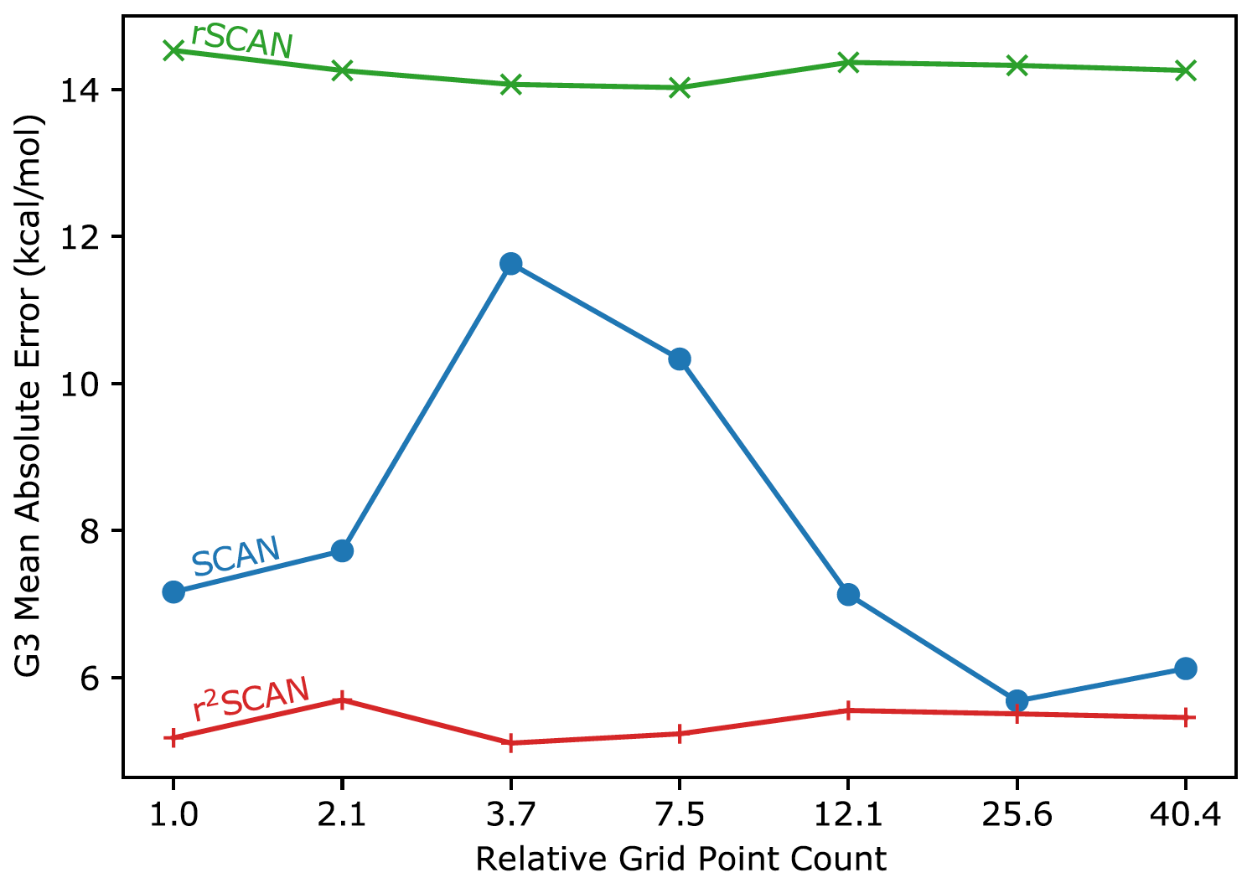
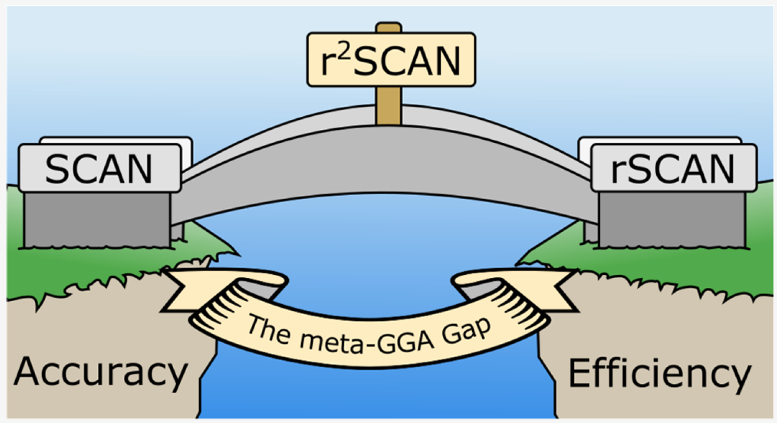
SCAN, rSCAN, r²SCAN
SCAN: J. Sun et al., Phys. Rev. Lett. 115, 036402 (2015).
rSCAN: A. Bartok et al., J. Chem. Phys. 150, 161101 (2019).
r²SCAN: J. Furness et al., J. Phys. Chem. Lett. 11, 8208 (2020).

Slide 56
Outline
Brief recap on KS-DFT. KS equations, common approximations to the xc energy functional, KS in practice
Exercise 0. Standard DFT: PBE electronic structure of FCC Silicon
Exercise 1-2. Hybrid DFT: electronic structure of FCC Silicon
Exercise 3-4. Meta-GGA: electronic structure of FCC Silicon and BCC Iron using SCAN

Slide 57
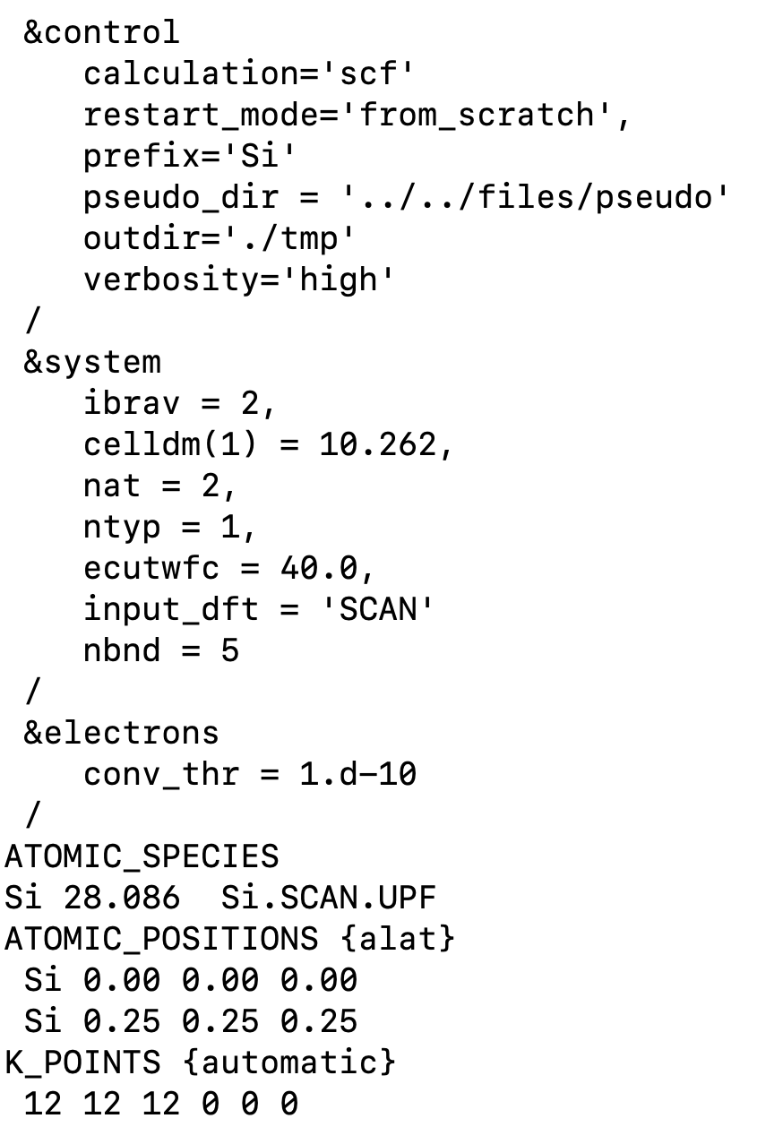
Input file
Experimental lattice parameter
It is necessary to perform convergence tests w.r.t ecutwfc
Set up the SCAN functional from the input
Quantum ESPRESSO must be compiled with Libxc
Pseudopotential generated using the SCAN functional
https://yaoyi92.github.io/scan-tm-pseudopotentials.html
It is necessary to perform convergence tests w.r.t k points mesh

Slide 58
SCAN functional & SCAN pseudopotential
Si
k mesh: 12x12x12

Slide 59
SCAN functional & SCAN pseudopotential
Si
110 Ry
0.939 eV
k mesh: 12x12x12

Slide 60
SCAN functional & SCAN pseudopotential
Si
110 Ry
FFT grid: 60x60x60
40 Ry
FFT grid: 32x32x32

Slide 61
SCAN functional & SCAN pseudopotential
Si
110 Ry
FFT grid: 60x60x60
Let us use a denser FFT grid
of size 60x60x60
40 Ry
FFT grid: 32x32x32

Slide 62
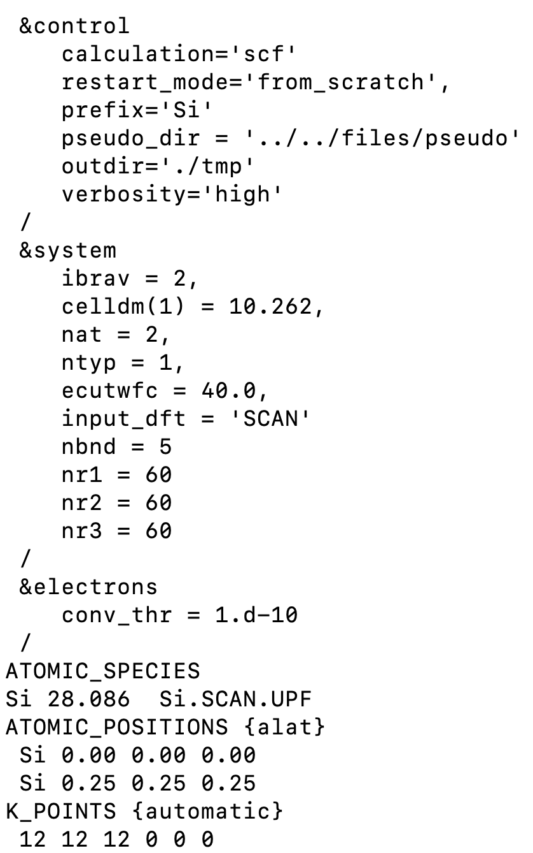
FFT grid specified from the input

Slide 63
SCAN functional & SCAN pseudopotential
Si
FFT grid: 60x60x60
0.002 eV
Meta-GGA contribution to the XC potential is compu-
ted in real space on the FFT grid. This is why the FFT
grid must be very dense.
Y. Yao and Y. Kanai, J. Chem. Phys. 146, 224105 (2017).
FFT grid: 32x32x32

Slide 64
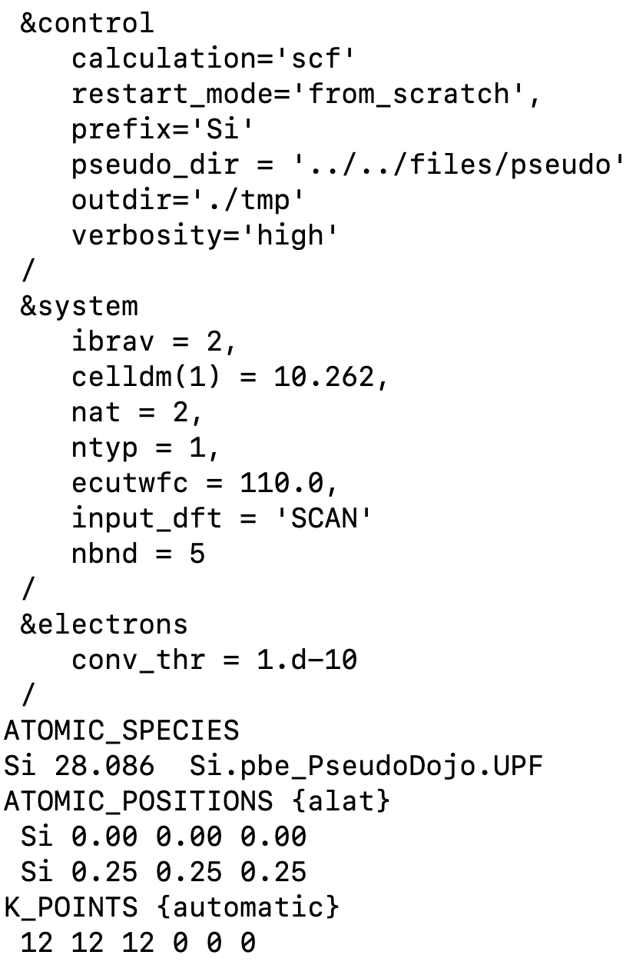
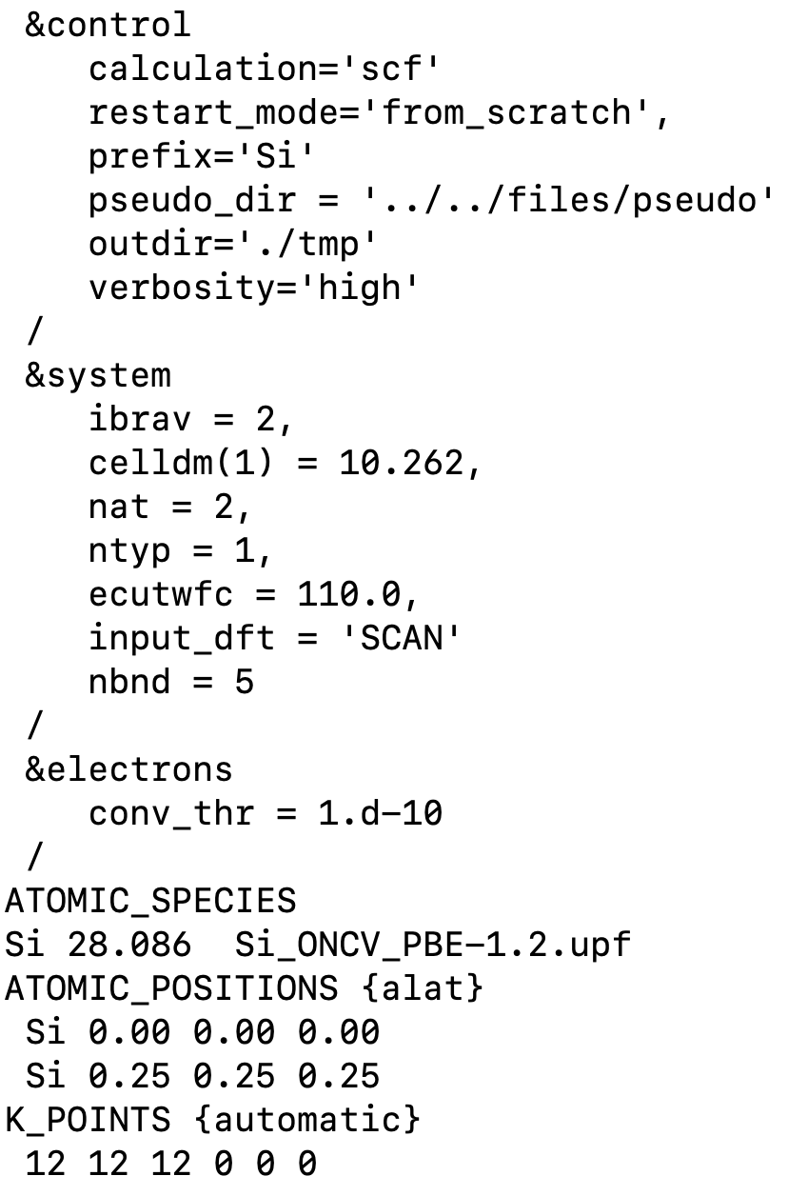
SCAN functional & PBE pseudopotential
Pseudo Dojo library
http://www.pseudo-dojo.org
SG15 library
http://www.quantum-simulation.org/potentials/sg15_oncv/

Slide 65
SCAN functional with different pseudopotentials
Ecut = 110 (Ry), k mesh: 12x12x12
Functional | Pseudopotential | Library | Gap (eV)
SCAN | SCAN | Yi Yao’s library | 0.94
SCAN | PBE | SG15 ONCV | 0.83
SCAN | PBE | Pseudo Dojo | 0.64
Gap_{expt} = 1.17 (eV)

Slide 66
SCAN functional with different pseudopotentials
Ecut = 110 (Ry), k mesh: 12x12x12
Functional | Pseudopotential | Library | Gap (eV)
SCAN | SCAN | Yi Yao’s library | 0.94
SCAN | PBE | SG15 ONCV | 0.83
SCAN | PBE | Pseudo Dojo | 0.64
NLCC=.false.
NLCC=.false.
WARNING
NLCC=.true.
Gap_{expt} = 1.17 (eV)
Currently, nonlinear core correction (NLCC) is not implemented for meta-GGA in Quantum ESPRESSO!
Pseudopotentials that have NLCC=.true. introduce some inconsistency for meta-GGA calculations.

Slide 67
SCAN functional with different pseudopotentials
Ecut = 110 (Ry), k mesh: 12x12x12
Functional | Pseudopotential | Library | Gap (eV)
SCAN | SCAN | Yi Yao’s library | 0.94
SCAN | PBE | SG15 ONCV | 0.83
SCAN | PBE | Pseudo Dojo | 0.64
PBE | PBE | SG15 ONCV | 0.56
PBE | PBE | Pseudo Dojo | 0.57
Gap_{expt} = 1.17 (eV)
SCAN calculation with the SCAN pseudopotential gives the most accurate results
Y. Yao and Y. Kanai, J. Chem. Phys. 146, 224105 (2017).

Slide 68
Convergence w.r.t. Ecut
k mesh: 12x12x12
SCAN with SCAN pseudopotential
PBE with PBE pseudopotential (SG15)
Convergence is achieved must faster with PBE than with SCAN

Slide 69
Setting up the XC functional
input_dft = ‘PBE’ or input_dft=‘XC-000I-000I-101L-130L-000I-000I’
Read more about this here: https://www.quantum-espresso.org/Doc/user_guide/node13.html
Libxc with IDs: https://tddft.org/programs/libxc/functionals/libxc-6.0.0/

Slide 70
Setting up the XC functional
GGA
exchange
GGA
correlation
input_dft = ‘PBE’ or input_dft=‘XC-000I-000I-101L-130L-000I-000I’
LDA
exchange
LDA
correlation
meta-GGA
exchange
meta-GGA
correlation
Read more about this here: https://www.quantum-espresso.org/Doc/user_guide/node13.html
Libxc with IDs: https://tddft.org/programs/libxc/functionals/libxc-6.0.0/

Slide 71
Setting up the XC functional
GGA
exchange
GGA
correlation
input_dft = ‘PBE’ or input_dft=‘XC-000I-000I-101L-130L-000I-000I’
LDA
exchange
LDA
correlation
meta-GGA
exchange
meta-GGA
correlation
input_dft = ‘SCAN’ or input_dft=‘XC-000I-000I-000I-000I-263L-267L’
no short
name in QE
input_dft = ‘rSCAN’ or input_dft=‘XC-000I-000I-000I-000I-493L-494L’
input_dft = ‘r2SCAN’ or input_dft=‘XC-000I-000I-000I-000I-497L-498L’
Read more about this here: https://www.quantum-espresso.org/Doc/user_guide/node13.html
Libxc with IDs: https://tddft.org/programs/libxc/functionals/libxc-6.0.0/

Slide 72
Different flavors of SCAN
Functional | Pseudopotential | Library | Gap (eV)
SCAN | PBE | SG15 ONCV | 0.83
rSCAN | PBE | SG15 ONCV | 0.71
r²SCAN | PBE | SG15 ONCV | 0.70
Gap_{expt} = 1.17 (eV)
SCAN is more accurate than rSCAN and r²SCAN for predicting the band gap of bulk Si
(at least when using the PBE pseudopotential)

Slide 73
Outline
Brief recap on KS-DFT. KS equations, common approximations to the xc energy functional, KS in practice
Exercise 0. Standard DFT: PBE electronic structure of FCC Silicon
Exercise 1-2. Hybrid DFT: electronic structure of FCC Silicon
Exercise 3-4. Meta-GGA: electronic structure of FCC Silicon and BCC Iron using SCAN

Slide 74
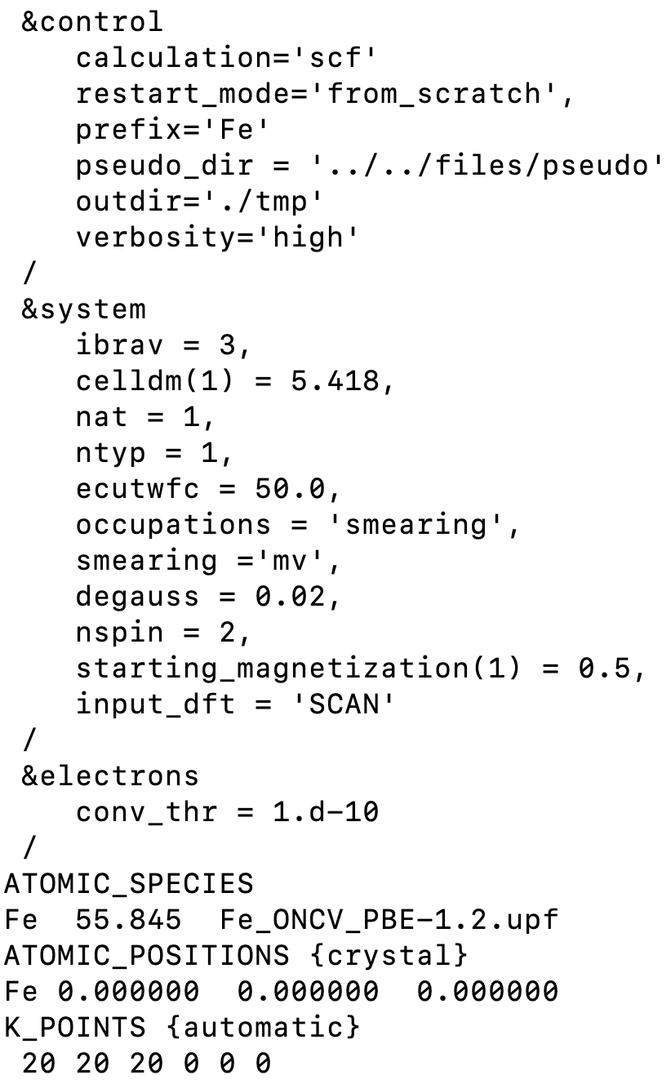
Input
Experimental lattice parameter
It is necessary to perform convergence tests w.r.t ecutwfc
Set up the SCAN functional from the input
Quantum ESPRESSO must be compiled with Libxc
Pseudopotential generated using the PBE functional
SG15 ONCV library (there is no SCAN pseudo for Fe)
It is necessary to perform convergence tests w.r.t k points mesh

Slide 75
SCAN functional & PBE pseudopotential (SG15)
Fe
k mesh: 20x20x20

Slide 76
SCAN functional & PBE pseudopotential (SG15)
Fe
50 Ry
2.76 $μ$_{B}
k mesh: 20x20x20

Slide 77
SCAN functional with different pseudopotentials
Ecut = 50 (Ry), k mesh: 20x20x20
Functional | Pseudopotential | Library | m ($μ$_{B})
SCAN | PBE | SG15 ONCV | 2.76
SCAN | PBE | Pseudo Dojo | 2.67
PBE | PBE | SG15 ONCV | 2.28
PBE | PBE | Pseudo Dojo | 2.26
NLCC=.false.
WARNING
NLCC=.true.
m_{expt} = 1.98 – 2.13 ($μ$_{B})
SCAN overestimates magnetic moments in itinerant ferromagnets
PBE is in closer agreement with experiments than SCAN for magnetic moments of itinerant ferromagnets
M. Ekholm et al., Phys. Rev. B 98, 094413 (2018).

Slide 78
Different flavors of SCAN
Functional | Pseudopotential | Library | m ($μ$_{B})
SCAN | PBE | SG15 ONCV | 2.76
rSCAN | PBE | SG15 ONCV | 2.73
r²SCAN | PBE | SG15 ONCV | 2.73
m_{expt} = 1.98 – 2.13 ($μ$_{B})
Different flavors of SCAN give very similar magnetic moments for bulk Fe

