Slide 1

Tutorial on DFT+U+V using Quantum ESPRESSO
Iurii Timrov, Fatemeh Haddadi, Edward Linscott, Nicola Marzari
THEOS and NCCR-MARVEL,
École Polytechnique Fédérale de Lausanne (Switzerland)

Slide 2
Outline
Example 1: Standard DFT calculation for CoO
Example 2: Calculation of Hubbard parameters for CoO
Example 3: DFT+U+V calculation for CoO

Slide 3
Outline
Example 1: Standard DFT calculation for CoO
Example 2: Calculation of Hubbard parameters for CoO
Example 3: DFT+U+V calculation for CoO

Slide 4
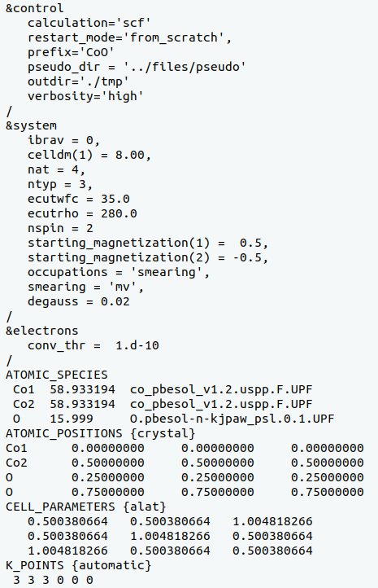
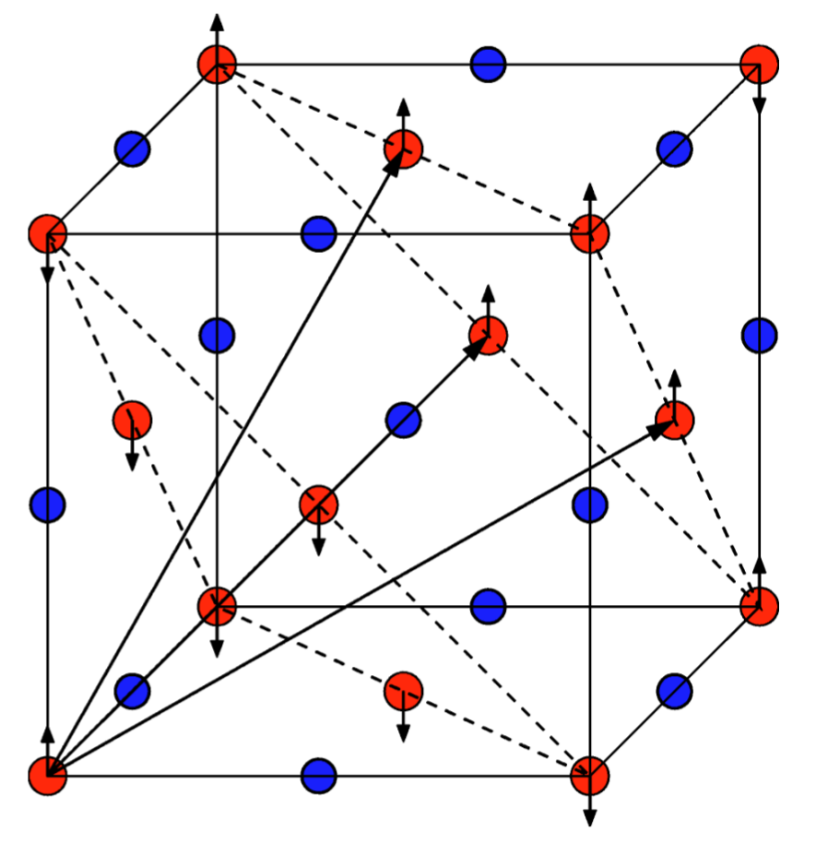
Input file CoO.scf.in
Self-consistent-field DFT calculation
Specification of the lattice (see CELL_PARAMETERS)
Number of atoms and atomic types
Cutoffs for the wavefunctions and density/potential
Spin-polarized (collinear) calculation (AFM)
Marzari-Vanderbilt smearing (broadening: 0.02 Ry)
Convergence threshold for self-consistency
Pseudopotentials and functional (PBEsol)
O
Co
https://www.quantum-espresso.org/Doc/INPUT_PW.html

Slide 5
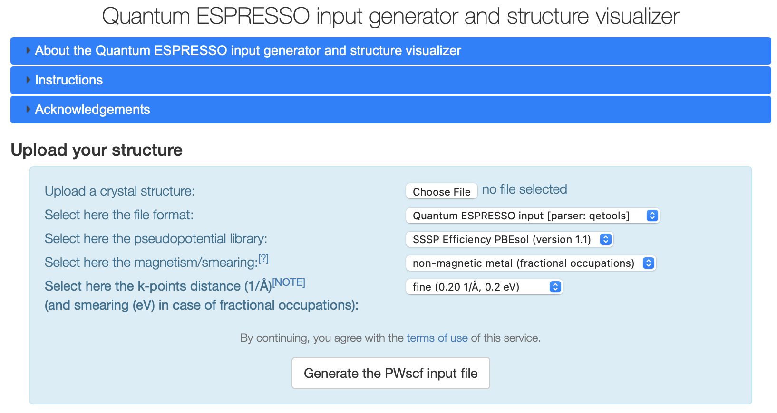
QE input generator
https://www.materialscloud.org/work/tools/qeinputgenerator

Slide 6
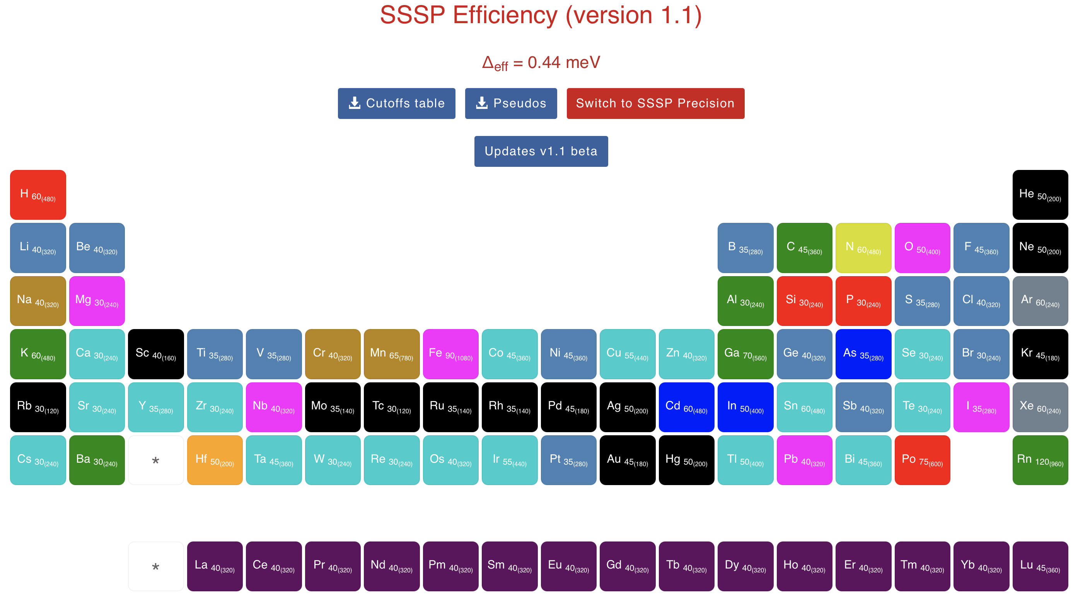
SSSP library
https://www.materialscloud.org/discover/sssp/table/efficiency

Slide 7
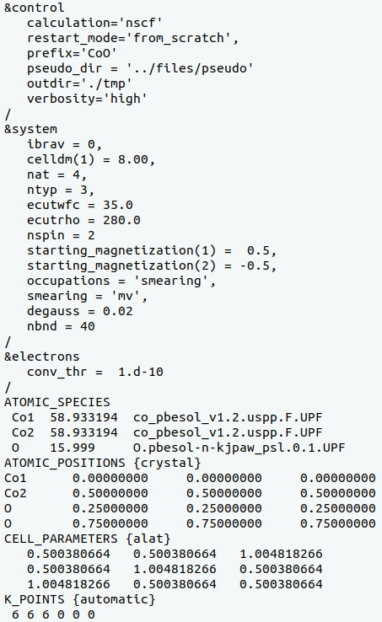
Input file CoO.nscf.in
Non-self-consistent-field DFT calculation
NSCF input is very similar to the SCF input,
but there are a few differences which are
highlighted here
Number of Kohn-Sham bands/states that are computed
Projected DOS must be converged with respect to
the number of k points. Also, number of bands must
be large enough, to have converged projected DOS
in a specific energy range. All this is controlled here.
Here we use a denser k points mesh (w.r.t SCF)

Slide 8
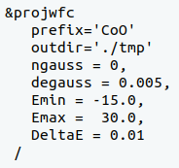
Input file CoO.projwfc.in
Gnuplot script: plot_pdos.gp
Gaussian broadening for PDOS
Value of the Gaussian broadening, in Ry (not eV!)
Minimum and maximum value of energy for the plot, in eV
Energy grid step
Inspect the script: it aims at plotting Co-3d state (majority spin and minority spin)
and O-2p states.
PDOS is shifted such that the Fermi energy corresponds to the zero of energy.
Visualize the file “CoO_PDOS.eps”

Slide 9
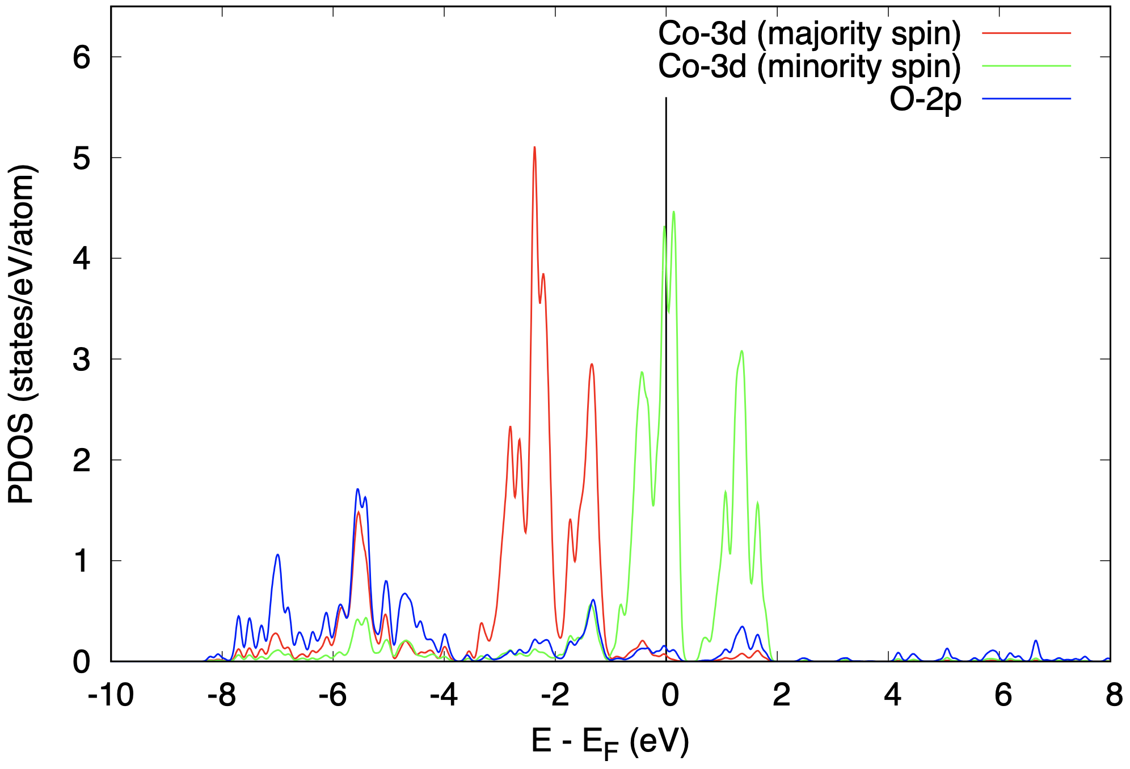
PDOS of CoO from a standard DFT calculation
DFT predicts CoO to be metallic (but this is wrong!)
Let's try DFT+U+V
Experimentally CoO is know to be insulating

Slide 10
Outline
Example 1: Standard DFT calculation for CoO
Example 2: Calculation of Hubbard parameters for CoO
Example 3: DFT+U+V calculation for CoO

Slide 11
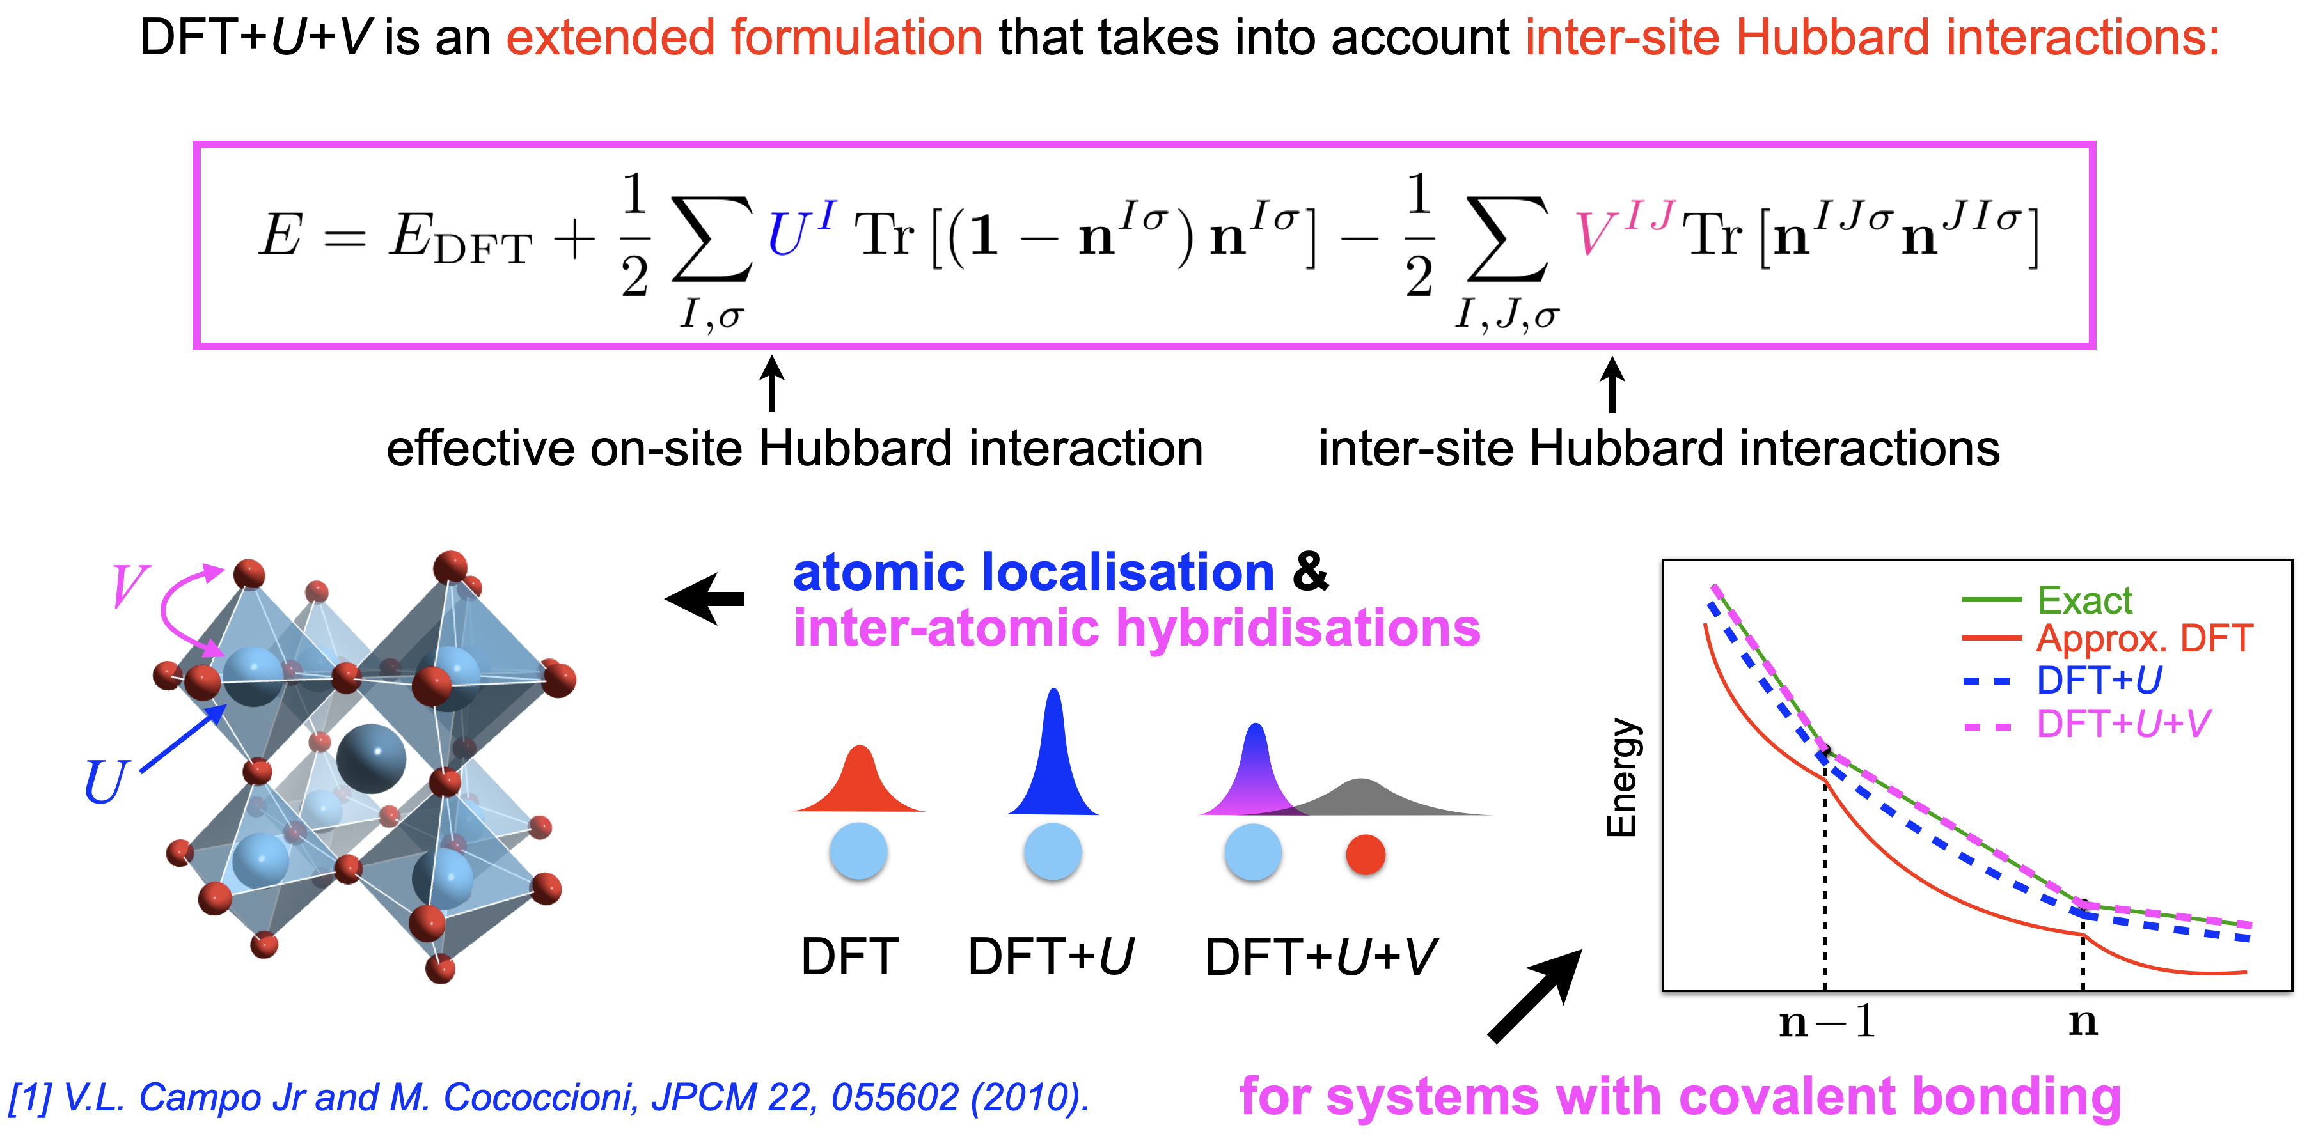
DFT+U+V
Both U and V are
computed using the
HP code
Theory:
V.L. Campo Jr and M. Cococcioni, JPCM 22, 055602 (2010)
I. Timrov, N. Marzari, M. Cococcioni, PRB 103, 045141 (2021)

Slide 12
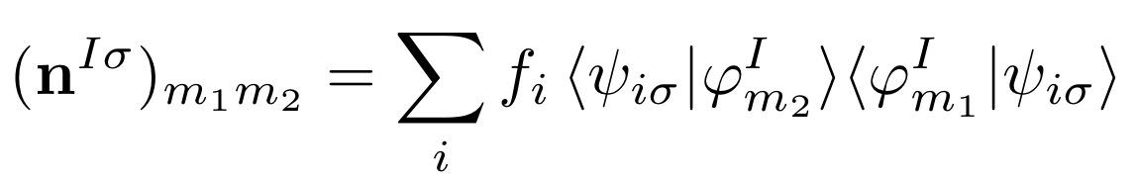
Hubbard projectors
Currently, Hubbard projectors are hard-coded (in Quantum ESPRESSO 6.7)
Check two subroutines in quantum-espresso/Modules :
set_hubbard_n.f90
set_hubbard_l.f90
principal quantum number “n”
orbital quantum number “l”
For Co : n = 3
For Co : l = 2
3d atomic orbitals (orthogonalized) of Co are Hubbard projector functions

Slide 13
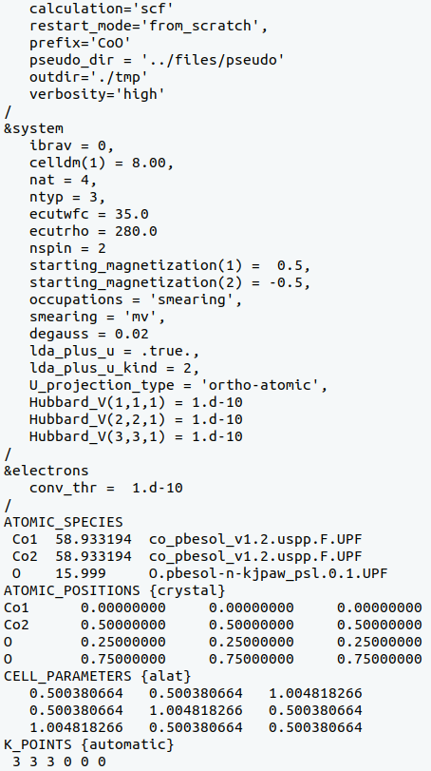
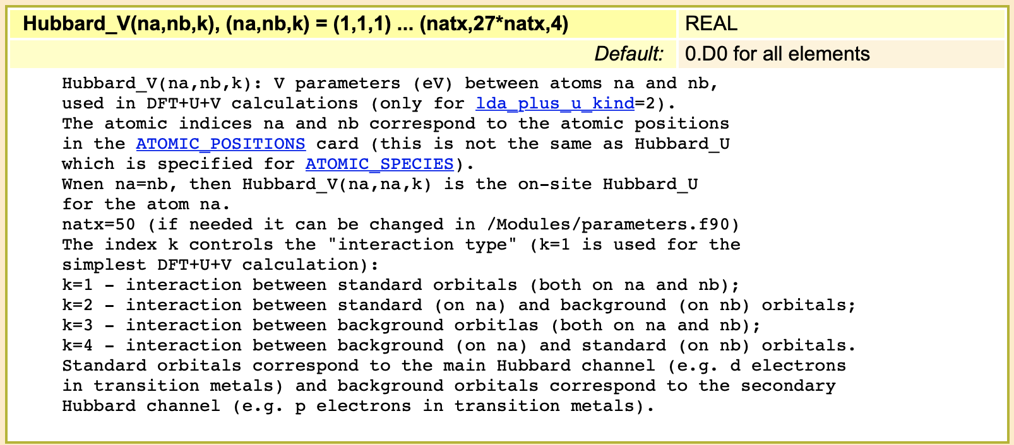
Input file CoO.scf.in for DFT+U+V
Hubbard-specific input keywords
lda_plus_u_kind = 0 (DFT+U, Dudarev)
lda_plus_u_kind = 1 (DFT+U, Lichtenstein)
lda_plus_u_kind = 2 (DFT+U+V, Dudarev)
U_projection_type = 'atomic'
U_projection_type = 'ortho-atomic'

Slide 14
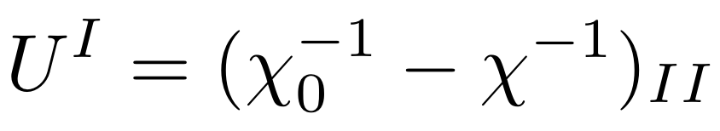
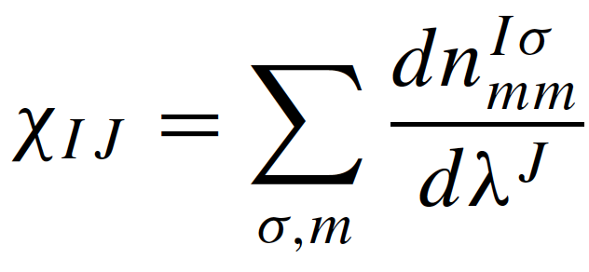
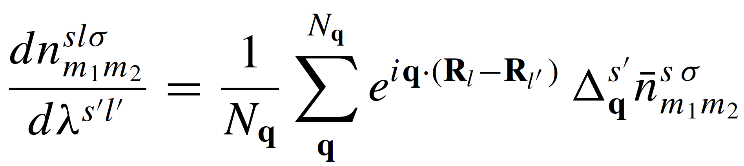
How to compute the Hubbard U and V parameters?
Linear response theory
Density-functional perturbation theory (DFPT)
Sum over q points (each q point corresponds to a different perturbation of electronic occupations)

Slide 15
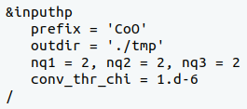

How to compute the Hubbard U and V parameters?
Using the HP (Hubbard Parameters) code of Quantum ESPRESSO
Input file “CoO.hp.in”:
Prefix and outdir must be exactly the same as in
the input file CoO.scf.in
Size of the q point mesh: 1x1x1 in this case
Convergence threshold for
parameters.out
(file with Hubbard parameters U and V)
Warning: These Hubbard parameters are not converged with respect to k and q!
You need to perform careful convergence tests!
Documentation: quantum-espresso/HP/Doc/INPUT_HP.txt
Theory:
I. Timrov, N. Marzari, M. Cococcioni, PRB 98, 085127 (2018)
I. Timrov, N. Marzari, M. Cococcioni, PRB 103, 045141 (2021)

Slide 16
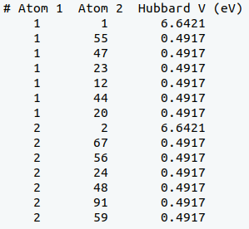
File parameters.out
U for Co1(3d)
V between Co1(3d) and its
6 nearest neighbors O(2p)
U for Co2(3d)
V between Co1(3d) and its
6 nearest neighbors O(2p)
What is the meaning of these indices for Atom 1 and Atom 2? (see next slides)

Slide 17
Neighbors in periodic boundary conditions
Let us consider a 2D case with 2 atoms in the primitive unit cell

Slide 18
Neighbors in periodic boundary conditions
Let us periodically repeat our cell along all directions (virtual 3x3 supercell in 2D)

Slide 19
Neighbors in periodic boundary conditions
18
4
6
17
3
5
16
2
8
15
7
15
1
14
12
10
13
3
11
9
Let us number/label all the atoms

Slide 20
Neighbors in periodic boundary conditions
18
4
6
17
3
5
16
2
8
15
7
15
1
14
12
10
13
11
9
Now we can determine nearest neighbors for each transition-metal atom

Slide 21
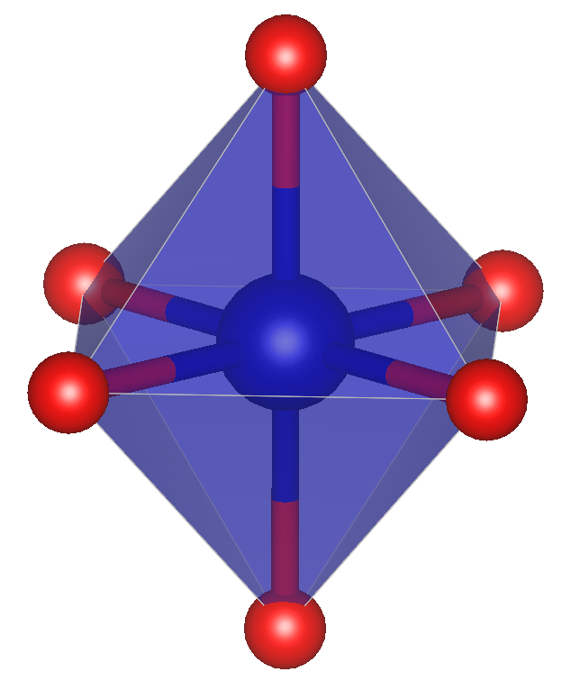
The 3D case of CoO: 3x3x3 virtual supercell
O23
O47
O20
Co1
O55
O12
O44
Co1 and Co2 both have 6 nearest neighbors which are O atoms

Slide 22
Outline
Example 1: Standard DFT calculation for CoO
Example 2: Calculation of Hubbard parameters for CoO
Example 3: DFT+U+V calculation for CoO

Slide 23
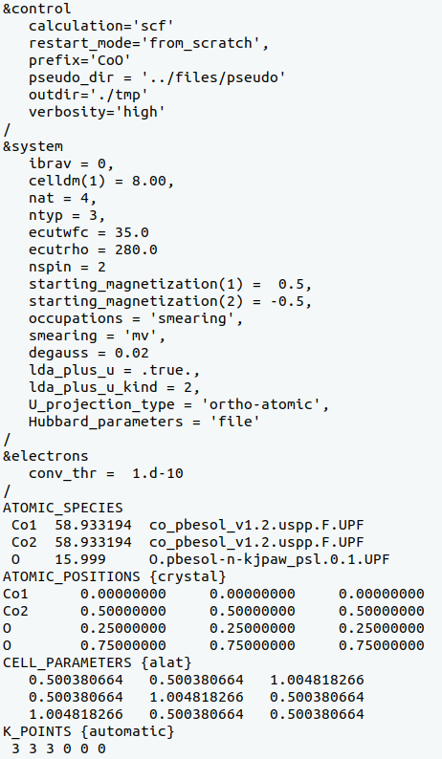
Input file CoO.scf.in
Self-consistent-field DFT+U+V calculation
Hubbard keywords as before
Read Hubbard U and V from file parameters.in
Note: you need to rename the previously obtained
file from parameters.out to parameters.in and use
it in exercise “3_DFT+U+V”

Slide 24
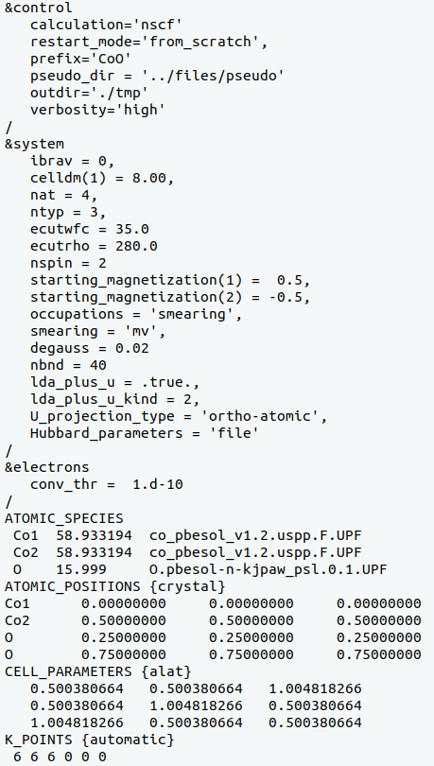
Input file CoO.nscf.in
Non-self-consistent-field DFT+U+V calculation
Hubbard keywords as before
Read Hubbard U and V from file parameters.in

Slide 25
Input file CoO.projwfc.in
Gnuplot script: plot_pdos.gp
Gaussian broadening for PDOS
Value of the Gaussian broadening, in Ry (not eV!)
Minimum and maximum value of energy for the plot, in eV
Energy grid step
Inspect the script: it aims at plotting Co-3d state (majority spin and minority spin)
and O-2p states.
PDOS is shifted such that the Fermi energy corresponds to the zero of energy.
Visualize the file “CoO_PDOS.eps”

Slide 26
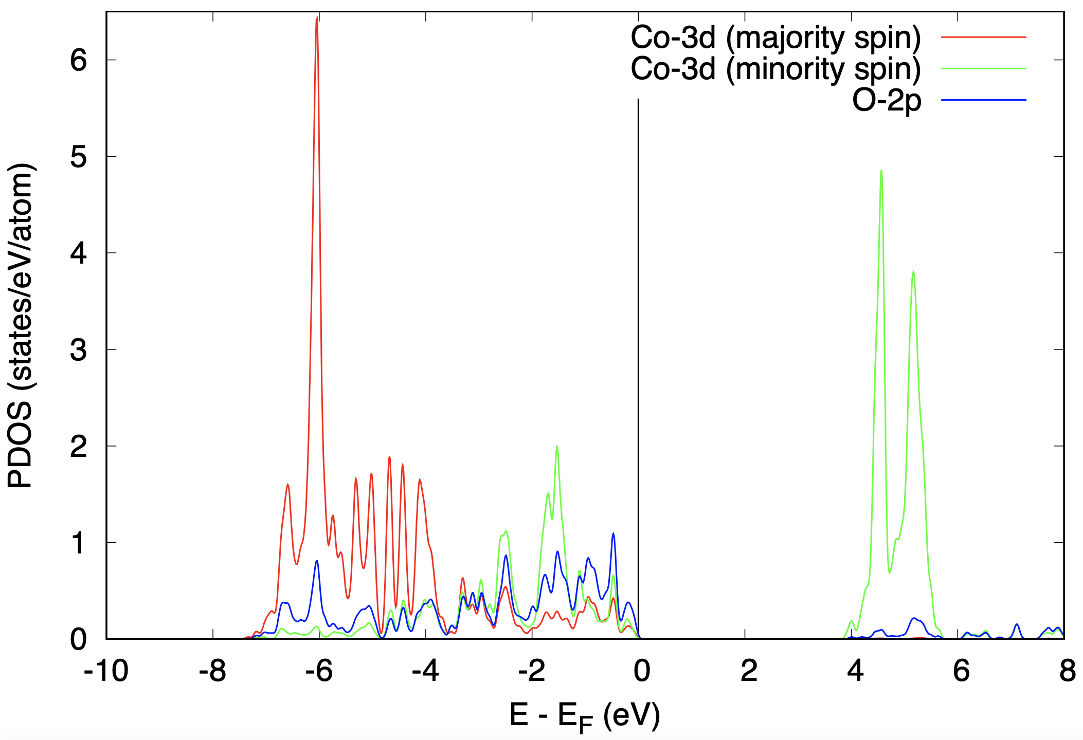
DFT vs DFT+U+V
DFT
DFT+U+V
The solution with DFT is metallic
The solution with DFT+U+V is insulating
Agreement with the experiment!

Slide 27
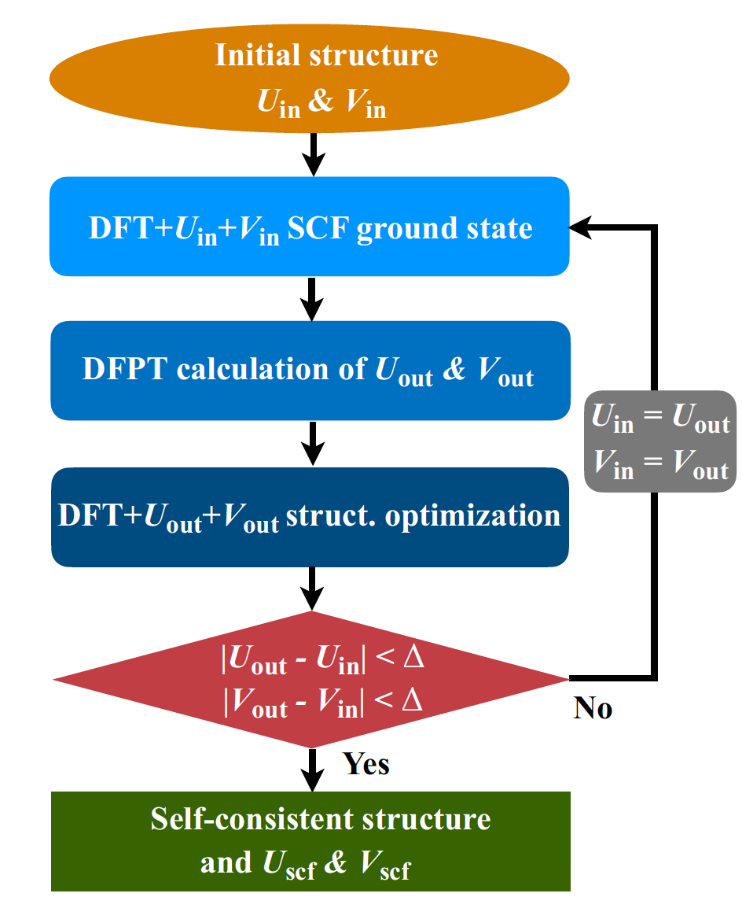
Self-consistent calculation of Hubbard parameters
I. Timrov, N. Marzari, M. Cococcioni, PRB 103, 045141 (2021)

Slide 28
Some examples where intersite Hubbard V is important
- Structural properties and energetics of molecular complexes: J. Chem. Phys. 134, 094103 (2011)
- Voltages in Li-ion batteries: Phys. Rev. Materials 3, 033801 (2019)
- Formation energies of oxygen vacancies: Phys. Rev. Research 2, 023313 (2020)
- Energetics of complex magnetic systems: arXiv: 2106.00520 (2021)

