Slide 1
Bode Diagram (1)
Hany Ferdinando
Dept. of Electrical Engineering
Petra Christian University

Slide 2
General Overview
This section discusses the steady-state response of sinusoidal input
The frequency response analysis uses Bode diagram
Students also learn how to plot Bode diagram

Slide 3
What is frequency response?
X(s)
G(s)
Y(s)
If x(t) = X sin ωt then y(t) = Y sin (ωt + φ)
The sinusoidal transfer function G(jω) is a complex quantity and can be represented by the magnitude and phase angle with frequency as a parameter

Slide 4
Presenting the freq. resp.
Bode Diagram or logarithmic plot (this section)
Nyquist plot or polar plot
Log-magnitude versus phase plot
Matlab can be used to plot both Bode diagram and Nyquist plot

Slide 5
Preparation
Bode diagram uses the open loop transfer function
The plot is a pair of magnitude and phase plots
  The representation of logarithmic magnitude is 20 log |G(jω)| in dB
The main advantage: multiplication is converted into addition

Slide 6
Basic factor of G(jω)
Gain K
Derivative and integral factors (jω)^{±1}
First-order factors (1+jωΤ)^{±1}
Quadratic factors [1+2ζ(jω/ω_{n})+(jω/ω_{n})²]^{±1}
One must pay attention to the corner frequency and the form of the equation must be fitted to above

Slide 7
Gain K
It is real part only → no phase angle
The log-magnitude is a straight line at 20 log (K)
  If K > 1, then the magnitude is positive
  If K < 1, then the magnitude is negative
Varying K only influences the log-magnitude plot, the phase angle remains the same
Slope is 0 at corner frequency 0 rad/s

Slide 8
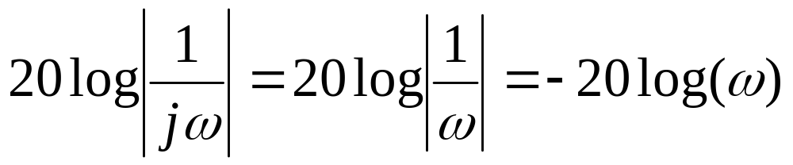
Integral (jω)⁻¹
It has only imaginary part
Log-magnitude = -20 log (ω)
Phase angle = 90º (constant)
Slope is -20 dB/decade at corner frequency ω=1 rad/s

Slide 9
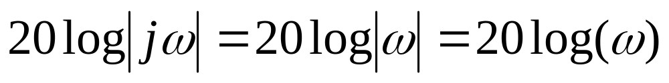
Derivative (jω)
It has only imaginary part
Log-magnitude: 20 log (ω)
Phase angle: 90º (constant)
Slope is 20 dB/decade at corner frequency ω=1 rad/s

Slide 10
First order (1+jωΤ)^{±1} (1)
Integral:
  Corner frequency is at ω=1/T
  Slope is -20 dB/decade
  Phase angle is -45º at corner frequency
Derivative:
  Corner frequency is at ω=1/T
  Slope is 20 dB/decade
  Phase angle is 45º at corner frequency

Slide 11
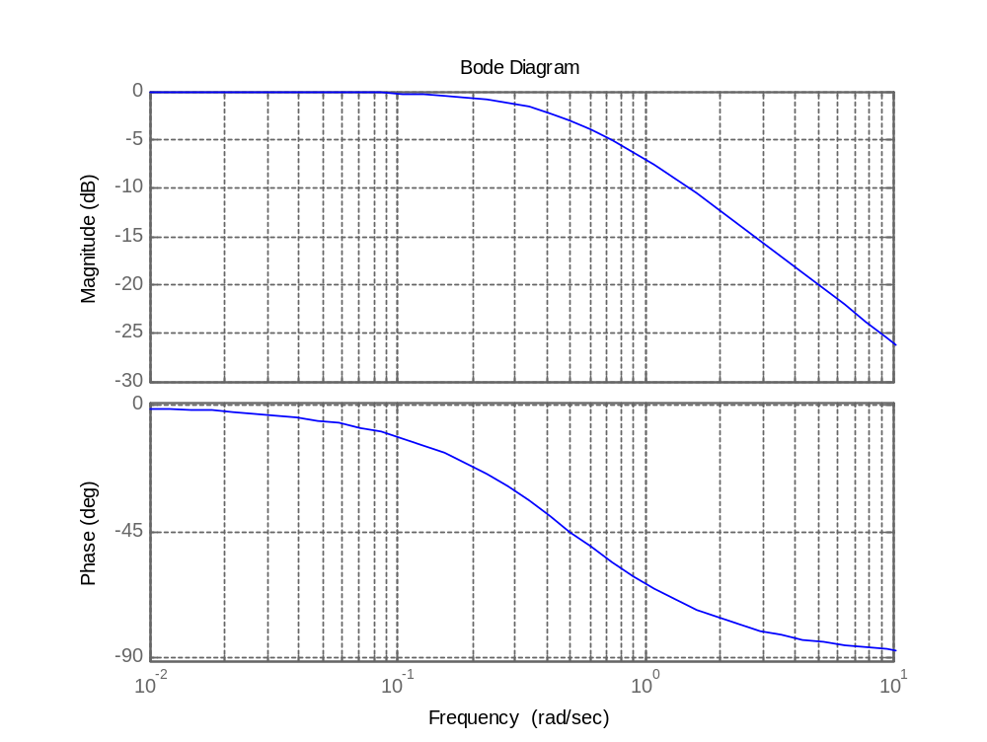
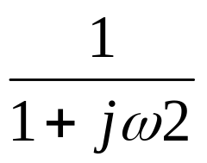
First order (1+jωΤ)^{±1} (2)
Slope: 20dB/dec
45º at ω=0,5 rad/s

Slide 12
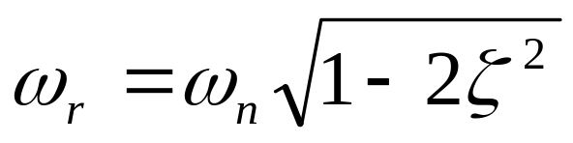
Quadratic factors (1)
Integral:
  Corner frequency is at ω=ω_{n}
  Slope is – 40 dB/decade
  Phase angle is -90º at corner frequency
Derivative:
  Corner frequency is at ω=ω_{n}
  Slope is 40 dB/decade
  Phase angle is 90º at corner frequency
Resonant freq:

Slide 13
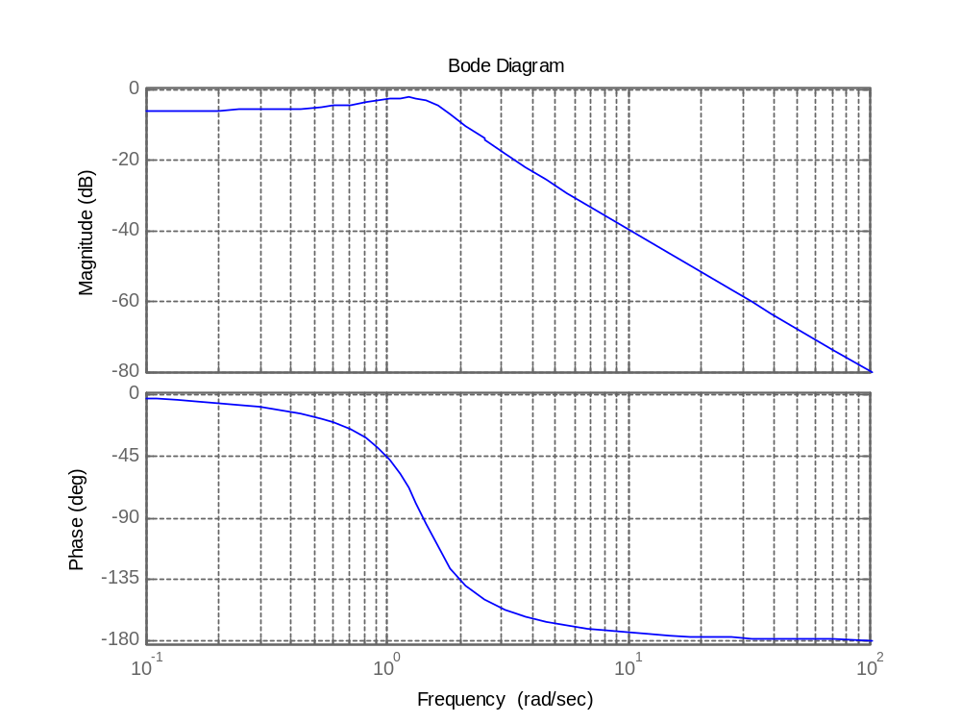
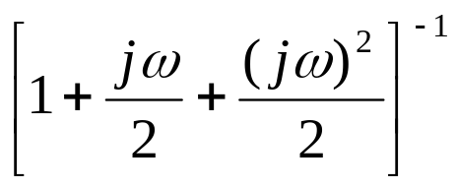
Quadratic factors (2)
ω_{n} = √2
Slope = 40dB/dec
90º at corner freq. ω_{n} = √2

Slide 14
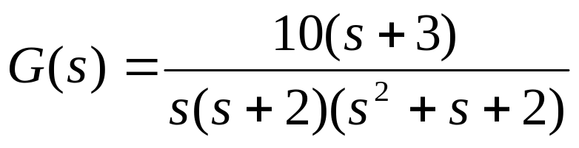
Example:
Draw Bode diagram for the following transfer function:

Slide 15
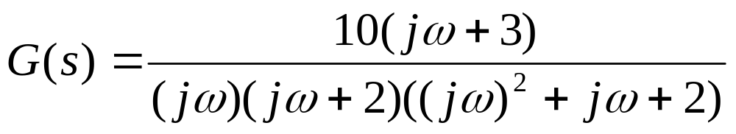
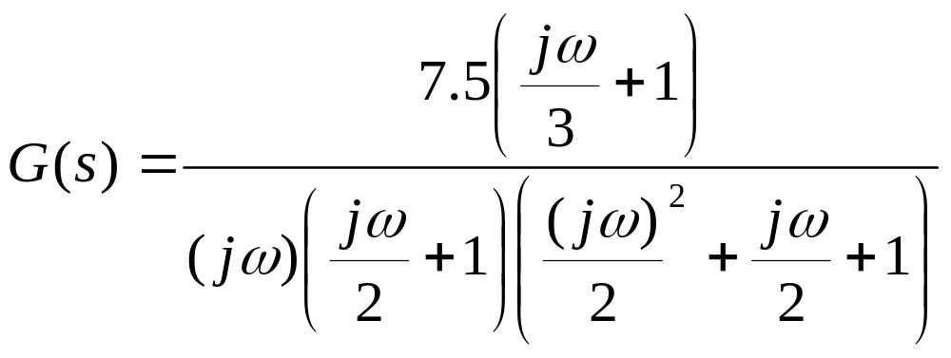
Answer:
Substitute the s with jω! We got
Make it to the standard form… Proot it!!!

Slide 16
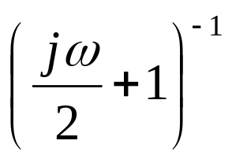
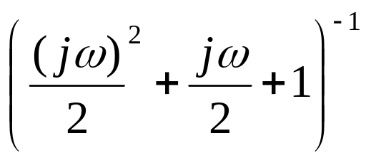
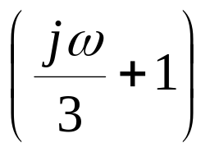

Answer:
from
We got
7.5
With ζ = 0.35

Slide 17
Answer:
7.5 is gain
  Log-magnitude = 20 log (7.5)
  Phase = 0º
The
  Slope = 20 dB/decade
  Phase = 45º at ω = 3 rad/s

Slide 18
Answer
The
  Slope = -20 dB/decade
  Phase = -90º (constant)
The
  Slope = -20 dB/decade
  Phase = - 45º at ω = 2 rad/s

Slide 19
Answer:
The
  Slope = - 40 dB/decade
  Phase = -90º at ω = √2 rad/s
The next step is to combine all magnitudes and phases respectively, then add all of them to from a sketch of Bode diagram

Slide 20

Next…
The Bode diagram has been discussed here, the next topic is Phase and Gain Margin. Several important points will be discussed as well
Please prepare yourself by reading the book!

