Slide 1
Statistical Machine Translation
Part I - Introduction
Alexander Fraser
Institute for Natural Language Processing
University of Stuttgart
2010.04.28 Seminar: Statistical MT (with Schmid)

Slide 2
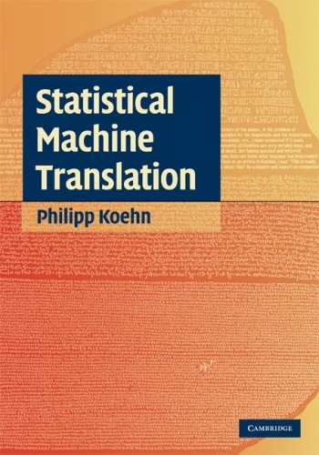
Please see the web page for details of Schein for SS 2010 Seminar
Slides are on the reading group web page
Other resources: Philipp Koehn’s book ->
Prof. Sebastian Pado has a course meeting on Thursdays discussing the utility of parallel text
  Prof Pado’s course will briefly consider Statistical Machine Translation, and cover a wide range of other applications of parallel text (annotation projection, cross-lingual information retrieval, etc)

Slide 3
Lecture 1 – Introduction + Eval
Machine translation
Data driven machine translation
  Parallel corpora
  Sentence alignment
  Overview of statistical machine translation
Evaluation of machine translation

Slide 4
A brief history
Machine translation was one of the first applications envisioned for computers
Warren Weaver (1949): “I have a text in front of me which is written in Russian but I am going to pretend that it is really written in English and that it has been coded in some strange symbols. All I need to do is strip off the code in order to retrieve the information contained in the text.”
First demonstrated by IBM in 1954 with a basic word-for-word translation system
Modified from Callison-Burch, Koehn

Slide 5
Interest in machine translation
Commercial interest:
  U.S. has invested in machine translation (MT) for intelligence purposes
  MT is popular on the web—it is the most used of Google’s special features
  EU spends more than $1 billion on translation costs each year.
  (Semi-)automated translation could lead to huge savings
Modified from Callison-Burch, Koehn

Slide 6
Interest in machine translation
Academic interest:
  One of the most challenging problems in NLP research
  Requires knowledge from many NLP sub-areas, e.g., lexical semantics, syntactic parsing, morphological analysis, statistical modeling,…
  Being able to establish links between two languages allows for transferring resources from one language to another
Modified from Dorr, Monz

Slide 7
Machine translation
Goals of machine translation (MT) are varied, everything from gisting to rough draft
Largest known application of MT: Microsoft knowledge base
  Documents (web pages) that would not otherwise be translated at all

Slide 8

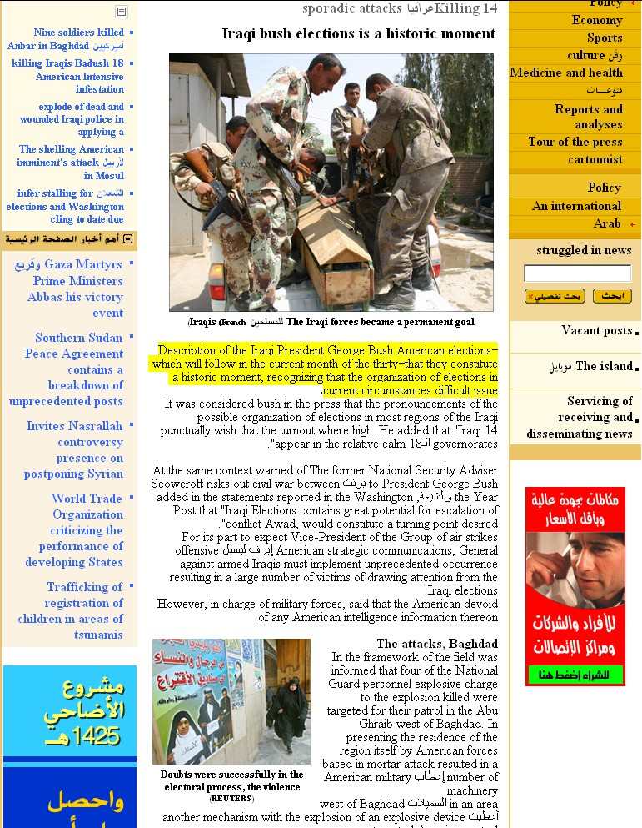

Language Weaver Arabic to English
v.2.0 – October 2003
v.2.4 – October 2004
v.3.0 - February 2005

Slide 9
Document versus sentence
MT problem: generate high quality translations of documents
However, all current MT systems work only at sentence level!
Translation of independent sentences is a difficult problem that is worth solving
But remember that important discourse phenomena are ignored!
  Example: How to translate English it to French (choice of feminine vs masculine it) or German (feminine/masculine/neuter it) if object referred to is in another sentence?

Slide 10
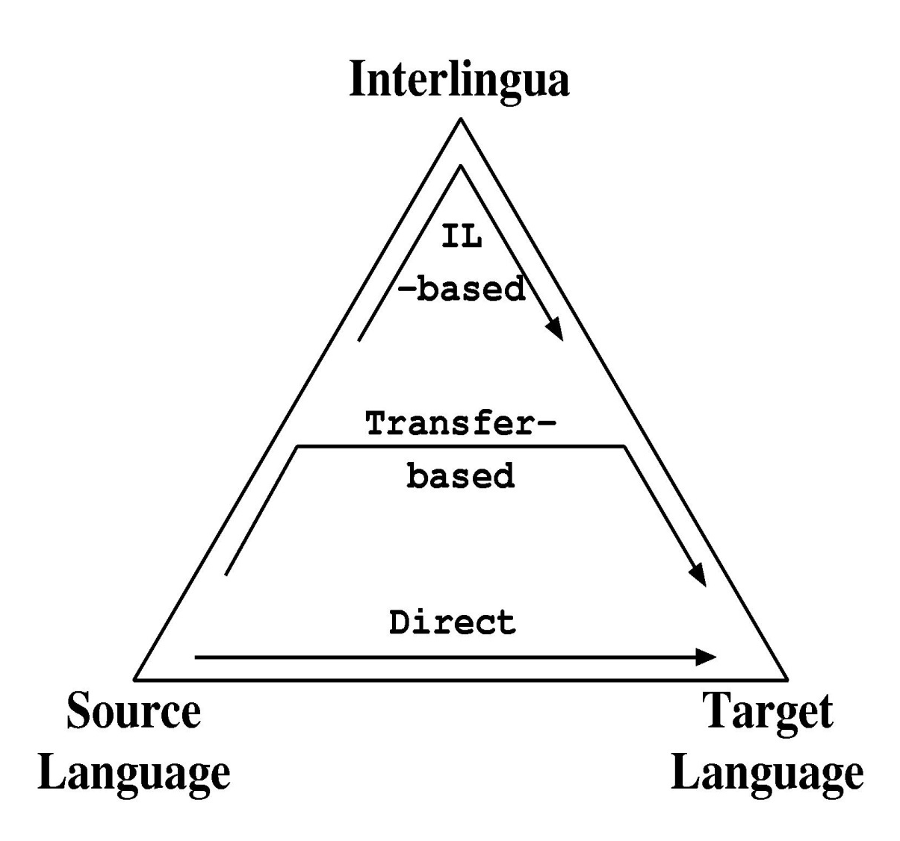
Machine Translation Approaches
Grammar-based
  Interlingua-based
  Transfer-based
Direct
  Example-based
  Statistical
Modified from Vogel

Slide 11
Statistical versus Grammar-Based
Often statistical and grammar-based MT are seen as alternatives, even opposing approaches – wrong !!!
Dichotomies are:
  Use probabilities – everything is equally likely (in between: heuristics)
  Rich (deep) structure – no or only flat structure
Both dimensions are continuous
Examples
  EBMT: flat structure and heuristics
  SMT: flat structure and probabilities
  XFER: deep(er) structure and heuristics
Goal: structurally rich probabilistic models
 | No Probs | Probs
Flat Structure | EBMT | SMT
Deep Structure | XFER, Interlingua | Holy Grail
Modified from Vogel

Slide 12
Statistical Approach
Using statistical models
  Create many alternatives, called hypotheses
  Give a score to each hypothesis
  Select the best -> search
Advantages
  Avoid hard decisions
  Speed can be traded with quality, no all-or-nothing
  Works better in the presence of unexpected input
Disadvantages
  Difficulties handling structurally rich models, mathematically and computationally
  Need data to train the model parameters
  Difficult to understand decision process made by system
Modified from Vogel

Slide 13
Outline
Machine translation
Data-driven machine translation
  Parallel corpora
  Sentence alignment
  Overview of statistical machine translation
Evaluation of machine translation

Slide 14
Parallel corpus
Example from DE-News (8/1/1996)
English | German
Diverging opinions about planned tax reform | Unterschiedliche Meinungen zur geplanten Steuerreform
The discussion around the envisaged major tax reform continues . | Die Diskussion um die vorgesehene grosse Steuerreform dauert an .
The FDP economics expert , Graf Lambsdorff , today came out in favor of advancing the enactment of significant parts of the overhaul , currently planned for 1999 . | Der FDP - Wirtschaftsexperte Graf Lambsdorff sprach sich heute dafuer aus , wesentliche Teile der fuer 1999 geplanten Reform vorzuziehen .
Modified from Dorr, Monz

Slide 15
Most statistical machine translation research
has focused on a few high-resource languages
(European, Chinese, Japanese, Arabic).
(~200M words)
Approximate
Parallel Text Available
(with English)
Various
Western European
languages:
parliamentary
proceedings,
govt documents
(~30M words)
{
u
{
Bible/Koran/
Book of Mormon/
Dianetics
(~1M words)
Nothing/
Univ. Decl.
Of Human
Rights
(~1K words)
{
…
…
…
French
Arabic
German
Finnish
Serbian
Uzbek
Chechen
Kasem
AMTA 2006
Overview of Statistical MT
Chinese
Spanish
Tamil
Pwo
Modified from Schafer&Smith

Slide 16
How to Build an SMT System
Start with a large parallel corpus
  Consists of document pairs (document and its translation)
Sentence alignment: in each document pair automatically find those sentences which are translations of one another
  Results in sentence pairs (sentence and its translation)
Word alignment: in each sentence pair automatically annotate those words which are translations of one another
  Results in word-aligned sentence pairs
Automatically estimate a statistical model from the word-aligned sentence pairs
  Results in model parameters
Given new text to translate, apply model to get most probable translation

Slide 17
Sentence alignment
If document D_{e} is translation of document D_{f} how do we find the translation for each sentence?
The n-th sentence in D_{e} is not necessarily the translation of the n-th sentence in document D_{f}
In addition to 1:1 alignments, there are also 1:0, 0:1, 1:n, and n:1 alignments
In European Parliament proceedings, approximately 90% of the sentence alignments are 1:1
Modified from Dorr, Monz

Slide 18
Sentence alignment
There are several sentence alignment algorithms:
  Align (Gale & Church): Aligns sentences based on their character length (shorter sentences tend to have shorter translations then longer sentences). Works well
  Char-align: (Church): Aligns based on shared character sequences. Works fine for similar languages or technical domains
  K-Vec (Fung & Church): Induces a translation lexicon from the parallel texts based on the distribution of foreign-English word pairs
  Cognates (Melamed): Use positions of cognates (including punctuation)
  Length + Lexicon (Moore): Two passes, high accuracy, freely available
Modified from Dorr, Monz

Slide 19

Word alignments
Given a parallel sentence pair we can link (align) words or phrases that are translations of each other:
Modified from Dorr, Monz

Slide 20
How to Build an SMT System
Construct a function g which, given a sentence in the source language and a hypothesized translation into the target language, assigns a goodness score
  g(die Waschmaschine läuft , the washing machine is running) = high number
  g(die Waschmaschine läuft , the car drove) = low number

Slide 21
Using the SMT System
Implement a search algorithm which, given a source language sentence, finds the target language sentence which maximizes g
To use our SMT system to translate a new, unseen sentence, call the search algorithm
  Returns its determination of the best target language sentence
To see if your SMT system works well, do this for a large number of unseen sentences and evaluate the results

Slide 22
SMT modeling
We wish to build a machine translation system which given a Foreign sentence “f” produces its English translation “e”
  We build a model of P( e | f ), the probability of the sentence “e” given the sentence “f”
  To translate a Foreign text “f”, choose the English text “e” which maximizes P( e | f )

Slide 23
Noisy Channel: Decomposing P(e|f )
    argmax P( e | f ) = argmax P( f | e ) P( e )
    e e
P( e ) is referred to as the “language model”
  P ( e ) can be modeled using standard models (N-grams, etc)
  Parameters of P ( e ) can be estimated using large amounts of monolingual text (English)
P( f | e ) is referred to as the “translation model”

Slide 24
SMT Terminology
Parameterized Model: the form of the function g which is used to determine the goodness of a translation
  g(die Waschmaschine läuft, the washing machine is running) = P(e | f)
  P(the washing machine is running|die Waschmaschine läuft)=

Slide 25
SMT Terminology
Parameterized Model: the form of the function g which is used to determine the goodness of a translation
  g(die Waschmaschine läuft, the washing machine is running) = P(e | f)
  P(the washing machine is running|die Waschmaschine läuft)=
  What??
  Unless we have seen exactly the input sentence in our training data, we can’t GENERALIZE.
  So we will decompose this translation into parts, so that we can generalize to new sentences.

Slide 26
SMT Terminology
Parameterized Model: the form of the function g which is used to determine the goodness of a translation
  g(die Waschmaschine läuft, the washing machine is running) = P(e | f)
  P(the washing machine is running|die Waschmaschine läuft)=
  Suppose we translate:
  “die” to “the”
  “Waschmaschine” to “washing machine”
  “läuft” to “is running”
  (and further suppose we don’t worry about word order…)

Slide 27
SMT Terminology
Parameterized Model: the form of the function g which is used to determine the goodness of a translation
  g(die Waschmaschine läuft, the washing machine is running) = P(e | f)
  P(the washing machine is running|die Waschmaschine läuft)=
    n(1 | die) t(the | die)
    n(2 | Waschmaschine) t(washing | Waschmaschine)
    t(machine | Waschmaschine)
    n(2 | läuft) t(is | läuft) t(running | läuft)
    l(the | START) l(washing | the) l(machine | washing) l(is | machine) l(running | is)

Slide 28
SMT Terminology
Parameters: lookup tables used in function g
  P(the washing machine is running|die Waschmaschine läuft) =
    n(1 | die) t(the | die)
    n(2 | Waschmaschine) t(washing | Waschmaschine)
    t(machine | Waschmaschine)
    n(2 | läuft) t(is | läuft) t(running | läuft)
    l(the | START) l(washing | the) l(machine | washing) l(is | machine) l(running | is)
    0.1 x 0.1
    x 0.5 x 0.8
    x 0.7
    x 0.1 x 0.1 x 0.1
    x 0.0000001
Notes:
the car is running

Slide 29
SMT Terminology
Parameters: lookup tables used in function g
  P(the washing machine is running|die Waschmaschine läuft) =
    n(1 | die) t(the | die)
    n(2 | Waschmaschine) t(washing | Waschmaschine)
    t(machine | Waschmaschine)
    n(2 | läuft) t(is | läuft) t(running | läuft)
    l(the | START) l(washing | the) l(machine | washing) l(is | machine) l(running | is)
    Change “washing machine” to “car”
    0.1 x 0.1
    x 0.1 x 0.0001 n( 1 | Waschmaschine)
    t(car | Waschmaschine)
    x 0.1 x 0.1 x 0.1
    x also different
    0.1 x 0.1
    x 0.5 x 0.8
    x 0.7
    x 0.1 x 0.1 x 0.1
    x 0.0000001
Notes:
the car is running

Slide 30
SMT Terminology
Training: automatically building the lookup tables used in g, using parallel sentences
One way to determine t(the|die)
  Generate a word alignment for each sentence pair
  Look through the word-aligned sentence pairs
  Count the number of times „die“ is translated as „the“
  Divide by the number of times „die“ is translated.
  If this is 10% of the time, we set t(the|die) = 0.1

Slide 31
SMT Last Words
  Translating is usually referred to as decoding (Warren Weaver)
  SMT was invented by automatic speech recognition (ASR) researchers. In ASR:
    P(e) = language model
    P(f|e) = acoustic model
    However, SMT must deal with word reordering!

Slide 32
Outline
Machine translation
Data-driven machine translation
  Parallel corpora
  Sentence alignment
  Overview of statistical machine translation
Evaluation of machine translation

Slide 33
Evaluation driven development
  Lessons learned from automatic speech recognition (ASR)
    Reduce evaluation to a single number
      For ASR we simply compare the hypothesized output from the recognizer with a transcript
      Calculate similarity score of hypothesized output to transcript
      Try to modify the recognizer to maximize similarity
    Shared tasks – everyone uses same data
      May the best model win!
  These lessons widely adopted in NLP and Information Retrieval

Slide 34
Evaluation of machine translation
We can evaluate machine translation at corpus, document, sentence or word level
  Remember that in MT the unit of translation is the sentence
Human evaluation of machine translation quality is difficult
We are trying to get at the abstract usefulness of the output for different tasks
  Everything from gisting to rough draft translation

Slide 35
Sentence Adequacy/Fluency
Consider German/English translation
Adequacy: is the meaning of the German sentence conveyed by the English?
Fluency: is the sentence grammatical English?
These are rated on a scale of 1 to 5
Modified from Dorr, Monz

Slide 36
Human Evaluation
Je suis fatigué.
Adequacy
Fluency
Tired is I.
5
2
Cookies taste good!
1
5
I am tired.
5
5
Modified from Schafer, Smith

Slide 37
Automatic evaluation
Evaluation metric: method for assigning a numeric score to a hypothesized translation
Automatic evaluation metrics often rely on comparison with previously completed human translations

Slide 38
Word Error Rate (WER)
WER: edit distance to reference translation (insertion, deletion, substitution)
Captures fluency well
Captures adequacy less well
Too rigid in matching
Hypothesis = „he saw a man and a woman“
Reference = „he saw a woman and a man“
WER gives no credit for „woman“ or „man“ !

Slide 39
Position-Independent Word Error Rate (PER)
PER: captures lack of overlap in bag of words
Captures adequacy at single word (unigram) level
Does not capture fluency
Too flexible in matching
Hypothesis 1 = „he saw a man“
Hypothesis 2 = „a man saw he“
Reference = „he saw a man“
Hypothesis 1 and Hypothesis 2 get same PER score!

Slide 40
BLEU
Combine WER and PER
  Trade off between rigid matching of WER and flexible matching of PER
BLEU compares the 1,2,3,4-gram overlap with one or more reference translations
  BLEU penalizes generating long strings because they would unfairly overlap more
  References are usually 1 or 4 translations (done by humans!)
BLEU correlates well with average of fluency and adequacy at corpus level
  But not at sentence level!

Slide 41
BLEU discussion
BLEU works well for comparing two similar MT systems
  Particularly: SMT system built on fixed training data vs. Improved SMT system built on same training data
  Other metrics such as METEOR extend these ideas and work even better – ongoing research!
BLEU does not work well for comparing dissimilar MT systems
There is no good automatic metric at sentence level
There is no automatic metric that returns a meaningful measure of absolute quality

Slide 42
Language Weaver Arabic to English
v.2.0 – October 2003
v.2.4 – October 2004
v.3.0 - February 2005

Slide 43
Reading for next time is on the web page (easy to find from my home page)
  Kevin Knight tutorial on word alignment models
  Next lecture will be more mathematical, doing the reading will help!

Slide 44
Thank you for your attention!

