Slide 1
Metabolic Pathway Analysis
DUPIS Alexis, VIDAL Ugo, TERRIEN Marie, LEFOL Yohan

Slide 2
Mise en contexte
Glycolyse
Aucun outil existe pour les voies non-canoniques
Non-canoniques → Voies métabolique non standard
Exemple : La glycolyse + cycle de Krebs
Pyruvate
Autre
Krebs

Slide 3
Objectif
Créer un outils facile d’utilisation
Résultats parlants et publiables dans des articles scientifiques.
Analyse ‘Topographique’ pour les voies canoniques.
Sur le site du client (Cellomet)

Slide 4
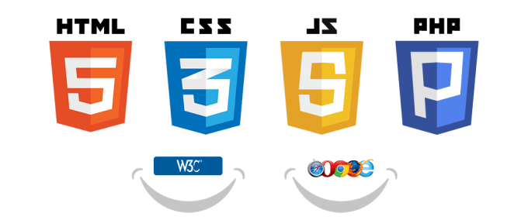




Les outils
Travail collaboratif
Langage de programmation pour faire des analyses statistique
Packages :
- ROntoTools
- DESeq2

Slide 5
Gantt
Comprendre l'outil ROntoTools
100%
Nov 11 - Nov 22
Créer l'interface web
Nov 11 - Dec 20
Écrire les différents script fonctionnels
100%
Nov 11 - Nov 22
Réunir les scripts en un seul
Dec 9 - Dec 20
Faire le lien entre l'interface web et les scripts R
Jan 13 - Feb 21
Ajouter des voies non-canoniques
Jan 13 - Feb 21
Implémenter l'outils sur le serveur client
Mar 9 - Mar 20
Nov
Dec
2020
Feb
Mar
2020
Today

Slide 6
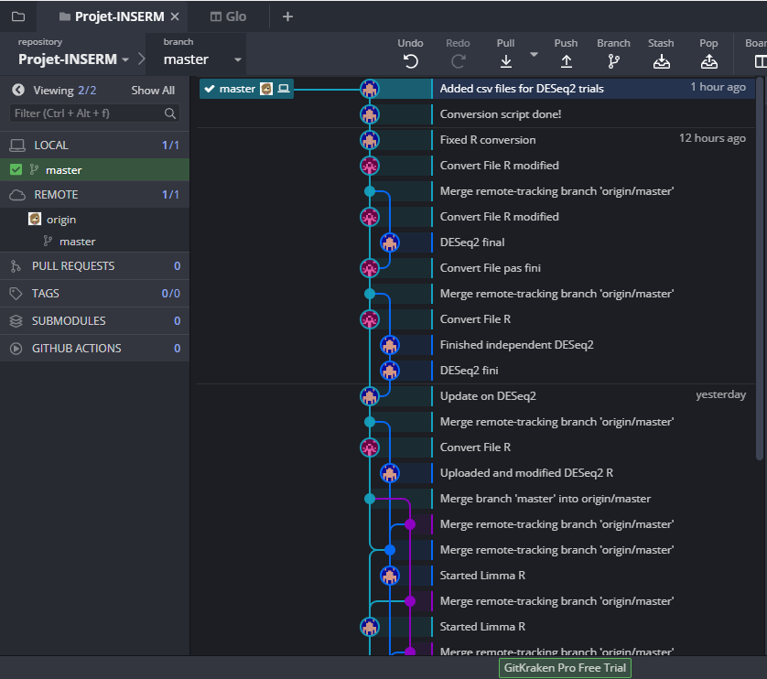
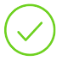

Avancement du Projet
GitKraken mis en place et fonctionnel
4 scripts R fonctionnels ont été écrits et testés
L’interface web a été débutée
Convertir les 4 scripts R en un seul script et tester
Finir l’interface web
Section de l’interface de Git Kraken

Slide 7
Context
Nowadays, there are no tools that can analyze a genome to find non-canonical pathways that are over or under-regulated.
Non-canonical pathways represent non-standard metabolic pathways, which represents metabolic pathways that use components from other pathways or pathways that are linked with other pathways through an over-production of a molecule.
For example, the overexpression of the glycolysis pathway (production of pyruvate) can be interpreted as an augmentation of acetyl-CoA metabolisation as the Krebs cycle uses pyruvate and creates acectyl-CoA.

Slide 8
Goal
Develop an analysis tool for canonical and non-canonical pathways. This tool will be available for all researchers and will be usable without any knowledge in computer science.
The tool will produce results and graphs that can be used in scientific publications.
The tool will use a ‘Topography-base’ type of analysis for canonical pathways.
The tool will be uploaded on the client’s server (Cellomet).

Slide 9
Tools
GitHub/GitKraken
Allows the team to work as group for different scripts in the project
R/R studio
It’s the main tool for the project. Allows us to use different R packages for specific analysis.
ROntoTools
It’s an R package that analyzes metabolic pathways via a ‘Topography-based’.
DESeq2
It’s an R package that will filter and pre-process data before it is used with the ROntoTools package;
HTML5/Sublime Text
A language and text editor that will be used to create the tool’s interface and store it on client’s server;
Odoo
Project management tool, that allows us to use a KANBAN method for our project management.
Google Scholar
A research tool that filters search results to obtain scientific articles. With this, we will do research on non-canonical pathways.

Slide 10
Deadlines
Understand ROntoTools package → November 22nd, 2019
Write the tool’s functional script → December 20th, 2019
Create web interface → December 20th, 2019
Link the web interface and the functional R script → February 21st, 2020
Implement the tool on Cellomet’s server → March 20th, 2020
If we have the time
Understand and define non-canonical pathways
Add the possibility to analyze non-canonical pathways to the tool

Slide 11
Progress
GitKraken was set up and is functional
4 functional R scripts have been written and tested
Web interface creation has begun
Convert the 4 R scripts in one script
Finish the web interface
Section de l’interface de Git Kraken

