Slide 1

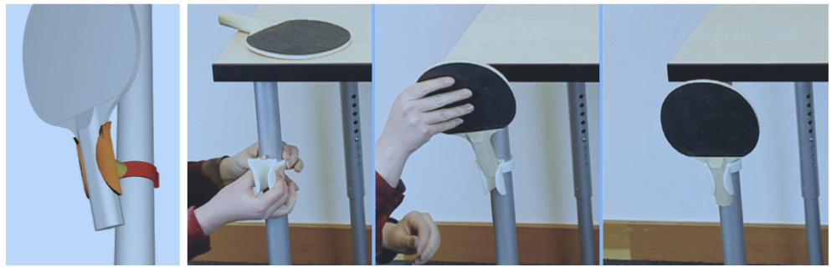
AutoConnect
Computational Design of 3D-Printable Connectors
Gai Greenberg, Yaniv Blum, Jonathan Matetzky

Slide 2
Abstract
AutoConnect is an automatic method that creates customized, 3D-printable connectors attaching two physical objects together
Users simply position and orient virtual models of the two objects that they want to connect and indicate some auxiliary information such as weight and dimensions
Then, AutoConnect creates several alternative designs that users can choose from for 3D printing
The design of the connector is created by combining two holders, one for each object

Slide 3
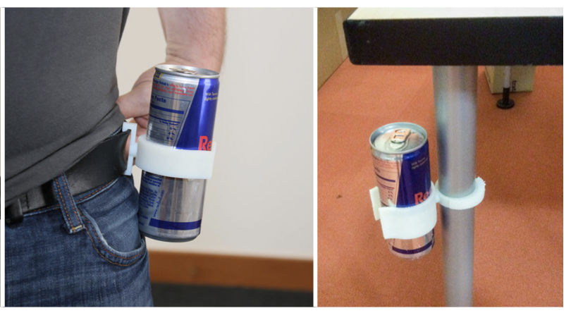
Objective
Partial implementation of the algorithm presented in the paper
Given a mesh of free form object, compute a “holder mesh”
The holder should meet the user's requirements regarding the direction of movement

Slide 4
Challenges & Mitigations
Working with 3D-objects – trimesh package
Understanding the math behind the concept
Choosing the interface
Writing Descriptive Algorithm
Working with limited resources – stick to relatively simple meshes – long runtime for complicated calculations
Notes:
Mesh =
a collection of interconnected vertices, edges, and faces that define the shape of a 3D object
Trimesh =
"trimesh" is a popular Python library for working with triangular mesh models.
It provides functions for creating, loading, and manipulating mesh models,
as well as for performing a wide range of operations on the meshes, such as mesh repair, simplification, and analysis.

Slide 5
Implementation
Implemented with python
The project was developed and deployed to a remote git repo to allow east access and collaboration: https://github.com/matetzky/auto-connect-final-proj
Frameworks used:
Numpy
Configargparse
Trimesh
Sklearn
Scipy
Requirements and README files
Notes:
Scipy = free and open-source Python library used for scientific and technical computing.
built on top of the NumPy library, and provides a collection of algorithms and tools for working with numerical data and performing scientific computing tasks.
Configargparse = a Python library for parsing command-line arguments and configuration files.

Slide 6
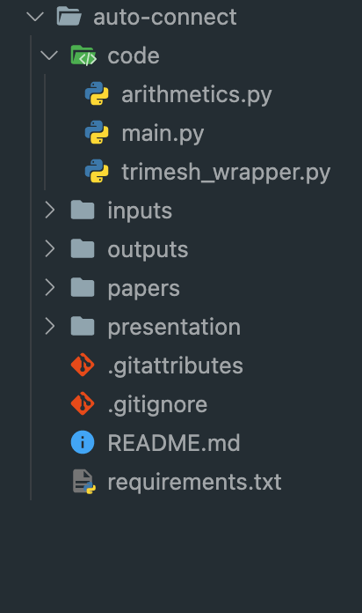
General Flow
1
2
3
4
5
Load the input mesh and perform preliminary calculations
Calculate the seed starting point (from which the mesh is additively computed)
Add triangles to the holder until conditions are met
Repeat 2 and 3 according to user’s command
Output clustered representative holders to “Outputs” folder

Slide 7
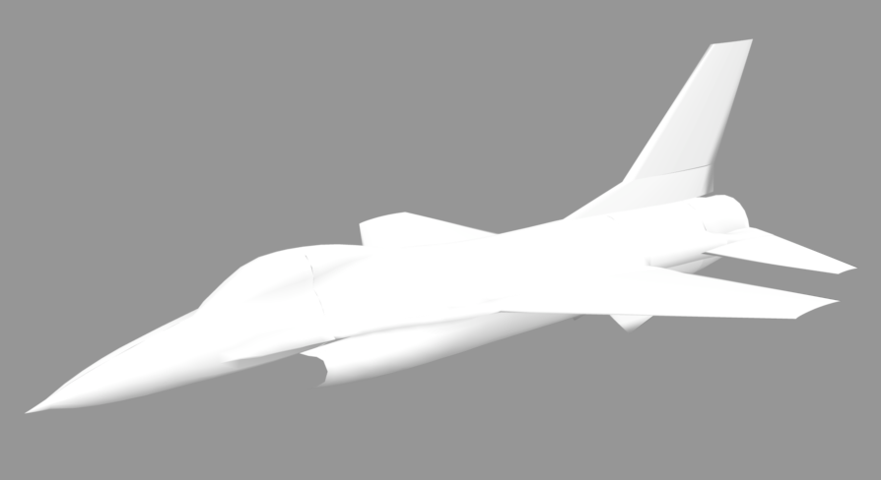
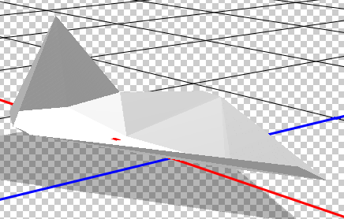
Results

