Slide 1
THE P-MEDIAN
PROBLEM

Slide 2
The P-median Problem
In the p-median problem we are interested in finding the location of p facilities to serve demand nodes so that the transportation cost is minimized.
The transportation cost is given by the product of the demand at the demand node and the distance between the demand node and the facility that serves the demand node.
There are no capacity constraints at the facilities.

Slide 3
The P-median Problem
15
10
12
18
15
22
18
A
B
C
D
24
16
12
20
18
E
5
25
24
F
24
12
12
15
30
G
H
I
11
13
22
16
19
22
25
19
J
K
L
19
21
22
19
20

Slide 4
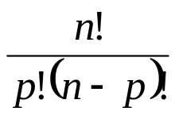
The P-median Problem
Remarks
As there are no capacity constraints at the facilities, it is optimal to satisfy the demand at a demand node from a single facility.
An optimal solution can be found by restricting the search to the demand nodes.
Fixed costs are assumed to be equal.
The number of possible solutions is

Slide 5
The P-median Problem
For even moderate values of n and p the number of possible solutions can be very large:
For example, if n=20 and p=5, there are 15,504 solutions.
If n=50 and p=10, the problem has more than 10¹⁰ possible solutions.
If you could evaluate 1 million solutions per second, it will take you 3 hours for total enumeration.

Slide 6
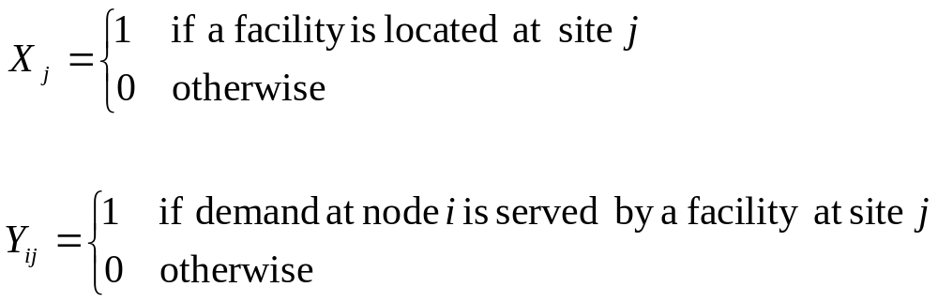
The P-median Problem
Inputs:
h_{i} = demand at node i
d_{ij} = distance between demand node i and site j
p = number of facilities
Decision variables:

Slide 7
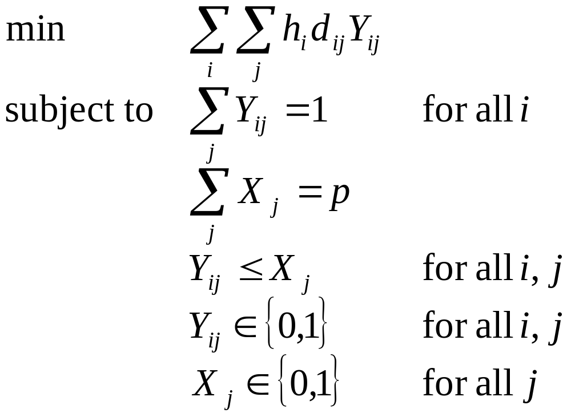
The P-median Problem

Slide 8
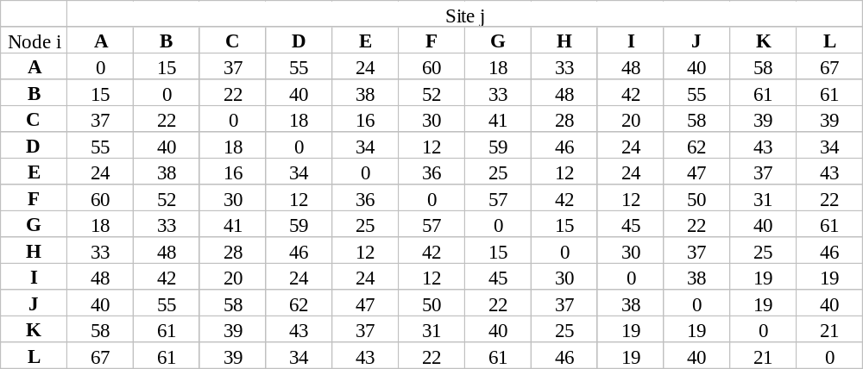
The P-median Problem
Distance matrix for the network

Slide 9
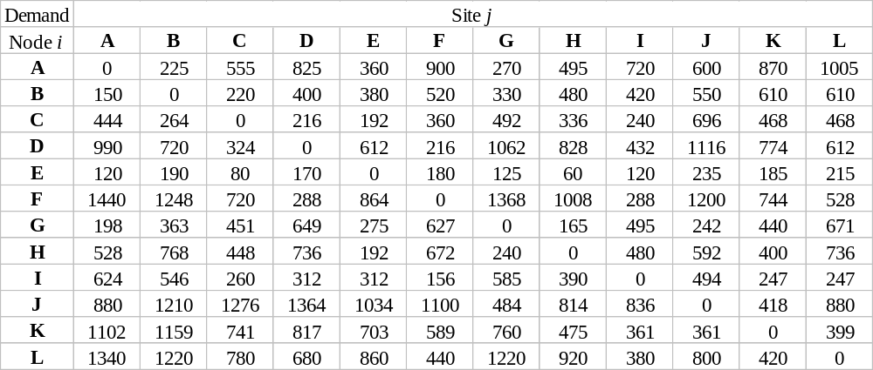
The P-median Problem
Cost (demand x distance) matrix for the network
h_{i} x d_{ij}

Slide 10
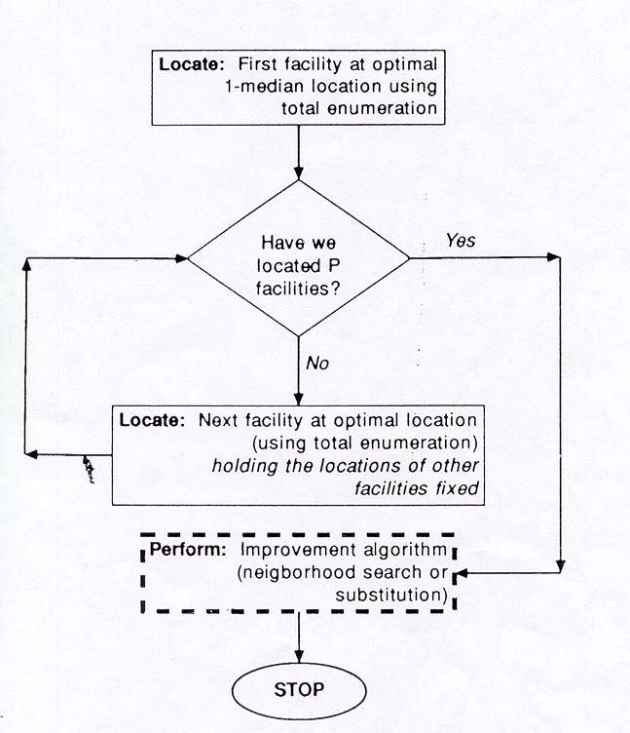
The P-median Problem
Heuristic Algorithm

Slide 11
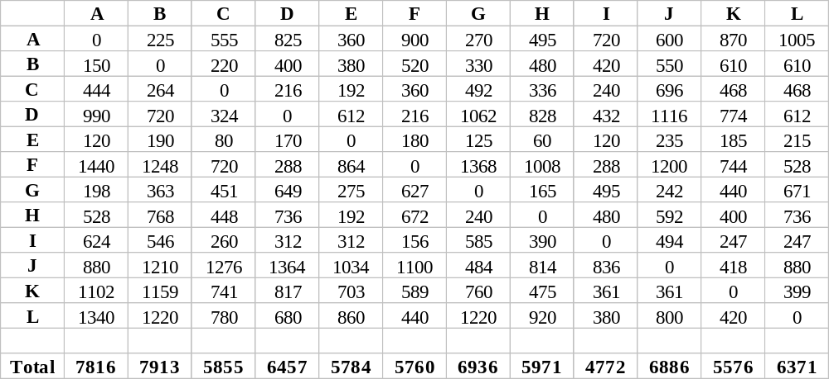
The P-median Problem
serving all the demand from a facility at A

Slide 12
The P-median Problem
If we locate only one facility, it should be at site I with a total cost of 4772.
What if we want to open a second facility?
A B ... I
A 0 225 720
B 150 0 420
C 444 264 240
D 990 720 432
E 120 190 120
F 1440 1248 288
G 198 363 495
H 528 768 480
I 624 546 0
J 880 1210 836
K 1102 1159 361
L 1340 1230 380
A B
A 0 225
B 150 0
C 240 240
D 432 432
E 120 120
F 288 288
G 198 363
H 480 480
I 0 0
J 836 836
K 361 361
L 380 380

Slide 13
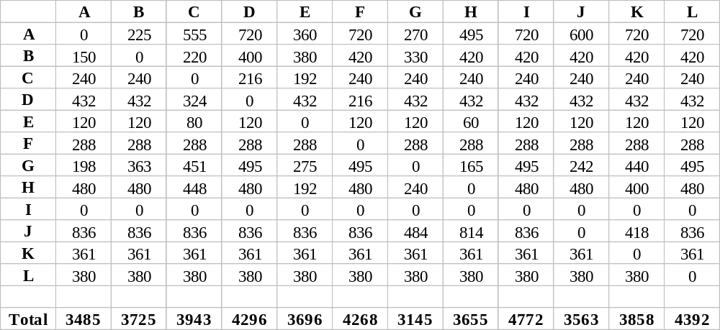
The P-median Problem
It is best to open the second facility at site G.

Slide 14
The P-median Problem
Results for first five locations (medians)
Location Number Site Total cost
1 I 4772
2 G 3145
3 F 2641
4 J 2157
5 A 1707
Now, given the location of five facilities, each demand node should be assigned to the nearest facility.

Slide 15
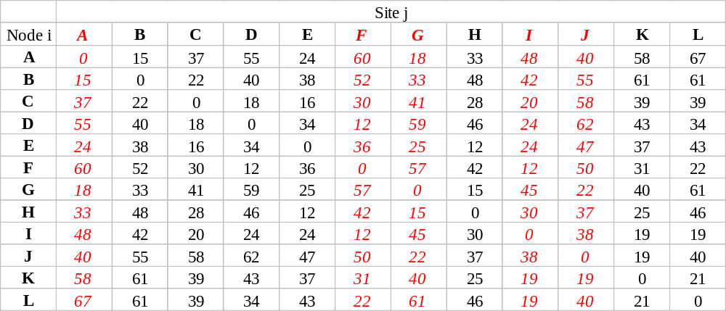
The P-median Problem
Assign nodes A, B, E* to facility A
D, F F
G, H G
C, I, K*, L I
J J

Slide 16
The P-median Problem
15
10
12
18
15
22
18
A
B
C
D
16
24
5
12
20
18
E
25
24
F
24
12
15
30
12
G
H
I
11
13
22
16
19
22
25
19
J
K
L
19
21
22
19
20

Slide 17
The P-median Problem
Note that the optimal solution had a total cost of 1444 whereas the heuristic solution provides a total cost of 1707.
This means that we can improve the solution obtained by the heuristic. Therefore we apply an improvement algorithm.
For each facility site, this algorithm identifies the set of demand nodes that are served from the facility called as the neighborhood.
Within each neighborhood, the optimal 1-median is found.

Slide 18
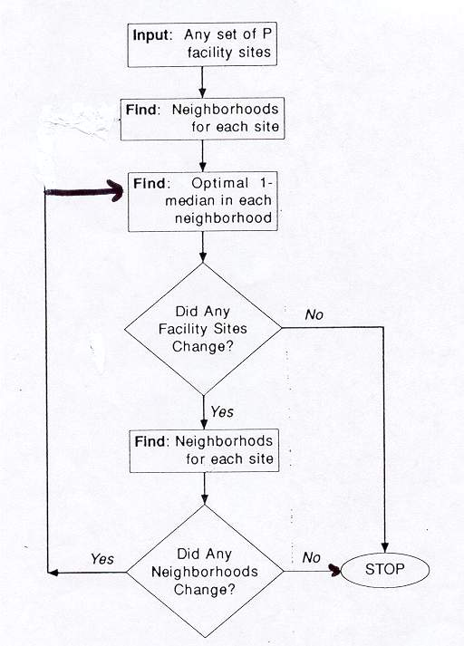
The P-median Problem

Slide 19
The P-median Problem
15
10
12
18
15
22
18
A
B
C
D
16
24
5
12
20
18
E
25
24
F
24
12
15
30
12
G
H
I
11
13
22
16
19
22
25
19
change=-75
J
K
L
19
21
22
19
20

Slide 20
The P-median Problem
15
10
12
18
15
22
18
A
B
C
D
24
16
12
20
18
5
E
25
24
F
24
12
15
30
12
G
H
I
11
13
22
16
19
22
25
19
change=-60
J
K
L
19
21
22
19
20

Slide 21
The P-median Problem
The new solution has a cost of 1707-135=1572.
Because of a limitation in this heuristic, some relocations which are beneficial in a global (but not local or neighborhood) sense are not considered.
This leads us to consider an exchange algorithm as an improvement procedure.

Slide 22
The P-median Problem
15
10
12
18
15
22
18
A
B
C
D
24
16
12
20
18
5
E
25
24
F
24
12
15
30
12
G
H
I
11
13
22
16
19
22
25
19
J
K
L
19
21
22
19
20

Slide 23
The P-median Problem
Summary of Exchange Opportunities from Neighborhood Search Solution (Facilities at sites A, F, H, I and J with a total cost of 1572)
Remove Replace Total Change
With Cost
A B 1647 75
F D 1620 48
H E 1689 117
I L 1444 -128
J K 1629 57

Slide 24
The P-median Problem
15
10
12
18
15
22
18
A*
B
C
D
24
16
12
20
18
5
E
25
F*
24
24
12
15
30
12
G
H*
I
11
13
22
16
19
22
25
19
J*
K
L*
19
21
22
19
20

Slide 25
The P-median Problem
Summary of Exchange Opportunities from Improved Solution (Facilities at sites A, F, H, J and L with a total cost of 1444)
Remove Replace Total Change
With Cost
A B 1447 3
F D 1487 43
H E 1465 21
J K 1501 57
L K 1503 59

