Slide 2
5 year forecast monthly residential customers
Proven Historical Accuracy:
“Our historical data shows a strong linear relationship since 2002, indicating that linear regression has been a reliable predictor of customer growth. This consistency gives us confidence in its ability to forecast future trends accurately.”
Simplicity and Clarity:
“Linear regression offers a clear and transparent forecasting method. Its simplicity allows us to easily explain the model and its predictions to all stakeholders, ensuring everyone understands the basis of our projections.”
Efficient Baseline Model:
“Using linear regression as our baseline model provides a reliable starting point. It allows us to establish a benchmark for evaluating the performance of more sophisticated forecasting methods, ensuring we make data-driven decisions.”

Slide 3
LIMITATIONS – DO NOT PRESENT
While linear regression can be a useful tool for forecasting, it does have some limitations in the context of predicting monthly residential customers for an electric utility:
Assumption of Linearity:
Limitation: Linear regression assumes a linear relationship between the independent variable (time) and the dependent variable (number of customers). If the actual relationship is non-linear, the model may not provide accurate forecasts.
Impact: This could lead to underestimating or overestimating future customer numbers if there are changes in growth patterns.
Ignoring External Factors:
Limitation: Linear regression does not account for external factors that might influence customer numbers, such as economic conditions, policy changes, technological advancements, or significant events.
Impact: These factors can cause deviations from the predicted trend, leading to inaccuracies in the forecast.
Sensitivity to Outliers:
Limitation: Linear regression is sensitive to outliers, which can disproportionately affect the model’s predictions.
Impact: Anomalies or sudden changes in customer numbers due to unforeseen events can skew the results, making the forecast less reliable.

Slide 4
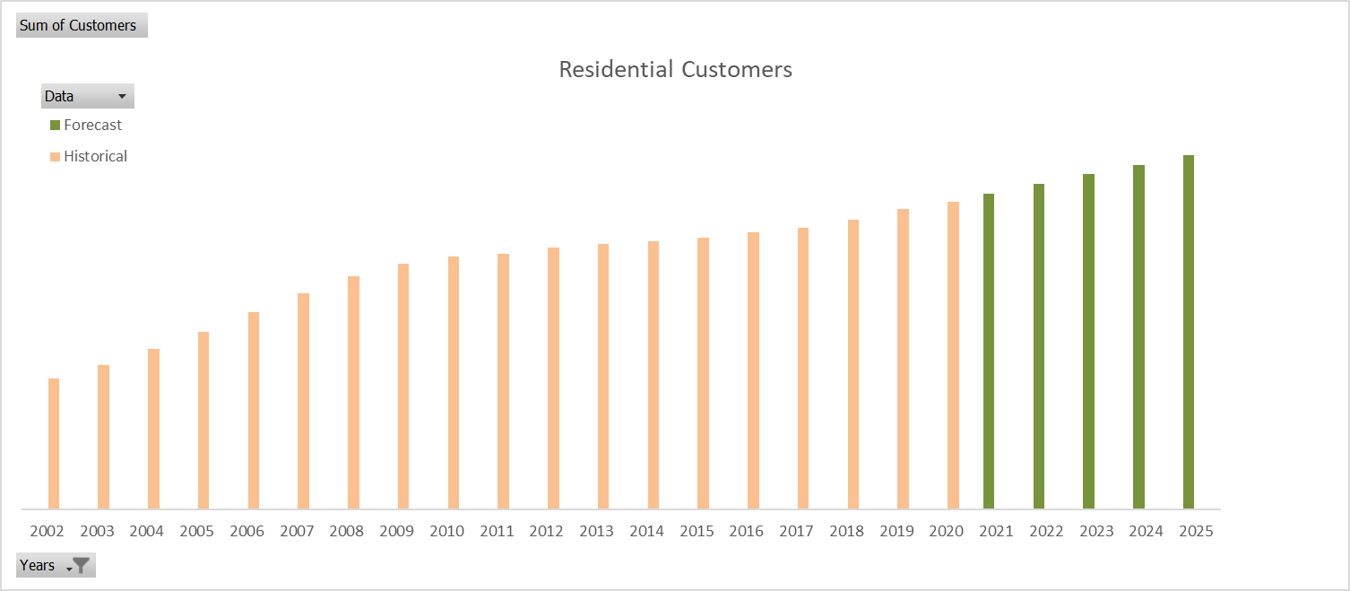
5 year forecast monthly residential customers

Slide 5
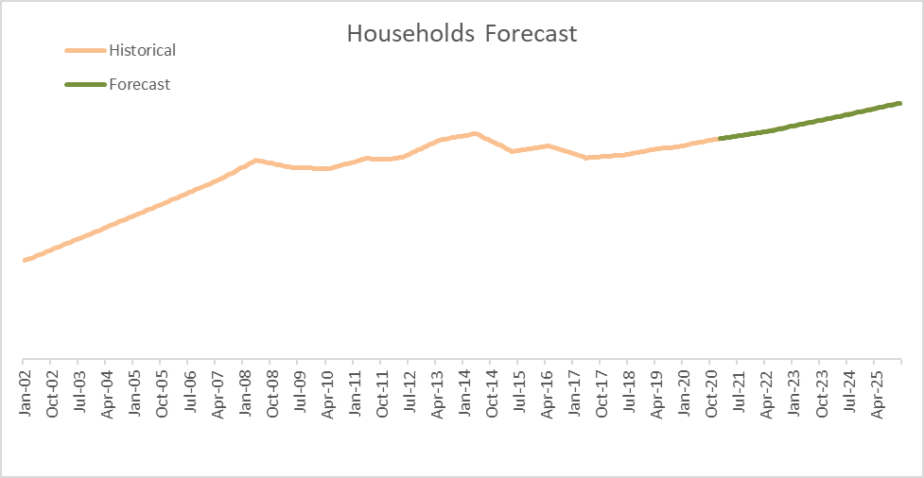
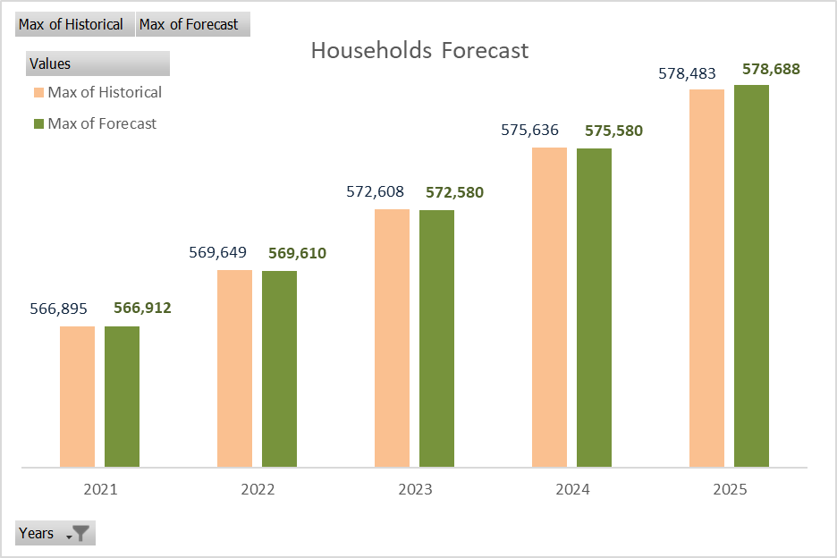
Backtest: Households Forecast
Assuming Households and Customers have similar growing patterns, a back test was run and compared to known results.
The accuracy of a Linear Regression for Households in the end of 2025 was 99.96%

Slide 6
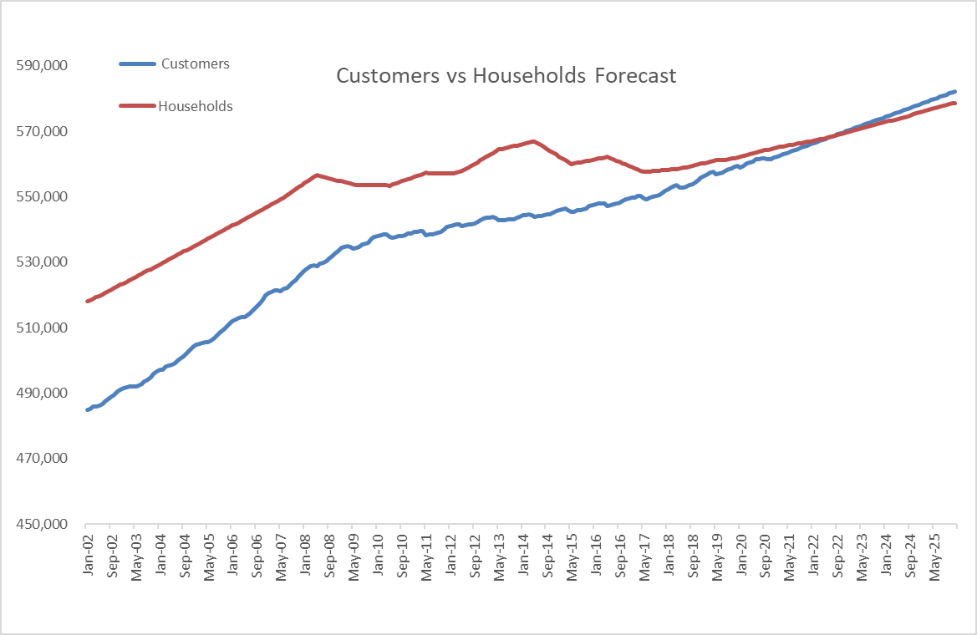
Customers vs Households Forecast
The growing rate of customers is clearly higher than households in the historical data provided
In Aug 2022 for the first time the number of Customers was higher than Housesolds
568677 Customers
568633 Households

Slide 7
Monthly Billed MWh Forecast

Slide 8
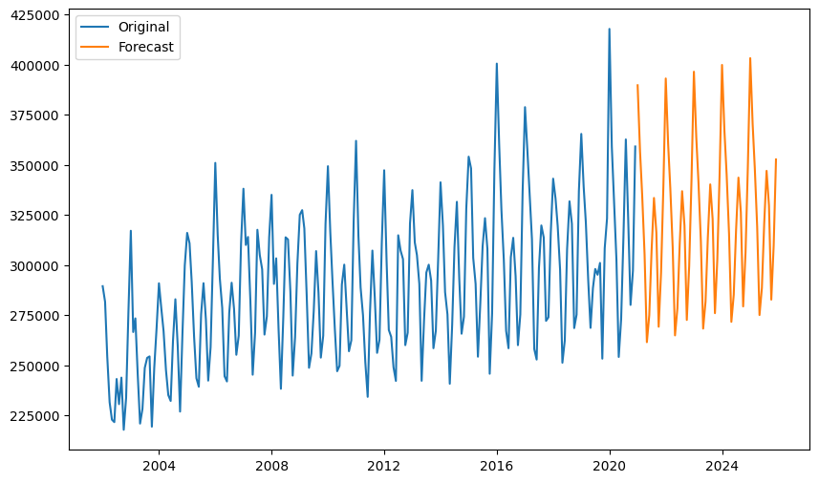

Plot 1

Slide 9
Plot 2

