Slide 2
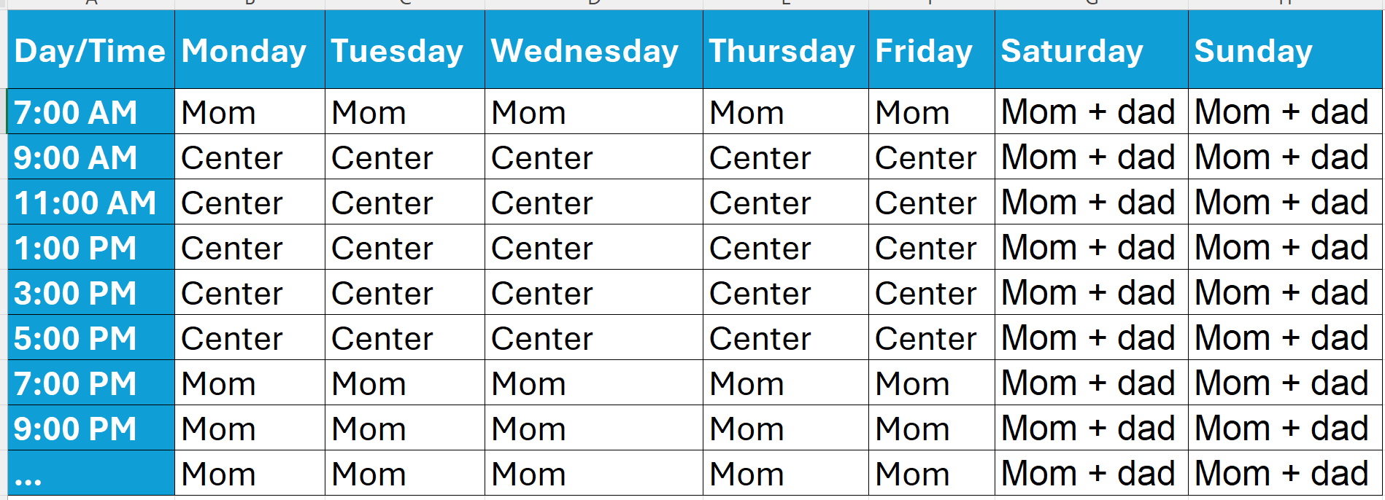

Slide 3
Multiplicity = number of different arrangements
Instability = degree to which the same arrangement repeats itself at the same timeslot over historical time
Search = are you searching yes/no?
Inadequacy with work schedule = don’t know

Slide 4

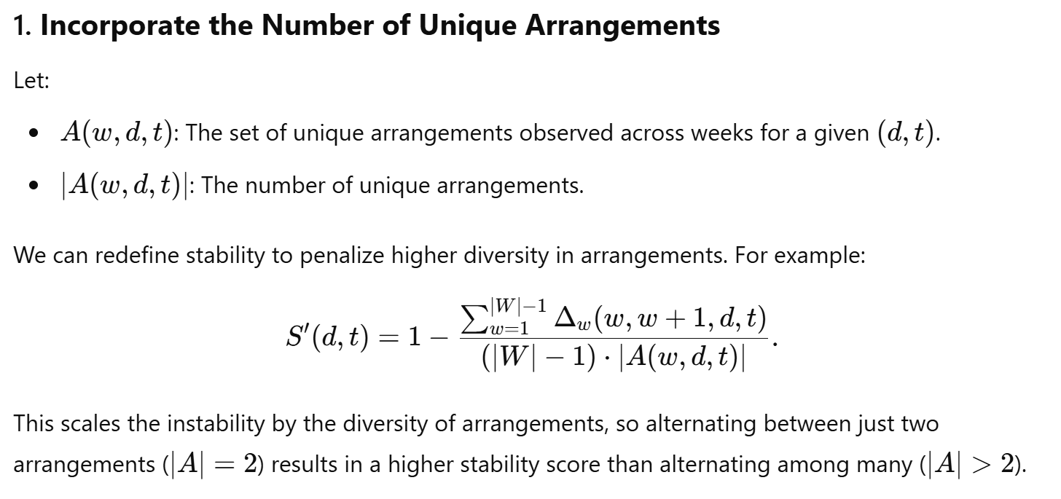


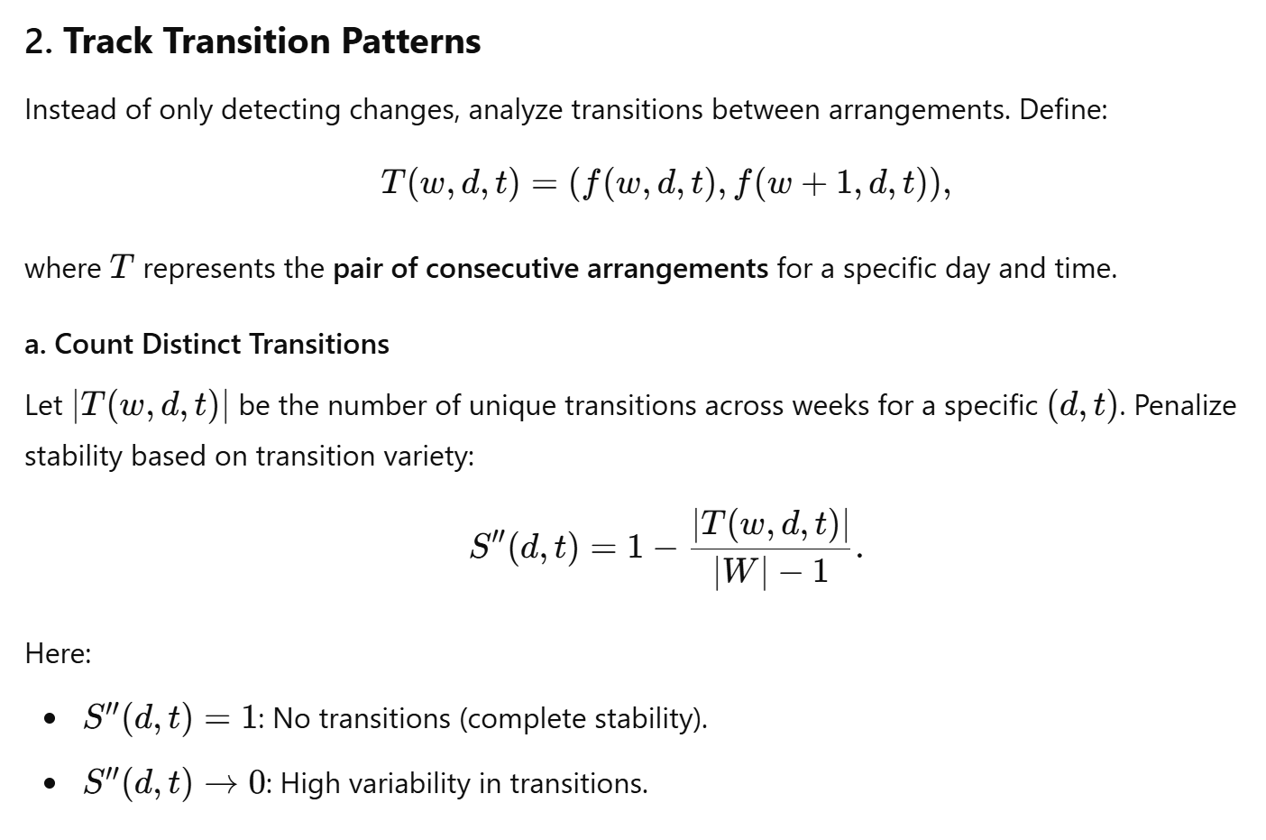

Instability (stochastic unpredictability)

Slide 5
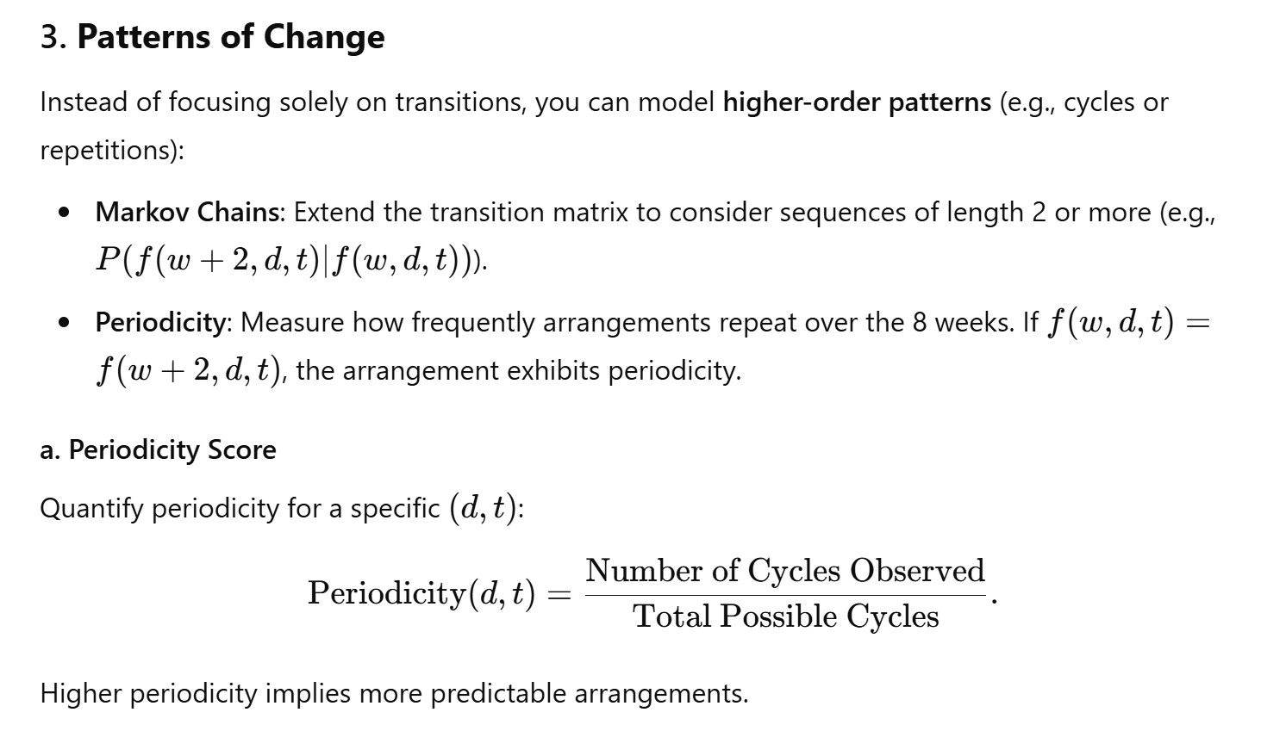
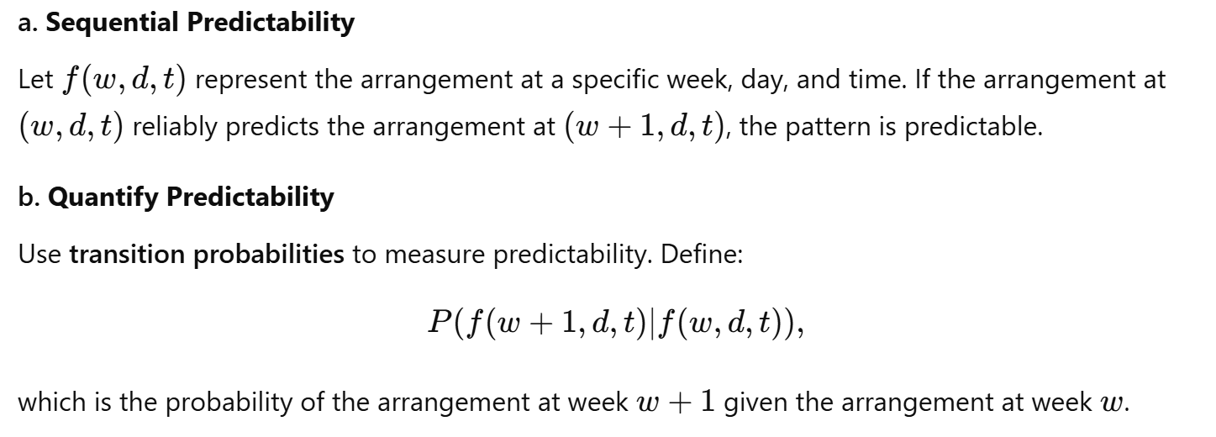

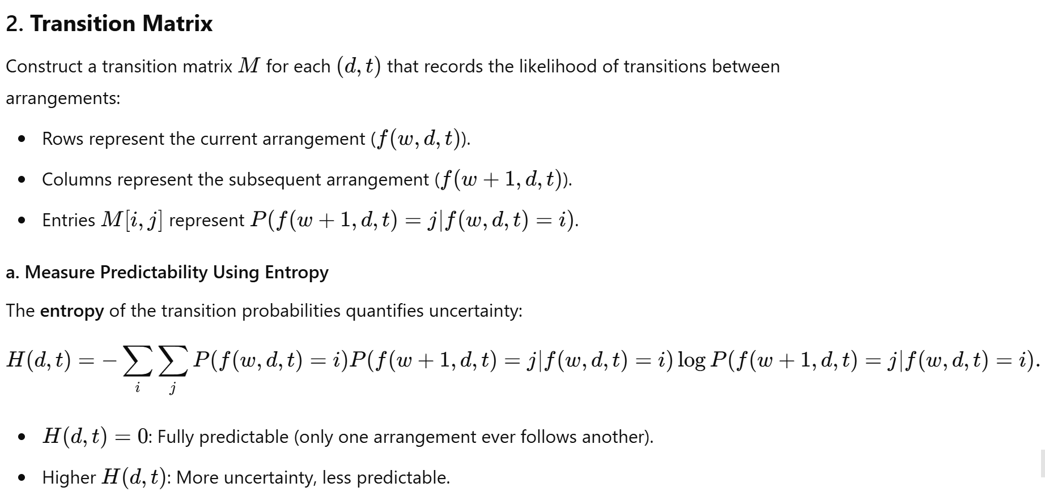
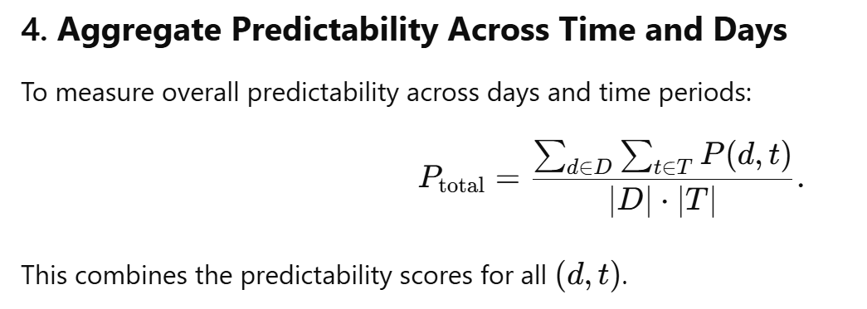
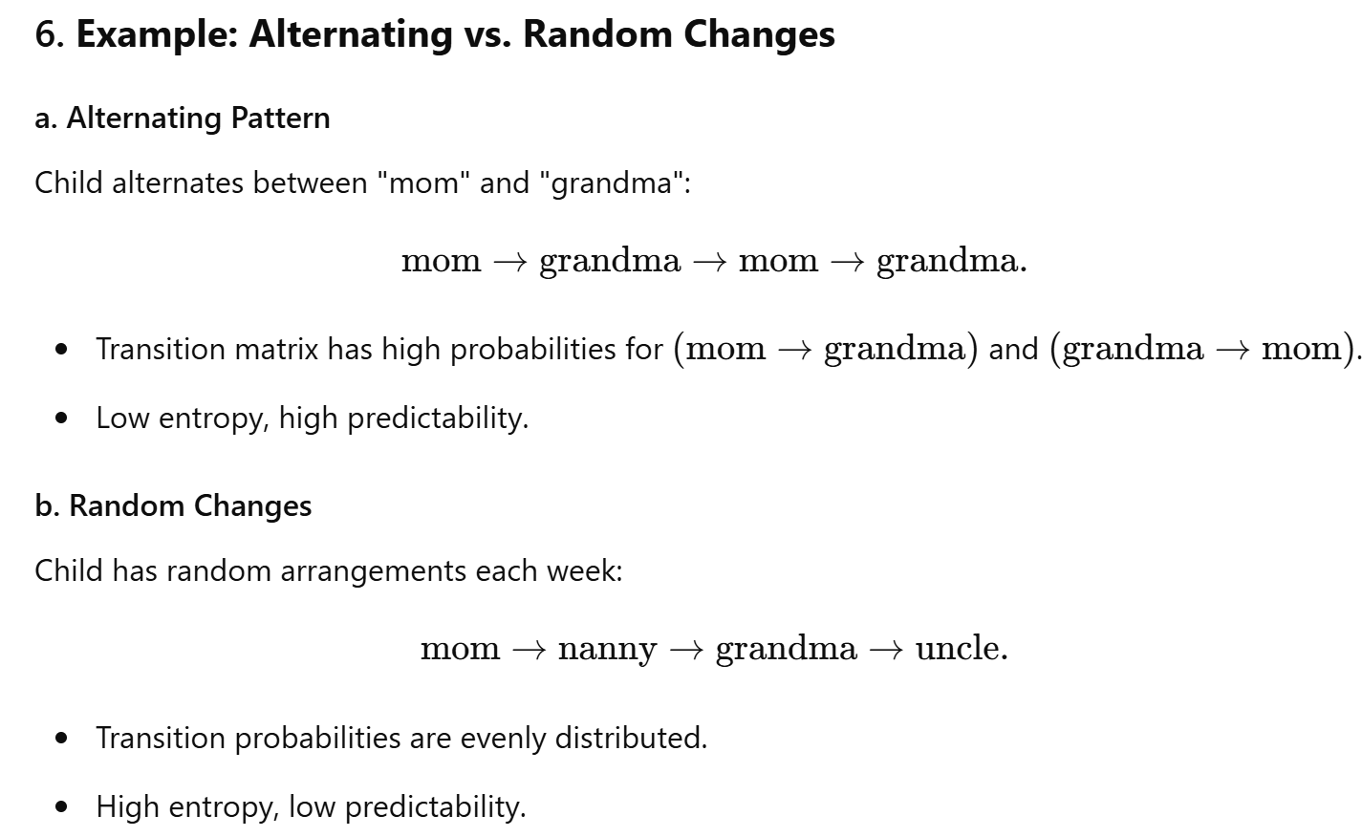
Predictability paradigm

