Slide 1
Capstone Project - The Battle of Neighborhoods
Mateus Teruyuki Nakata
04/11/2020

Slide 2
Introduction
In a globalized world, It is very common for a company to transfer an employee to another city or even country, offering better career prospects or salary increase. Or someone could find a better job in other company in other city. No matter the reasons, moving to other city is always very stressful, and people are afraid about not get used with the new city . The problem is worse when the person is married with children. To minimize the problems, it is better to move a place similar to his last location, with compatible venues, like schools, restaurants, swimming pools, gyms, coffee-shops, supermarkets, etc. To help people in this situation, the goal of this project is to develop a system to find out which neighborhoods are similar to the current location. We will simulate a situation where a person is moving from New York to Toronto and vice versa.

Slide 3
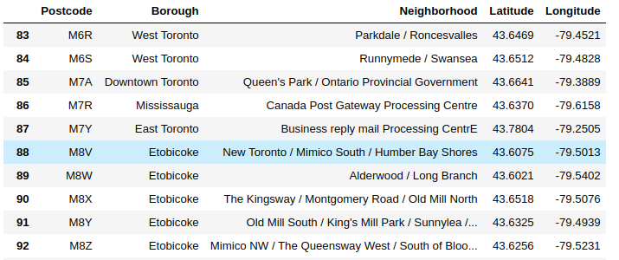
Data Preparation
New York
  5 boroughs and 306 neighborhoods
  dataset:https://geo.nyu.edu/catalog/nyu_2451_34572
  Use of Pgeocode to get the latitude and longitude

Slide 4
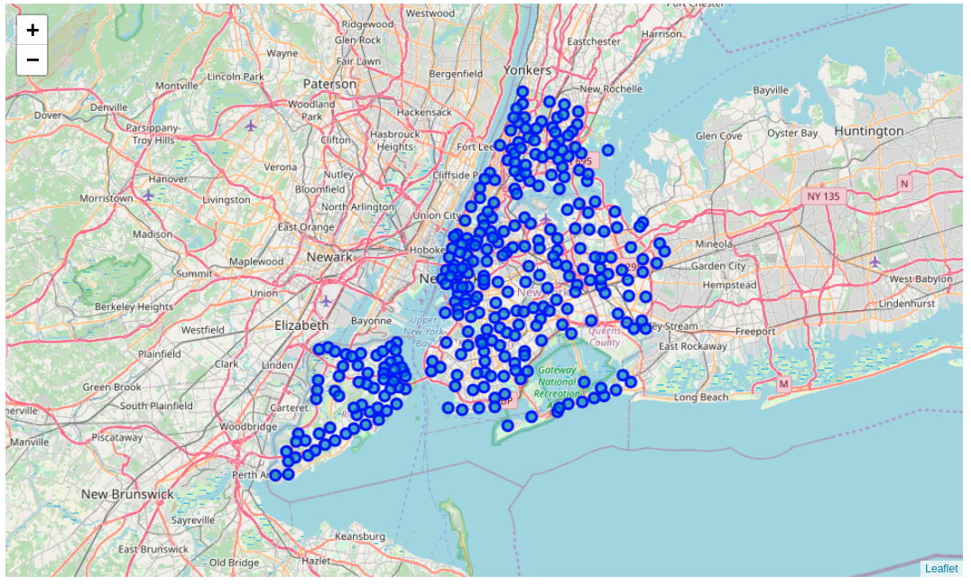
Visualization

Slide 5
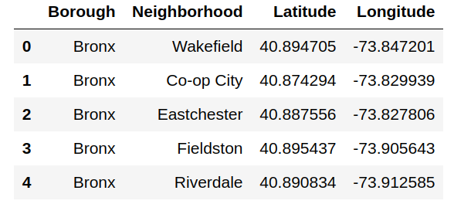
Data Preparation
Toronto
  10 boroughs and 103 neighborhoods
  Wikipedia page, https://en.wikipedia.org/wiki/List_of_postal_codes_of_Canada:_M
  json format and it can be transformed into pandas dataframe

Slide 6
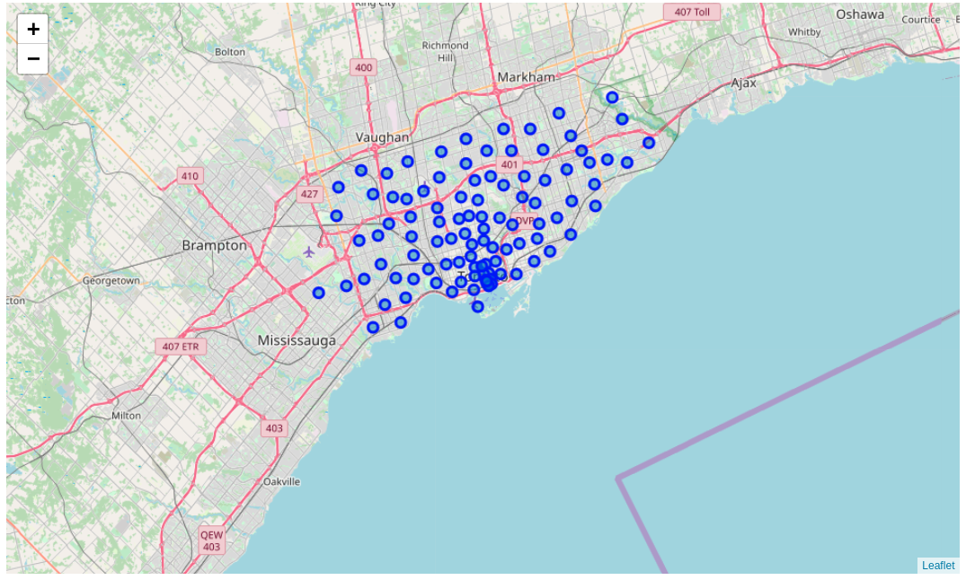
Localization

Slide 7
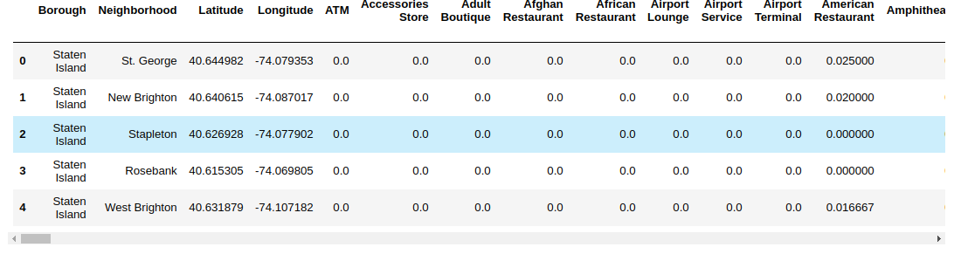
Foursquare to Get Venue Data
Free online API access
Information about the location venues

Slide 8
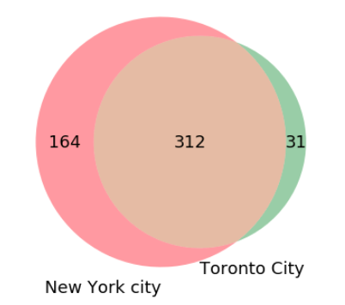
Methodology
New York and Toronto dataset are very similar:
Number of common venue categories in both data are :312
Number of different venue categories in New York city are : 164
Number of different venue categories in Toronto city are : 31
As we had 312 common categories, we used only these categories to compare the venues of both cities.
The measure the similarity of the locations, we used the Cosine similarity.

Slide 9
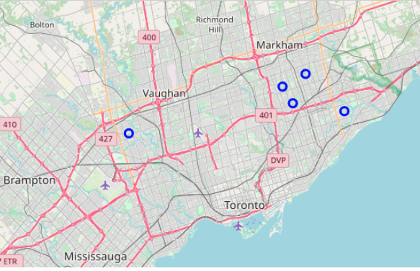
Results
Moving from Wingate, Brooklyn, NY, to Toronto

Slide 10
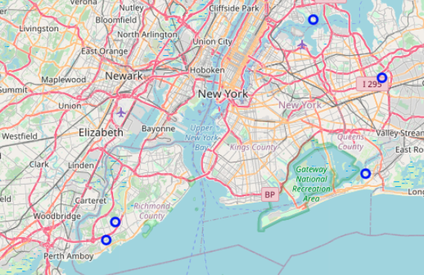
Results
Moving froMoving from Woburn, Scarborough, to New Yorkm Woburn, Scarborough, to New York

