Slide 1
Matthew’s Analysis’
Author: Matthew Hall

Slide 2
Introduction
Using a sample data set of houses with over 80 columns, our ask was to improve upon a model Dr. W had shown that had a somewhat decent correlation off of two attributes.
This project selects 5 independent variables to be used in creating a confident home price prediction model using linear regression. I have plotted and described my results via this deck and a jupyter notebook.
I will walk through the analysis and creation of the model. In the following slides.

Slide 3
The Data
We are working with a set of data with100 rows (houses/properties) by 82 columns. The last column (SalePrice) Is our dependent variable (y) throughout this project. We will be selecting 5 independent variables (x) to correlate toward predicting y / SalePrice.
I will be using the top correlated fields because they not only returned a strong correlation but had few nulls in the data set. I felt these attributes would be relevant to help assume Sale Price because of a stronger correlation to Sale Price

Slide 4
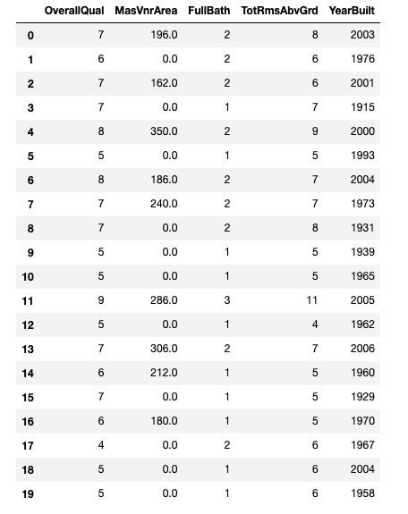
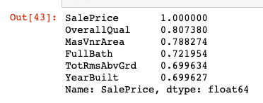
Data Exploration
The below are print outs of the correlation values and data frames of the sample data set used.

Slide 5
Data Preparation
Numeric data is what we are using. Thankfully our most closely correlated columns are already of this value, otherwise we would have to modify our data set. Using .corr() function we are able to pick out our top 5 (not including Sale Price) most closely correlated attributes that we can use for our model.
These top 5 attributes are ‘OverallQual’, ‘MasVnrArea’, ‘FullBath’, ‘TotRmsAbvGrd’, and ‘YearBuilt’ in order respectively.

Slide 6
Correlation
Here is the linear regression equation I used in abstract sense
Y = X1 β 1 + X2 β 2 + X3 β 3 +X4 β 4 + X5 β 5
The Correlation values for each attribute are
OverallQual .807
MasVnrArea .788
Full Bath .721
TotRmsAbvGrd .699
YearBuilt .699
6

Slide 7
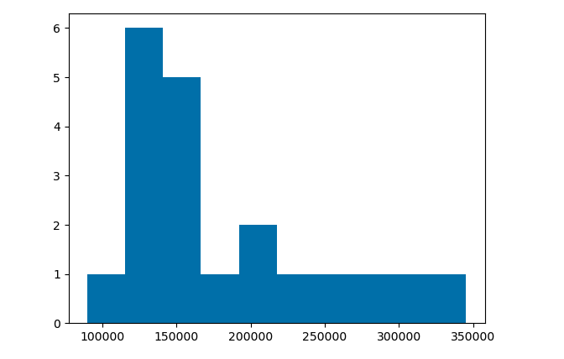
Project Description
The ask was to fine a linear regression to help determine the R² value. This value is between 0 and 1 and falls in the correlation coefficient range of 90%
For reference: our 20 sample size Sale Price data looks like this via house prices via histogram. With the proper independent values we can input values and assume our own prices once we have strong enough evidence.
(no skew added here / no attempt to use log instead either)

Slide 8
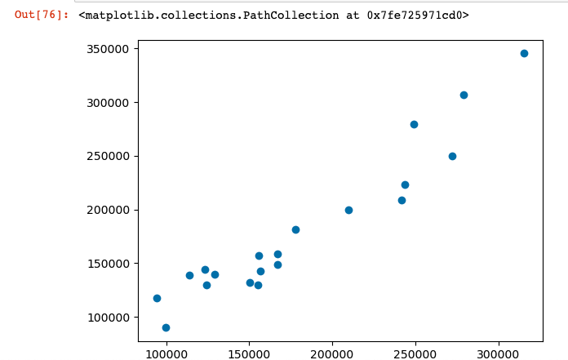
Analysis and Results
Using the beforementioned top 5 correlated variables, we are able to draw a VERY strong correlation of .908 to determining sales price. This is the R² value

Slide 9
Verification
Utilizing the 5 best correlated attributes to verify a STRONG correlation along with each other has proven to be great choice. I had ideas on what to decide but using statistical data can be tested and proven.
Using the variable nulls I verified the attributes (x values) I chose has a low number of nulls. One would not want to analyze with a higher null count as it would be considered dirty data and not best correlate.

Slide 10
Conclusion
In conclusion, I found that using a sample size of 20 houses we were able to make a simple yet strongly correlated result set pointing out the 5 most influential attributes and were able to model that and compare against test data, just the same. If we were to later improve on results, more testing of the same nature and larger data sets would help further prove our theory that we discovered in this project.
Through this project I have learned how to effectively size up, correlate, and suggest attributes that will help influence a dependent variable in a data set using linear regression. Although a small sample size the template is reusable and scalable for other linear regression models.

