Slide 1
Objectives
Create model to predict time left to next calibration
Alghoritm based on historical data
Data used in model: raw data with pedestals substracted, calibration timestamps

Slide 2
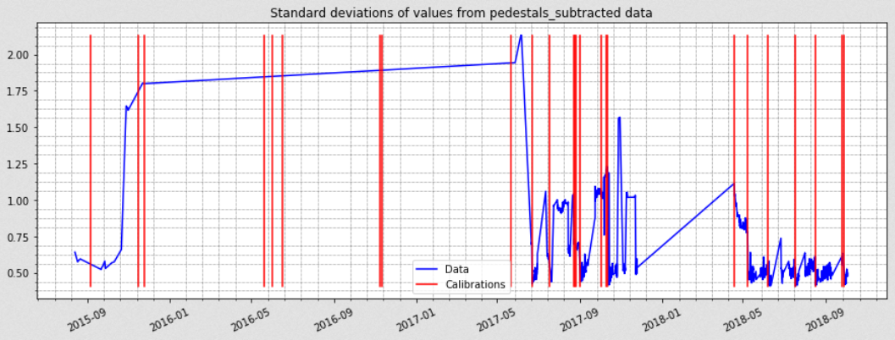
Standard deviation from pedestals substracted data
Notes:
Historical data overview:
Irregular measurements and calibrations timesteps
Missing data
2018 – best period for data mining/exploration and model fitting
Standard deviation from all 172 032 values (84 sensors x 2048 channels/sensor)
Standard deviation as an example – we will focus on this measure in this model, explanation on next slides

Slide 3
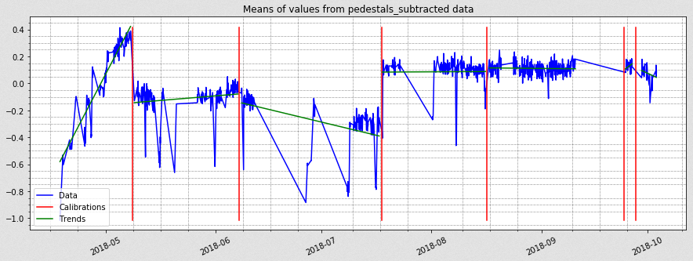
Means from pedestals substracted data - 2018
Notes:
Data from 2018
Means of all 172 032 values (84 sensors x 2048 channels/sensor)
Nothing special to observe – means fluctuate around zero, except first period (probably caused by voltage changes)

Slide 4
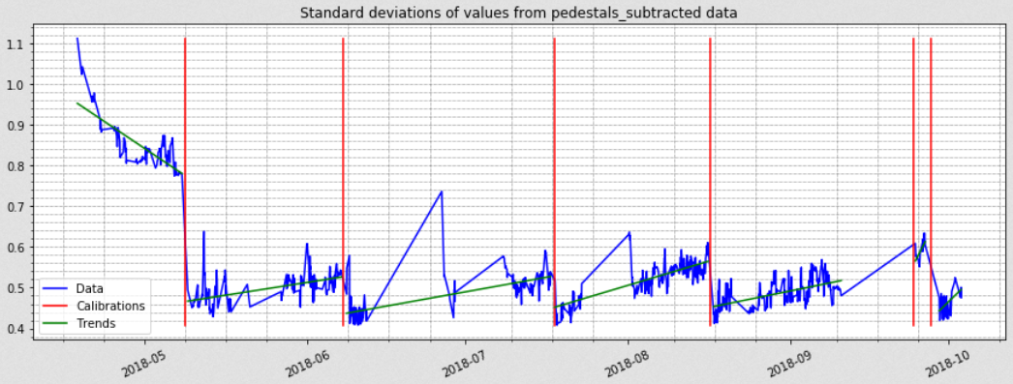
Standard deviation from pedestals substracted data - 2018
Notes:
Standard deviation from all 172 032 values (84 sensors x 2048 channels/sensor)
Again, first period different (probably caused by voltage changes)
Visible trend on periods between calibrations – standard deviation grows between calibrations and declines rapidly after calibration

Slide 5
Notes:
Proposed Solution:
Weibull Time To Event Recurrent Neural Network
Sequential predicting a distribution over the time to the next event. We want to assign high probability at the next event or low probability where there wasn't any events.
Assume Weibull distribution with parameters αt and βt
Let θt=(αtβt)=g(x0:t) to be the output of an RNN
So αt and/or βt is controlled by the feature data xt
In our example, standard deviation is a feature, and callibration is an event.
We assume, that calibrations were executed in a timely manner, at least in 2018

Slide 6
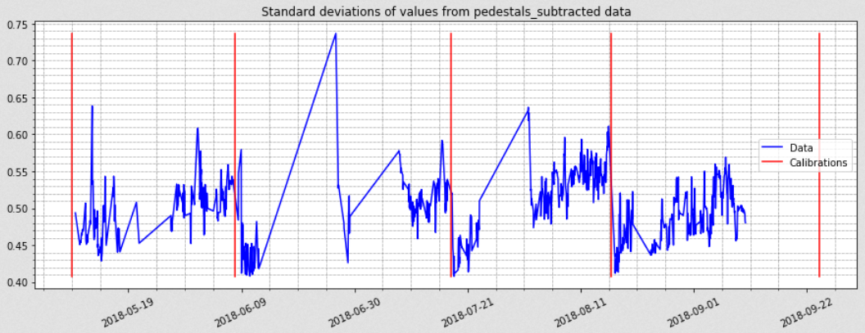
Input Data – every measurement with 100 measurements history
Notes:
Data to train model:
We use 4 periods with most appropriate data
Every single entry contains „current” standard deviation value, with 100 values history
For each standard deviation value, entry contain also deltatime – time passed since previous measurment
3 first periods are used for training, and the last one for testing

Slide 7
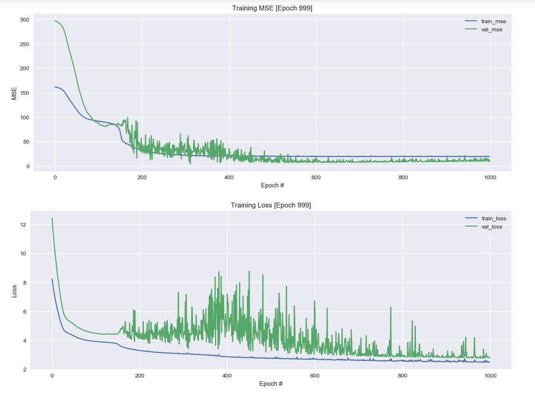
Learning NN
Notes:
Two measures are used to evaluate trainig proces:
MSE - Mean squared deviation between real and predicted time to calibration
Loss function - Discrete log-likelihood for Weibull hazard function
MSE is finally even better for validation data, the reason could be that validation data is more regular

Slide 8
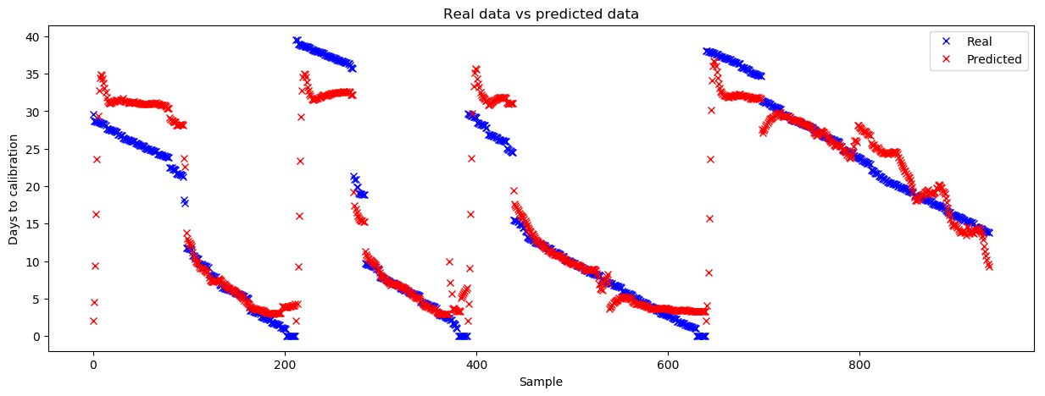
Results – all data
Notes:
Comparation between Real and Predicted days to callibration – all data.
Model can predict quite good how much time left to next callibration.
Unfortunatelly model cannot reach values near zero

Slide 9
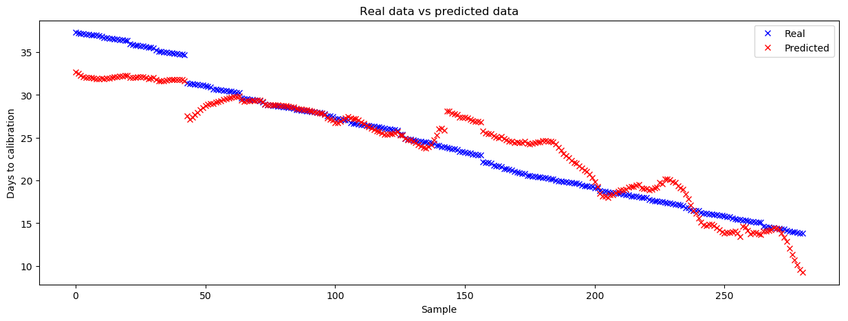
Results – test data only
Notes:
Comparation between Real and Predicted days to callibration – test data only.

