Slide 1


Software Architecture - Principles and Practices
Mateusz Dymiński

Slide 2
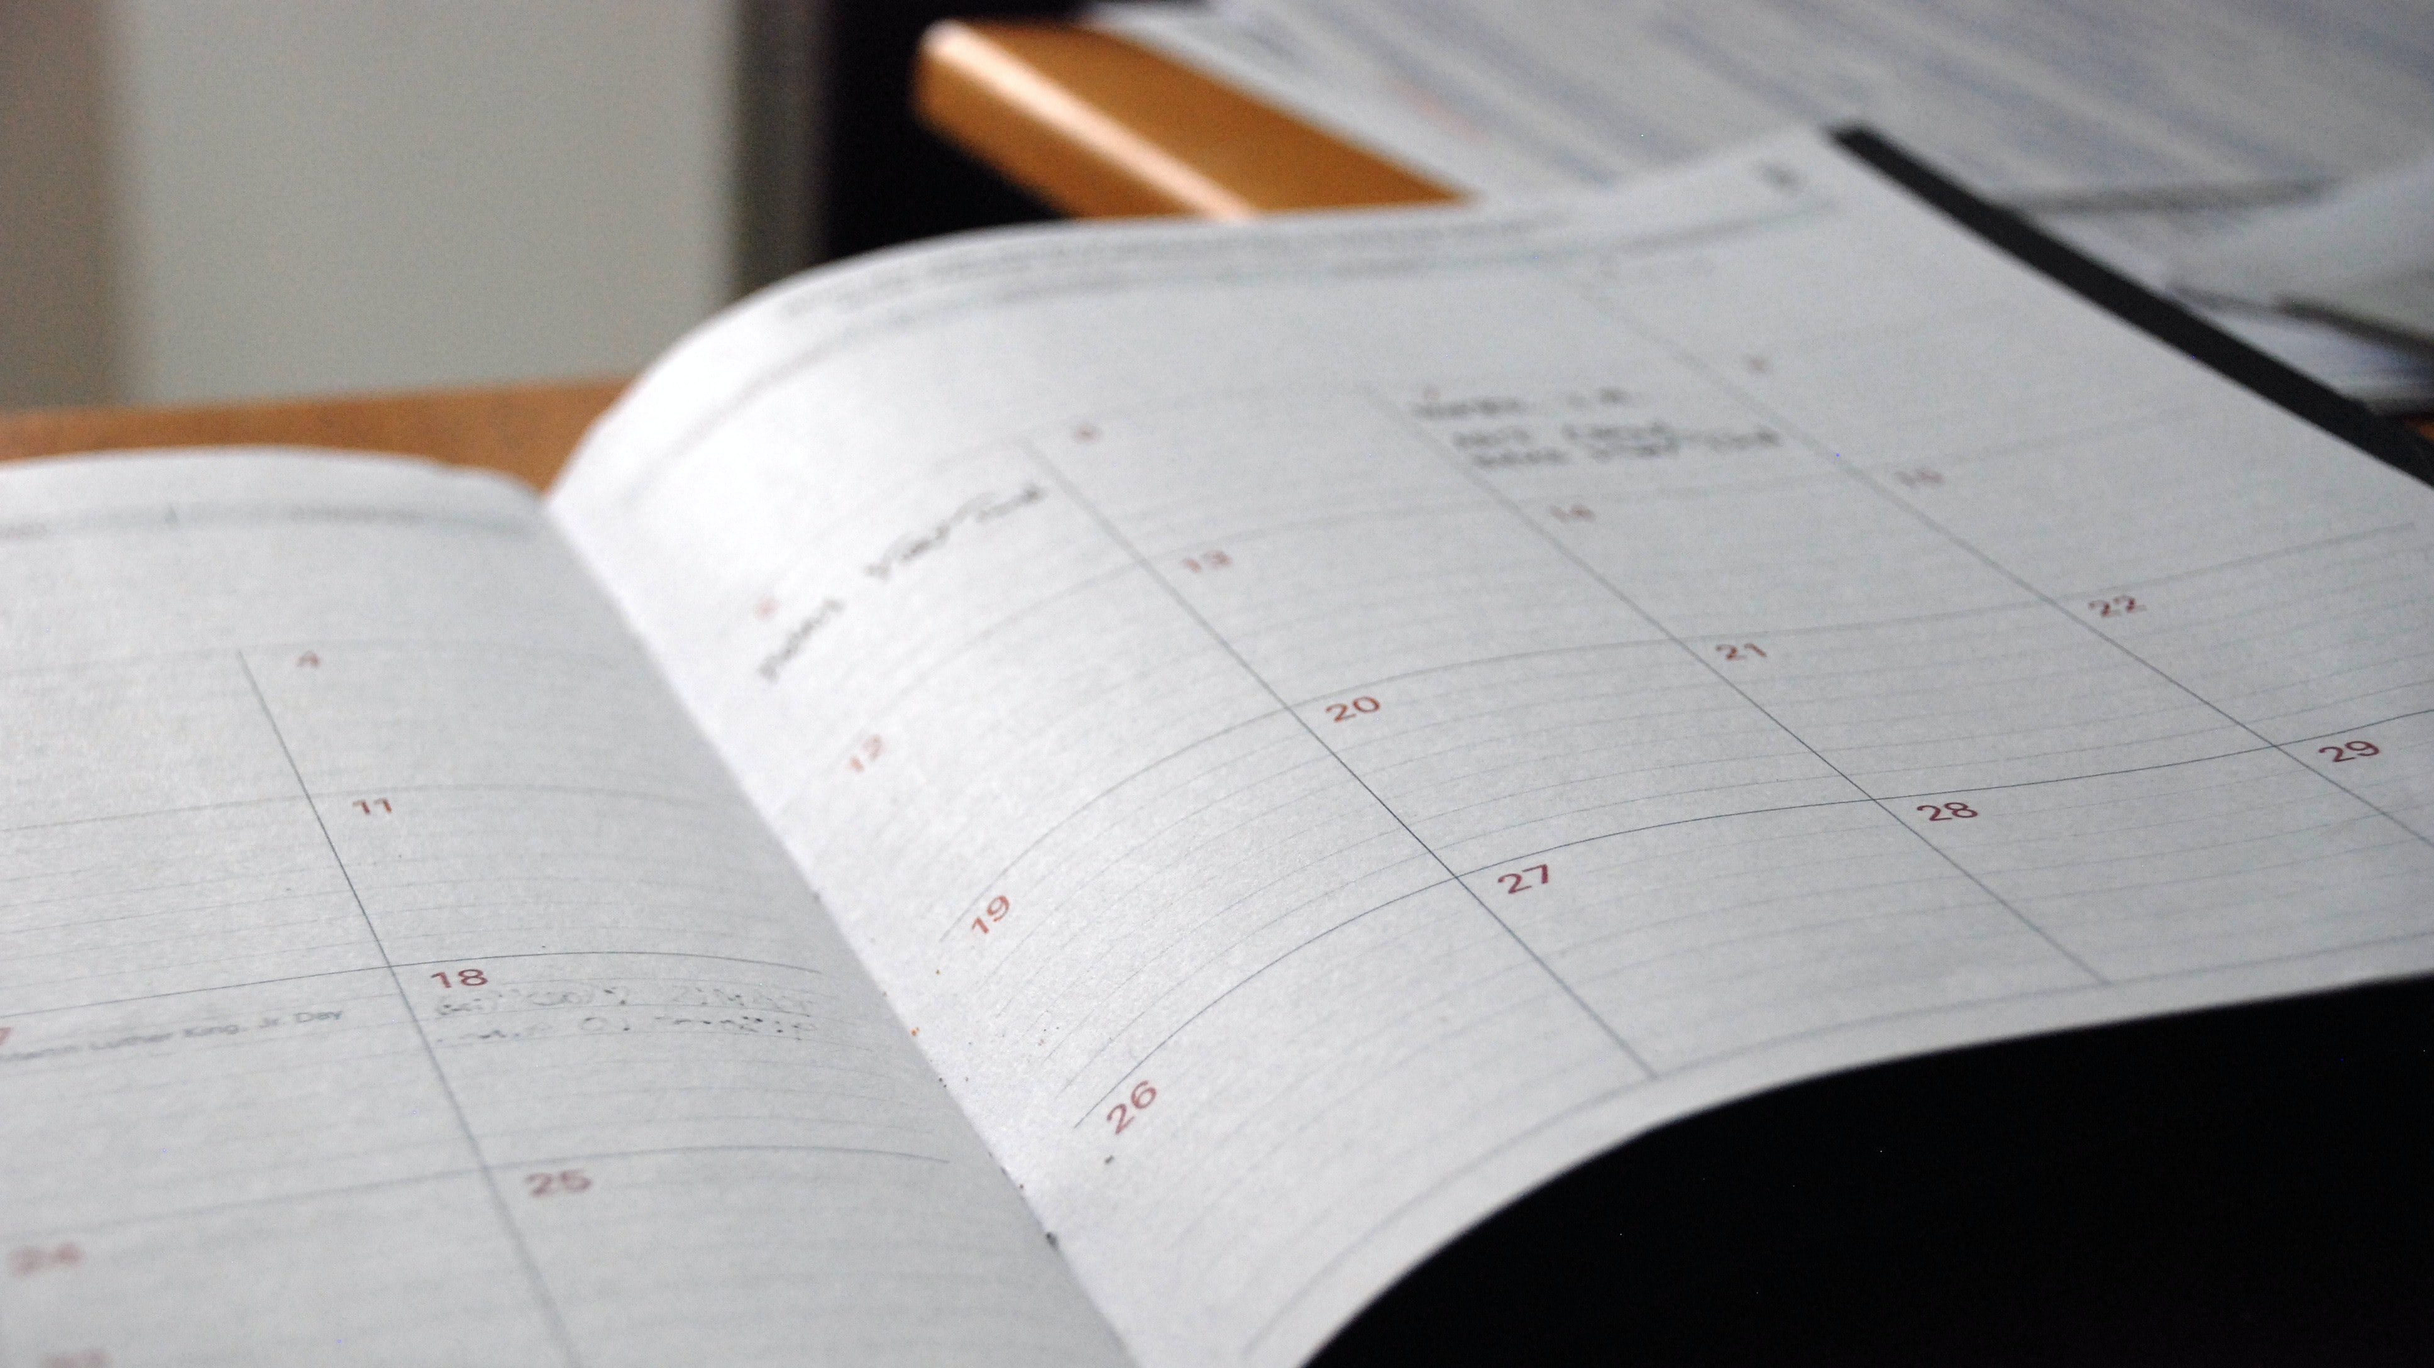
Agenda

Slide 3
Agenda
Day 1
Day 2
Day 3
Intro
Software Architect and Architecture definitions/level/roles
Domain Driven Design
Architecture Documentation and Metrics
Company Culture
Architecture Guild
Tips and Tricks
Application Architectures
System Architecture Patterns
Concepts independent from the application architecture
Communication
Testing
Event Sourcing + CQRS
Continuous Integration/Delivery
DevOps/GitOps/GitSecOps
Infrastructure
Cloud
Deployment models
Operations
Security
Refactoring of Legacy Systems

Slide 4
Agenda
Day 1

Slide 5
Agenda – Day 1
Intro
Software Architecture definition
Software Architecture Levels:
Application level
Solution level
Enterprise level
Infrastructure level
Software Architect
Role
Types - same as levels
Application architect
Solution architect
Enterprise architect
Infrastructure architect

Slide 6
Agenda – Day 1
Architecture documentation and visualization
C4
UML
BPMN
Domain Driven Design
Domains and subdomains
Bounded context
Event Storming – Big Picture
Architecture Metrics
Company Culture in Context of Software Architecture
Architecture Guild
How to design it to help making Architecture decisions

Slide 7
Agenda – Day 1
Key Software Development Concepts
YAGNI
SOLID
DRY
KISS
Tips and Tricks
Whiteboard iteration vs Sprint iteration
Pencil and paper vs VS Code
How to make architecture decisions
RFC

Slide 8
Agenda
Day 2

Slide 9
Agenda – Day 2
Application Architectures:
Layered architecture
Pipes and Filters architecture
Modularity architecture
Hexagonal/Clean/Onion/Ports and Adapters architecture
Microkernel architecture
Event-Driven architecture
Serverless architecture
System Architecture Patterns
Distributed application
SOA
Microservices
Monolith application
Monolith with modules

Slide 10
Agenda – Day 2
Concepts independent from the application architecture
12 Factor application
Cloud native apps
Containers
Service Mesh

Slide 11
Agenda – Day 2
Communication
Asynchronus vs synchronous
Synchronous
REST vs GraphQL vs RPC
REST
GraphQL
RPC
Backend for frontend
Asynchronous
Messaging
Messaging with order
Public APIs
API Gateway
Service discovery

Slide 12
Agenda – Day 2
Testing microservices
Consumer-driven contract
Consumer-side contract
Service component
Smoke tests
Event Sourcing
CQRS
Domain event

Slide 13
Agenda
Day 3

Slide 14
Agenda – Day 3
Continuous Integration
How to design perfect CI pipelines
DevOps culture
GitOps
GitSecOps
Infrastructure
Public vs private cloud
Cloud
Cloud capabilities
SaaS vs PaaS
Vendor lock-in problems
Deployment models
Where? On-prem vs public cloud vs public VMs
Continuous Deployment and Delivery
Zero-downtime deployments
Graceful shutdowns
Canary deployment
A/B testing
Chaos engineering

Slide 15
Agenda – Day 3
Operations
Observability
Services Health
Log aggregators
Metrics/instrumentation
Audit logging
Distributed tracing
Alarms

Slide 16
Agenda – Day 3
Security
Security culture
Production cluster access
Responsibilities
Security patterns and tools
IAM solutions
Secrets/passwords management
Security between services
Audit logs
Static security analysis
VMs scanning
Containers scanning
Code scanning
Refactoring of Legacy Systems
Patterns

Slide 17

Q&A

