Slide 1
Kubernetes Auto-Scaling
Mateusz Dymiński
Nokia

Slide 2
Whoami
Mateusz Dymiński
Software Developer at Nokia
8+ exp with Java
4+ exp with Go
One of the organizer GoWroc - Golang Wroclaw Meetup
Github: github.com/mateuszdyminski
Twitter: @m_dyminski
LinkedIn: linkedin.com/in/mdyminski

Slide 3
Agenda
Auto-Scaling
Types of Auto-Scaling in Kubernetes
Demo Application
Auto-Scaling based on CPU/Memory
Auto-Scaling based on custom metrics
Prometheus Alertmanager

Slide 4
github.com/mateuszdyminski/auto

Slide 5
What is this auto-scaling?
Method used in cloud computing, whereby the amount of computational resources in a server farm, typically measured in terms of the number of active servers, scales automatically based on the load on the farm.
It is closely related to, and builds upon, the idea of load balancing

Slide 6
Types of auto-scaling
Horizontal - allows a user to create a set of rules to start or stop a server when a pre-defined monitoring threshold is breached. This allows users to scale the number of servers up or down based on monitoring results.
Vertical – allows automatically adjust the CPU or RAM resources on your platform available to each server so your application runs at peak performance. You have the added control to adjust the metric by pre-defined increments.

Slide 7
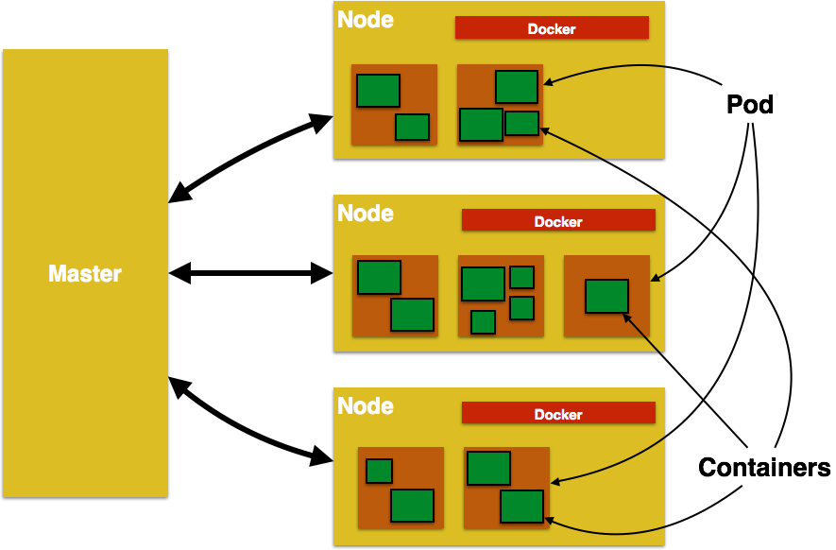
Types of auto-scaling in Kubernetes
Auto-Scaling of Kubernetes Nodes

Slide 8
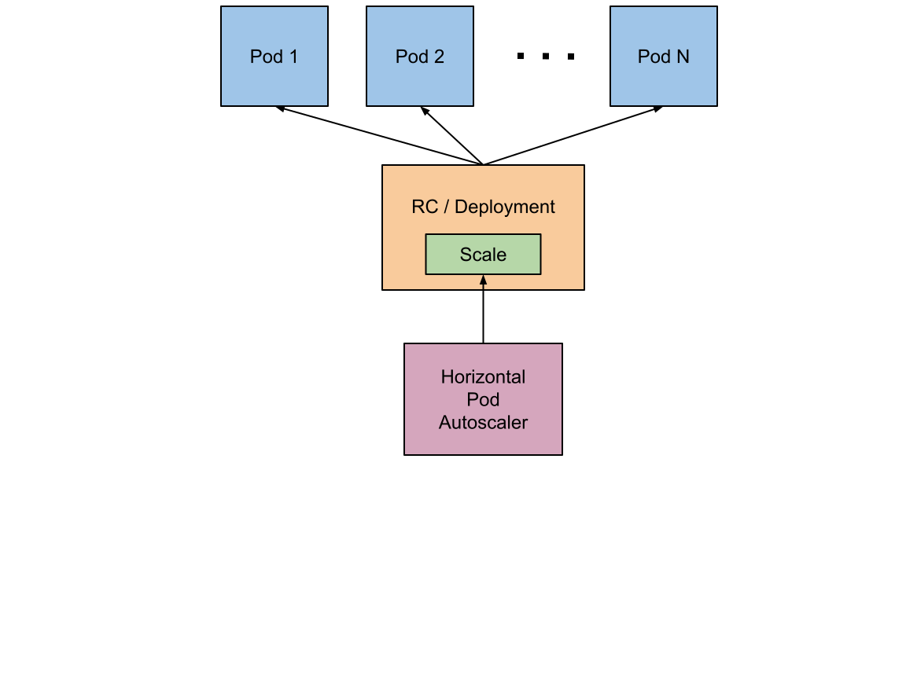
Types of auto-scaling in Kubernetes
Auto-Scaling pods in Kubernetes cluster

Slide 9
Horizontal Pod Autoscaler
The Horizontal Pod Autoscaler is implemented as a control loop, with a period controlled by the controller manager’s
--horizontal-pod-autoscaler-sync-period flag (with a default value of 30 seconds).
During each period, the controller manager queries the resource utilization against the metrics specified in each HorizontalPodAutoscaler definition. The controller manager obtains the metrics from either the resource metrics API (for per-pod resource metrics), or the custom metrics API (for all other metrics).

Slide 10
Horizontal Pod Autoscaler
For per-pod resource metrics (like CPU), the controller fetches the metrics from the resource metrics API for each pod targeted by the HorizontalPodAutoscaler.
If a target utilization value is set, the controller calculates the utilization value as a percentage of the equivalent resource request on the containers in each pod.
If a target raw value is set, the raw metric values are used directly. The controller then takes the mean of the utilization or the raw value (depending on the type of target specified) across all targeted pods, and produces a ratio used to scale the number of desired replicas.

Slide 11
Horizontal Pod Autoscaler
The HorizontalPodAutoscaler normally fetches metrics from a series of aggregated APIs (metrics.k8s.io, custom.metrics.k8s.io, and external.metrics.k8s.io). It can also fetch metrics directly from Heapster. Fetching metrics from Heapster is deprecated as of Kubernetes 1.11.
Easiest way to scale the deployment:
To get status of scaling:
$ kubectl autoscale rc foo --min=2 --max=5 --cpu-percent=80
$ kubectl get hpa

Slide 12
Horizontal Pod Autoscaler – cooldown/delay
When managing the scale of a group of replicas using the Horizontal Pod Autoscaler, it is possible that the number of replicas keeps fluctuating frequently due to the dynamic nature of the metrics evaluated.
Starting from v1.6, a cluster operator can mitigate this problem by tuning the global HPA settings exposed as flags for the kube-controller-manager component:
--horizontal-pod-autoscaler-downscale-delay: The value for this option is a duration that specifies how long the autoscaler has to wait before another downscale operation can be performed after the current one has completed. The default value is 5 minutes.
--horizontal-pod-autoscaler-upscale-delay: The value for this option is a duration that specifies how long the autoscaler has to wait before another upscale operation can be performed after the current one has completed. The default value is 3 minutes

Slide 13
Horizontal Pod Autoscaler – custom metrics
By default, the HorizontalPodAutoscaler controller retrieves metrics from a series of APIs. In order for it to access these APIs, cluster administrators must ensure that:
The API aggregation layer is enabled.
The corresponding APIs are registered:
For resource metrics, this is the metrics.k8s.io API, generally provided by metrics-server. It can be launched as a cluster addon.
For custom metrics, this is the custom.metrics.k8s.io API. It’s provided by “adapter” API servers provided by metrics solution vendors. Check with your metrics pipeline, or the list of known solutions. If you would like to write your own, check out the boilerplate to get started.
For external metrics, this is the external.metrics.k8s.io API. It may be provided by the custom metrics adapters provided above.
The --horizontal-pod-autoscaler-use-rest-clients is true or unset. Setting this to false switches to Heapster-based autoscaling, which is deprecated.

Slide 14
Demo Application

Slide 15
Demo Application
Collect all Flight Crashes from CSV file
Find GPS coordinates in Google Maps API
Index Crashes in ElasticSearch
Show all Flight Crashes in Real Time on the map

Slide 16
Demo Application
Problem:
Google API is very Slow
Solution
Scale pod which is responsible for fetching GPS coordinates

Slide 17
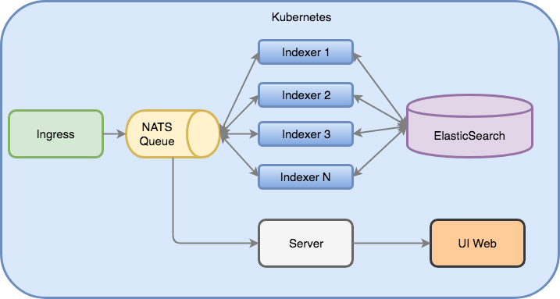
Demo Application Architecture

Slide 18
Demo Application - deployment
Start Minikube:
Install ElasticSearch:
Install NATS
$ minikube start --docker-env HTTP_PROXY=http://10.144.1.10:8080 --docker-env HTTPS_PROXY=https://10.144.1.10:8080 --disk-size=25g
$ kubectl apply -f kube/es/es-namespace.yaml
$ kubectl apply -f kube/es
$ kubectl apply -f kube/nats/nats-operator.yaml
$ kubectl apply -f kube/nats/deployment.yaml

Slide 19
Demo Application - deployment
Indexer:
UI:
Server:
$ kubectl apply -f kube/indexer/indexer.dep.yaml
$ kubectl apply -f kube/indexer/indexer.svc.yaml
$ kubectl apply -f kube/ui/ui.dep.yaml
$ kubectl apply -f kube/ui/ui.svc.yaml
$ kubectl apply -f kube/server/server.dep.yaml
$ kubectl apply -f kube/server/server.svc.yaml

Slide 20
Demo Application - deployment
Open:
To start whole pipeline:
http://192.168.99.100:32222
$ kubectl apply -f kube/ingress/ingress.job.yaml

Slide 21
Let’s scale up our Demo App!

Slide 22
Horizontal Pod Autoscaler
The Horizontal Pod Autoscaler feature was first introduced in Kubernetes v1.1 and has evolved a lot since then.
Version 1 of the HPA scaled pods based on observed CPU utilization and later on based on memory usage.
In Kubernetes 1.6 a new API Custom Metrics API was introduced that enables HPA access to arbitrary metrics.

Slide 23
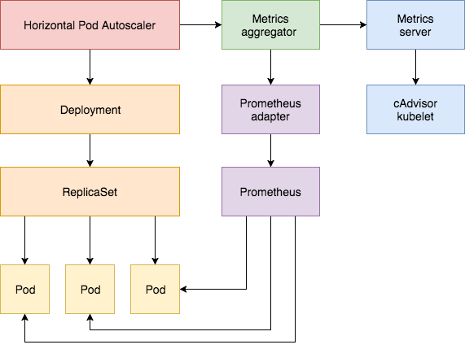
Horizontal Pod Autoscaler
The Horizontal Pod Autoscaler is implemented as a control loop that periodically queries the Resource Metrics API for core metrics like CPU/memory and the Custom Metrics API for application-specific metrics.

Slide 24
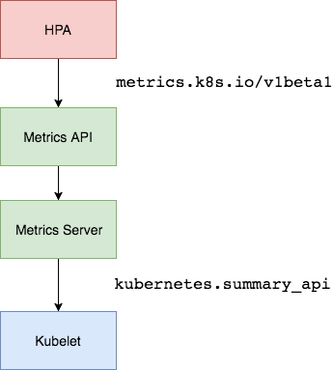
Setting up the Metrics Server
The Kubernetes Metrics Server is a cluster-wide aggregator of resource usage data and is the successor of Heapster. The metrics server collects CPU and memory usage for nodes and pods by pooling data from the kubernetes.summary_api. The summary API is a memory-efficient API for passing data from Kubelet/cAdvisor to the metrics server.

Slide 25
Setting up the Metrics Server
Deploy the Metrics Server in the kube-system namespace:
After one minute the metric-server starts reporting CPU and memory usage for nodes and pods.
View nodes metrics:
View pods metrics:
$ kubectl create -f kube/metrics-server
$ kubectl get --raw "/apis/metrics.k8s.io/v1beta1/nodes" | jq .
$ kubectl get --raw "/apis/metrics.k8s.io/v1beta1/pods" | jq .

Slide 26
Auto Scaling based on CPU and memory usage

Slide 27
Demo Application - scaling
Easiest:
$ kubectl autoscale deployment indexer --cpu-percent=50 --min=1 --max=3

Slide 28
Demo Application - scaling
---
apiVersion: autoscaling/v2beta1
kind: HorizontalPodAutoscaler
metadata:
name: indexer
spec:
scaleTargetRef:
apiVersion: extensions/v1beta1
kind: Deployment
name: indexer
minReplicas: 1
maxReplicas: 3
metrics:
- type: Resource
resource:
name: cpu
targetAverageUtilization: 50
- type: Resource
resource:
name: memory
targetAverageValue: 200Mi

Slide 29
Demo Application - scaling
Create the HPA:
HPA controller contacts the metrics server and fetches the CPU and memory:
$ kubectl create -f kube/indexer/indexer.hpa.yaml
$ kubectl get hpa
$ kubectl describe hpa

Slide 30
Auto Scaling based custom Metrics

Slide 31
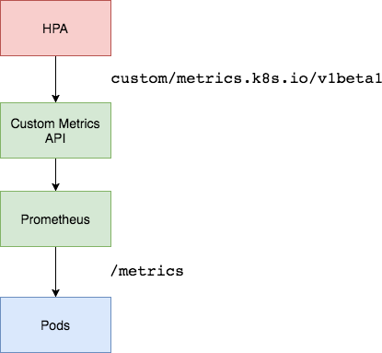
Setting up a Custom Metrics Server
In order to scale based on custom metrics you need to have two components. One component that collects metrics from your applications and stores them the Prometheus time series database. And a second component that extends the Kubernetes custom metrics API with the metrics supplied by the collect, the k8s-prometheus-adapter.

Slide 32
Setting up a the custom Metrics Server
Create the monitoring namespace:
Deploy Prometheus v2 in the monitoring namespace:
Generate the TLS certificates needed by the Prometheus adapter:
Deploy the Prometheus custom metrics API adapter:
$ kubectl create -f kube/monitoring/namespace.yaml
$ kubectl create -f kube/monitoring/prometheus
$ cd kube && make certs
$ kubectl create -f kube/custom-metrics-api

Slide 33
Setting up a the custom Metrics Server
List the custom metrics provided by Prometheus:
Get the FS usage for all the pods in the monitoring namespace:
Open Prometheus Web:
$ kubectl get --raw "/apis/custom.metrics.k8s.io/v1beta1" | jq .
$ kubectl get --raw "/apis/custom.metrics.k8s.io/v1beta1/namespaces/monitoring/pods/*/fs_usage_bytes" | jq .
$ http://192.168.99.100:31190/

Slide 34
Custom Metrics in our Application

Slide 35
Custom Prometheus Metrics in Go
Initialization
counter := prometheus.NewCounterVec(
prometheus.CounterOpts{
Subsystem: "http",
Name: "requests_google_api_total",
Help: "The total number of Google API requests.",
},
[]string{"status"},
)
prometheus.MustRegister(counter)

Slide 36
Custom Prometheus Metrics in Go
Incrementing counter:
r := &maps.GeocodingRequest{
Address: flight.Location,
}
geo, err := mapClient.Geocode(context.Background(), r)
if err != nil {
counter.WithLabelValues("500").Inc()
return nil, err
}
counter.WithLabelValues("200").Inc()

Slide 37
Custom Prometheus Metrics in Go
Registering /metrics endpoint:
// register handlers
s.mux.HandleFunc("/healthz", s.healthz)
s.mux.HandleFunc("/readyz", s.readyz)
s.mux.HandleFunc("/version", s.version)
s.mux.Handle("/metrics", promhttp.Handler())

Slide 38
Horizontal Pod Autoscaler with custom metrics

Slide 39
Horizontal Pod Autoscaler with custom metrics
apiVersion: autoscaling/v2beta1
kind: HorizontalPodAutoscaler
metadata:
name: indexer
spec:
scaleTargetRef:
apiVersion: extensions/v1beta1
kind: Deployment
name: indexer
minReplicas: 1
maxReplicas: 5
metrics:
- type: Pods
pods:
metricName: http_requests_google_api
targetAverageValue: 300m

Slide 40
Demo of auto-scaling based on custom metrics
Delete old indexer and HPA:
Restart deployment and create new HPA:
Restart ingress:
$ kubectl delete -f kube/indexer/indexer.dep.yaml
$ kubectl delete -f kube/indexer/indexer.hpa.yaml
$ kubectl apply -f kube/indexer/indexer.dep.yaml
$ kubectl apply -f kube/indexer/indexer.hpa.custom2.yaml
$ kubectl delete -f kube/ingress/ingress.job.yaml
$ kubectl apply -f kube/ingress/ingress.job.yaml

Slide 41
Demo of auto-scaling based on custom metrics
Let’s see how it scales:
Let’s see our custom metric in Prometheus Web:
Or check the metrics via the kubectl:
$ watch -n1 kubectl get hpa
http://192.168.99.100:31190/graph?g0.expr=http_requests_google_api_total
$ kubectl get --raw "/apis/custom.metrics.k8s.io/v1beta1/namespaces/default/pods/*/http_requests_google_api" | jq .

Slide 42
Prometheus AlertManager

Slide 43
Prometheus Alert Manager
The Alertmanager handles alerts sent by client applications such as the Prometheus server. It takes care of deduplicating, grouping, and routing them to the correct receiver integration such as email, PagerDuty, or Slack. It also takes care of silencing and inhibition of alerts.

Slide 44
Prometheus Alerts
Alert Rules An alert rule is a Prometheus query with some more special context to it. Like for how long this query has to active for and other meta information on what this alert is and what groups they belong to for notifications.
ALERT HighCPU IF ((sum(node_cpu{mode=~"user|nice|system|irq|softirq|steal|idle|iowait"}) by (instance, job)) -(sum(node_cpu{mode=~"idle|iowait"}) by (instance,job) ) )
FOR 10m LABELS { service = "backend" } ANNOTATIONS { summary = "High CPU Usage", description = "This machine has really high CPU usage for over 10m", }

Slide 45
Prometheus Alert Manager configuration
global:
resolve_timeout: 5m
slack_api_url: 'https://hooks.slack.com/services/<TOKEN_HERE>'
templates:
- '/etc/alertmanager/template/*.tmpl'
route:
group_by: ['alertname', 'cluster', 'service']
group_wait: 30s
group_interval: 5m
repeat_interval: 1h
receiver: default-receiver
routes:
- match:
alertname: HighCPU
receiver: 'default-receiver'
inhibit_rules:
- source_match:
severity: 'critical'
target_match:
severity: 'warning'
# Apply inhibition if the alertname is the same.
equal: ['alertname', 'cluster', 'service']

Slide 46
Prometheus Alert Manager configuration
receivers:
- name: 'default-receiver'
slack_configs:
- channel: '#general'
title: '[{{ .Status | toUpper }}{{ if eq .Status "firing" }}:{{ .Alerts.Firing | len }}{{ end }}] Prometheus Event Notification'
text: >-
{{ range .Alerts }}
*Alert:* {{ .Annotations.summary }} - `{{ .Labels.severity }}`
*Description:* {{ .Annotations.description }}
*Graph:* <{{ .GeneratorURL }}|:chart_with_upwards_trend:> *Runbook:* <{{ .Annotations.runbook }}|:spiral_note_pad:>
*Details:*
{{ range .Labels.SortedPairs }} • *{{ .Name }}:* `{{ .Value }}`
{{ end }}
{{ end }}
send_resolved: true

Slide 47
Thank you!

