Slide 1
Take your microservices to the next level with gRPC
Mateusz Dymiński
Nokia

Slide 2
Whoami
Mateusz Dymiński
Software Developer at Nokia
7+ exp with Java
3+ exp with Go
One of the organizer GoWroc - Golang Wroclaw Meetup
Github: github.com/mateuszdyminski
Twitter: @m_dyminski
LinkedIn: linkedin.com/in/mdyminski

Slide 3
Agenda
What's gRPC
Problems in the microservices world
How gRPC solves them
Demo
Summary
Q&A

Slide 4
How many of you have heard of gRPC?
How many of you use microservices?
How many of you use JSON to transfer your data between microservices

Slide 5
What is gRPC?

Slide 6

= RPC on steroids

Slide 7
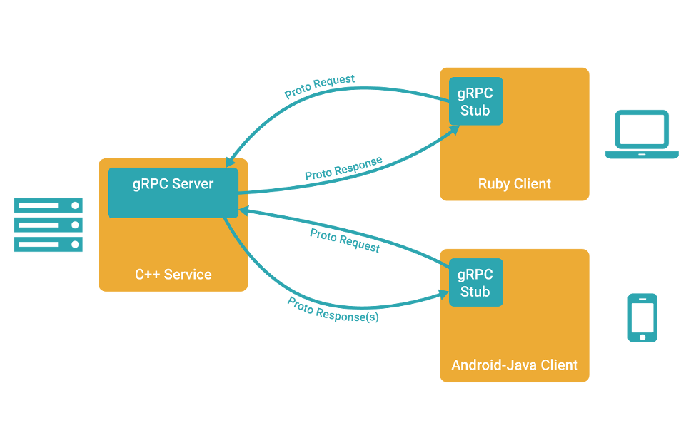
Retrieved from: https://grpc.io/

Slide 8
RPC
RPC – Remote Procedure Call
Allows client and server to communicate
Used in almost all distributed systems
Solves problems: security, synchronization, and data flow handling etc
Examples: NFS, D-Bus, JSON-RPC, SOAP, Apache Thrift, CORBA, Apache Avro, gRPC

Slide 9
gRPC
RPC framework
classic RPC and streaming RPC
Multi-language: Java, Go, C, C++, Node.js, Python, Ruby, Objective-C, PHP and C#
IDL: Protocol Buffers 3, Flatbuffers
Transport: HTTP2
Auth: SSL/TLS
Open sourced: github.com/grpc/

Slide 10
gRPC – main usage scenarios
Efficiently connecting polyglot services in microservices style architecture
Connecting mobile devices, browser clients to backend services
Generating efficient client libraries
Low latency, highly scalable, distributed systems.
Retrieved from: https://grpc.io/

Slide 11

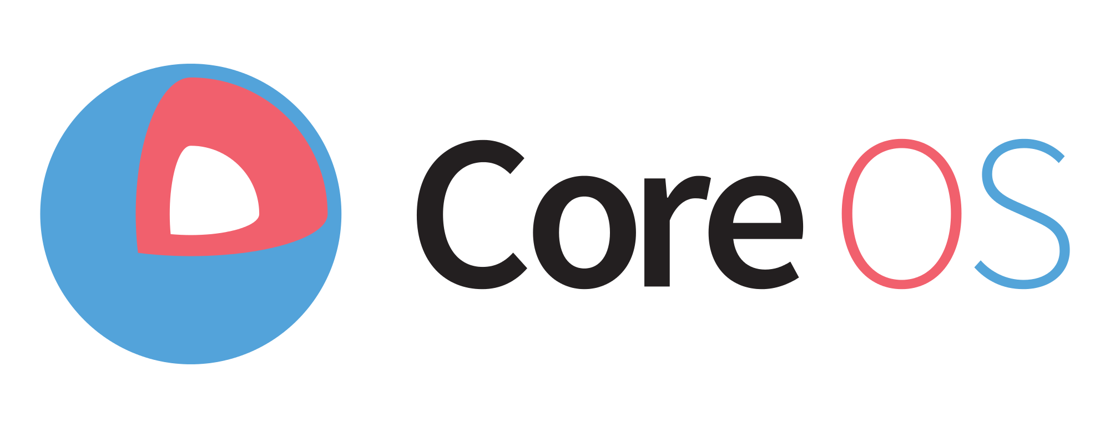





gRPC – powered by

Slide 12
gRPC – Go tools
Docker
CockroachDB - Super stable distributed DB
CoreOS/Etcd - Distributed consistent key-value store
Google Cloud Bigtable - Sparse table storage
YouTube/Vitess - Storage platform for scaling MySQL

Slide 13
gRPC – Java tools
GCE pub/sub - Google Cloud Engine Pub/Sub client
GCE Speech - Google Cloud Engine Speech client
Netflix Ribbon - Inter Process Communication library
Tensorflow - Scalable machine learning framework

Slide 14
Problems in Microservices world

Slide 15

Usually it looks like this:

Slide 16
You need to be this tall to use [micro] services:
here
gRPC
helps
Distributed logging, tracing
Know how to build, expose and maintain good APIs and contracts
Ready to honor backward and forward compatibility, even if you're the same person consuming this service on the other side
Provide Quality of service(QoS) - request deadline even if it's propagated to many different services
Provide request propagations/cancellations - stop cascading failures
Basic Monitoring, instrumentation, health checks
Ready to isolate not just code, but whole build+test+package+promote for every service
Can define upstream/downstream/compile-time/runtime dependencies clearly for each service
Good unit testing skills and readiness to do more (as you add more microservices it gets harder to bring everything up, hence more unit/contract/api test driven and lesser e2e driven)
Aware of [micro] service vs modules vs libraries, distributed monolith, coordinated releases, database-driven integration, etc
Know infrastructure automation (you'll need more of it)
Have working CI/CD infrastructure
Have or ready to invest in development tooling, shared libraries, internal artifact registries, etc
Have engineering methodologies and process-tools to split down features and develop/track/release them across multiple services (xp, pivotal, scrum, etc)
Retrieved from: HackerNews - https://news.ycombinator.com/item?id=12508655

Slide 17
Microservices - problems
Distributed tracing
Build, expose and maintain good APIs and contracts
Backward and forward compatibility
Provide Quality of service(QoS) - deadline
Provide request propagations/cancellations

Slide 18
Demo – Search Engine

Slide 19
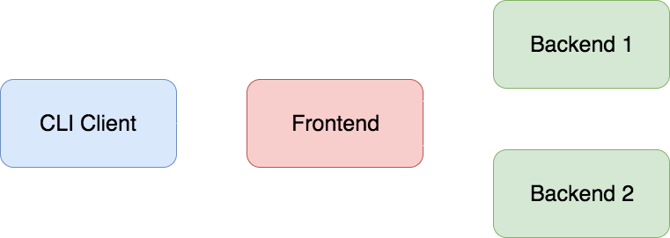
Search Engine

Slide 20
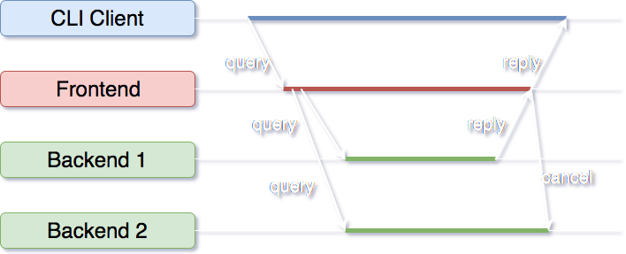
Search Engine – timeline

Slide 21
Demo - Search Engine
Frontend request tracing
Backend request tracing
Event logs

Slide 22
Protocol Buffers definition file
syntax = "proto3"; option java_multiple_files = true; option java_package = "com.grpc.search"; option java_outer_classname = "SearchProto"; option objc_class_prefix = "GGL"; package search; service Google { // Search returns a Search Engine result for the query. rpc Search(Request) returns (Result) {} } message Request { string query = 1; } message Result { string title = 1; string url = 2; string snippet = 3; }

Slide 23
How to generate code – Go
Requirements:
Protobuf github.com/google/protobuf
Golang protoc wrapper:
go get github.com/golang/protobuf/protoc-gen-go
> protoc ./search.proto --go_out=plugins=grpc:../golang/search

Slide 24
How to generate code – Java
Requirements:
Gradle/Maven
protobuf-gradle-plugin/protobuf-maven-plugin
> gradle generateProto
> mvn protobuf:compile

Slide 25
Generated code - Golang
type SearchEngineServer interface { // Search returns a Search Engine result for the query. Search(context.Context, *Request) (*Result, error) }
type SearchEngineClient interface { // Search returns a Search Engine result for the query. Search(ctx context.Context, in *Request, opts ...grpc.CallOption) (*Result, error) }
type Request struct { Query string `protobuf:"bytes,1,opt,name=query" json:"query,omitempty"` }
type Result struct { Title string `protobuf:"bytes,1,opt,name=title" json:"title,omitempty"` Url string `protobuf:"bytes,2,opt,name=url" json:"url,omitempty"` Snippet string `protobuf:"bytes,3,opt,name=snippet" json:"snippet,omitempty"` }

Slide 26
Generated code - Java
public final class Request extends com.google.protobuf.GeneratedMessageV3 implements // @@protoc_insertion_point(message_implements:search.Request) RequestOrBuilder {
public static final int QUERY_FIELD_NUMBER = 1; private volatile java.lang.Object query_; /** * <code>string query = 1;</code> */ public java.lang.String getQuery() { java.lang.Object ref = query_; if (ref instanceof java.lang.String) { return (java.lang.String) ref; } else { com.google.protobuf.ByteString bs = (com.google.protobuf.ByteString) ref; java.lang.String s = bs.toStringUtf8(); query_ = s; return s; } }

Slide 27
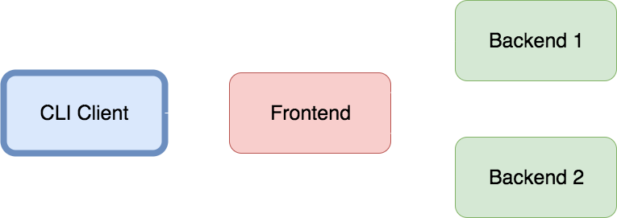
Source code – client

Slide 28
Source code – Java client
/** * BlockingClient is a client which blocks the execution until gets its response. */ public class BlockingClient implements SearchClient { private final ManagedChannel channel; private final SearchEngineGrpc.SearchEngineBlockingStub googleBlockingStub; public BlockingClient(String host, int port) { channel = ManagedChannelBuilder.forAddress(host, port) .usePlaintext(true) .build(); googleBlockingStub = SearchEngineGrpc.newBlockingStub(channel); }
}

Slide 29
Source code – Java client - sync
/** * Search query in Search engine backend. */ @Override public Result search(String query) { final Request request = Request.newBuilder().setQuery(query).build(); return Try .ofFailable(() -> googleBlockingStub.search(request)) .onSuccess(r -> logger.info("Search result: " + r)) .onFailure(e -> logger.log(Level.SEVERE, "RPC failed: {0}", e)) .getUnchecked(); }

Slide 30
Source code – Java client - async
/** * Search searches query in async way in Search engine backend. */ @Override public Result search(String query) { Request request = Request.newBuilder().setQuery(query).build(); ListenableFuture<Result> resultFuture = googleFutureClient.search(request); return Try.ofFailable(() -> resultFuture.get(1000, TimeUnit.MILLISECONDS)) .onSuccess(r -> logger.info("Search result: " + r)) .onFailure(e -> logger.log(Level.SEVERE, "RPC failed: {0}", e)) .getUnchecked(); }

Slide 31
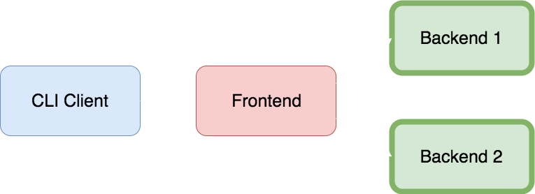
Source code - backend

Slide 32
Source code – Go backend
func main() { flag.Parse() rand.Seed(time.Now().UnixNano()) go http.ListenAndServe(fmt.Sprintf(":%d", 36661+*index), nil) // HTTP debugging lis, err := net.Listen("tcp", fmt.Sprintf(":%d", 36061+*index)) // RPC port if err != nil { log.Fatalf("failed to listen: %v", err) }
g := grpc.NewServer() pb.RegisterSearchEngineServer(g, new(server)) g.Serve(lis) }

Slide 33
Source code – Go backend
// Search sleeps for a random interval then returns a string func (s *server) Search(ctx context.Context, req *pb.Request) (*pb.Result, error) { d := randomDuration(100 * time.Millisecond) logSleep(ctx, d) select { case <-time.After(d): return &pb.Result{ Title: fmt.Sprintf("result for [%s] from backend %d", req.Query, *index), }, nil case <-ctx.Done(): return nil, ctx.Err() } }

Slide 34

Source code - frontend

Slide 35
Source code – Go frontend
// Search issues Search RPCs in parallel to the backends and returns first result. func (s *server) Search(ctx context.Context, req *pb.Request) (*pb.Result, error) { c := make(chan result, len(s.backends)) for _, b := range s.backends { go func(backend pb.SearchEngineClient) { res, err := backend.Search(ctx, req) c <- result{res, err} }(b) } first := <-c return first.res, first.err }
type result struct { res *pb.Result err error }

Slide 36
Source code – Go frontend
func main() { go http.ListenAndServe(":36660", nil) // HTTP debugging lis, err := net.Listen("tcp", ":36060") // RPC port if err != nil { log.Fatalf("failed to listen: %v", err) } s := new(server) for _, addr := range strings.Split(*backends, ",") { conn, err := grpc.Dial(addr, grpc.WithInsecure()) if err != nil { log.Fatalf("fail to dial: %v", err) } client := pb.NewSearchEngineClient(conn) s.backends = append(s.backends, client) } g := grpc.NewServer() pb.RegisterSearchEngineServer(g, s) g.Serve(lis) }

Slide 37
What is better than a demo?

Slide 38
Another demo!

Slide 39
Demo – Streaming Search Engine
Debugging active stream
Request cancelation

Slide 40
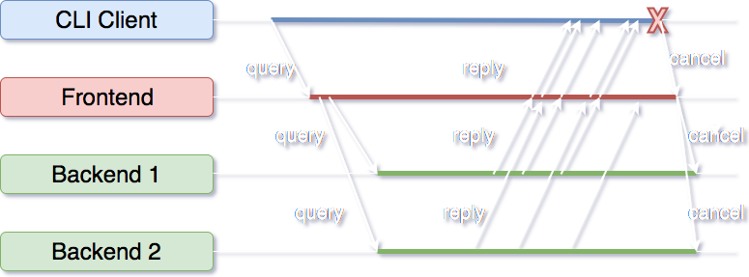
Streaming Search Engine

Slide 41
Protocol Buffers definition file
syntax = "proto3"; option java_multiple_files = true; option java_package = "com.grpc.search"; option java_outer_classname = "SearchProto"; option objc_class_prefix = "GGL"; package search; service Google { // Search returns a Search Engine result for the query. rpc Search(Request) returns (Result) {}
// Watch returns a stream of Search Engine results for the query. rpc Watch(Request) returns (stream Result) {} } message Request { string query = 1; } message Result { string title = 1; string url = 2; string snippet = 3; }
New method >

Slide 42
Source code - client

Slide 43
Source code – Java client - streaming
public void watch(String query) { final Request request = Request.newBuilder().setQuery(query).build(); final CountDownLatch latch = new CountDownLatch(1); // we expect only 1 result StreamObserver<Result> stream = new StreamObserver<Result>() { public void onNext(Result value) { logger.info("Search result: " + value.getTitle()); } public void onError(Throwable t) { logger.severe(("Error while watching for results! " + t.getMessage())); latch.countDown(); } public void onCompleted() { logger.info("Watch done!"); latch.countDown(); } }; googleStub.watch(request, stream); Uninterruptibles.awaitUninterruptibly(latch, 100, TimeUnit.SECONDS); }

Slide 44
Source code – backend – streaming

Slide 45
Source code – Go backend - streaming
// Watch returns a stream of results identifying the query and this // backend, sleeping a random interval between each send. func (s *server) Watch(req *pb.Request, stream pb.SearchEngine_WatchServer) error { ctx := stream.Context() for i := 0; ; i++ { d := randomDuration(1 * time.Second) logSleep(ctx, d) select { case <-time.After(d): err := stream.Send(&pb.Result{ Title: fmt.Sprintf("result %d for [%s] from backend %d", i, req.Query, *index), }) if err != nil { return err } case <-ctx.Done(): return ctx.Err() } } }

Slide 46
Source code – frontend – streaming

Slide 47
Source code – Go frontend- streaming
// Watch runs Watch RPCs in parallel on the backends and returns a // merged stream of results. func (s *server) Watch(req *pb.Request, stream pb.SearchEngine_WatchServer) error { ctx := stream.Context() c := make(chan result) var wg sync.WaitGroup for _, b := range s.backends { wg.Add(1) go func(backend pb.SearchEngineClient) { defer wg.Done() watchBackend(ctx, backend, req, c) }(b) } go func() { wg.Wait() close(c) }() for res := range c { if res.err != nil { return res.err } if err := stream.Send(res.res); err != nil { return err } } return nil }

Slide 48
Source code – Go frontend- streaming
// watchBackend runs Watch on a single backend and sends results on c. // watchBackend returns when ctx.Done is closed or stream.Recv fails. func watchBackend(ctx context.Context, backend pb.SearchEngineClient, req *pb.Request, c chan<- result) { stream, err := backend.Watch(ctx, req) if err != nil { select { case c <- result{err: err}: case <-ctx.Done(): } return } for { res, err := stream.Recv() select { case c <- result{res, err}: if err != nil { return } case <-ctx.Done(): return } } }

Slide 49
gRPC – ecosystem

Slide 50
gRPC - ecosystem
grpc-gateway - gRPC to JSON proxy generator following the gRPC HTTP spec
grpc-prometheus - Prometheus monitoring for your gRPC servers.
go-grpc-middleware - Golang gRPC Middlewares: interceptor chaining, auth, logging, retries and more.
grpc-opentracing - OpenTracing is a set of consistent, expressive, vendor-neutral APIs for distributed tracing and context propagation
Polyglot - A universal grpc command line client

Slide 51


Slide 52
Summary

Slide 53
Use gRPC when:
Efficiently connecting polyglot services in microservices style architecture – implementations in (Java, Go, C, C++, Node.js, Python, Ruby, Objective-C, PHP, i C#)
Connecting mobile devices, browser clients to backend services
Generating efficient client libraries
Creating low latency, highly scalable, distributed systems.

Slide 54
gRPC is the answer to most of the microservices problems

Slide 55
Thank you!

