Slide 1
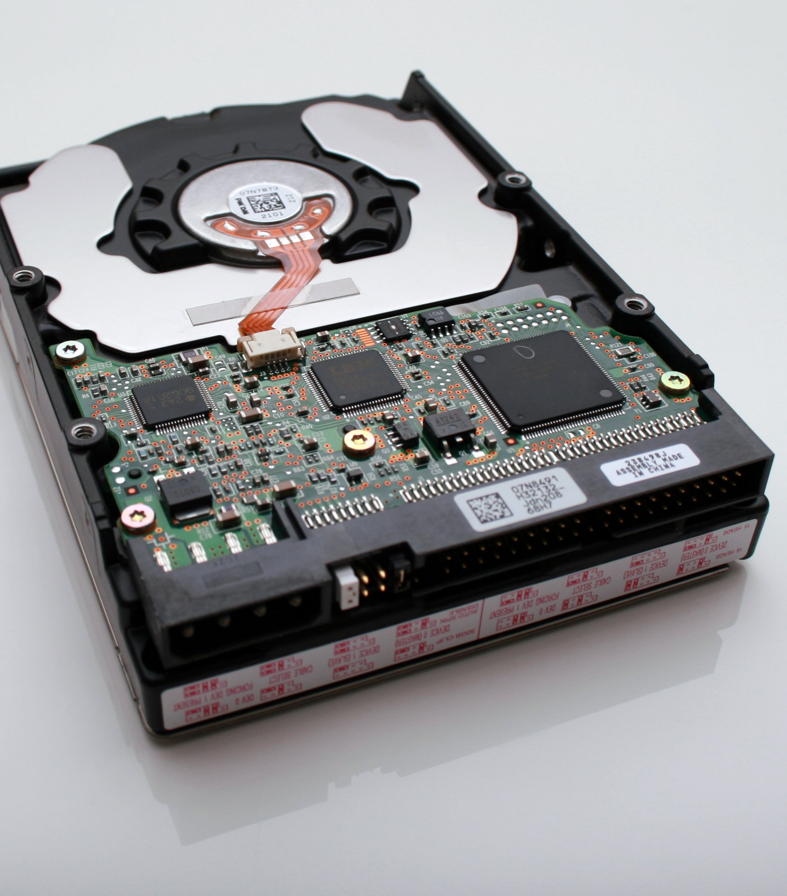
Kubernetes Storage 101
Mateusz Dymiński

Slide 2
Containers are stateless
Cleared on exit
Unless a persistent volume is used.

Slide 3
Database in Pod
apiVersion: apps/v1
kind: Pod
metadata:
name: mysql
spec:
containers:
- image: mysql:5.6
name: mysql
env:
- name: MYSQL_ROOT_PASSWORD
value: password
ports:
- containerPort: 3306
name: mysql
All the data is lost
when container ends

Slide 4
Kubernetes Storage Entities

Slide 5
Pod
Mounts PersistentVolumeClaim into container(s)

Slide 6
PersistentVolumeClaim (PVC)
Application request for storage.
Created by user / devops.
Binds to single PV.
Usable in Pods.

Slide 7
PersistentVolume (PV)
Pointer to physical storage.
Binds to single PVC.
Created by admin ("pre-provisioning").
Created by Kubernetes on demand ("dynamic provisioning").

Slide 8
StorageClass
Collection of PersistentVolumes with the same characteristics.
"Fast", "Cheap", "Replicated", ...
Parameters for dynamic provisioning.
Created by admin. Subject of quota per namespace.

Slide 9
Kubernetes Storage Entities Portability
Portable across Kubernetes clusters.
Pod
PersistentVolumeClaim (PVC)

Slide 10
Kubernetes Storage Entities Portability
Not portable across Kubernetes clusters.
PersistentVolume (PV)
StorageClass
Both contain details about the storage:
Volume plugin.
IP addresses of storage server(s).
Paths.
Usernames / passwords.

Slide 11
Stateful Pod Step by Step

Slide 12
Pod mounts PersistentVolumeClaim into container(s)
apiVersion: apps/v1
kind: Pod
metadata:
name: mysql
spec:
containers:
- image: mysql:5.6
name: mysql
env:
- name: MYSQL_ROOT_PASSWORD
value: password
volumeMounts:
- name: mysql-persistent-storage
mountPath: /var/lib/mysql
volumes:
- name: mysql-persistent-storage
persistentVolumeClaim:
claimName: mysql-pv-claim

Slide 13
PersistentVolumeClaim = request for storage
kind: PersistentVolumeClaim
apiVersion: v1
metadata:
name: mysql-pv-claim
spec:
resources:
requests:
storage: 1Gi
accessModes:
- ReadWriteOnce
"Give me 1 GiB of storage."
"That is mountable to single pod as read/write."
"And I don't really care about the rest."

Slide 14
PersistentVolumeClaim
$ kubectl create -f pvc.yaml
persistentvolumeclaim/mysql-pv-claim created
$ kubectl get pvc
NAME STATUS VOLUME CAPACITY ACCESS MODES STORAGECLASS AGE
my-mysql-claim Bound pvc-6428 1Gi RWO standard 1m

Slide 15
PersistentVolume
kind: PersistentVolume
apiVersion: v1
metadata:
name: task-pv-volume
labels:
type: local
spec:
storageClassName: cheap
capacity:
storage: 10Gi
accessModes:
- ReadWriteOnce
persistentVolumeReclaimPolicy: Retain
hostPath:
path: "/mnt/data"
StorageClass where this
volume belongs.

Slide 16
PersistentVolume
kind: PersistentVolume
apiVersion: v1
metadata:
name: task-pv-volume
labels:
type: local
spec:
storageClassName: cheap
capacity:
storage: 10Gi
accessModes:
- ReadWriteOnce
persistentVolumeReclaimPolicy: Retain
hostPath:
path: "/mnt/data"
Size of the Volume

Slide 17
PersistentVolume
kind: PersistentVolume
apiVersion: v1
metadata:
name: task-pv-volume
labels:
type: local
spec:
storageClassName: cheap
capacity:
storage: 10Gi
accessModes:
- ReadWriteOnce
persistentVolumeReclaimPolicy: Retain
hostPath:
path: "/mnt/data"
Access modes that the
volume supports

Slide 18
PersistentVolume
kind: PersistentVolume
apiVersion: v1
metadata:
name: task-pv-volume
labels:
type: local
spec:
storageClassName: cheap
capacity:
storage: 10Gi
accessModes:
- ReadWriteOnce
persistentVolumeReclaimPolicy: Retain
hostPath:
path: "/mnt/data"
What to do when the volume is
not needed any longer. Options:
Recycle (deprecated),
Retain,
Delete

Slide 19
PersistentVolume
kind: PersistentVolume
apiVersion: v1
metadata:
name: task-pv-volume
labels:
type: local
spec:
storageClassName: cheap
capacity:
storage: 10Gi
accessModes:
- ReadWriteOnce
persistentVolumeReclaimPolicy: Retain
hostPath:
path: "/mnt/data"
Pointer to Storage
AWS EBS, Azure DD, Ceph FS & RBD, CSI, FC, Flex, GCE PD, Gluster, iSCSI, NFS, OpenStack Cinder,
Photon, Quobyte, StorageOS, vSphere

Slide 20
StorageClass
kind: StorageClass
apiVersion: storage.k8s.io/v1
metadata:
name: slow
provisioner: kubernetes.io/gce-pd
annotations:
storageclass.kubernetes.io/is-default-class: "true"
parameters:
type: pd-standard
zone: us-east1-d
Collection of PersistentVolumes with the same characteristics.
Usually admin territory.
Global, not namespaced.

Slide 21
StorageClass
kind: StorageClass
apiVersion: storage.k8s.io/v1
metadata:
name: slow
provisioner: kubernetes.io/gce-pd
annotations:
storageclass.kubernetes.io/is-default-class: "true"
parameters:
type: pd-standard
zone: us-east1-d
Who dynamically provisions volumes.
Name of hardcoded volume plugin.
Name of external provisioner.
Name of CSI driver.

Slide 22
StorageClass
kind: StorageClass
apiVersion: storage.k8s.io/v1
metadata:
name: slow
provisioner: kubernetes.io/gce-pd
annotations:
storageclass.kubernetes.io/is-default-class: "true"
parameters:
type: pd-standard
zone: us-east1-d
Parameters for dynamic provisioning.
Depend on the provisioner.

Slide 23
StorageClass
kind: StorageClass
apiVersion: storage.k8s.io/v1
metadata:
name: slow
provisioner: kubernetes.io/gce-pd
annotations:
storageclass.kubernetes.io/is-default-class: "true"
parameters:
type: pd-standard
zone: us-east1-d
One StorageClass in the cluster can be default.
PVC without any StorageClass gets the default one.

Slide 24
PersistentVolume lifecycle

Slide 25
PersistentVolume – Dynamic Provisioning
Admin
Storage
Storage Class
Persistent
Volume
User
PersistentVolumeClaim

Slide 26
PersistentVolume – Manual Provisioning
Admin
Storage
Storage Class
Persistent
Volume
User
PersistentVolumeClaim

Slide 27
PersistentVolume – Release
Admin
Storage
Storage Class
Persistent
Volume
User
PersistentVolumeClaim

Slide 28
PersistentVolume – Release
PVC is deleted: persistentVolumeReclaimPolicy is executed:
Recycle (deprecated):
All data from the volume are removed ("rm -rf *").
PV is Available for new PVCs.
Delete:
Volume is deleted in the storage backend.
PV is deleted.
Usually for dynamically-provisioned volumes
Retain:
PV is kept Released.
No PVC can bind to it.
Admin should manually prune Released volumes. In all cases, user can't access the data!

Slide 29
Stateful applications

Slide 30
Deployment
Runs X replicas of a single Pod template.
When a pod is deleted, Deployment automatically creates a new one.
Scalable up & down.
All pods share the same PVC!

Slide 31
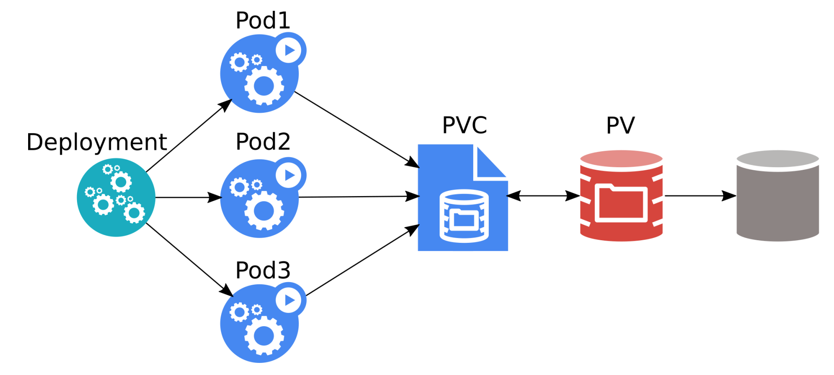
Deployment
Source: Kubernetes Storage 101 - Jan Šafránek, Red Hat & David Zhu, Google

Slide 32
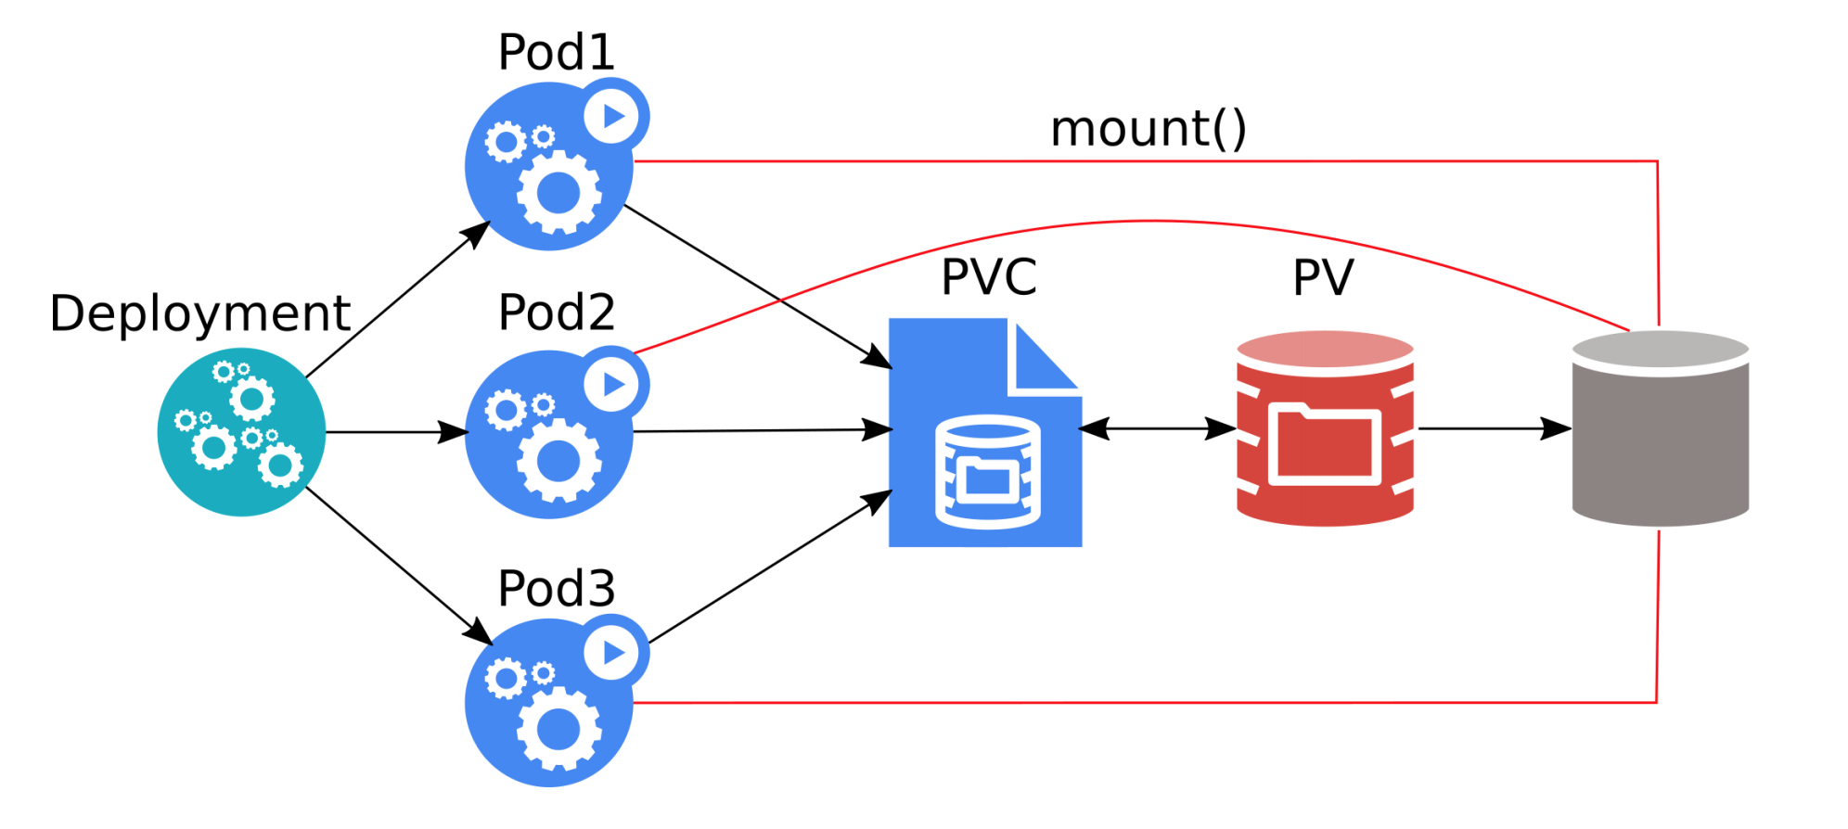
Deployment
All three pods can overwrite data of each other!
Most applications crash / refuse to work.
Source: Kubernetes Storage 101 - Jan Šafránek, Red Hat & David Zhu, Google

Slide 33
StatefulSet
Runs X replicas of a single Pod template.
Each pod gets its own PVC(s) from a PVC template.
When a pod is deleted, StatefulSet automatically creates a new one.
Each pod has a stable identity.
Scalable up & down.

Slide 34
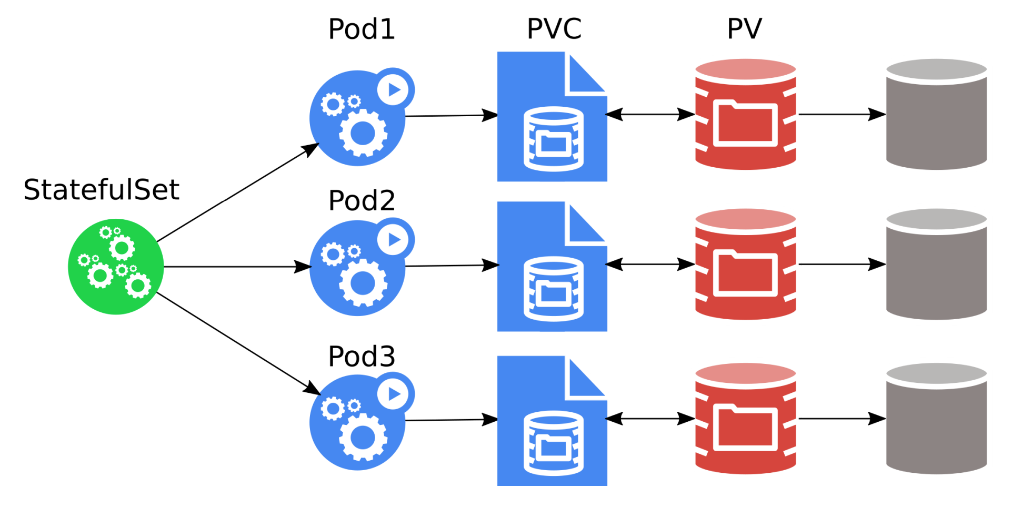
StatefulSet
The pods must be aware of the other StatefulSet members!
Source: Kubernetes Storage 101 - Jan Šafránek, Red Hat & David Zhu, Google

Slide 35
Storage features

Slide 36
LocalVolumes
Unused local disks can be used as PVs.
Extra speed.
Lower reliability.
No pod scheduling flexibility.

Slide 37
Resize
Only expansion is supported.
Offline.
Online (alpha).

Slide 38
Snapshots
Alpha.
Part of CSI.
Can take a snapshot of PVC.
PVC can be provisioned from a snapshot.
More: https://kubernetes.io/blog/2018/10/09/introducing-volume-snapshot-alpha-for-kubernetes/

