Slide 1


Kubernetes Operator 101
Mateusz Dymiński

Slide 2
Kubernetes Operator Agenda
What’s the problem which Operator solves
Definition
Concept
Examples

Slide 3
What’s the problem which Operator solves
Installing software on Kubernetes is more and more complicated – i.e. Kafka + Zookeeper
Multiple different type of resources need to be maintained – Deployments, StatefulSets, Services, ConfigMaps etc
Configuration is cumbersome and error prone

Slide 4
Kubernetes Operator Definition
An Operator is a Kubernetes pattern that is extending the Kubernetes control plane with a custom Controller and Custom Resource Definitions that add additional operational knowledge of an application.

Slide 5
Kubernetes Operator
CoreOS introduced operators
Designed for automating the handling of these kinds of complex operational scenarios.
Operators extend the Kubernetes API through a third party resources mechanism (custom resource)
Give us fine-grained access and control over what’s going on inside the cluster
CoreOS also developed an SDK for developing

Slide 6
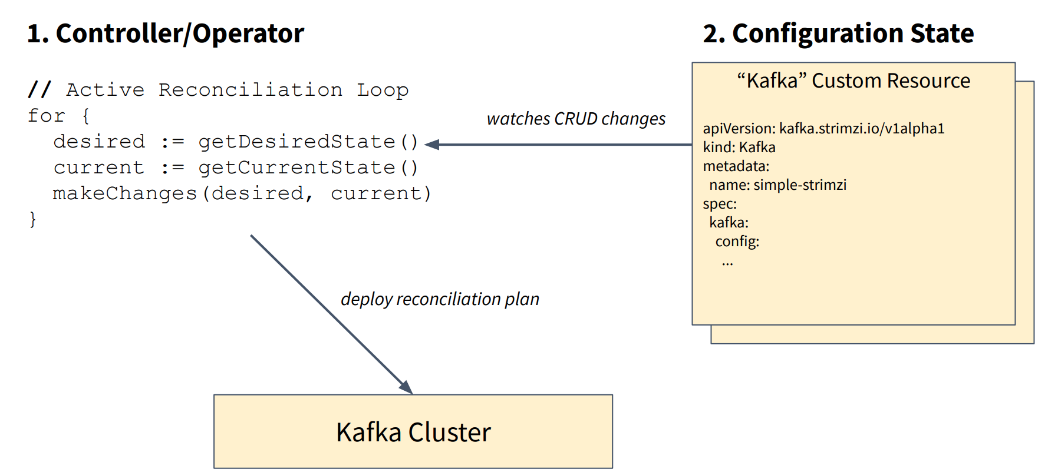
Kubernetes Operator Concept
Source: https://www.slideshare.net/Lightbend/running-kafka-on-kubernetes-with-strimzi-for-realtime-streaming-applications

Slide 7
Kubernetes Operators Hub
https://operatorhub.io/

Slide 8

Thanks!

