Slide 1
Mathematical Optimization Algorithms
Exercise 4: Process Optimization

Slide 2
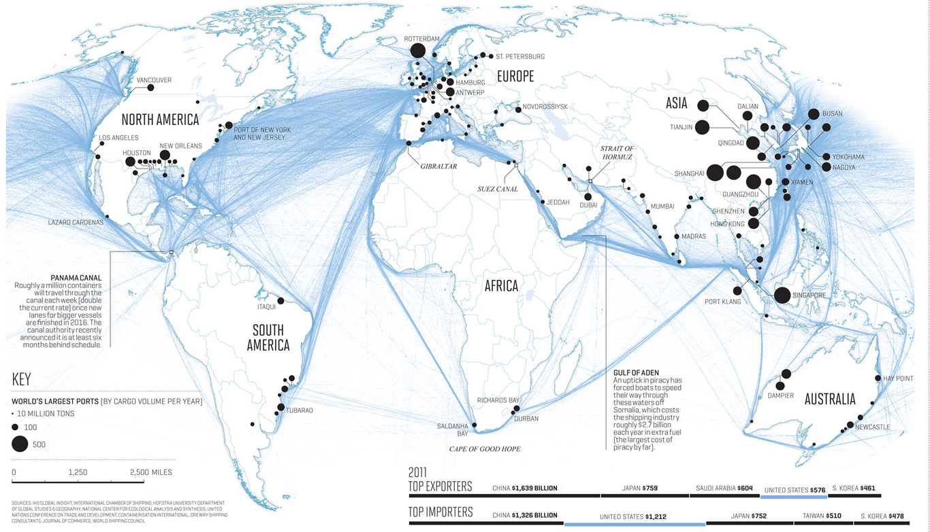
Contact Lenses Supply Chain Optimization
Scenario:
You are a Data Scientist at a leading medical device company focused on eye care, with a specialization in manufacturing contact lenses.
Objective:
The Head of Supply Chain has asked you to develop a set of optimization models to reduce operating costs associated with the distribution of contact lenses from production plants to distribution centers and warehouses.

Slide 3
Contact Lenses Supply Chain Optimization
Data
Production 2023.xlsx
Distribution PRD-GDC 2023.xlsx
Locations PMP.xlsx
Locations GDC.xlsx
Locations WHS.xlsx
Locations MKT.xlsx
Demand 2023.xlsx (Q6)
Shipment Constraints.xlsx (Q7)
Prices 2023.xlsx (Q8)

Slide 4




Contact Lenses Supply Chain Optimization
Supply Chain
Stage 1: PMP
Stage 2: GDC
Stage 3: WHS
Stage 4: MKT

Slide 5
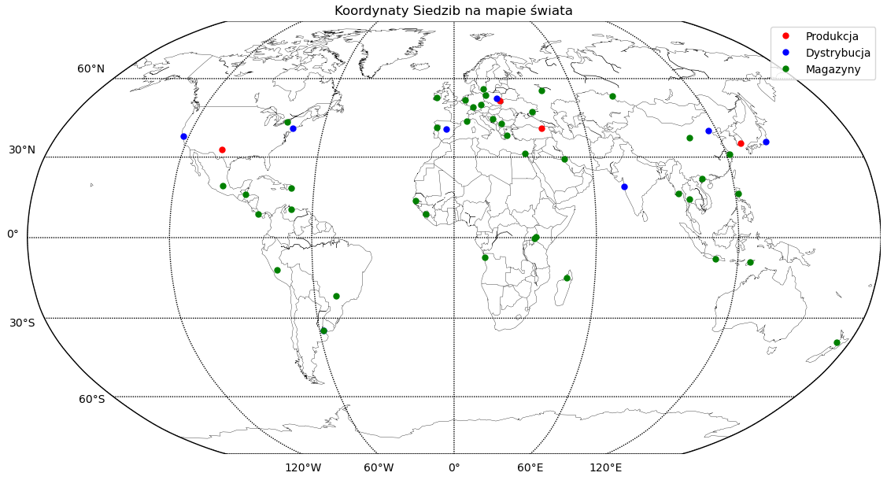
Contact Lenses Supply Chain Optimization
Distribution
Manufacturing > Distribution > Warehouses

Slide 6
Contact Lenses Supply Chain Optimization
Questions
Q1. Calculate the Cost of Supply from Manufacturing to Distribution.
Q2. Calculate the Optimal Cost from Manufacturing to Distribution if the cost is 0.1 USD per Unit per 1000 km.
Q3. Calculate the Optimal Cost of the Supply from Manufactuiring to Distribution to Warehouse if the cost is 0.1 USD per Unit per 1000 km.
Q4. Create a Python Code to generate a Map with the locations similar to the one in the page before.

Slide 7
Contact Lenses Supply Chain Optimization
Questions
Q5. Calculate the Optimal Cost of the Supply from Manufacturing to Distribution to Warehouse to Market if the cost is 0.1 USD per Unit per 1000 km.
Q6. Calculate the Optimal Cost of the Supply from Manufacturing to Distribution to Warehouse to Market if the cost is 0.1 USD per Unit per 1000 km, and you need to cover the Market Demands.
Q7. Calculate the Optimal Cost of the Supply from Manufacturing to Distribution to Warehouse to Market if the cost is 0.1 USD per Unit per 1000 km, and you need to cover the Market Demands, and you cannot Shipped between the Source and Destinations Specified in File Shipment Constraints.
Q8. Without taking into account the Constraints calculate the Maximum Revenue, and the minimum Supply Costs, just taking into account that all production units arrives to Market, check if the Supply is the same.

Slide 8
Mathematical Optimization Algorithms
Exercise 4: Process Optimization

