Slide 1
Unit test problems – how not to die of old age and stay calm
Mateusz Winnicki
www.mateuszwinnicki.pl
mateusz.winnicki@euvic.pl

Slide 2
Unit test – so hard to define

Slide 3
Why should
I even care?
(https://www.computer.org/csdl/mags/so/2007/03/s3024.html)

Slide 4
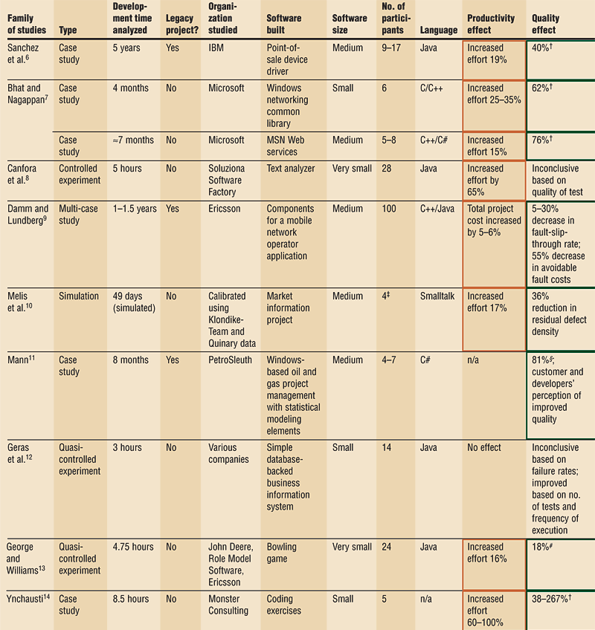

Slide 5
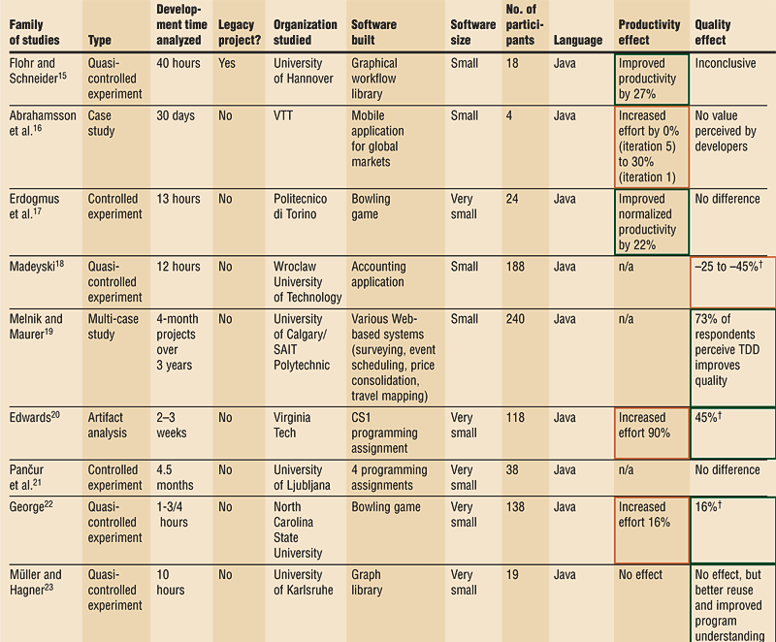

Slide 6
If it is so helpful why I don’t like it?

Slide 7
Tests are written AFTER implementation

Slide 8
Downsides
- no influence on a design
- zero help during implementation
- no fast feedback
- slow down the implementation
- not all requirements are tested
- writing tests just to pass
- “is it hard to write? Just skip”

Slide 9
Use TDD/BDD always when you are writing new code

Slide 10
Too many assertions

Slide 11
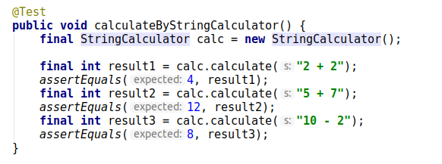
Too many tests in one

Slide 12
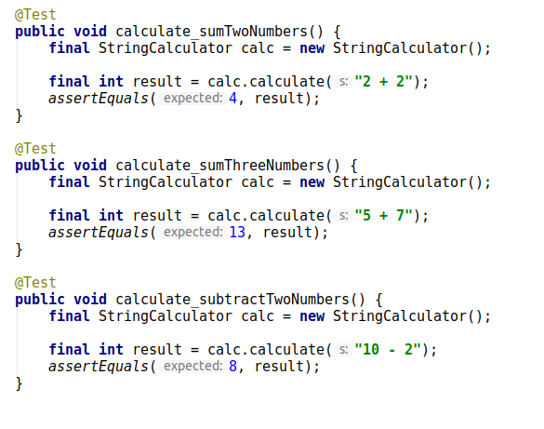

Slide 13
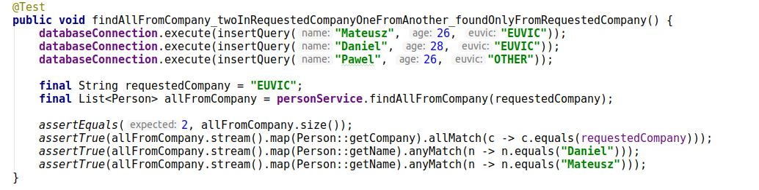
Too many assertions

Slide 14
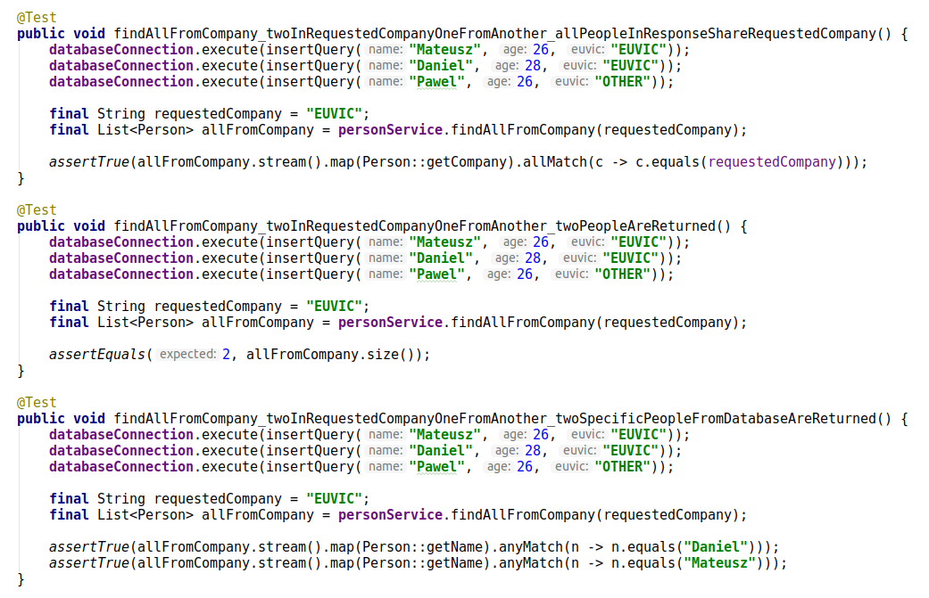

Slide 15
Dependencies between tests

Slide 16
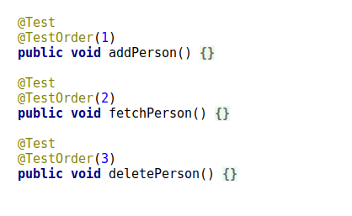
Order?!

Slide 17
Tests have to be independent

Slide 18
Independent to extreme level

Slide 19
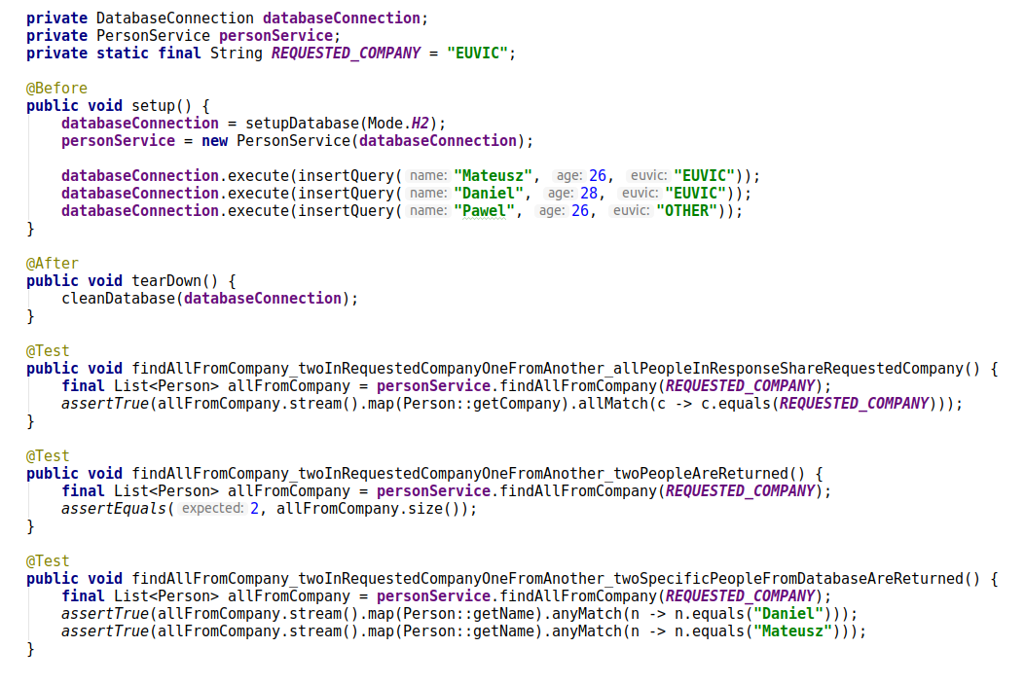

Slide 20
Downsides
- big coupling between tests
- you cannot read tests from up to bottom
- one change during test refactoring will blow up all the others
- you cannot introduce new specific tests without changing rest of them

Slide 21
What we can do?
- always generate literals, numbers etc. which are not important for current test
- all setups and cleanups in test method
- Test Data Builders
- you have to be sane here. In example - setting up a database will be always the same (so it can be in separate method)

Slide 22
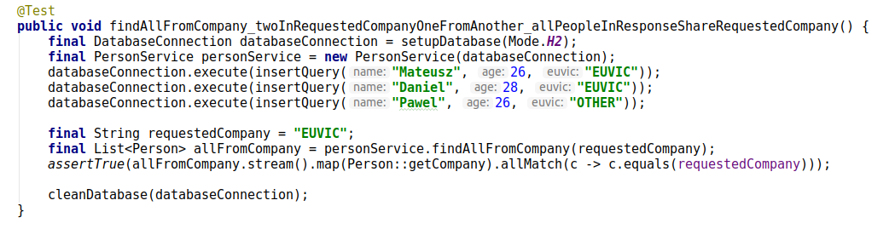

Slide 23
DRY is not really a rule in unit testing

Slide 24
Non-deterministic tests

Slide 25
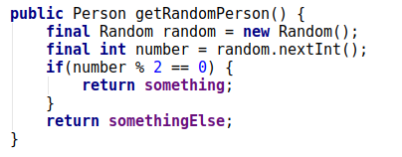
Generation of something in the production code

Slide 26
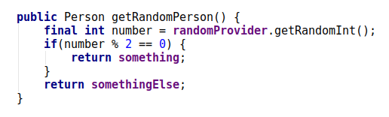
Instead:

Slide 27
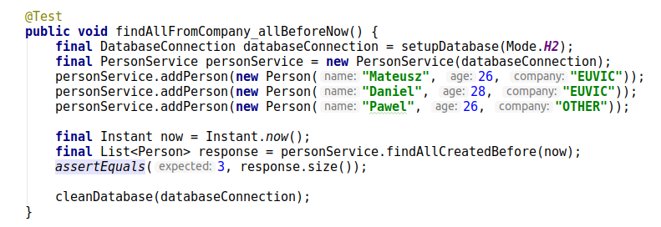
Randomness in tests:

Slide 28
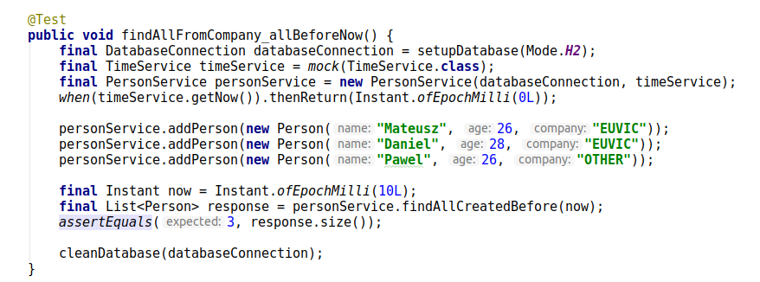
Instead:

Slide 29
Slow unit test

Slide 30
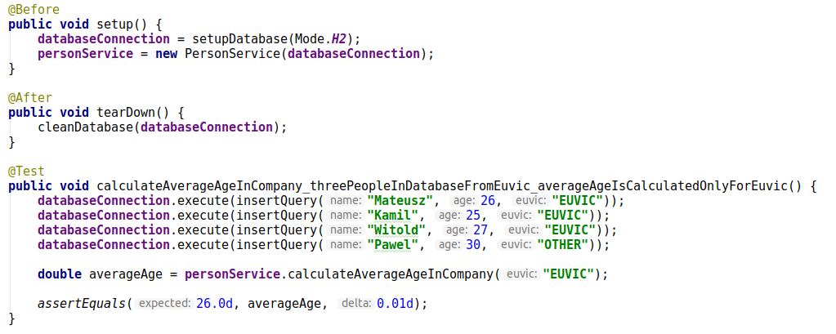
IO operations

Slide 31
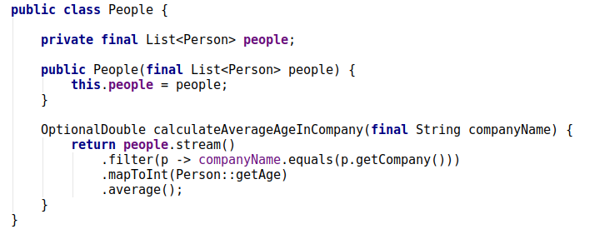
Split the IO and algorithm

Slide 32
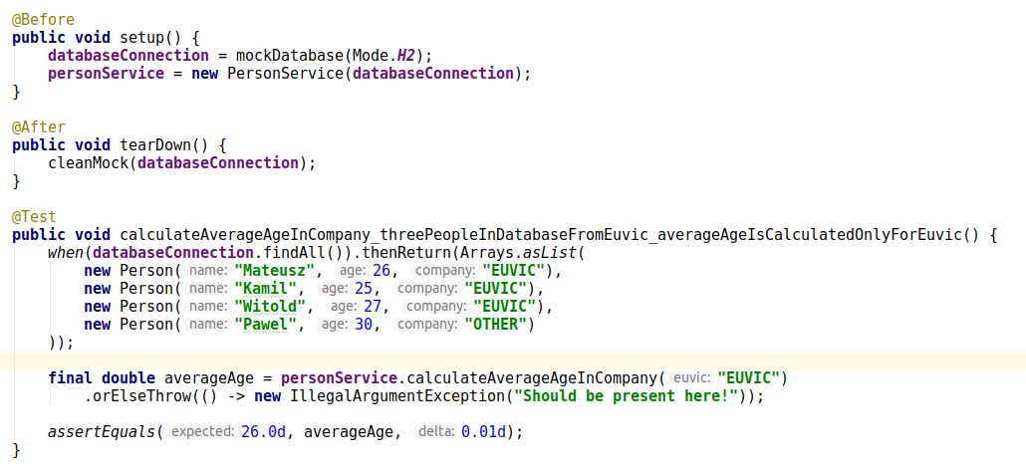
Use mocks

Slide 33
Intentional waiting

Slide 34
Problem with mocks

Slide 35
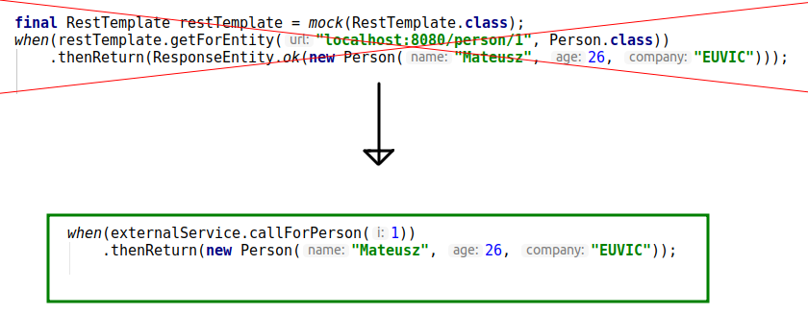
Do not mock what you don’t own

Slide 36
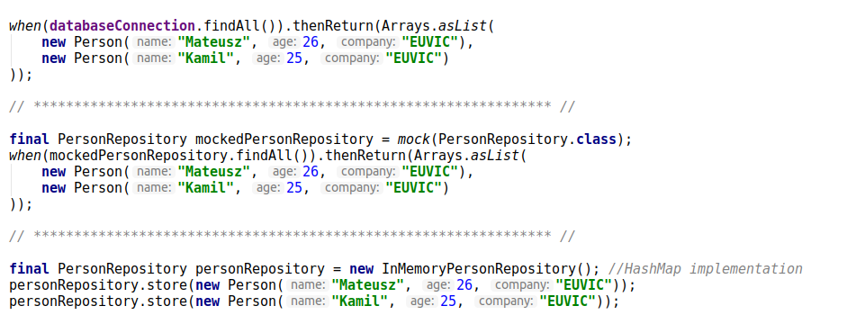
Do not mock if you don’t have to

Slide 37
In memory real implementations

Slide 38
Increasing coverage to infinity

Slide 39
Should I?
- makes no sense to test getters/setters
- some tests will mock the whole world and test nothing
- test coverage doesn’t tell you anything about the quality of your tests

Slide 40
What can happen?
- testing directly dumb methods
- you will hack your production code to create test (changing private to higher visibility). And I am not talking about code refactoring.
- you will start using reflection in you tests

Slide 41
Testing API of external libraries or generated code

Slide 42
Core rules!
- always use TDD/BDD
- too many assertions are not fine
- staying DRY generally will not help
- unit test has to be fast
- don’t mock too much
- 100% is not your ultimate goal

Slide 43
Q&A

