Slide 1
Resilience Patterns For Newbies
Mateusz Winnicki
www.mateuszwinnicki.pl
mateusz.winnicki@euvic.pl

Slide 2
Resilience

Slide 3
Partial failure

Slide 4
Client Side Patterns

Slide 5
..just RETRY

Slide 6
- temporary network problems
- temporary internal errors of target
- temporary big loads on target

Slide 7
and some code...

Slide 8
TIMEOUT maybe?

Slide 9
- always needed
- high/low enough
- not as trivial as you think

Slide 10
and some code...

Slide 11
sometimes FALLBACK

Slide 12
- not always possible
- good if default is sufficient

Slide 13
and some code...

Slide 14
switch the
CIRCUIT BREAKER

Slide 15
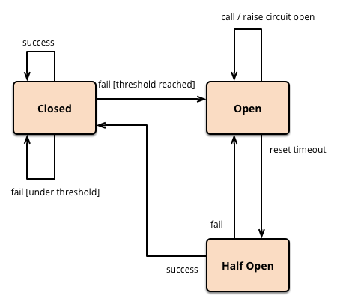

Slide 16
and some code...

Slide 17
sky is the limit, but in some case
RATE LIMITER

Slide 18
and some code...

Slide 19
don’t drown, you have a
BULKHEAD

Slide 20
and some code...

Slide 21
What else can I do?

Slide 22
Q&A

