Slide 1
Fast food vs slow food - JMH
Mateusz Winnicki
www.mateuszwinnicki.pl
mateusz.winnicki@euvic.pl

Slide 2


Slide 3
Microbenchmark
- measures performance of something “small”
- provides comparison between two implementations of the similar/same interface
- educate && experimenting
- use it when nothing else can be improved
- hard to write them properly without good tool

Slide 4
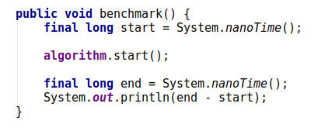
Difficult?

Slide 5
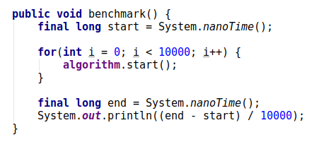
Go for the loop!

Slide 6
What about
- granularity of time measurement
- differences between operating systems timers
- System.nanoTime() execution time
- measurement errors
- JIT

Slide 7
JIT is you enemy here

Slide 8
JIT optimizations
- dead code eliminations
- branch predictions
- loops unrolling
- methods inlining
- constant folding

Slide 9
JMH – Java Microbenchmark Harness

Slide 10
What is it?
JMH is a Java harness for building, running, and analysing nano/micro/milli/macro benchmarks written in Java and other languages targeting the JVM.

Slide 11
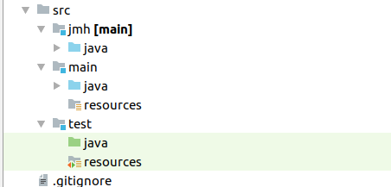
Folder structure

Slide 12
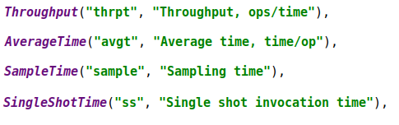
Benchmark Mode

Slide 13
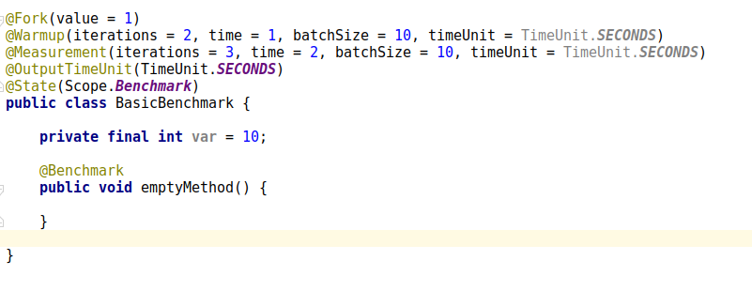
Basic Annotations

Slide 14
JIT is you enemy here (in most cases)

Slide 15
Examples

Slide 16
Q&A
Code:
(https://github.com/mateuszwinnicki/talks/tree/master/MicrobenchmarksJMH)

