Slide 1
Code review - how
static analysis
saves the work
Mateusz Winnicki
www.mateuszwinnicki.pl
mateusz.winnicki@euvic.pl

Slide 2
Code review

Slide 3
Goals
- Defect-free, well-documented software
- Ensuring coding standards
- Knowledge sharing
- Teaching
- Improving quality

Slide 4
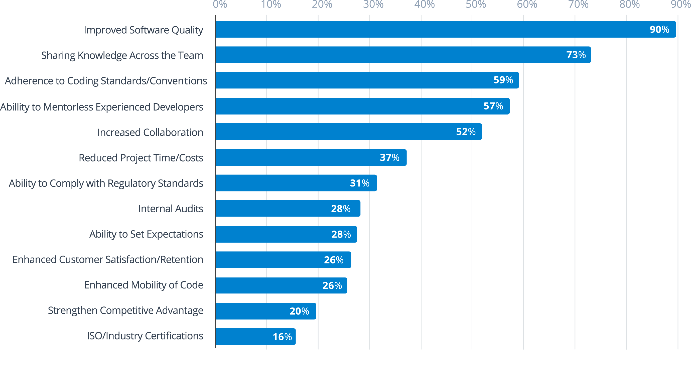
2018 State of Code Review report
https://smartbear.com

Slide 5
CR – some best practices
- 300 LOC at time
- 30 - 45 minutes
- use checklist
- blame the code, not an author
- annotate your code before review (for author)

Slide 6
But...

Slide 7
...how many times we were arguing about irrelevant stuff?

Slide 8
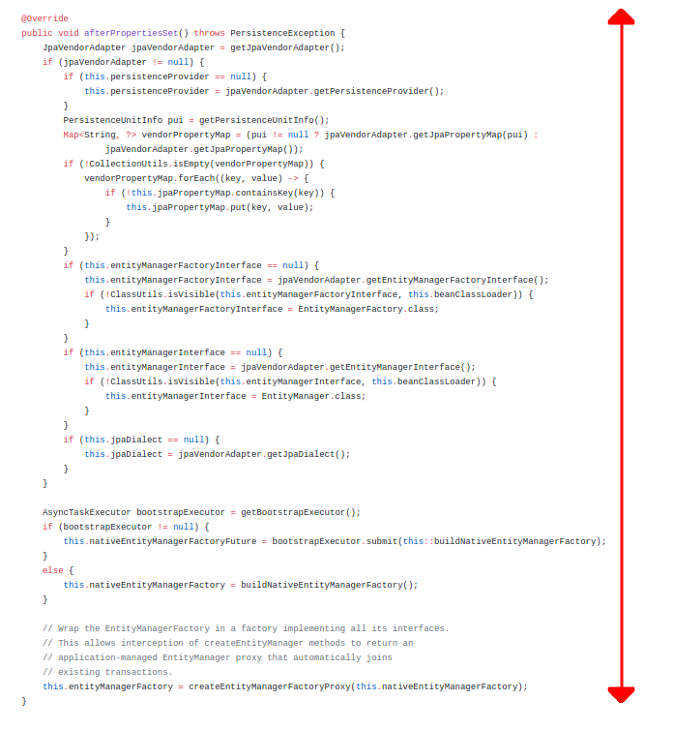

Slide 9
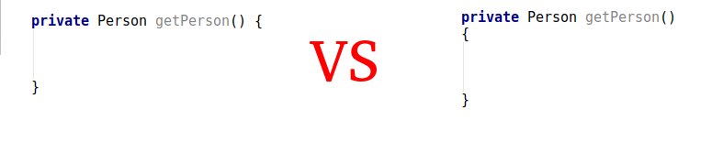
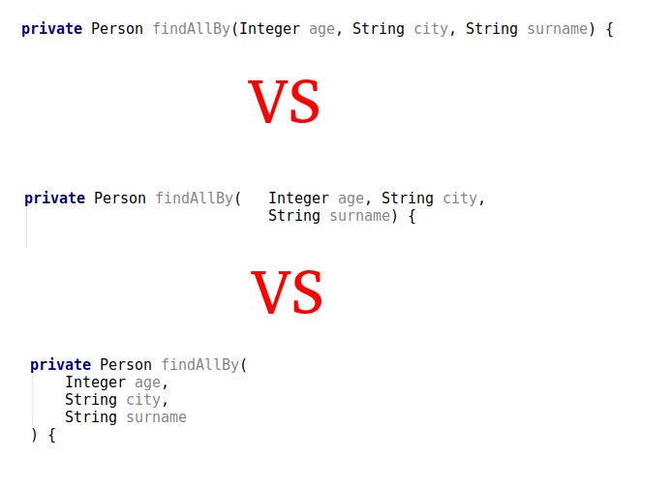

Slide 10
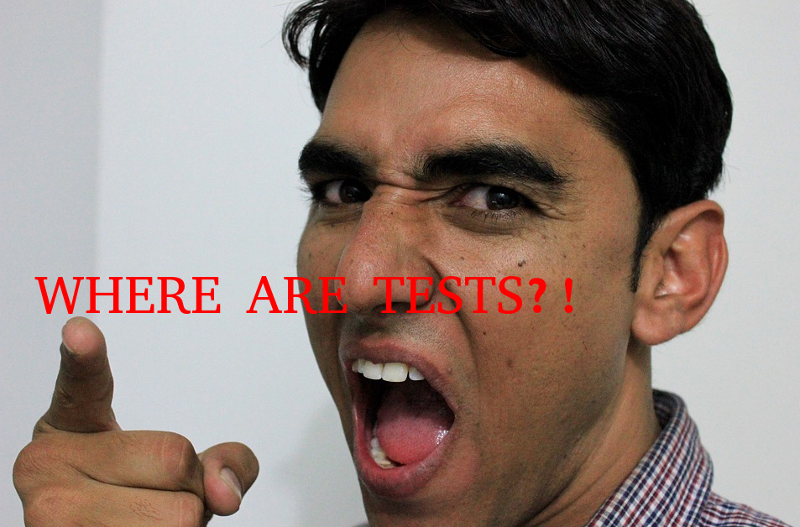

Slide 11
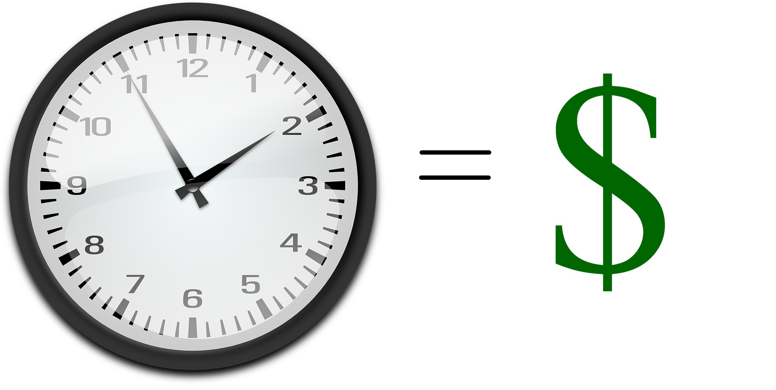

Slide 12
Let’s automate irrelevant!

Slide 13
Static analysis

Slide 14
Code formatting

Slide 15
Broken rule?

Slide 16


Slide 17
Code style analysis
(eg. Checkstyle)

Slide 18
Broken rule?

Slide 19


Slide 20
Potential problems analysis
(eg. Findbugs)

Slide 21
Broken rule?

Slide 22


Slide 23
Test coverage analysis
(eg. JaCoCO)

Slide 24
Broken rule?

Slide 25


Slide 26
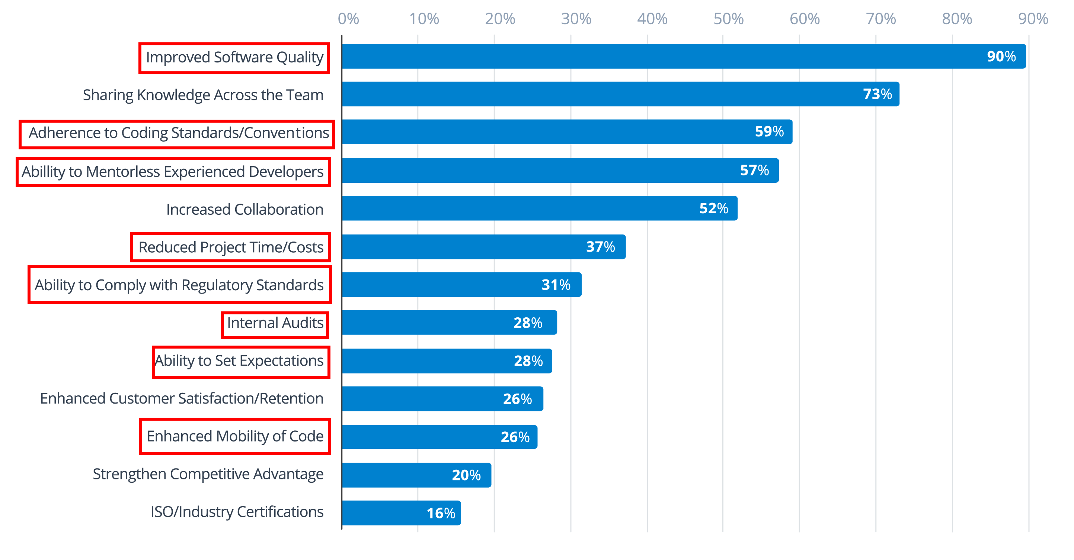

Slide 27
Why so strict with these rules?

Slide 28
Who will set the rules?

Slide 29
What about stupid rules?

Slide 30
What can I gain?
- more time to focus on domain problems
- more time to focus on real code complexity problems
- predictability of design
- ensuring the standards
- learning

Slide 31
Q&A

